Slide 1
Basic English Conversation
Telling the Time and Asking for direction

Slide 2
Scenario
Your are late for a meeting and your wrist watch is not working!!!
So you ask for the time from the people next to you on the bus BTS or also Song Tiew !!

Slide 3
Telling the Time
Excuse me, what is the time?
Time Please?
Time?

Slide 4
Activity!!!
Tell the time that I will display!!!

Slide 5
BREAK Time

Slide 6
Asking for Direction!!
Because I’m lost
Because I need to go to a place that I never heard about1

Slide 7
Sample conversation 1
A: Excuse me. Is there a post office near here?
B: Yes, there is one on the next street.
A: Is it far from here? How do I get there?
B: No, it is only five minutes’ walk from here. Go straight ahead. Take the first right at the traffic lights and go straight on. It’s on the left.
A: Thank you.

Slide 8
Asking for directions: sample conversation 2
A: Is there a super market near here?
B: Yes, there is one at the end of this street. Go straight ahead. It is on the right.
A: Is it far?
B: Not really.
A: Thank you.
B: That’s all right.

Slide 9
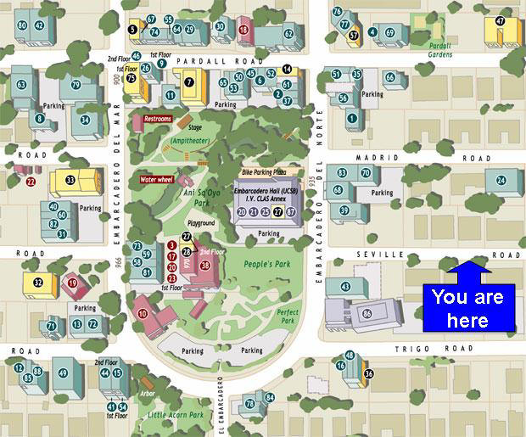

Slide 10
Use key words when asking direction.
How to go to……
Where is…….

Slide 11
Use key words when telling directions.
Left/ right
Next to
Located on

Slide 12
Activity:
Ask the directions to the followings:
Siam Paragon
Jatujak Market
Suvarnabhumi Airport

