Slide 1
MIND MAPPING
26/ April/ 2016

Slide 2
What is a Mind Map?
It is a diagram used to represent words, ideas, tasks, or other items linked to and arranged around a central key word or idea.
Mind maps are used to generate, visualize, structure, and classify ideas, and as an aid to studying and organizing information, solving problems, making decisions, and writing.

Slide 3
Mind Map created by Tony Buzan

Slide 4
Purpose of Mind Mapping
A mind map is often created around a single word or text, placed in the center, to which associated ideas, words and concepts are added.

Slide 5
Mind maps can be used for:
problem solving
outline/framework design
structure/relationship representations
marriage of words and visuals
individual expression of creativity
team building or synergy creating activity

Slide 6
WHY IT is Important?
Easy to understand
Make boring things interesting
Plan you ideas
Avoid confusion

Slide 7
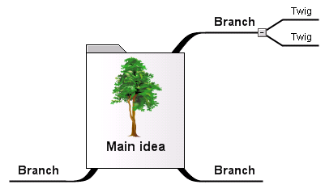
Starting A mind map

Slide 8
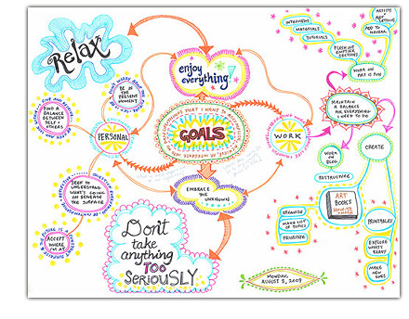
Example of Mind Map about Personal Goals

Slide 9
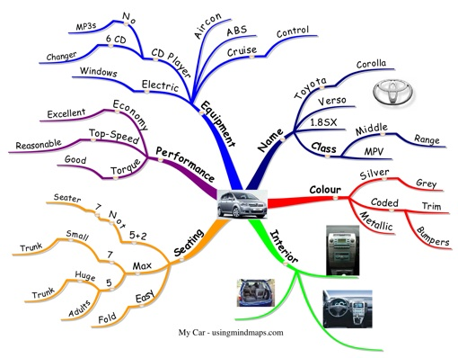
Example of Mind Map about a Car

Slide 10
Class Group ACTIVITY:
Mathematics
English as a Teaching Medium
Summary of the Whole Week

Slide 11
Conclusion
Thank You

