Slide 1
English composition for daily life
E-mail: k.kanyapilai@gmail.com

Slide 2
agenda
Course outline for this semester
Scoring
Regulations
Pretest
Assignment “My Diary”

Slide 3
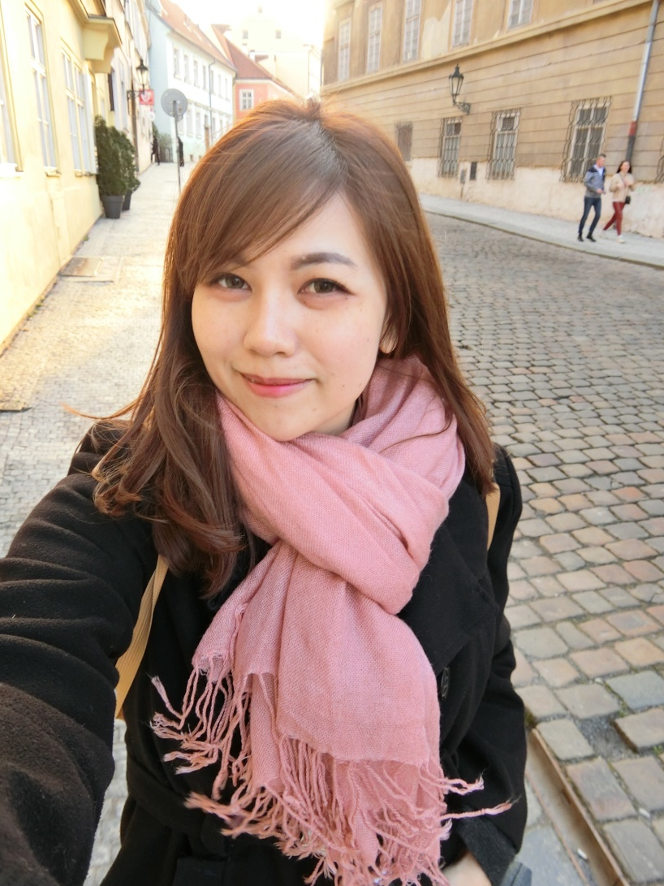
Lecturer
Let me introduce myself.
Miss Kanamon Suwantada
อาจารย์กัญจน์อมล สุวรรณธาดา
( Aj.Saiparn ) อ.สายป่าน

Slide 4
Education
Bachelor Degree: Faculty of Arts, Chulalongkorn University
Master Degree: Hospitality Management, Glion Institude of Higher education, Switzerland.

Slide 5
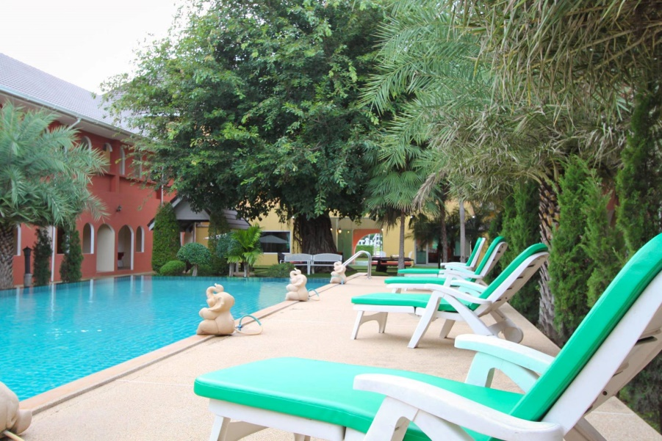
Experiences: Hotel Management

Slide 6
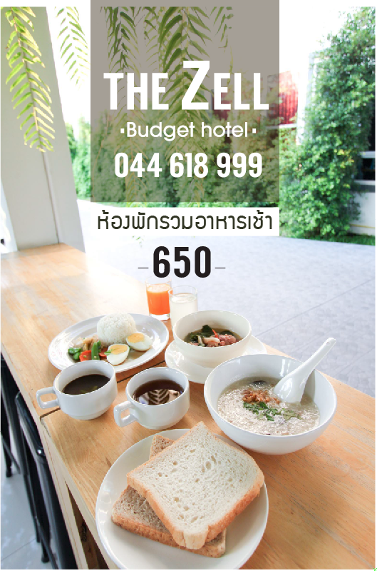

Slide 7
How to contact your teacher
Facebook: Aj Saiparn Kanamon
E-mail: K.suwantada@gmail.com
Tel: 0616923545

Slide 8
Inbox to me

Slide 9
Course outline
Unit 1:Writing Basics
Unit 2: Writing an Essay
Unit 3: Describing a person
Unit 4: Describing a place
Week 8 : Midterm Exam
Unit 5: Describing present event
Unit 6: Leisure Time
Unit 7: Education and student life
Week 15: Personal Journal
Week 16: Final Exam

Slide 10
Scoring Criteria
Attendance 10%
Midterm 20%
Final 30%
Class Assignment 20%
Personal Diary 20%
Total 100%

Slide 11
10 Reasons You Should Write Something Each Day
Remove stress from mind, place on paper
Sweep Your Mind
Keep Your Writing Skills Sharp
Make Some Pocket Money
Turn the Noise Off
Enhance Your Communication Skills
Know What You Want
Develop Your Analytical Skills
Get Away from Technology
Meet Yourself All Over Again
http://www.lifehack.org/articles/lifestyle/10-reasons-you-should-write-something-each-day.html

Slide 12
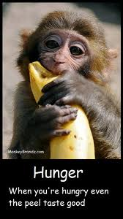
regulations
Ways to succeed
Do not be late
Submit assignments on time
Pay Attention
Practice -> Non stop ->Continuing improvement
No Thai speaking
Do not give up
We will not give up to learn English. It is easier than eating banana
Look at a poor monkey
is trying to hard to eat banana.

Slide 13
Thank you for your attention

Slide 14
Relaxing Friday
Let’s play some fun game before we start the class
This game is call “Vocabularies Guessing”

Slide 15
PRE-TEST
Test your writing skills
10 sentences
Translate in to Thai

Slide 16
Basic writing (Pretest)
Write the following sentences in English
1. ฉันชอบเรียนภาษาอังกฤษ

Slide 17
2. ฉันสวย/หล่อ และฉันรักเด็ก

Slide 18
3. ผู้หญิงคนนั้นใส่เสื้อยืดสีม่วง

Slide 19
4. ดอกไม้สีทองอยู่ในแจกัน

Slide 20
5. ฉันขึ้นรถเมล์สาย 505 ไปสวนสัตว์ดุสิต

Slide 21
6. ภาษาอังกฤษสำคัญสำหรับการทำงานในอนาคต

Slide 22
7. แมวกำลังเดินผ่านประตูไป

Slide 23
8. ยินดีด้วยที่คุณได้เลื่อนตำแหน่ง

Slide 24
9. การเขียนเป็นวิธีการสื่อสารที่เป็นทางการ

Slide 25
10. ในอนาคตฉันอยากทำงานบริการในโรงแรมห้าดาว

Slide 26
Semester Project 20 points
Personal Diary
1. buy a pretty books
2. Students writes a daily personal diary
Start from 26 August 2017 to 30 October 2017

Slide 27
Example
26 August 2016
Today is my first day of studying with Aj. Saiparn. She is also my supervisor. The course I study today is IGL1103 English Composition for Daily life. I’m really exited to learn how to write proper English. At dinner time, me and my friend went to eat somtam and grill chicken in front of Mahidol University. I really like spicy food.

Slide 28
Grammar Review
Part of Speech
(Pronoun)
(verbs)

