Slide 1
Seminar and Events
Kanamon Suwantada

Slide 2
Seminar Definition
The American Heritage Dictionary of the English Language (2009) defined seminar as
“A small group of advanced students in a college or graduate school engaged in original research or intensive study under the guidance of a professor who meets regularly with them to discuss their reports and findings” and
“A meeting for an exchange of ideas; a conference”
Collins English Dictionary (1991) suggested definitions of seminar
“a small group of students meeting regularly under the guidance of a tutor, professor, etc., to exchange information, discuss theories, etc.” and “any group or meeting for holding discussions or exchanging information”

Slide 3
Seminar vs Convention
A convention is an event where the primary objective is educational ie; participate in meeting/discussions, socialize or attend other organized events. There maybe a second exhibit component.

Slide 4
Resent Seminar Trends
The evolvement is continuously gained popularity amount developed and emerging country alike.
A tool to increase potential of the participants
Content focus ( organizer will feature topics that they feel are interesting however, today events are now delegate driven i.e.; events based needs of attendees and what they want to learn.

Slide 5
Resent Seminar Trends
A seminar , can also lead to significant social legacies with the host destination as well; those legacies consist of the following
Knowledge Expansion
Networking, relationship and collaboration
Education Benefit ( Knowledge Transfer)
Technology and know-how transfer
Fundraising ( if associate based)
Raising awareness
Showcasing and destination reputation

Slide 6
Seminar and Convention Industry Development
Rank | Country | Number of association meeting
1 | USA | 623
2 | Germany | 542
3 | Spain | 451
4 | United Kingdom | 399
5 | France | 371
6 | Italy | 341
7 | Japan | 305
8 | China | 282
9 | Brazil | 275
Statistic in Global Seminar
According to ICCA , the top three
Topics discussed in 2010 were
medical science, technology and
Sciences respectively
Emerging Trends: smaller and shorter Conventions and venues experiencing High turnover

Slide 8
Seminar and Convention industry outlook
Technology (1/2)
Internet, Wi-Fi Access, Mobile phone, Tablets/ E-books, Smart Phones resulted in the birth of mobile application and Social media
The internet change the way we “Meet”
The mobility revolution start with Wi-Fi Technology empowering the world-wild-web (www)to heights beyond anyone’s imagination
Absolute mobility with a 24 hours access to information and communication purposed
The increased popularity of Smartphone has redefined needs within the industry
Headed toward Green Events ( CSR/Sustainable Events)
Mobility has lead to lower paper use
On-line, Digital media such as emails, websites, social networks (i.e., facebook, twitter, instragram, socialcam, ect) make a more cost-effective tool in spreading the buzz to advertise or promote
Facebook, LinkedIn and twitter, the big three social media platforms have gained immense popularity and should continued to grow in the future

Slide 9
Seminar and Convention industry outlook (Con’t)
Sustainability
Sustainability issues have now become major concerns in the convention industry and planer in every area
1. Meeting are expected to show efforts to promote sustainability since meeting activities are highly visible to the entire of community
2. Attendees demands more green services
3. Sustainability measure can c0ntribute to cost effective operation and if managed with ongoing perspective, can help to reduced overall long-term cost of operations
4.Law and regulations have now shifted toward integrating sustainability into regulation

Slide 10
Definition
Globatt (1990) defined events as
“a unique moment in time with ceremony and ritual to satisfy specific needs”
Getz(1997) suggested two definitions,
“ a special event is a one-time or infrequently occurring event outside normal program or activity of the sponsoring or organizing body” and “ To the customer or Guest, a specific event is an opportunity for a leisure, social or cultural experience outside the normal range of choices or beyond everyday experience.
Based on these definitions, “ Special event can be summarized as a non routine events or occasions that are not a normal activity, have various objectives and can be organized for several Purposes”
Shone (2001) definition covers all significant characteristic
“Special events are the phenomenal arising from those non-routine occasions which have leisure, cultural, personal or organizational objectives set apart from normal activity of daily life, whose purpose is to enlighten, celebrate, entertain or challenge the experience of a group of people”

Slide 11
Characteristic
According to Shone (2011), an events have been grouped into four categories;
Events
Leisure Events (Leisure/sports/recreation)
Cultural Events (ceremonial/sacred/heritage/art/folklore)
Personal Events
(wedding/birthday/
anniversary)
Organization Events
(commercial/political/
charitable/sales)

Slide 12
Leisure Events
Leisure events, thus, are any special event held for entertainment purpose or involving recreation activities
These special events can be organized in both commercial and non-commercial form

Slide 13
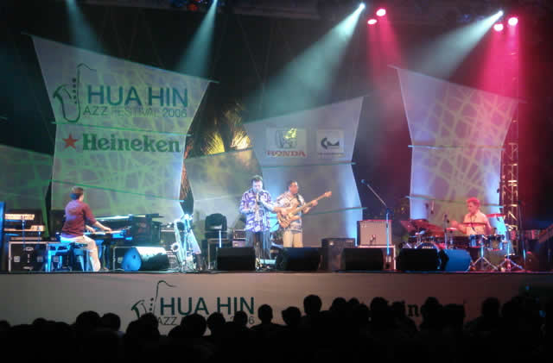
Hua Hin Jazz Festival

Slide 14
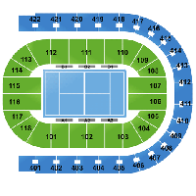
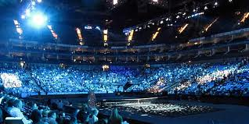
ATP World Tour Finals

Slide 15
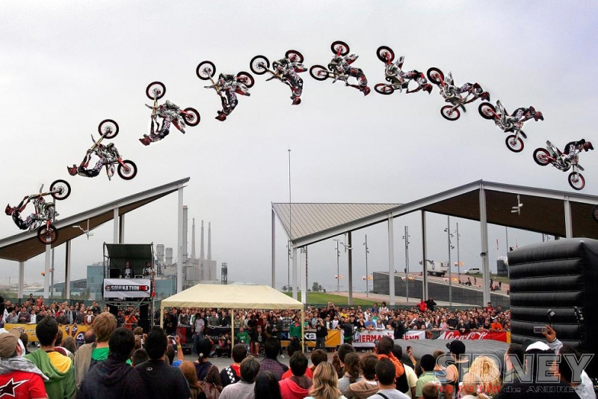
Barcelona Extreme Sports Festival

Slide 16
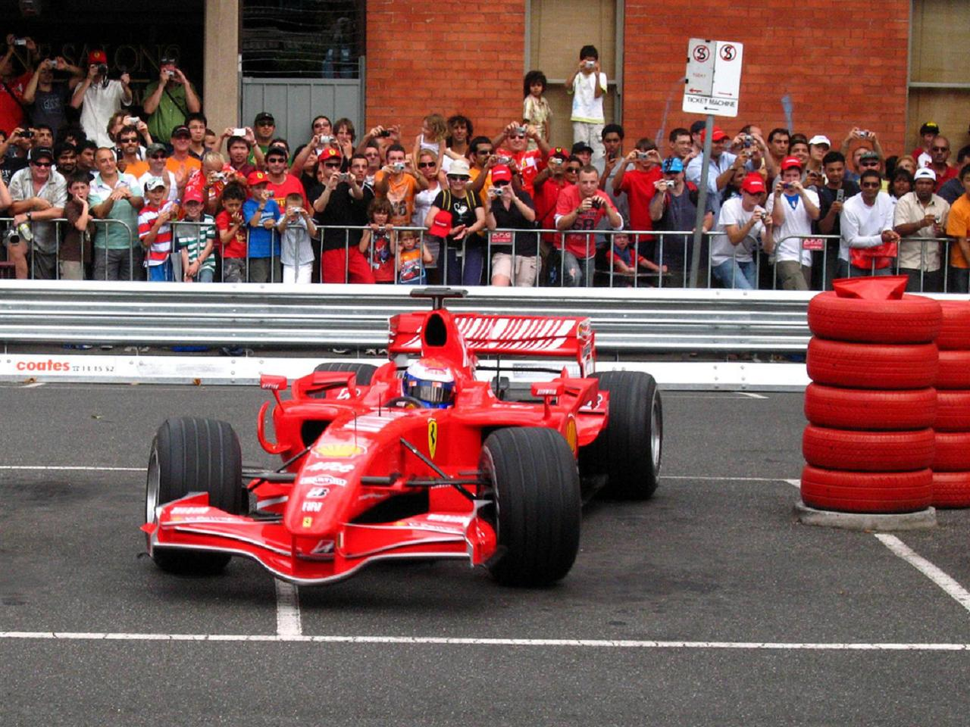
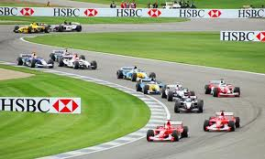
Formula 1

Slide 17
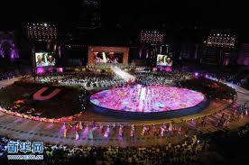
Universiade

Slide 18
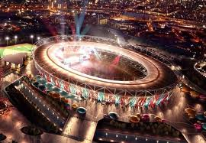
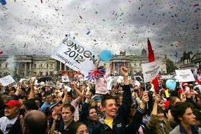
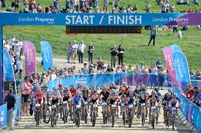
2012 London Olympic

Slide 19
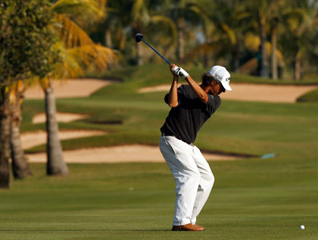
Johnnie Walker Classic PGA Tour

Slide 20
Personal Events
Personal Events are held to celebrate or commemorate a communal, societal or life-cycle occasion
Personal Events can be arranges for small group invited to a private birthday party or a large scale 500 guest wedding

Slide 21
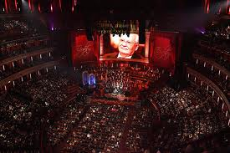
Mikhail Gorbachev 80th birthday celebration

Slide 22
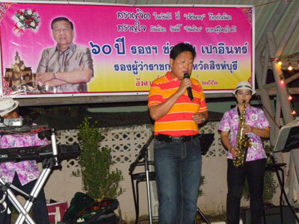
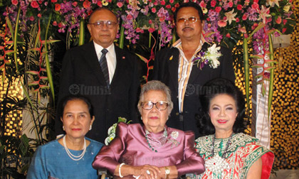
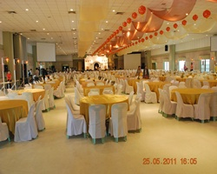
Birthday Celebration

Slide 23
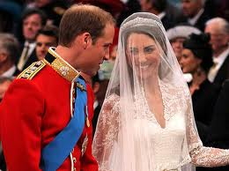
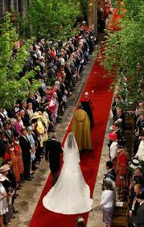
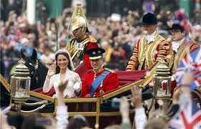
prince william and kate middleton wedding

Slide 24
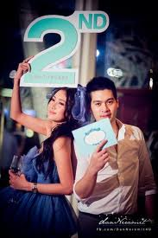
Todd & Nune 2nd Anniversary

Slide 25
84th Birthday Celebration of king Bhumibol Adulyadej
http://www.youtube.com/watch?v=mWk4Ccw2Jas&feature=relmfu
– 3D mapping Video
The longest in the world 300 meter.
6 months of preparation,
Budget 40 millions baht
Total participant: 200,000 people/day

Slide 26
Cultural Events
Cultural Events are special events associate with ceremony, tradition, art and religious aspects a s a celebration or culture confirmation and are usually a prominent part of a larger cultural events

Slide 27
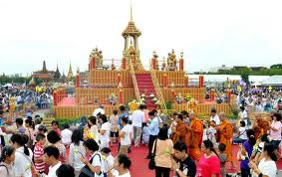
งานเฉลิมฉลองพุทธชยันตี 2600 ปี ณ ท้องสนามหลวง

Slide 28
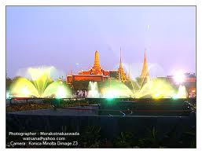
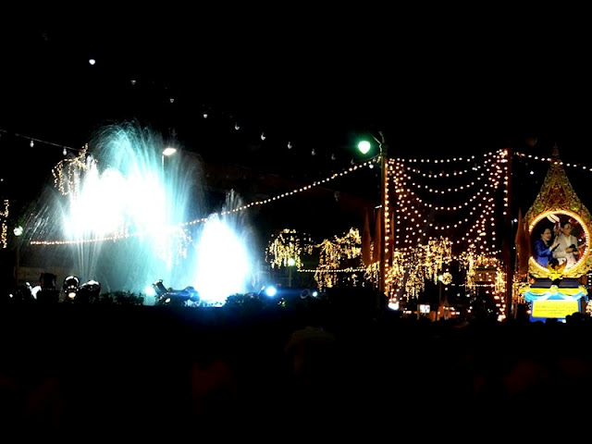
เย็นทั่วหล้ามหาสงกรานต์

Slide 29
Tomatina Festival, Spain

Slide 30
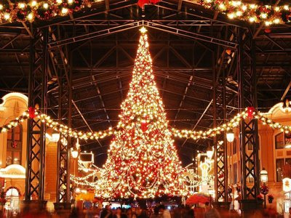
Christmas’s Eve

Slide 31
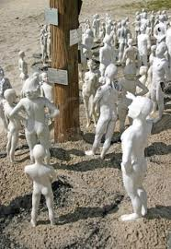
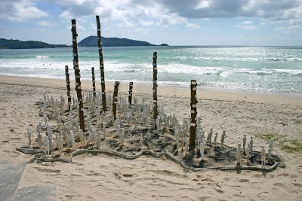
Art on the Beach Exhibition at Patong Beach, Phuket

Slide 32
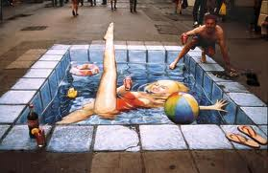
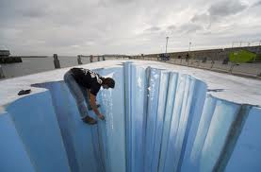
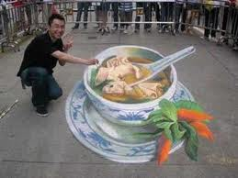
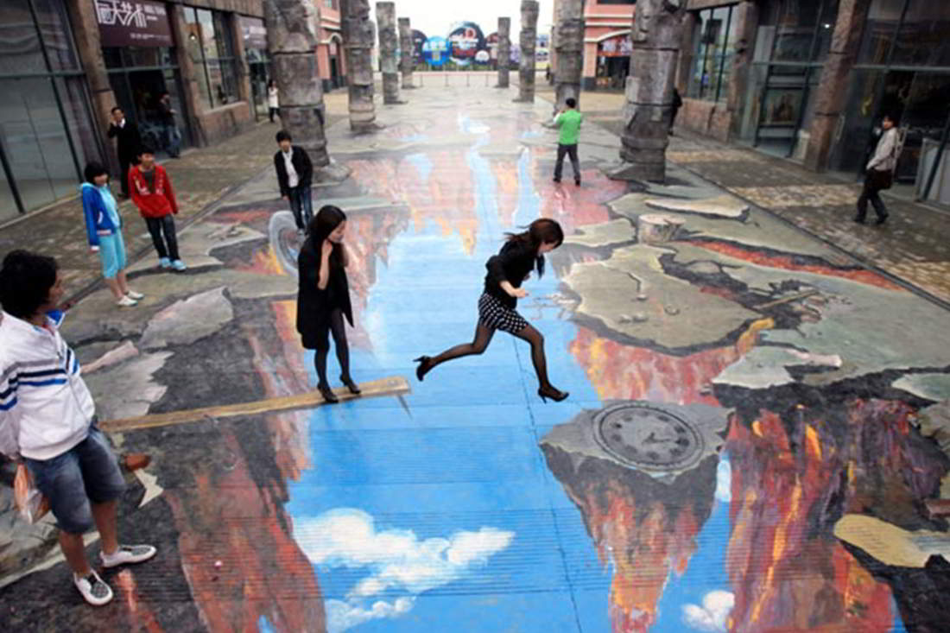
Art on street

Slide 33
Organization Events
Almost Every organization activities is a part of an organization’s events with attendees being members of the same institution or the same industry ( commercial, political, charitable, sales)

Slide 34
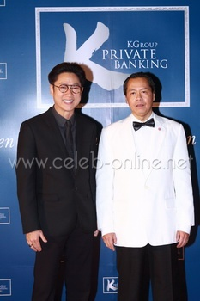
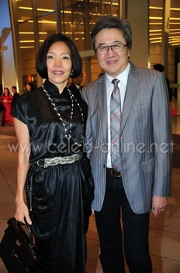
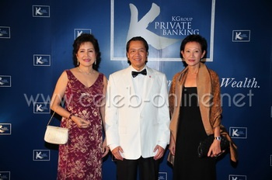
K Bank Private Banking: Make a wish

Slide 35
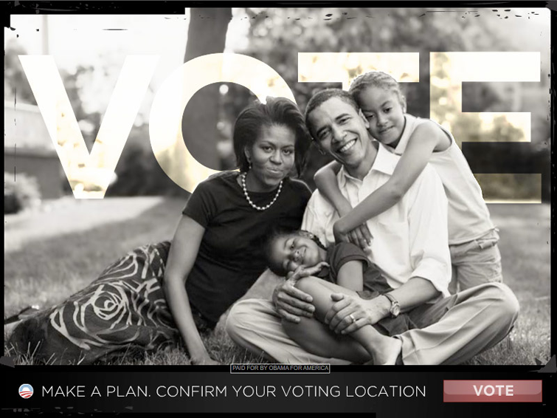
Political Campaign
Obama for America Campaign Ad.

Slide 36
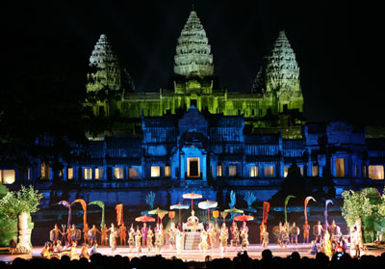
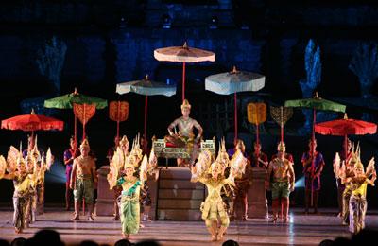
The Legend of Angkor Wat
http://www.youtube.com/watch?v=x3Ijt0pgfdk

Slide 37
Component of Events
Aims
Increase Sales
Celebrate
Launch new product
Every events consist of event content or a main activities that can be quite diverse depending on the type or purposes of the special events

Slide 38
Component: Venue
Church, Temple
Sport Field
Hotel
Beach
A venue can be either public or private owned facility ranging from a hotel meeting room to a public square in the middle of the city

Slide 39
Other Components
Host
Organizers
Events Participants

Slide 40
Social and Economic Impact of Seminar and Events
Social Impact
+Improve Social Interaction
+Develop Community Cohesion
+Improve Community and Pride
+Entertainment Variety
- Traffic Congestion
-Over crowding
- Garbage

Slide 41
Economic Impact
Direct Impact
Economic Gain
Indirect Impact
Income within the region
Revenue from visitor and organization Spending
Employment opportunities
Infrastructure and Facility

Slide 42
References
Kunawong Sermkhun. (2012). Chapter 7: Special Events. The Business Creative and Event Management Association ( EMA)
Sumet Sutad na Ayuthaya& Penthip Chomprang. (2012). Conventions&Professional Convention Organiser. Coach the coaches program for MICE Industry.

