Slide 1
SOCIAL SKILL
A. Kanyapilai K.

Slide 2
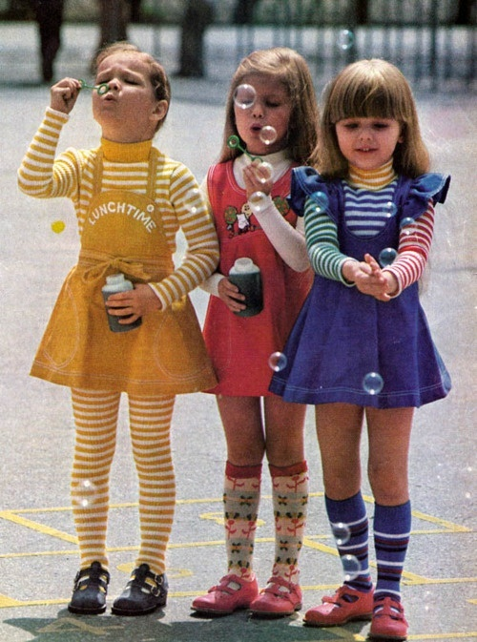
Outline
Definition of Social Skills
Characteristics of Social Skills
Advantages of well developed social skills
Table manner

Slide 3
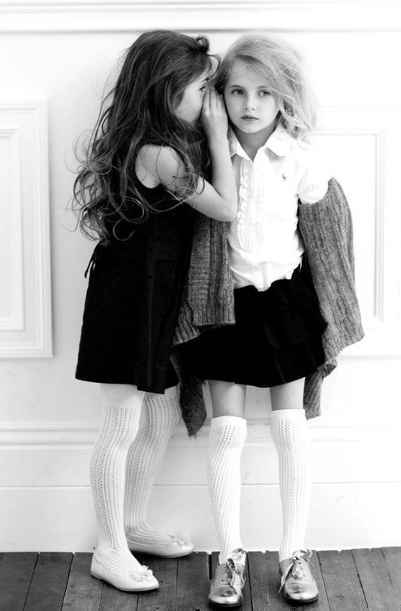
What are social skills?
Social skills are the skills we use to communicate and interact with each other, both verbally and non-verbally, through gestures, body language and our personal appearance.

Slide 4
What are social skills?
Human beings are sociable creatures and we have developed many ways to communicate our messages, thoughts and feelings with others.
What is said is influenced by both verbal language and the way we use it - tone of voice, volume of speech and the words we choose - as well as by more subtle messages such as body language, gestures and other non-verbal communication methods.

Slide 5
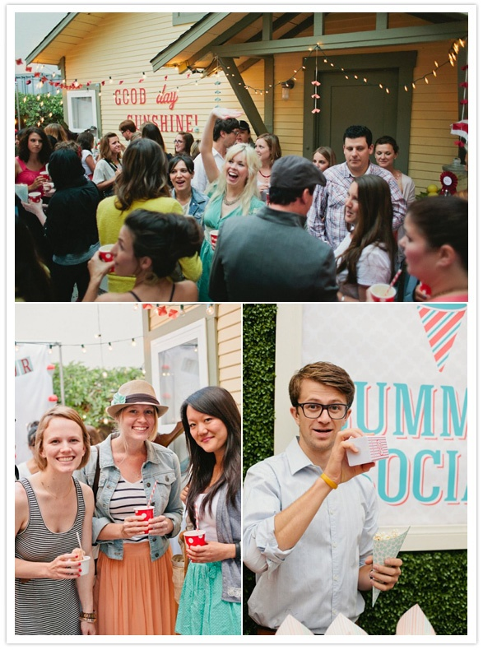
Characteristics of Social Skills
Social skills are goal-directed.
Socially skilled behaviors are interrelated in the sense that one person may use more than one kind of behavior at the same time, for the same goal.
Social skills should be appropriate to the situation of communication. Different social skills will be used for professional and personal communication.

Slide 6
Characteristics of Social Skills
Social skills can be identified as certain types of behavior whereby an individual can be judged on how socially skilled they are.
Social skills can be taught, practiced and learned.
Social skills should be under the cognitive control of the individual - learning them involves learning when to use particular behaviors, as well as what behaviors to use, or how to use them.

Slide 7
Advantages of well developed social skills
More and Better Relationships
Identifying well with individuals leads to more relationships and, at times, friendships.
Better Communication
Relating with people and being able to work in large groups naturally develops one's communications skills.
Greater Efficiency
If you are good with people, you can more easily avoid being with the people you do not like as much as others.

Slide 8
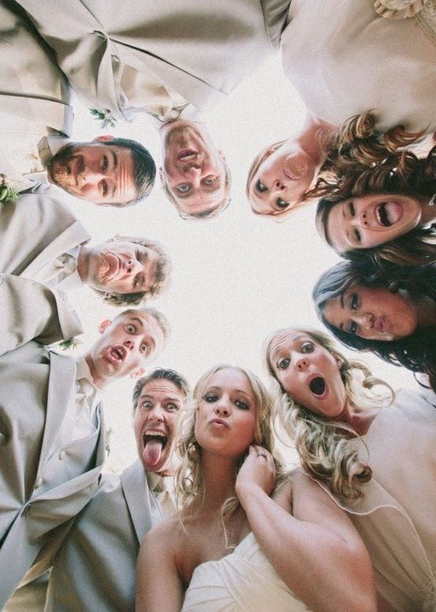
Advantages of well developed social skills
Advancing Career Prospects
Most worthwhile jobs have a people component' and the most lucrative positions often involve a large amount of time spent interacting with employees, media and colleagues.
Increased Overall Happiness
Getting along and understanding people will help to open many personal and career-related doors.

Slide 9
Table manner
Wash hands before eating
Wear clean clothes to the table
Place napkin in your lap
Stay at the table until finished
Lean over your plate
Chew with your mouth closed
Don’t talk with food in your mouth
Cover your mouth when you burp
Say excuse me when you burp
Don’t slurp food or drinks
Wipe your mouth with a napkin
Clean your spot at the table
Always say Please and Thank You

Slide 10
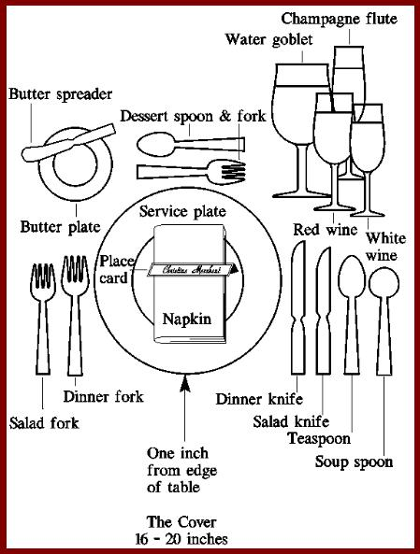
Table setting

Slide 11
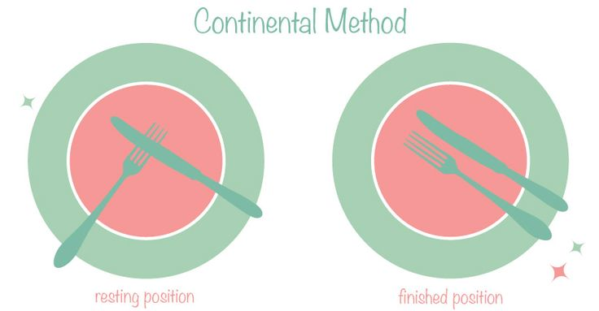
Table Etiquette

Slide 12
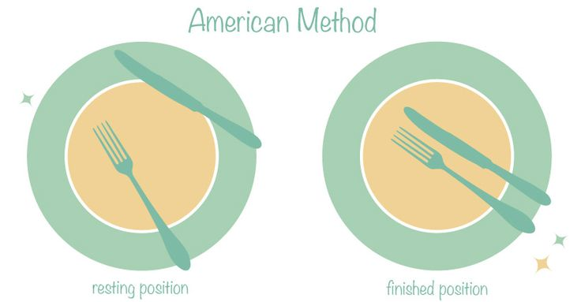
Table Etiquette

Slide 13
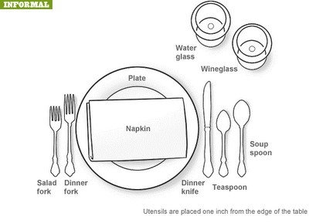

Slide 14
