Slide 1
Introduction

Slide 2
The group project: 7 people each group
VDO (30 scores)
Phone inquiry for room reservation
Pick up guest at the airport
Guest checking in process
Briefly room information
Situation during guest stay
At a restaurant or room service
At a fitness
At a swimming pool
At a bar
At a front desk
At a guest room
Checking out
Guest transfer back to the airport
Individual assignment (20 scores)
Speaking test ( providing rooms and hotel information to incoming guests)
Remark: 7 members 5 groups and 8 members 2 groups

Slide 3
Scores criteria
Lively, natural
English pronunciation
Movie story
Close to reality

Slide 4
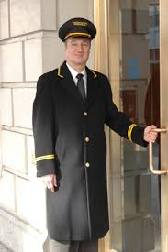
In the lobby
Doorman
-Welcoming guest in front of the door
-Opening the door
-Lifting up luggage
-Calling a taxi
-Keeping eyes open once cars entering to hotel

Slide 5
Bellhop/Bellboy/Bellman
-Carry the luggages
-Taking guests to hotel room
-Introducing facilities in hotel room

Slide 6
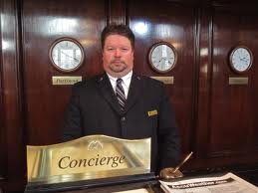
Concierge
-Conduct facilities information and service in hotel
-Conduct traveling and ticket
-Conduct reservation

Slide 7
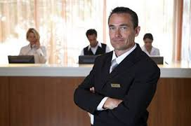
Front Desk Clerk
-Check-in/out
-Provide hotel information
-Conduct customers inquiry
-Conduct customers complaint
Front Desk Manager
-Monitoring bellboy, driver, GR, operator, cashier, receptionist

Slide 8
In hotels room
Housekeeper/
Chambermaid/
Maid
-Cleaning
-Changing bed sheet set
-Providing room facilities

Slide 9
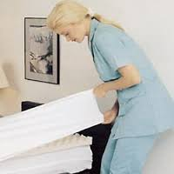
Laundry Staff
-Washing bed sheet set, napkins, guest’s cloth and hotel uniform

Slide 10
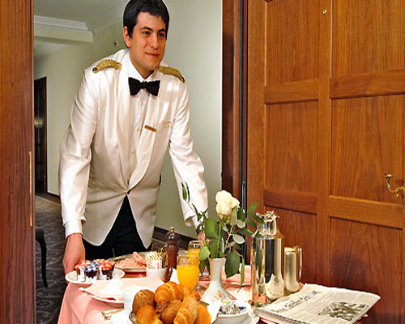
Room Service Staff
- Taking an order
- Preparing and delivery
food

Slide 11
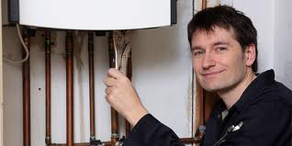
Maintenance Worker
- Maintaining and repairing facilities

Slide 12
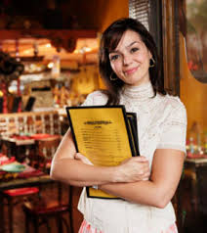
In the restaurant
Host/Hostess
Preparing restaurant information to customers
Checking reservation
Preparing table for customer
Providing menu

Slide 13
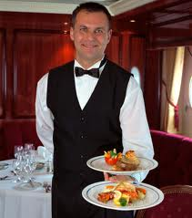
Waiter/Waitress
Taking an order
Serving food and drink
Preparing receipt to customers
F&B Manager
-Monitoring staffs in the restaurant

Slide 14
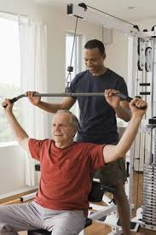
Facilities
Fitness Center Attendant
Demonstrate fitness equipments
Prepare activities at the fitness
Check fitness equipments conditions
Returning equipment in storage
Business Center Attendant
Send and receive fax
Secretary service
Computer service

Slide 15
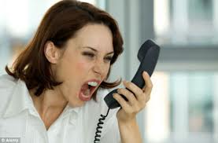
Event Planner
Wedding, party, conference
Place decoration
Brochure and symbol sign
Operator
Dealing with telephone
Recording message, take note

Slide 16
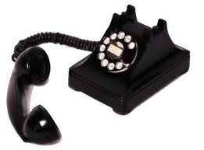
Unit1: Phone Inquiries

Slide 17
Objectives
Introduction about the places/room types and facilities in hotel
Describes about the hotels’ location
Making a reservation by phone

Slide 18
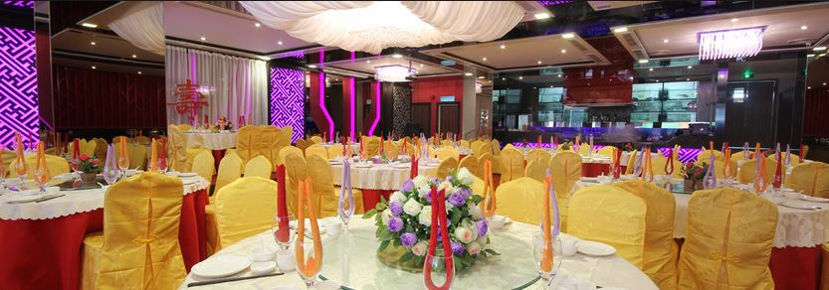
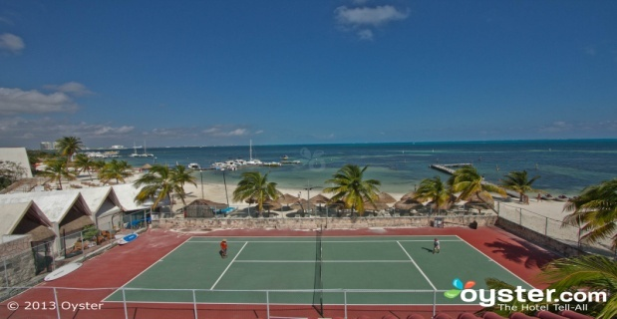
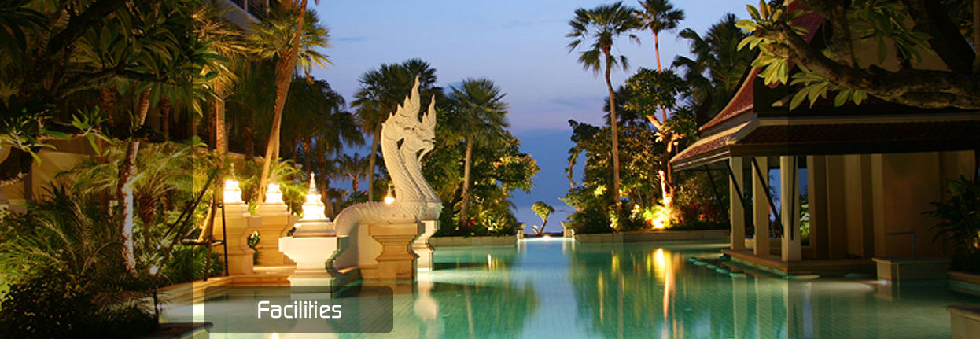
Around the Hotel - facilities In hotel
Swimming Pool
Restaurant
Bar
Café
Business Center
Fitness Center
Sauna
Spa
Golf Course
Tennis Court
Conference Room
Boutique
Drugstore
Beauty Salon
Gift Shop
Florist Shop

Slide 19
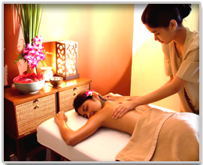
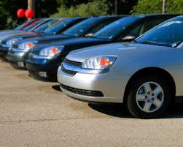
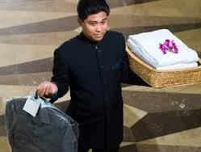
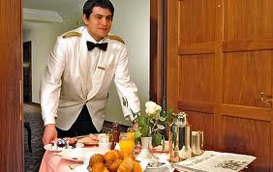
-Services in the Hotel
Room Service
Massage
Facial
Babysitting
Car Rentals
Safe-Deposit box
Wireless Internet Access
Laundry and Dry-cleaning
Currency Exchange
Baggage Storage
Postal/Parcel services
Secretarial Services
Translation Services
First aid
Airport shuttle bus

Slide 20
What should you ask on phone to book a room?
Room available, room type
Price
Location
What should an operator response?
Date checking in-out
Guest detail
Credit card guarantee
Services detail (Transportation)

Slide 21
https://www.eslfast.com/robot/topics/hotel/hotel01.htm
https://www.tititudorancea.com/z/i_d_like_to_book_a_room_please.htm

Slide 22
Listening Practice: Tell me about the hotel

Slide 23
Vocabulary
Single
Rate
Range
Include
Rent
Buffet
Comprehensive

Slide 24
Visiting Kaohsiung

Slide 25
Vocabulary
Reservation
Currently
Available
Nonsmoking
Tax
Freeway
Exit
Block
Miss

Slide 26
Listening Practice: I’d Like to Make a Reservation

Slide 27
Vocabulary
1.Book (v.)
2.Double
3.Confirm
4.Fully
5.Charge
6.Complimentary
7.Contact

Slide 28
Role Play: Read the information below and act out a short dialogue.
Guest name: Chery Hilton
Phone:2589-6320
Room type: Single (3,000 baht per night)
No. of guests: one
Arrival Date : February 6
Departure Date: February 9
Requests: Room facing the garden

Slide 29
Language Center
A. N.+rate vary depending upon/on+N.
For example:
Room rates vary depending on the time of the year
Or
Room rates vary depending upon the check-in/checkout dates.
B.Useful expressions
-Talking about Hotel Facilities
For example:
We have an indoor swimming pool.
The tennis courts open at 6 am.
-Talking about the shuttle Service
For example:
How often does the shuttle bus run/come?
What time does the last shuttle bus leave?
Does the shuttle bus go to the airport and the train station?

Slide 30
Language Center
A. Talking about room vacancies. “ Are there any rooms available on June 16th?
For example:
Do you have a room for tonight?
Are there any vacancies?
Do you have a suite available for three nights?
Ans:
I’m afraid we’re full.
I’m sorry, but we’re out of rooms.
It’s not too late to reserve a room.
B.Helping Guests Find the Hotel
For example:
Where are you coming from?
What mode of transportation are you taking?
Are you familiar with the city
You might want to take a taxi
We’ll arrange for airport pickup.

Slide 31
Word to Practice
January, February, March, April, May, June, July, August, September, October, November, December
Month of the year
First(1st )/ second(2nd ) /third(3rd)/fourth(4th )/fifth(5th )/twelfth(12th)/Thirteenth(13th )/Twenty-first(21st )
Ordinal numbers

Slide 32
Word to Practice
How to Say and Write Date
Tuesday, October 31st
Monday, January the third
Sunday the 13th , December
the 22nd of June
the sixth of next month

Slide 33
You also can use:
auxiliary verb | subject | main verb |  | Answer
Do | you | have | room available? | Yes, we have room available
Do | you | have | any vacancies?
Exception! verb be simple present and simple past
 | Is | there | a room available?
 | Are | there | any vacant single rooms?

Slide 35
Thank you for your attentions

