Slide 1
Selection and Placement

Slide 2
Overview of the Selection Process
For any company in any size, hiring the best employees lays a strong foundation on excellence
Selection – the process of choosing individuals who have relevant qualifications to fill existing or projected job openings
The goal of selection is to maximize ‘hits’ and avoid ‘ misses’, hits are accurate predictions, and misses are inaccurate ones
The cost of miss would be the direct and indirect expense of hiring the employee who turns out to be unsuccessful
The other cost is an opportunity cost – someone who could have been successful did not a chance

Slide 3
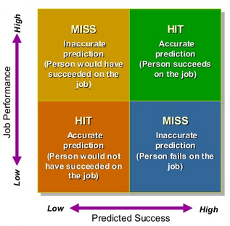
The Goal of Selection

Slide 4
Begin with Job Analysis
Job specifications help identify the individual competencies employees need for success – the knowledge, skills, abilities, and other factors (KSAOs)
Companies use selection method such as interviews, references, and preemployment test to measure applicants’ KSAOs
Complete and clear job specification help interviewers differentiate between qualified and unqualified applicants to reduce the the effect of biases and prejudices

Slide 5
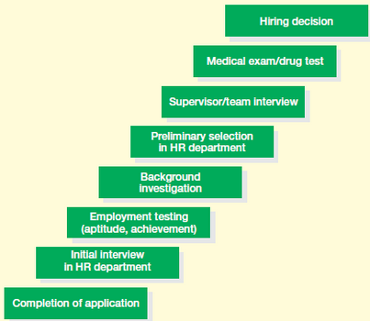
Steps in the Selection Process

Slide 6
Steps in the Selection Process
The number of steps in the selection process and their sequence will vary, with the organization, type and level of jobs
The figure shows that organizations use different means to obtain information about applicants
For internal candidates, not all the steps may be required

Slide 7
Obtaining Reliable and Valid Information
It is essential that the information gathered about candidates be reliable and valid, gathered legally, and the privacy of applicants safeguarded
Reliable – the degree to which selection procedures yield comparable data overtime and alternative measures
Interviewers judge the capabilities of a group of applicants to be the same today as they did yesterday, or two or more methods yield similar result or consistent
Validity – the degree to which the test or selection procedure measures a person’s attributes
What a test measures and how well it measures

Slide 8
Initial Screening
Cover Letters and Resumes
A lack of cover letter could be on way to eliminate applicants, and well- written cover letter are important if the job require good written communication skills
Evaluating resume can be difficult as they vary from person to person, bias can also enter the process
Developing explicit evaluation criteria and structured way to review resume can help
To speed up, many firms now using software to scan resume to find qualified applicants

Slide 9
Initial Screening
Internet Checks and Phone Screening
Companies often ‘Google’ about applicants before deciding weather to invite them for an interview
The downside of conducting internet search relates to the privacy of applicants, which in some countries it is illegal
Short phone interview, or screening interview, are also often conducted

Slide 10
Initial Screening
Application Forms
Application forms provide a fairy quick and systematic mean of obtaining a variety of information about the applicants
It is a way to gather consistent information about candidate
Online Applications
Most large companies accept applications online, and some conduct preappication screen test online
The advantage is that companies can recruit much faster
However, it leads to large volume of applications being submitted

Slide 11
Employment Interview
The interview plays an central role in the selection process because:
It is practical when there are a small number of applicants
It serves other purposes
Interviewers maintain great faith and confident in their judgment
However, interview can have problems of validity, subjectivity, and personal bias

Slide 12
Employment Interview
Interview methods differ in a several ways, in terms of the amount of structure or control by the interviewers
Each type of interview has it own pros and cons
The different types of interview and questions can be mixed and matched to get a more complete picture of candidates

Slide 13
Employment Interview
The Non Directive Interview
The applicant can maximize the freedom in determining the course of discussion
“Tell me about your experience on your last job”
The freedom help interviewers to pay attention to any information, attitude, or feelings candidates might not disclose during more structured questioning
However, reliability and validity of the interview are not likely to be high
Used for high-level positions and in counseling

Slide 14
Employment Interview
The Structured Interview
The interview has a set of standardized questions (based on job analysis) and a set of answers
It provides a more consistent basis for evaluating candidates and the type of information needed to make sound decision
The Situational Interview
An applicant is given a hypothetical incident and asked how he or she will respond it , then the response will be evaluated
Many organizations are using situational interview to select new graduates

Slide 15
Employment Interview
The Behavioral Description Interview
The interview focus on actual work incident in the interviewees’ past and ask what they did in the situation
Panel and Sequential Interviews
The panel interview involves a panel of interviewers who question and observe a single candidate
The pros includes higher reliability because it involves many inputs, shorter decision-making period, and applicants are more like to accept the decision
In sequential interview, a candidate is interviewed by multiple people, one right after another

Slide 16
Employment Interview
Phone Interviews
It can be effective and help to expand pool of talent
Computer Interviews
A computer interview ask candidates to a series of multiple choice questions tailored to the job
Video Interviews
Use videoconference, webcams, and Skype to evaluate candidates
The pros are flexibility, speed, and cost

Slide 17
Post-Interview Screening
When the interview is satisfied that the applicant is potentially qualified, information about applicant is investigated
Reference Checks
Conduct the check via phone, faxes, mail, and e-mail
Background Checks
Past employment, education, certification and license, driving record, military record, and criminal record
Credit Checks
Check if applicants have been unemployed, faced bankruptcies, or home foreclosure

Slide 18
Preemployment Tests
Preemployment test – a objective and standardized measure of a sample of behavior that is used to measure person’s KSAOs relative to other people
Many companies use professional test consultants
Firms should pay attention to the issue of reliability and validity
Job Knowledge Tests
A type of test designed to measure a person’s level of understanding about a particular job

Slide 19
Preemployment Tests
Work Sample Tests
The tests require applicants to perform tasks that are actually apart of the work required on the job
Assessment Center Tests
An assessment center is a process used to evaluate candidates as they participate in a series of situation that might be called on to handle the job
Cognitive Ability Tests
The tests measure mental capabilities such as intelligence, verbal fluency, numerical ability, and reasoning ability

Slide 20
Preemployment Tests
Honesty and Integrity Tests
Many firms are using pen-can-paper honest and integrity test
Physical Ability Tests
Particularly for demanding and dangerous jobs such as police officers and firefighters
Medical Examinations
A medical examinations is given to ensure that the health of an applicant is adequate to meet the job requirements

Slide 21
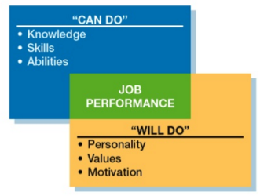
Reaching a Selection Decision
Summarizing Information about Applicants
Focus on what applicants ‘can do’ and ‘will do’
Decision Making Strategy
The strategy used for making decision for one job might differ from the other job
The two basic approach are clinical and statistical approaches

Slide 22
Reaching a Selection Decision
Final Decision
For large organizations, managers or supervisors usually make the final decision
Then HR personnel notify and make job offer to the applicants and confirm the details of the job
Rejecting both internal and external applicants can difficult, especially internal candidates
Organizations should not fail to notify candidates who are not chosen for the position

Slide 23
References
Bohlander, G.W. and Snell, S.A., 2013. Principles of Human Resource Management. 16th Ed. South-Western: Cengage Learning.
Noe, R.A. et al., 2016. Fundamentals of Human Resource Management. 6th Ed. New York: McGraw-Hill Education.

