Slide 1
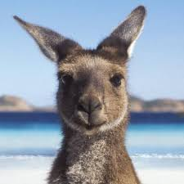
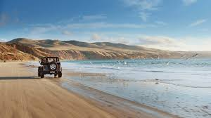
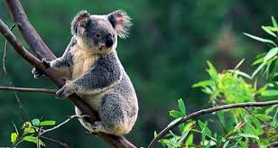
Discovering Australia

Slide 2
https://youtu.be/Vgj70MSUFho

Slide 3
Australia is home to one of the world’s oldest living cultures, with Aboriginal communities established nearly 60,000 years before European settlement.
Today, Australia is one of the world’s most multicultural countries, rich in Indigenous and immigrant cultures.

Slide 4
The Commonwealth of Australia or Australia is a continent by itself. The island nation is bound by the Indian and Pacific Oceans. Across the water its neighbors are Indonesia, Papua New Guinea and Timor Leste to the North, and New Zealand to the South east.

Slide 5
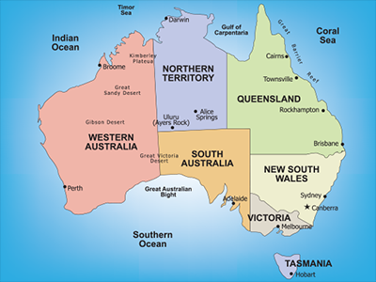
It is the world's smallest continent and the sixth-largest country (after Russia, Canada, China, the USA, and Brazil)
The country is divided into six states and two inland territories.

Slide 6
State and territories
Australian Capital Territory (ACT)
The bounds the national capital of Canberra and is center of government.
It is home to a number of important national institutions, including Parliament House, the Australian War Memorial and the National Gallery of Australia.

Slide 7
Northern Territory (NT)
Darwin is capital
Alice Springs is the principal inland town and is heart of Australia.
Northern Territory is home to the famous Uluru (Ayers rock)

Slide 8
Queensland (QLD)
Is the second largest state ( in size) and is home of Great Barrier Reef and world’s most extensive subtropical rainforest including the world Heritage listed: Fraser Island
Brisbane is the state’s capital

Slide 9
South Australia (SA)
Sits in the southern central part of the country and covers some of the most arid parts of the continent.
The state capital is Adelaide

Slide 10
Tasmania (TAS)
Separated from mainland by Bass Strait .It is the smallest state in Australia.
The capital is Hobart , the second oldest capital city after Sydney
One –fifth is covered by national parks and it is one of the world most mountainous islands.

Slide 11
Victoria (VIC)
Is the smallest of the mainland states in size.
The capital is Melbourne which is the second most populated city

Slide 12
Western Australia (WA)
Australia’s largest state desert from the east to 13,000 km of pristine coastline of the west
The capital is Perth; the fourth most populous in Australis

Slide 13
New South Wales (NSW)
Is the oldest and most populous state. It is home of popular attraction including the Blue Mountains and Hunter Valley wine region
The capital is Sydney

Slide 14
Daylight Saving Time (DST) is the practice of advancing clocks one hour during the warmer months of the year. In Australia, Daylight saving is observed in New South Wales, Victoria, South Australia, Tasmania, and the Australian Capital Territory.
Daylight Saving Time begins at 2am on the first Sunday in October, It ends at 2am (which is 3am Daylight Saving Time) on the first Sunday in April, when clocks are put back one hour.

Slide 15
people
Before the arrival of British in 1788, Australia was inhabited by the Indigenous peoples - Aborigines and Torres Strait Islanders, sometimes referred to as the First Australians.
Aboriginal people inhabited the whole of Australia and Torres Strait Islanders lived on the islands between Australia and Papua New Guinea, in what is now called the Torres Strait.

Slide 16
people
Home to nearly five million immigrants from 160 countries, Australia is rich in cultural diversity.
Australians, or "Aussies," enjoy an easy-going lifestyle and are generally friendly and relaxed. Modesty and equality are valued.

Slide 17
language
Australia does not have an official language, but the national language is English .While English is the dominant language in Australia, many people speak a language other than English within their families and communities.
The most common languages other than English are: Italian, Greek, Cantonese, Arabic, Mandarin and Vietnamese. Collectively, Chinese languages (including Cantonese, Mandarin and other Chinese languages)

Slide 18
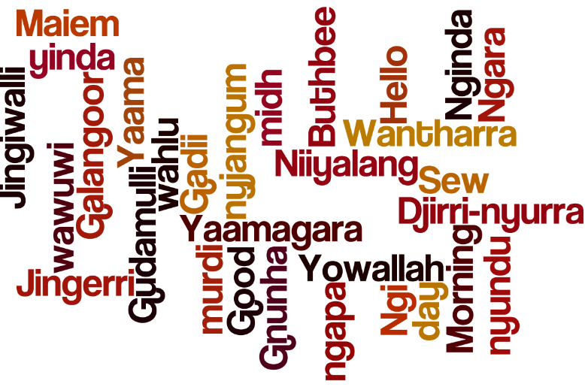
One of the most important influences on Australian English has been Aboriginal languages.
There are a number of Aboriginal words that have been adopted colloquially within Australian English, for example 'boomerang', 'humpy' or 'corroboree'. One of the first words collected was kangaroo.

Slide 19
Meeting and Greeting
Business meeting
Shake hands with everyone present upon meeting and before leaving. Allow women to offer their hands first.
Women generally do not shake hands with other women.
Use titles, Mr., Mrs., and Miss when first introduced.

Slide 20
Formal Meeting
Australians are not very formal, so greetings are casual and relaxed – a handshake and a smile are appropriate
However, while an Australian may say, ‘G’day’ or ‘G’day, mate’, this may sound patronising from a foreigner. Visitors should simply say the traditional ‘Hello’ or ‘Hello, how are you?’ As to titles of courtesy, they prefer to use first names, even at the initial meeting..

Slide 21
etiquette
When yawning, cover your mouth and excuse yourself.
Winking at women is considered rude.
The "V" sign (made with index and middle fingers, palm facing inward) is a very vulgar gesture.
Strong eye-contact is essential - it demonstrates involvement.

Slide 22
The accepted distance between people at meetings is an arm's length.
The "thumbs up" gesture is also a vulgar one. So be careful when you want to express joy or victory!
Australians take punctuality seriously. If possible, arrive fifteen minutes early for a business meeting.
When invited to an Australian’s home, bring a small gift (flowers, chocolates, or books about your home country or region) for your hosts. They should be opened when received.

Slide 23
Australia produces excellent wine. Taking wine would be like taking sand to the desert.
Avoid discussions about the treatment of the aboriginal people.
Do not sniff or blow your nose in public.

Slide 24
Australians respect people with strong opinions, even if they don't agree.
Table manners are same as in Europe.
Do not say "I am stuffed" after a meal. This means you are pregnant.

Slide 25
The Art of Conversation
English is the spoken language at business meetings. However, stick with standard terms; do not experiment with Australian terms.
Popular welcome topics include the weather, sports (particularly Australian Football AFL in Victoria, and National Rugby League NRL in New South Wales and Queensland). Anything related to Australia in a positive way is a good conversation starter.
–

Slide 26
Topics to avoid though are religion, politics and sex - unless the Australian counterpart brings it up.
Do not get into immigration and aboriginal issues no matter how curious you are.
Also, comments on accents will not be welcome, as they often distinguish social classes

Slide 27
cuisine
Australian cuisine has been influenced by that of the British and Irish given that the island was a British Colony.
However, derived from its aboriginal hunter gatherer traditions, indigenous Australian cuisine based on Kangaroo, Emu, and crocodile meat is also popular in the country.
On the other hand, the nation’s multi-cultural immigration population has ensured a wide range of multi-ethnic foods as well as fusion cuisine. Roast dinners, meat pies, and fish and chips, are some of the country’s most popular meals.

Slide 28
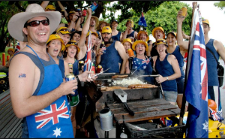
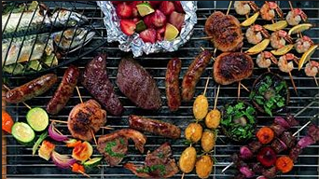
cuisine
The barbecue, also 'barbie', in Australia is a way for Aussies to socialize with friends and family and is probably so popular because of the fantastic weather all year.
A typical Aussie barbecue is with sausages, burgers, steak, fresh seafood, bread and tomato or barbecue sauce, they sometimes include salad but it's mainly about the meat and fish

Slide 29
Vegemite is a dark brown paste made from various vegetables, yeast extract and spice additives. The most popular way to eat it is on bread or toast with butter.
Pies are a popular snack to eat on the go and almost every corner shop, bakery and supermarket will have a display case with lots of hot meaty pies to choose

Slide 30
Religion
The main religion in Australia is Christianity, comprising of Protestants, Catholics, Eastern Orthodox and other Christian sects, however the country also has Buddhists, Muslims and followers of other unspecified religions.
Ethnic groups living in Australia include whites, Asians, aboriginals and others.

