Slide 1
IAC 1201: Introduction to AVIATION INDUSTRY
UNIT 3 Aviation Industry today

Slide 3
What is aerospace Industry?
Aerospace industry such as General Electric Company and The Boeing Company, is a firms engaged in research, development, and manufacture in these following
Aerospace system ; manned and unmanned aircraft; missiles
Space-launch vehicles
Spacecraft; propulsion, guidance, and control units for all of the foregoing; and a variety of airborne and ground-based equipment essential to the testing, operation, and maintenance of flight vehicles

Slide 4
Characteristics of the industry
Prior 1950, product line was entirely aeronautical – aircraft, engines, propellers, avionic components, and accessories
Early 1950, transformation began, new type of engines, different air-frame, different on-board equipment, new tooling and facilities
R & D , with increasing scientists, engineers, highly skilled technicians, make managerial more sophisticated

Slide 5
Mode of Transportation Features
All modes of transportation have common features. They require an infrastructure, terminals, vehicles as means of transportation and operations to control the transportation systems

Slide 6
In the Airline Industry
the ‘transport networks’ ‘Airways’
the ‘terminal' ‘Airports.’
The ‘vehicles’ ‘different types of airplanes.
‘Air Traffic Control (ATC)’ a service offered
by the appropriate
authority to promote
the safe, orderly flow
of air traffic.

Slide 7
Airline Industry is…
System of Transportation . Focus on moving people and goods from place to place by using airways
Mode of Transportation
: Passengers automobile, busses, air and railways
: Freight sea, road, railways, and air

Slide 8
Aviation Industry
Airline Industry is a part of aviation industry, which scope of activities provided by:
1. Aircraft Manufacturers
2. Airport Operations
3. Aviation Support Industries
4. Service Provider

Slide 9
1. Aircraft Manufacturers
Produce
Commercial planes with 2, 3, 4 engines
Small planes called ‘General aviation planes’ with 1,2 jet engines or propeller .Small planes or light planes use for flight instruction, spraying field crops, serve small communities to larger airports called ‘Commuter plane’
Military planes, which include bombers, fighters

Slide 10
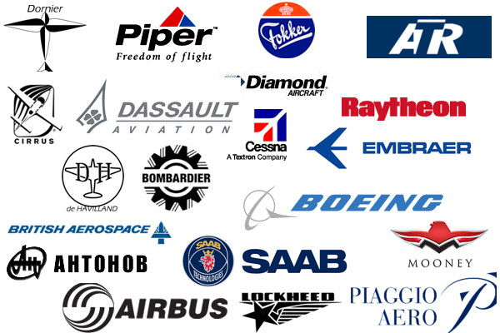
Aircraft Manufacturers

Slide 11
2. Airport Operations
Ground Facilities such as reservation, check in, gate, etc.
Including Runway and Navigation Aids
Air Traffic Control (ATC)

Slide 12
Airport Operations

Slide 13
3. Aviation Support Industries
Provide services and supplies to airlines or airports
Company supply fuel for airplanes
Furnish Maintenance, or Repair services
Food suppliers
Airport support involve ground transportation
Freight forwarder
Specialized professional ie. flight insurance, weather information

Slide 14
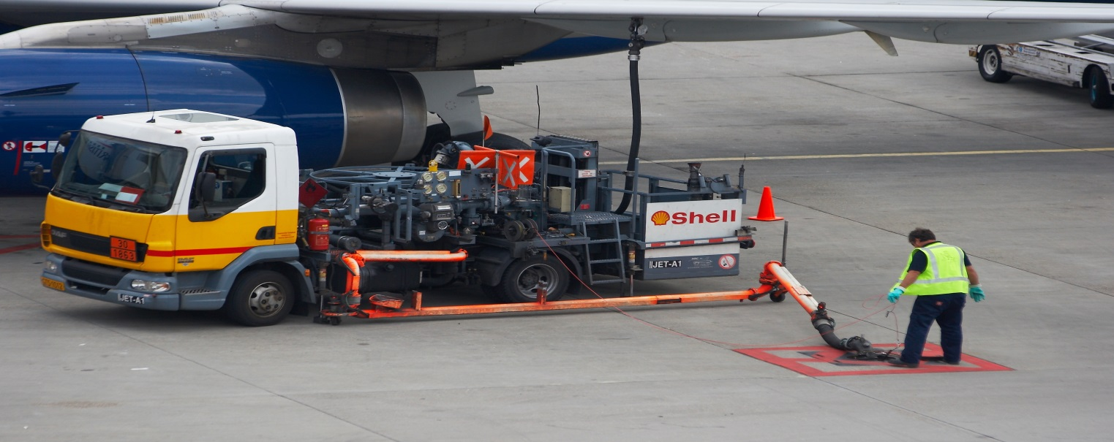
Aviation Support Industries

Slide 15
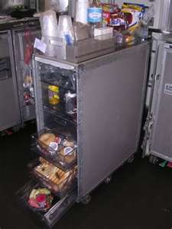
Aviation Support Industries

Slide 16
4. Service Providers or Travel Agents
Important contributor
Authorized to sell and issue tickets in and affordable price
Supporting hospitality service such as hotel, car rental, tourism agent, or cruise operator
Things needed when arrive at destination

Slide 17
Types of Airline service
Scheduled Flights
Non-scheduled Flights

Slide 18
Scheduled Flights
Predetermined routes according to timetable which refers to regular, published schedules
Use ‘Wide’ or ‘Narrow’ body aircraft
The airlines that provide scheduled flight service Major Airlines, Low Cost Carriers, or Regional Airlines.

Slide 19
Major Airlines is large airlines that connect to major cities of the world. These airlines have the capability to handle international destination
Low Cost Carriers, known as ‘no-frills’ airlines, offer low fares The term originated within the airline industry referring to airlines with a low – or lower – operating cost structure than their competitors

Slide 20
Regional Airlines known as ‘feeder airlines’. The role of feeder airlines is to bring passengers to the major airports, to connect for longer distance flights on larger aircraft.
Sometimes offer transportation service between small, isolated communities unable to support larger aircraft. they are referred to as ‘commuter airlines’.

Slide 21
Scheduled Flights

Slide 22
Non-Scheduled Flights
Not operate under a planned timetable
Chartered for commercial use by tour operators or other hiring arrangements with customers
Markets for these services include athletic teams, corporations and government agencies
A growing part of Airline industry

Slide 23
Non-Scheduled Flights

Slide 24
Passenger Travel
The business market : main goal is to meet with customers and attend conferences or meetings .
Fast growing markets and world trade in the Asia market are the main driving factors contributing to business travel.
This travel market is the most profitable segment of passenger travel.

Slide 25
The leisure market consists of passengers travelling for a more extended period of time for the purposes of recreation or other personal reasons. ; holiday

Slide 26
different classes of service on a plane
Airlines traditionally have four travel classes depending on the cabin configuration.
First Class, generally the most expensive and most comfortable accommodations available.
Business Class, high quality, traditionally purchased by business travelers (sometimes called executive class)

Slide 27
Premium Economy, slightly better Economy Class seating (greater distance between rows of seats; the seats themselves may or may not be wider than regular economy class)
Economy Class (also known as coach class or travel class), basic accommodation, commonly purchased by leisure travelers

Slide 28
Economy class
Premium Economy Class

Slide 29
Business Class

Slide 30
First class

Slide 31
References
http://www.thehindubusinessline.com/multimedia/dynamic/01047/bl09_blswe_blter_t_1047704f.jpg
http://www.aspireaviation.com/wp-content/uploads/2012/12/K65105-02.jpg
http://www.supremeaviation.com/images/refrences/logo.jpg
http://www.akfen.com.tr/wp-content/uploads/2012/11/IST-1.jpg
http://cdn2-b.examiner.com/sites/default/files/styles/image_content_width/hash/49/db/49db577b2e20847551e9e5909d2a9c5a.jpg?itok=JvOcbqT1
http://upload.wikimedia.org/wikipedia/commons/e/e7/Airbus_A321-231_-_British_Airways_-_G-EUXH_-_EHAM_(5).jpg
http://content.emirates.com/newsimages/Flavour-2_tcm133-395365.jpg
http://www.hometravelagentsite.com/wp-content/uploads/2014/07/travelagent3.jpg
http://www.vosizneias.com/wp-content/uploads/2014/05/F140508ZEL03-725x482
http://elafgroup.com/wp-content/uploads/2013/02/15.jpg
http://www.rentittoday.com/rental-blog/wp-content/uploads/2010/12/stratos-jets.jpg

