Slide 1
IAC 2205 English for airline career preparation
Unit 1: Job Advertisement

Slide 2
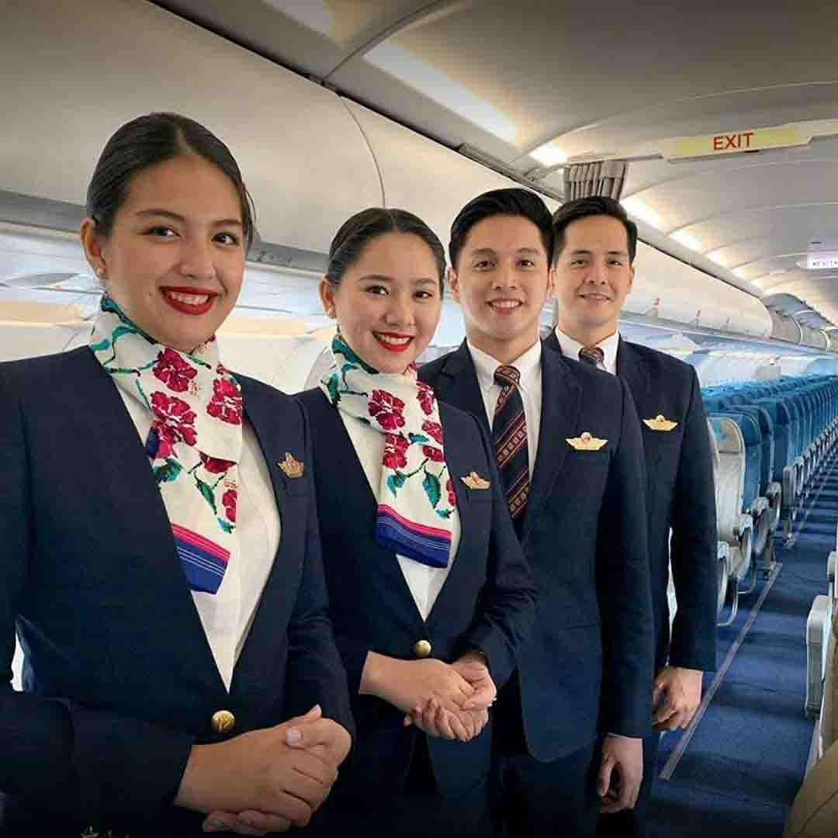
Thai airways

Slide 3
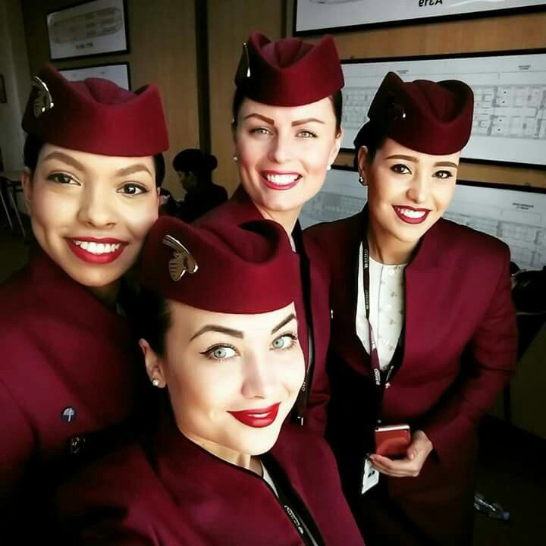

Slide 4
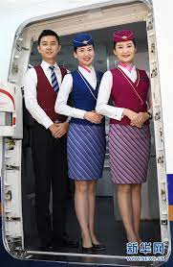

Slide 5
Airline jobs Apply online for Various Posts.
Airline jobs 2022 Post Details
Customer service executive female and male
Air ticketing executive
Ground services staff
Technical support Engineer
Airport manager
Cabin crew
In-flight supervisor
Airport reservation executive
Technical
Product manager
Duty engineer

Slide 6
How to get any job in Airline?
To get jobs in airlines, there are a lot of ways. There are some leading job portals like Naukri, Shine, Monster, Glassdoor, etc., through which you can apply for airline jobs. For the steps:
Four steps to get any job in Airline
First registered in the reported job portal like Naukri shine monster Glassdoor etc.
Search the job you are looking for from the portals or job portals
Check the necessary qualifications, age limit, salary location of job role and others carefully
Apply to get notified for an interview for written test (if applicable)

Slide 7
How to Face the Airline interview?
You will get selected if you have cracked the interview, and all of your information satisfies the requirement of the Airline’s authority.
How Much is the Application fee for Airline career 2022?
Airline jobs don’t require any application fee.
What is the minimum required age for Airline Jobs 2022?
To get a job in the airline industry has to be 18 years plus.
Required Qualification for airline jobs in 2022?
There are various posts available for airline jobs. As a result, Qualification is also not the same. For multiple positions, different qualifications are needed. One thing is common a minimum of 10 + 2 is the primary need to get a job in the airline industry.

Slide 8
Who can apply for airline jobs in 2022?
Candidates who have a keen interest in developing their career in the aviation industry can only apply in airline jobs.
Young freshers and experienced candidates also apply to the airline industry because it is one of the world’s growing sectors.
Apart from that, people having specified qualifications and skills from different fields can also apply.

Slide 9
Some Airline Companies official Career Link
Indigo Jobs 2022 – LINK SpiceJet Recruitment 2022 – LINK Go Air Recruitment 2022 – LINK Air India Recruitment 2022 – LINK Air Asia Recruitment 2022 – LINK Jet Airways Recruitment 2022 – LINK Vistara Recruitment 2022 – LINK Air Asia All Jobs Hiring 2022 – LINK

Slide 11
https://th.jobsdb.com/th/job-list/transportation-logistics/airline/1
https://careers.qatarairways.com/global/en/job/220000CY/Customer-Experience-Cabin-Crew-Recruitment-Bangkok-Thailand-2022

Slide 12
Flight Attendant responsibilities include:
Providing information, guidance, and assistance for safety and comfort to passengers on board aircraft
Attending the “brief” and act on it
Conducting safety check before flight

Slide 13
Job brief
We are looking for a pleasant Flight Attendant to ensure the safety and comfort of passengers aboard flights. The successful candidate will be able to work independently, perform effectively in a team and build trust relationships with passengers.
The goal is to maximise revenue growth and enhance customer satisfaction.

Slide 14
Responsibilities
Provide information, guidance, and assistance for safety and comfort to passengers on board aircraft
Attend the “brief” and act on it
Conduct safety check before flight
Greet customers, check their tickets and accompany them to their seats
Prepare and serve drinks and food to passengers
Present emergency equipment and give instructions
Monitor and secure the cabin regularly
Comply with all aviation rules and regulations for safety and protection
Assist passengers and cabin crew during emergency situations
Provide special help to passengers with special needs (children, disabled persons, elders etc)
Submit analytic reports concerning flight incidents

Slide 15
Requirements and skills
Proven working experience as Flight Attendant or Customer Service experience
Fluency in English, multilingual is preferred
MS Office knowledge
Customer service-oriented
Professional image
Excellent communication and presentation skills
Problem solving skills and ability to handle difficult situations
Cabin crew certification or training

Slide 16
TICKETING OFFICER
Fischer & Partners Co., Ltd.
Bangkok
THB 20,000 - THB 45,000 /month
Posted on 20-May-22
Job Highlights
Experience: Ticketing/Cancellation/Exchange/Refund
Experience in reissue/exchange
Knowledge in GDS, ticketing systems

Slide 17
Customer Experience - Cabin Crew Recruitment | Bangkok, Thailand | 2022
Begin your journey with us.
Join our award-winning Cabin Crew team.
As the market conditions are improving and our network is growing, we are now looking to grow our Cabin Crew team, Qatar Airways’ Ambassadors to the world.
We are in search of highly motivated individuals who can deliver our legendary hospitality and world-class service. With industry-leading benefits and unparalleled training programs, you will support the Customer Experience division by creating memorable experiences for our passengers onboard.

Slide 18
As you work with Qatar Airways, you can take comfort knowing that you are flying with the only airline in the world that has, together with its state-of-the-art global hub Hamad International Airport, achieved four 5-Star Skytrax ratings – including the prestigious 5-Star Airline Rating, 5-Star Airport Rating, 5-Star COVID-19 Airline Safety Rating and 5-Star COVID-19 Airport Safety Rating.
We have always been a leader in the industry and have adapted since the beginning of pandemic becoming the biggest global carrier, whilst continuing to redefine our levels of safety, comfort and service throughout our onboard experience.
Start writing your own story with Qatar Airways, an airline that has never stopped flying and remained resilient throughout the pandemic.

Slide 19
Qualifications
To be successful in this role, you will have the following :
Minimum age: 21 years
Minimum arm reach: 212 cm (on tip toes)
Minimum education: high school education
Fluent in written and spoken English (ability to speak another language is an asset)
Excellent health and fitness
Willingness to relocate to Doha, Qatar
Outgoing personality with good interpersonal skills and the ability to work with a multinational team
Passion for service
You will also excel in a fast-paced, team environment, demonstrating your commitment to achieving the highest possible standards of customer service and guest experience, quality and professionalism.

Slide 20
Be part of an extraordinary story
Your skills. Your imagination. Your ambition. Here, there are no boundaries to your potential and the impact you can make. You’ll find infinite opportunities to grow and work on the biggest, most rewarding challenges that will build your skills and experience. You have the chance to be a part of our future, and build the life you want while being part of an international community. Our best is here and still to come. To us, impossible is only a challenge. Join us as we dare to achieve what’s never been done before.
Together, everything is possible

Slide 21
About Qatar Airways Group
Our story started with four aircraft. Today, we deliver excellence across 12 different businesses coming together as one. We’ve grown fast, broken records and set trends that others follow. We don’t slow down by the fear of failure. Instead, we dare to achieve what’s never been done before.
So whether you’re creating a unique experience for our customers or innovating behind the scenes, every person contributes to our proud story. A story of spectacular growth and determination. Now is the time to bring your best ideas and passion to a place where your ambition will know no boundaries, and be part of a truly global community.
How to apply
If you are interested in applying for this position, please upload your CV and complete the online application.
We encourage you to apply to the closest major city to your location.
Explore Location

