Slide 1
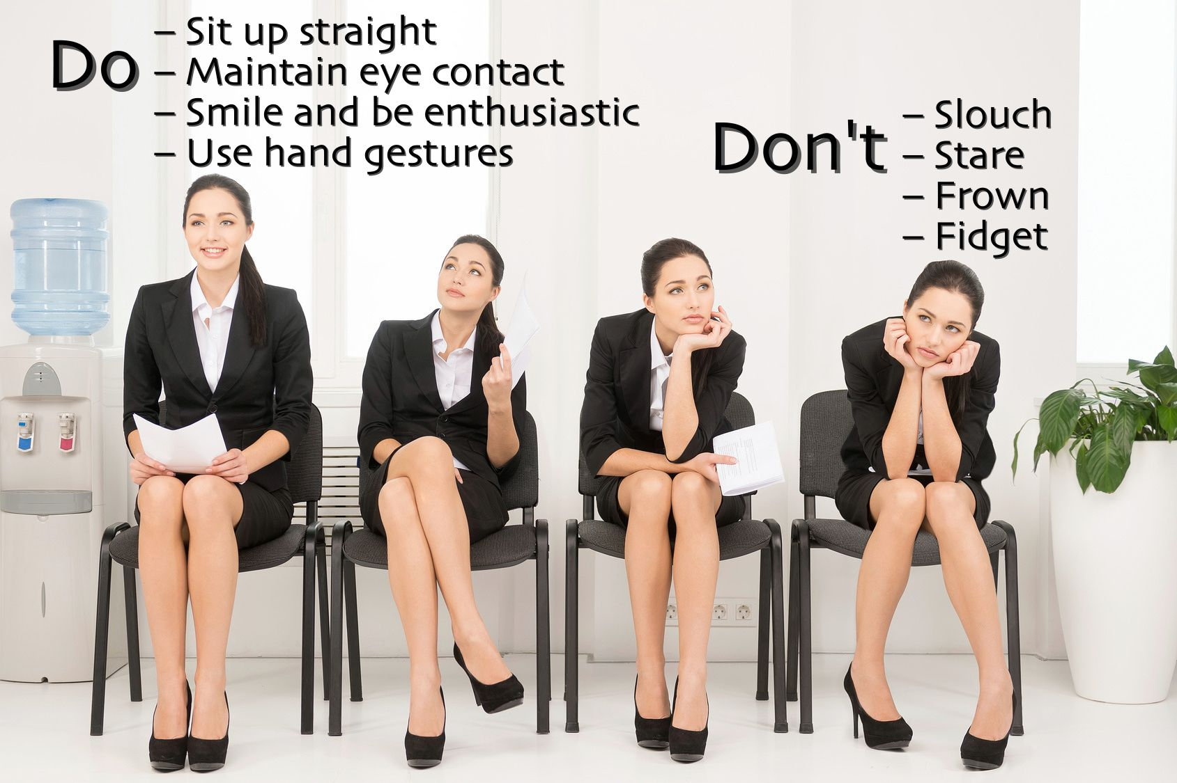
IAC 2205 English for Airline Career Preparation
Unit 2 First Impression on an Interview Day

Slide 2
The employer chose you based off how you look on paper: your education, your experience and your skills. Now, they need to see what you’re like in person.
This is where the first impression comes in. The optimal combination between your impressive resume and quality of character in the interview are the critical factors to landing the job.
So even if you successfully completed step one (the awesome resume), you won’t progress through the process unless you complete the second step.

Slide 3
The first thing the interviewer sees is your appearance. From the moment the interview begins, the interviewer is already evaluating you on your manners and posture.

Slide 4
The initial judgment is based upon three characteristics: the body language, speech and confidence of a candidate.
“A first impression is like a filter. Here's how others form an image of you:
People take in initial information - they notice your body language, what you say and how you respond.
2. Based on this initial information, they form an impression and make decisions about what you are like and how they expect you to behave in the future.

Slide 5
3. They see you through this filter. Everyone likes to think they are a good judge of character, and think
"I knew from the first moment I met him that he was . . ."
They seek information that is consistent with their first impression and will not look for, or even will ignore, behavior that doesn't fit their impression of you.”
Please also remember to turn off your cell phone before you go in for an interview.

Slide 6
Using the first impression to your advantage
1) Be on time (meaning be early)
Impression is generated in under a minute, so for every second you are late for an interview, you are losing traction with the interviewer that might never be regained.
Ten to fifteen minutes early is considered “on time” for an interview. And because behavior is heavily associated with personality, your prompt arrival will likely be correlated with good organizational skills.
When you get there a little early, you’ll have time to collect yourself, calm down and ensure you look clean and sharp

Slide 7
2) Make sure you look fresh
EYES: Vivian Diller, Ph.D., says that eyes make the most indelible impression on a person.
“Eyes that are bright and open send a message of curiosity … When people avert their eyes, we tend to see them as uncomfortable and insecure with themselves. Partially closed, narrowing or darting eyes can communicate shiftiness, insincerity and a lack of warmth.”
So make sure you got plenty of rest the night before

Slide 8
Smile: A smile elicits the most immediate and positive reaction from people.
People who are frowning or straight-faced may convey a lack of interest, while a stiff smile may suggest a lack of authenticity.
So make sure your lips are naturally curling upward and you’ll likely be perceived as personable, approachable and warm.

Slide 10
Clothing:
The basis of making a good impression with your appearance is cleanliness. As a professional, let's be conscious of your hairstyle, clothes, nails, and feet.
Unclean and sloppy appearance not only makes those around you uncomfortable, but also gives an impression that you are not serious about working. Please also remember to turn off your cell phone before you go in for an interview.

Slide 11
3) Be Personable
Be confident and use simple, accessible diction. Be polite and try to create chemistry with the interviewer

Slide 12
4) Practice
Check your appearance and practice your tone of voice in front of the mirror and test out your handshake on a friend.
Make a list of your strengths, weaknesses and goals
Researching the company and the interviewer, and make a killer first impression by asking intelligent questions to show the interviewer you are responsible enough to have planned ahead.

Slide 13
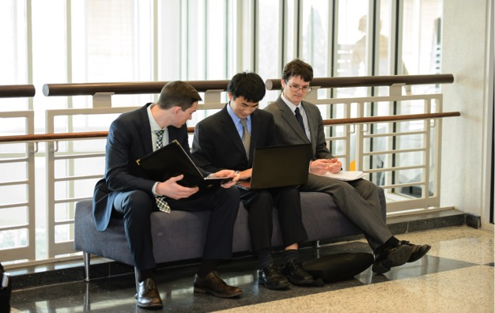
On arrival
Upon arrival , approach the reception desk and introduce yourself, your purpose and whom you are expecting to meet
Once signed in, thank the receptionist and take a seat in the waiting area

Slide 14
Meeting the candidates
As you approach the candidates, smile and make eyes contact, then say hello and introduce yourself.
In a one to one introduction, offer a handshake if you desire. In a group introduction, a handshake is unnecessary .
If the candidate responds positively to your approach , you may engage in further small talk

Slide 15
Meeting the recruiter
The way you stand will say a lot about the type of person you are.
Be careful when you enter the interview room, be sure to stand up straight , your back should be straight, shoulders relaxed, and feet together, make eye contact and smile.
Always greet and introduce yourself first. Say the first greeting enthusiastically and clearly.
State your name and thank them for allowing you to have this opportunity.

Slide 16
Sitting, try not to lean onto the chair, but leave some space between your back and the backrest.
Also, if you have any habits (shaking your legs, twirling pens, messing with hair, etc.), try to make extra effort to prevent it from happening. You may not be aware of your own habits so it’s a good idea to ask your friends and family about it.

Slide 17
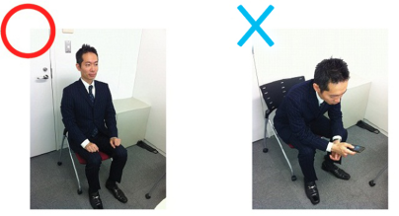
Relax and lean slightly forward, about 10 degrees, towards your interviewer. This gives the message that you are both interested and involved.
Leaning back makes you appear too casual.
Leaning to the side can be perceived as not feeling comfortable with the interviewer..

Slide 18
You can establish rapport by adopting the same posture as the other person. This is called mirroring.
If they have adopted a more formal posture do the same until you see that the interviewer has relaxed and become less formal.

Slide 20
What to do with your Hands
https://youtu.be/uAHb6uzDVrU
Rest them, Keep your hands gently closed together and on your lap or on the table in front of you. Control your hands by being aware of what you are doing with them.
Having your hands above the neck, fiddling with your face or your hair, is unprofessional and conveys nervousness and anxiety. Keep your hands away from your face.
Touching the nose or lips can indicate that the candidate is lying or uncertain.

Slide 21
Folding your arms across your chest suggests a closed and defensive attitude.
Waving your hands and arms around can be perceived as uncertainty and a lack of professionalism.
Practice a comfortable way to loosely place your arms and hands while you are sitting, both at a table and in a chair on its own.

Slide 22
Be Aware of your Legs
Lots of leg movement is both distracting and indicates nervousness.
Resting one leg or ankle on top of your other knee makes you look too casual and comes across as arrogant.
Crossing your legs high up conveys a defensive attitude in the one-on-one context of a job interview.
Crossing them at the ankles or placing both feet flat on the floor conveys a confident and professional look during the job interview

Slide 24
Making Eye Contact
If the interviewer is talking and you want to show that you are listening, you need to instigate direct eye contact and maintain it.
Avoid appearing as if you are staring aggressively by blinking at regular intervals and moving your head every now and then, such as giving a small nod.
When you are doing the talking you need to hold eye contact for periods of about 10 seconds before looking away briefly and then re-establishing eye contact.

Slide 25
Looking downwards makes you appear insincere or submissive. It is acceptable to look down if you are making notes or referring to information in front of you.
However if you are speaking, or the interviewer is asking you something, raise your head and make regular eye contact to show that you are actively involved.
With panel interviews it is best to look at and direct your answer to the person asking the question, with a glance periodically at the other interviewers.

Slide 28
Speaking
Speak clearly and concisely.
Speaking softly or mumbling doesn’t leave a great impression.
When speaking, don’t stop halfway (you are not confident in what you are saying) and finish what you have to say.
Some people start talking fast when they are nervous. Try not to rush, take your time, and speak with confidence.
Breathe and pause before answering a question, this gives you time to react in a considered way and it ensures that the interviewer has finished the question.

Slide 29
Listening
Listen to what the other person is saying until they are finished talking, and think over the question being asked before answering.
The interviewer has a purpose of asking the question and is expecting the candidate to answer it a certain way.
Instead of thinking about what the correct answer is, think more about what the interviewer is trying to learn from your answer.
Not listening until the end and jumping to conclusions or disregarding the question can give the impression that you lack comprehension skills or that you can only think of yourself and not the other person.

Slide 30
Understand the Interviewer's Message
Watch for body language signals from your interviewer to read the message they are sending you.
Body language cues that can indicate boredom include resting head on hand, fiddling with hands and losing eye contact. If this happens wrap up what you are saying and move on by asking the interviewer a question such as:
"Is there anything else you would like to know about that topic?"

Slide 31
After the interview
After the interview, get up from your seat, stand next to the chair, and thank them for their time.

Slide 32
Job Interview Clothes Do's and Don'ts
Your hair and make-up
Your hair should be neatly combed and styled. Avoid a style that allows you to fiddle with your hair - this makes you appear nervous and unsure.
Keep you hair off your face.
Sunglasses pushed up into your hair looks messy.

Slide 33
Wear understated makeup in natural tones. Overdone eyeshadow, heavy eyeliner and brightly-colored lipstick make you appear frivolous and unprofessional. Ensure your nails are clean and manicured and only wear neutral polish

Slide 34
Keep it professional
Your hemline should fall just above or on your knee. Short and split skirts are difficult to sit comfortably.
Wearing short skirts and sexy clothing to job interviews is unprofessional.

Slide 35
Job interview clothes should fit properly and not be too tight. Low neck-lines, transparent fabric and bra straps on display should be avoided.
Men should avoid wearing baggy interview clothes. Sweats and clothes that are too big create an impression of untidiness. Pants pulled down around your hips look unprofessional.

Slide 36
Your shoes
Wear closed, medium to low-heeled shoes. You should be able to walk comfortably in your shoes and appear confident and at ease. Very high-heeled shoes are unsuitable. Avoid brightly colored and trendy shoes - you are not there to make a fashion statement.
Invest in a pair of smart business-wear shoes.

Slide 37
Carry a smart bag
Carry a small briefcase or similar bag in place of a purse to your job interview. This provides an easy way of carrying a tablet or laptop, if you need to take one with you to the interview, as well as all your documents.
If you feel you need a purse, a small structured one is preferable to a large floppy bag. Avoid canvas, denim and straw, these look very unprofessional.

Slide 38
Your accessories
Wear understated jewelry. In-your-face jewelry is a big distraction and gives the impression of flashiness.
For men a classic watch and one simple ring per hand are acceptable. Avoid necklaces and bracelets.
Big, dangling earrings and jangling bracelets are particularly distracting on women candidates as they bounce as you talk and move your hands. Anklets can make your feet a focal point. You want the interviewer to concentrate on your face and what you have to say.

Slide 39
Select your clothes the day before
Take time to prepare. Pay attention to detail. All interview clothes should be clean, tidy and neatly pressed. Check for dangling threads, hems starting to come undone, stains etc.
If you are having to travel any distance to your job interview consider how wrinkled your clothes may look after a couple of hours traveling. Select job interview clothes that do not crease easily.

Slide 40
woman
Best color choices for an interview outfit
Grey or navy – An excellent color especially for conservative organizations.
Blue – A favored color especially if being interviewed by a male.
Black – Can be perceived as being "too strong" for an interview. If black is worn, soften the color by using white or pastel accents.
Accent colors
White, cream, light grey or blue – Good neutral colors for blouse or shirt.
Yellow – Gives impression of a productive and creative person.
Red – A powerful color for small accents such as a scarf.
Orange – A good accent color encourages conversation.

Slide 41
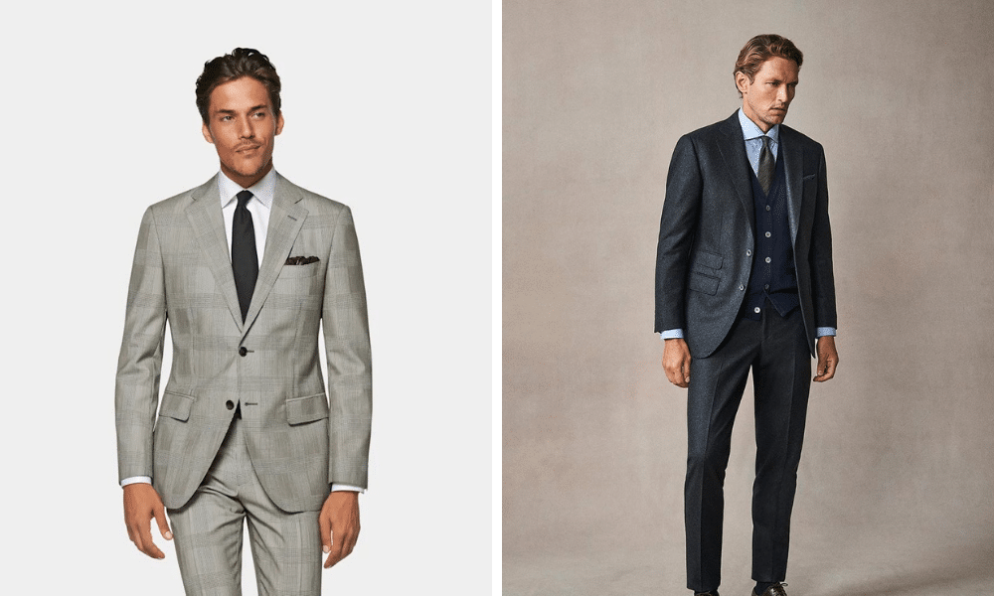
Men
getting a haircut about a week before the video call and making sure that your facial hair is trimmed (or shaved).

Slide 45
http://www.infusivesolutions.com/blog/bid/87721/First-Things-First-Understanding-the-Psychology-of-First-Impressions
http://extension.illinois.edu/dress/07interview-03factsheet.cfm
http://www.best-job-interview.com/job-interview-clothes.html
http://www.wikihow.com/Introduce-Yourself-at-a-Job-Interview

