Slide 1
IAC2207 Ground Service Management
Unit 2
Pre-flight preparation

Slide 2
Computer reservation system (CRS)
The CRS is a software that assists an airline with transaction related to make tickets reservations, blocking, reserving, cancelling and rescheduling tickets.
The CRS requires information of; first name, last name, address, phone number, e-mail address, sex and credit card no.

Slide 3
CRS has 3 internal Data Base
DB-User ; containing personal info of the registered user of the CRS – whoever use the system to reserve
DB-Reservation ; containing info regarding the number of seat available in each class on different flight – for checking flights and advise pax
DB-Geography ; contains info about the cities and towns serviced by the airline – information about flts

Slide 4
Blocked ticket
After the user checked the availability of flights and need times, airline will block seat for a certain period of time against a charge, you have to pay within period of time
If a user has a blocked ticket do not need to confirm the ticket. Automatically issued.

Slide 5
Departure control system (DCS)
The departure control system (DCS) is the system used by airlines and airports to check-in passengers.
It assists the airline in managing the information required for airport check-in, printing boarding passes and baggage tags and calculate the volume of baggage and cargo load control .

Slide 6
The DCS interfaces with
Computer reservation system (CRS)
Global distribution system (GDS )
Load control system
Airline’s inventory management

Slide 7
The DCS is able to perform a variety of functions. The key capabilities of the system are:
DCS
Check-in
Baggage reconciliation
Boarding
Weight and balances

Slide 8
A flight is usually created in the DCS 24hrs. before departure. All names, seat requests and special request sent to DCS so GSA can assist pax who has difficulty when using Customer user self service (CUSS)
DCS helps through check-in : the system will enable pax to check-in and get a boarding pass for both sectors.
DCS can automatically assign seats by selected cabin zone. It show the entire seat plan on the screen.

Slide 9
Weight and Balance
Known as load control
Trained on a/c type to control about weight of a/c
Provide the load manifest or load sheet

Slide 10
Baggage reconciliation
ICAO Annex 17,
Each contracting state shall ensure that commercial air transport operators do not transport the baggage of persons who are not on board the aircraft unless that baggage is identified as unaccompanied and subjected to appropriate screening.

Slide 11
PNL flowchart from CRS to DCS CRS DCS
Itinerary
Name
SSRs
FFP information
Seat assignment
TKT information
Phone number
Received (who requested the reservation or change)
OSIs
Remarks
Pricing record
Itinerary
Name
SSR
FFP information
Seat assignment
TKT information
OSIs

Slide 12
SSR special services request
FFP frequent flier program
OSI other service information
PNL passenger name list
CRS computer reservation system
PNR passenger name record

Slide 13
Flight editing
Important process for smooth check-in as can have a whole picture of the flight
Decided on how many counters require for the flight depending on the traffic
Decided on catering efficiently
All service items will be prepared for the passengers as their request

Slide 14
1.Reservation scan
Help reduce operating costs by minimizing meal and beverages order for in-flight service and for the lounges
Can plan ahead in case of overbook situations
Scan for passengers with multiple bookings and no show passengers

Slide 15
2. Seat editing
Very important when full flight . It will speed up check-in process.
Airlines can arrange seat in advance for passengers who require special assistance or who are traveling with infants and children.
Some request for legroom

Slide 16
Double check with pax who check-in from home to avoid duplicate
Infants : need cradle front row
Wheelchairs : front near toilet
Tour group : rear cabin for easier handling
Special request

Slide 17
3. Meal ordering
Fully booked flight, order by the aircraft configurations
Not fully booked flight, order by the accurate numbers of passenger
Special meal must be ordered 24 hrs. before flight

Slide 18
4.Pre-upgrade
Heavily overbooked
Seats in B/C or F/C available
Upgraded ‘Loyalty passengers’ then person who paid higher fares

Slide 19
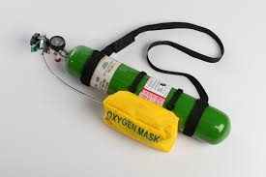
5. Additional requests
O2, Stretchers, Wheelchairs
O2, must be informed in advance to set the O2 bottles on the aircraft
Stretchers, need time to install
Wheelchairs, provide staff to assist pax

Slide 20
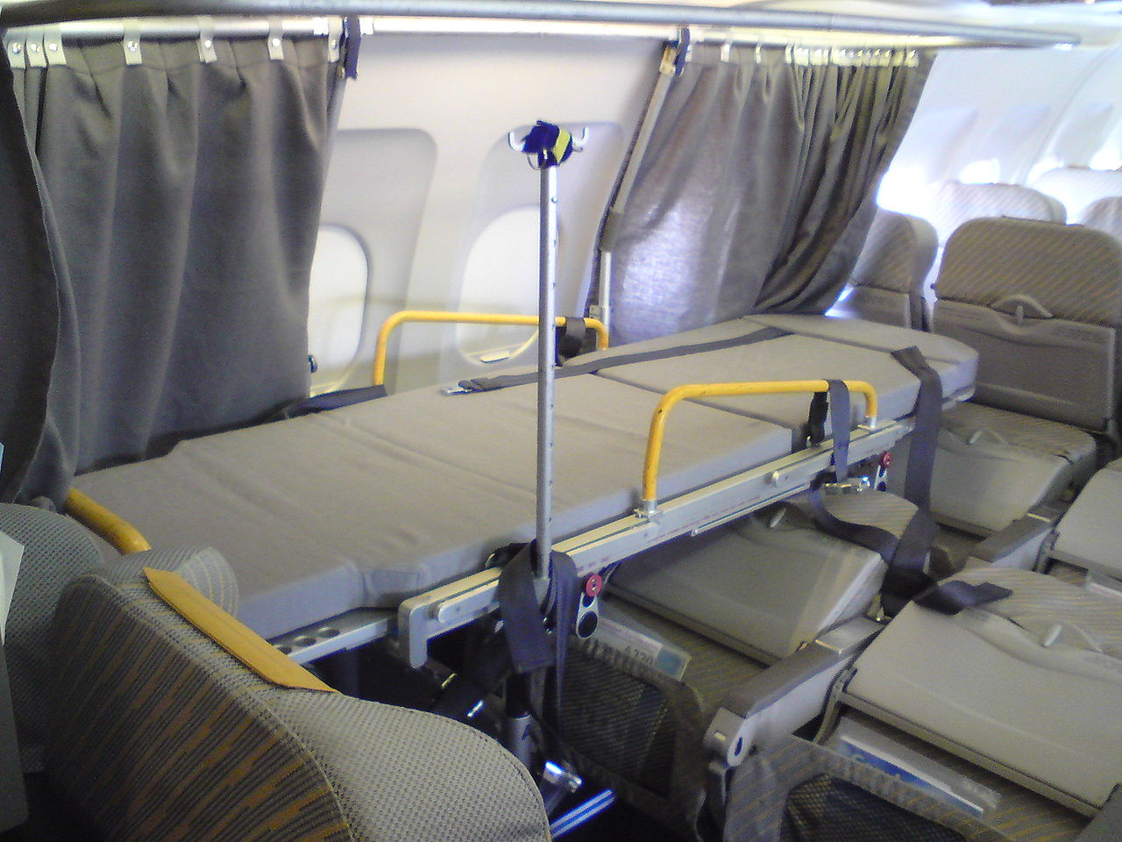
Stretchers Case

Slide 21
6. Telex
IATA (Air Transport Association) defines the available telex types
SITA is operating the network to distribute the messages between airlines, airports, ATC, ground handling agents and other relevant members of the airport

Slide 23
IATA addresses consist of 7 characters divided into the Origin IATA Code (AAA), a function indicator (BB), and the airline designator (CC). For example,
HKGFFLH would be the Cargo Office (FF) of Lufthansa (LH) in Hong Kong (HKG).
BKKLLTG: lost and found of TG in BKK.

Slide 24
Some standardize SITA code
KK = Station / Station manager
RR = Reservation
LL = Lost and Found
KN = Special handling
KW = Lounges
KP = Airport passenger service
CS = Customer service
FF = General Cargo code

Slide 25
Telex sample
FM: BKKLLBR
TO: BKKLLTG, TPELLBR, TPELLTG, TPEKKBR
REFER CASE BR789456 FOR PAX KOMO/ABC BAGTAG NO 123456 NOW RUSH TAG NO 654321 DEST TO TPE WL O/B TGXXX BKK/TPE ARR 31JAN19 // NAN

Slide 27
References
http://s.wsj.net/public/resources/images/OB-LE942_cathay_G_20101207090016.jpg
http://www.gotravel24.com/files/media/Objects/BusinessClassSeats_Qatar_450.jpg
https://c1.staticflickr.com/9/8028/7514458558_525a26b501_z.jpg
http://noam.com/images/QF747.jpg
http://www.aviationnews.eu/blog/wp-content/uploads/2012/04/impg4305-06-07-hdr-boeing-747-8kzf-scd-n50217.jpg
http://www.picpicx.com/wp-content/uploads/2014/12/5534375d6c66314567a4c7736a6c1c0c.jpg

Slide 28
References
http://upload.wikimedia.org/wikipedia/commons/thumb/8/80/Stretcher_im_Flugzeug.JPG/1280px-Stretcher_im_Flugzeug.JPG
http://www.airliners.net/aviation-forums/general_aviation/read.main/1586262/
http://technology.inquirer.net/files/2012/08/United-Airlines.jpg
http://www.nipponsysit.com/hardware-product/images/easycoder_PF4i/easycoder_PF4i.jpg
http://www.nipponsysit.com/hardware-product/images/easycoder_PF2i/easycoder_PF2i.jpg

Slide 29
References
http://upload.wikimedia.org/wikipedia/commons/6/64/Japan_Airlines_boarding_pass.jpg
http://www.slate.com/content/dam/slate/articles/life/design/2012/121003_DES_BaggageTagHandEX.jpg.CROP.article250-medium.jpg
http://www.airport-suppliers.com/content_images/supplier/Belting_Solutions_for_Airports_Baggage_Handling_and_Baggage_Screening_2.jpg

