Slide 1
TIM 3503 English for Airline business
Unit 1 Reservation

Slide 2
Pretest

Slide 3
1. I'll assign you _______ seat to give you more room to stretch
your legs out.
a cabin b. baggage c. an aisle
2. The captain and his co-pilot sit in the _______
a. Cockpit b. overhead compartment c. emergency exit
3. Passengers must stay seated on the plane during the one-hour _______
a. Stopover b. baggage claim c.gates
4. When you paid for your airfare online, you should have printed your
a. excess baggage b. Passport c. e-ticket
5. You are seated in _______ 30, seat B.
a. Aisle b. compartment c. row

Slide 4
6. _______ will be served before we begin the in-flight movie.
a. Luggage b. Jet lag c. Refreshments
7. In the unlikely event of a water landing, _____ can be found underneath your seats.
a. life vests b. motion sickness c. seatbelts
8. Please fasten your _______ while the captain prepares for take-off.
a. Runway b. Steward c. seatbelts
9. In about five minutes we will get ready to _______ to the runway.
a. taxi in b. taxi out c. taxi above
10. We are about to go through a large pocket of _______ so prepare for a bumpy ride.
a. Stopover b. touch down c. turbulence

Slide 5
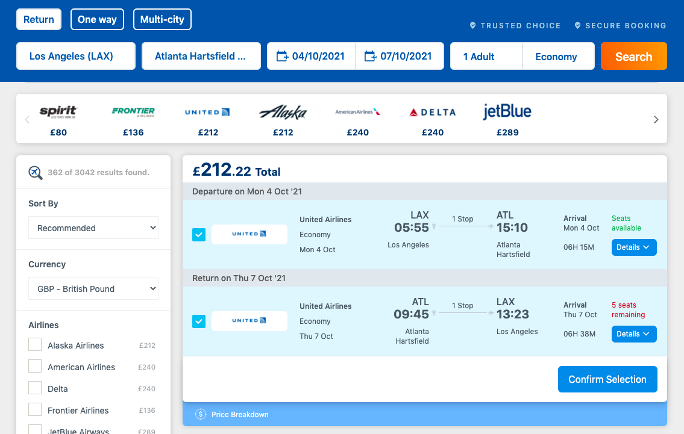
Ticketing and booking are two separate processes. Booking just holds the seat on the plane. Ticketing means that the seat is paid for and the passenger has the right to take it during the flight.

Slide 6
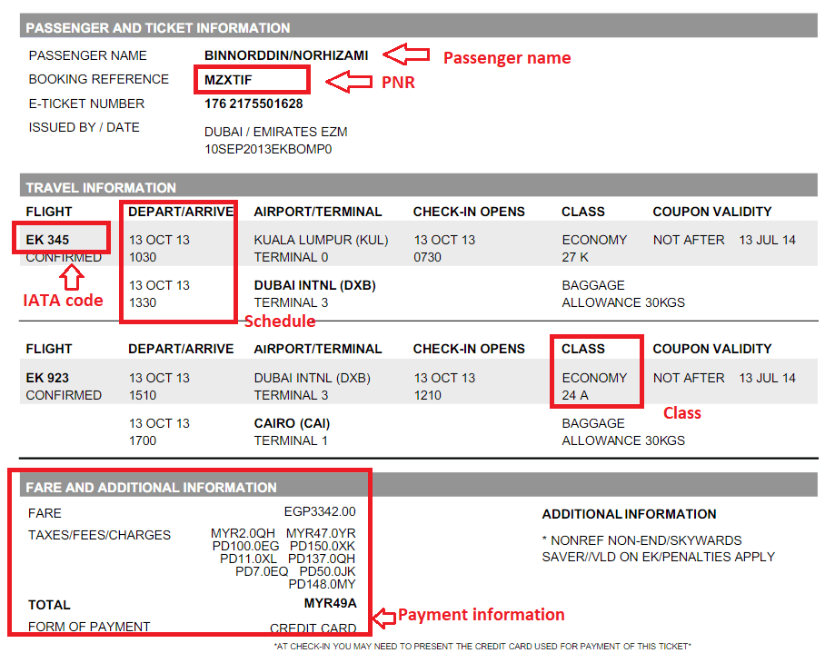

Slide 7
Making reservation Conversation 1
A: I’d like to book a flight to Tokyo please.
B: Which airline would you like to use?
A: Which is the cheapest?
B: When do you want to travel?
A: Next week, the 15th.
B: Would you like a return ticket?
A: Yes, I’m coming back on the 30th.
B: Let me see……. ABC costs £299.00, but you have to transfer at Hong Kong. XYZ is the cheapest direct flight at £349.00, both tourist class of course.
A: How long does the ABC flight take?
B: Total time is 15 hours, XYZ takes 11 hours.
A: I’ll go with XYZ then.
B: How many seats would you like?
A: Just the one, and could I have a vegetarian meal?
B: Certainly, there’s no extra charge.

Slide 8
Vocabulary
Return/ return ticket: a ticket for travel to a place and back again
Transfer: to move someone or something from one place to another
Transfer flight: Passengers who have a stopover of under 24 hours anywhere between the starting point and final destination of their journey and then board a connecting flight with the same or a different airline are referred to as transfer passengers.
Direct flight: you do not change planes and you have only one flight number.
Seat: a seat on an airliner in which passengers are accommodated for the duration of the journey.
Vegetarian meal :A vegetarian does not eat any animal flesh such as meat, poultry, or fish

Slide 9
Making reservation Conversation 2
https://www.esl-lab.com/difficult/travel-arrangements-script/
Travel Agent: Freedom Travel. How may I help you?
Caller: Yes, I’d like to make a flight reservation for the twenty-third of this month.
Travel Agent: Okay. What is your destination?
Caller: Well. I’m flying to Helsinki, Finland.
Travel Agent: Okay. Let me check what flights are available? [Okay] And when will you be returning?
Caller: Uh, well, I’d like to catch a return flight on the twenty-ninth. Oh, and I’d like the cheapest flight available.
Travel Agent: Okay. Let me see. Um, hmm . . .
Caller: Yeah?

Slide 10
Travel Agent: Well, the price for the flight is almost double the price you would pay if you leave the day before.
Caller: Whoo. Let’s go with the cheaper flight. By the way, how much is it?
Travel Agent: It’s only $980.
Caller: Alright. Well, let’s go with that.
Travel Agent: Okay. That’s flight 1070 from Salt Lake City to New York, Kennedy Airport, transferring to flight 90 from Kennedy to Helsinki.
Caller: And what are the departure and arrival times for each of those flights?
Travel Agent: It leaves Salt Lake City at 10:00 AM, arriving in New York at 4:35 PM, then transferring to flight 90 at 5:55 PM, and arriving in Helsinki at 8:30 AM the next day.
Caller: Alright. And, uh, I’d like to request a vegetarian meal.
Travel Agent: Sure, no problem. And could I have your name please?

Slide 11
Vocabulary and Sample Sentences
Destination (noun): the place a trip ends – We’ll reach our destination by 3:00 PM.
Available (adjective): not busy, ready for use Are there any seats available on the next train?
Catch (verb): get – You can catch a taxi outside of the hotel lobby.
Go with (phrasal verb): choose something – I think I’ll go with the budget tour to Hawaii on this trip.
Arrival (noun): reach a place at the end of a journey or a stage in a journey.
"we arrived at his house and knocked at the door"
Departure (noun): the act of leaving – Passengers should check in two hours before their departure time.

Slide 12
Listening
https://www.audioenglish.org/english-learning/english_dialogue_air_travel_reservations_airline_2.htm
Reservations clerk: — Northwind Airways, good morning. May I help you?
You: — ……………..
Reservations clerk: — One moment, please... Yes. There´s a flight at 16:45 and one at 18:00.
You: — ……………..
Reservations clerk: — Economy, business class or first class ticket?
You: — ……………..
Reservations clerk: — That would be €346.
You: — ……………..
Reservations clerk: — Certainly. Which flight would you like?
You: — ……………..
Reservations clerk: — Could I have your name, please?
You: — ……………..

Slide 13
Reservations clerk: — How would you like to pay, Ms.Jones?
You: — ……………..
Reservations clerk: — Yes, but you will have to confirm this reservation at least two hours before departure time.
You: — ……………..
Reservations clerk: — Now you have been booked, Ms. Jones. The flight leaves at 16:45, and your arrival in Sydney will be at 9:25 a.m., local time. The flight number is NWA 476.
You: — ……………..

Slide 14
Reservations clerk: | Northwind Airways, good morning. May I help you?
Mary Jones: | Yes, do you have any flights to Sydney next Tuesday afternoon?
Reservations clerk: | One moment, please... Yes. There´s a flight at 16:45 and one at 18:00.
Mary Jones: | That´s fine. Could you tell me how much a return flight costs? I´ll be staying three weeks.
Reservations clerk: | Economy, business class or first class ticket?
Mary Jones: | Economy, please.
Reservations clerk: | That would be €346.
Mary Jones: | OK. Could I make a reservation?
Reservations clerk: | Certainly. Which flight would you like?
Mary Jones: | The 16:45, please.
Reservations clerk: | Could I have your name, please?
Mary Jones: | My name is Mary Jones, that´s M-A-R-Y J-O-N-E-S.
Reservations clerk: | How would you like to pay, Ms. Jones?
Mary Jones: | Can I pay at the check-in desk when I pick up my ticket?
Reservations clerk: | Yes, but you will have to confirm this reservation at least two hours before departure time.
Mary Jones: | I see.
Reservations clerk: | Now you have been booked, Ms. Jones. The flight leaves at 16:45, and your arrival in Sydney will be at 9:25 a.m., local time. The flight number is NWA 476.
Mary Jones: | Thank you.

Slide 15
Vocabulary check
Matching the synonymous or similar meaning
1. serve a. plan, specific dates and times
2.change b. find
3. schedule c. get to
5. locate d. alter; revise
6. depart e. permit
7.allow f. hold for future use
8. book g. leave
9. arrive h. help; wait on

Slide 16
Prepositions of Time - at, in, on
at PRECISE TIME | in MONTHS, YEARS, CENTURIES and LONG PERIODS | on DAYS and DATES
at 3 o'clock | in May | on Sunday
at 10.30am | in summer | on Tuesdays
at noon | in the summer | on 6 March
at dinnertime | in 1990 | on 25 Dec. 2010
at bedtime | in the 1990s | on Christmas Day
at sunrise | in the next century | on Independence Day
at sunset | in the Ice Age | on my birthday
at the moment | in the past/future | on New Year's Eve
I have a meeting at 9am.
The shop closes at midnight.
Jane went home at lunchtime.
In England, it often snows in December.
Do you think we will go to Jupiter in the future?
There should be a lot of progress in the next century.
Do you work on Mondays?
Her birthday is on 20 November.
Where will you be on New Year's Day?

Slide 17
in | on
in the morning | on Tuesday morning
in the mornings | on Saturday mornings
in the afternoon(s) | on Sunday afternoon(s)
in the evening(s) | on Monday evening(s)
When we say last, next, every, this we do not also use at, in, on.
I went to London last June. (not in last June)
He's coming back next Tuesday. (not on next Tuesday)
I go home every Easter. (not at every Easter)
We'll call you this evening. (not in this evening)

Slide 18
Test
1. Choose the correct prepositions: "Let's meet _______ midday _______ Saturday.”
at, at in, on at, on
2. Choose the correct prepositions: "The manager isn't here _______ present, but she'll be back _______ half an hour."
at, in at, at in, in
3. Which are correct? "You won't be working _______ Saturday nights _______ the future, will you?"
at, in on, in on, at
4. Which are correct? "I'm busy _______ moment, but I'll be free ______ evening."
at the, in this in the, at this at the, this
1. at, on2. at, in3. on, in 4. at the, this

Slide 19
https://youtu.be/F0LgbCToueAhttps://youtu.be/F0LgbCToueA
https://www.youtube.com/watch?v=F0LgbCToueA
https://www.esl-lab.com/difficult/travel-arrangements-script/
https://www.eslfast.com/robot/topics/travel/travel02.htm

