Slide 1
Airline Safety Management

Slide 2
Outlines
Safety Management System basics
List of Civil Aviation Authorities
Acronyms and definition
The concepts of safety
The evaluation of safety

Slide 3
Why Aviation Safety is so important ?
To keep passengers and flight crew safe while flying, Safety always comes first.
Aviation safety is important because there are lives involve in every operation of aircraft.
Safety must be number one priority for any airlines in all aspect of air transportation.
Due to poor safety management in aviation not only damages associated with a single airplane crash but loss of many valuable human life.

Slide 4
Standards in Civil Aviation is very necessary in order to make safe air transportation.
Standardization brings quality and healthy environments to achieve the highest level of safety.
Standards can be achieved by following proper regulatory procedures.
The civil aviation authorities of state always audits of concern organizations to keep these standards up.
ICAO is the overall leader of all state government aviation authorities.

Slide 5
The objectives of the ICAO is to keep the aviation standard up and maintain aviation safety.
It sets the international civil aviation Standards and Recommended Practices (SARPs) and policies to support efficient, safe, secure, and economically sustainable civil aviation sector worldwide.

Slide 6
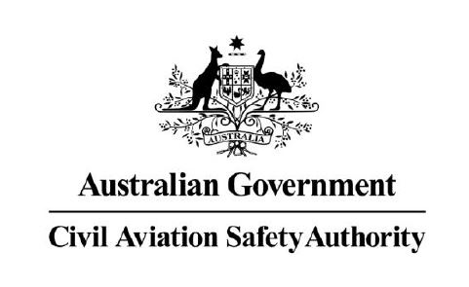
List of Civil Aviation Authorities
International Civil Aviation Organization (ICAO)
Federal Aviation Administration (FAA)
European Aviation Safety Agency (EASA)
Civil Aviation Safety Authority (CASA), Australia
Transport Canada (TC)

Slide 7
List of Civil Aviation Authorities (cont.)
Civil Aviation Administration of China (CAAC)
Civil Aviation Authority of Singapore (CAAS)
Civil Aviation Authority of Thailand (CAAT) สนง. การบินพลเรือนแห่งประเทศไทย

Slide 8
Acronyms 1
AOC Air operator certificate
AOG Aircraft on ground
ATC Air traffic control
ATM Air traffic management
CAA Civil aviation
CEO Chief executive officer

Slide 9
Acronyms 2
ERP Emergency response plan
H Hazard
HF Human factors
IATA International Air Transport Association
ICAO International Civil Aviation Organization
MEL Minimum equipment list
N/A Not applicable

Slide 10
Acronyms 3
QA Quality assurance
QC Quality control
SA Safety assurance
SARPs Standards and Recommended Practices (ICAO)
SMS Safety management system(s)
SOPs Standard operating procedures

Slide 11
Acronyms 4
SRM Safety risk management
TBD To be determined
TOR Terms of reference
UE Unsafe event
USOAP Universal Safety Oversight Audit Program (ICAO)
WIP Work in progress

Slide 12
DEFINITIONS 1
Errors: An action or inaction by an operational person that leads to deviations from organizational or the operational person’s intentions or expectations
Risk mitigation: The process of incorporating defenses or preventive controls to lower the severity and/or likelihood of a hazard’s projected consequence

Slide 13
DEFINITIONS 2
Safety risk: The predicted probability and severity of the consequences or outcomes of a hazard. Risk mitigation.
Safety management system: A systematic approach to managing safety, including the necessary organizational structures, accountabilities, policies and procedures.

Slide 14
What is Safety?

Slide 15
Safety is?
Zero accidents or serious incidents
Error avoidance
Freedom from hazard
( those factors which cause or are likely to cause harm )

Slide 16
Safety is?
The absence of undesired outcomes, effects on
People
Asset/ Equipment
Reputation
Freedom from the unacceptable risk of harm to individuals and business

Slide 17
Concept of safety (ICAO)
Safety is the state in which the risk of harm to persons or property damage is reduced to, and maintained at or below, an acceptable level through a continuing process of hazard identification and risk management.
Safety = How well risk is managed.

Slide 18
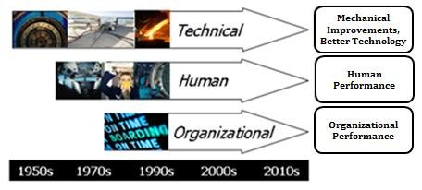

Slide 19
THE EVOLUTION OF SAFETY
The history of the progress in aviation safety can be divided into three eras.
1) The technical era — from the early 1900s until the late 1960s.
Aviation emerged as a form of mass transportation in which safety deficiencies were related to technical factors and technological failures.
The focus of safety endeavors was placed on the investigation and improvement of technical factors.

Slide 20
THE EVOLUTION OF SAFETY
2)The human factors era — from the early 1970s until the mid-1990s.
In the early 1970s, the aviation accidents was reduced due to technological advances and enhancements to safety regulations.
Aviation became a safer mode of transportation, and the focus of safety endeavors was include human factors issues including the man/machine interface. This led to a search for safety information from the earlier accident investigation.

Slide 21
THE EVOLUTION OF SAFETY
3)The organizational era — from the mid-1990s to the present day.
Safety began to be viewed from a systemic perspective, which was to encompass organizational factors in addition to human and technical factors.
As a result, the organizational accident was introduced, considering the impact of organizational culture and policies on the effectiveness of safety risk controls.

Slide 22
https://www.aviationhunt.com/aviation-safety/

