Slide 1
Airport Management: Unit 3
Facilities in airside area

Slide 2
Outline
Runway
Taxiway
Navigational aids
Airfields Signage

Slide 3
Runway
Rectangular area on land or water for aircraft landing & takeoff
Single runway
Primary runway
Crosswind runway
Runway configurations
Parallel Runways
Open-V Runways
Intersecting Runways

Slide 4
Runway marking and types of runway
3 Types
1. Basic or visual
2. nonprecision instrument
3. precision instrument

Slide 5
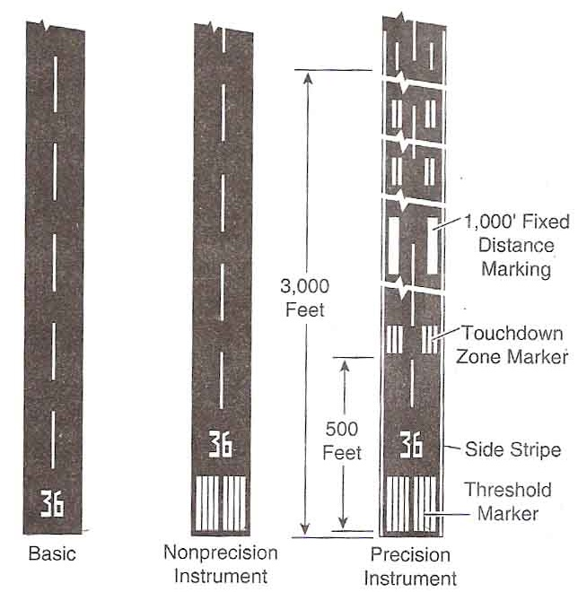
Runway marking and types of runway

Slide 6
Runway marking and types of runw
Runway Markings
Runway designators (Name of runway)
Runway centerlines
Runway aiming points
Threshold
Touchdown zone

Slide 7
Runway marking and types of runw
Runway Lighting
Visual approach slope indicators (VASI)
Precision approach path indicator (PAPI)
Tricolor visual approach slope indicators
Approach lighting
Runway end identifier light (REILs)
In-runway lighting systems
Runway centerline light
Touchdown zone lights
Taxiways leads off lights

Slide 8
Taxiway
a path for the taxiing of aircraft and to provide a link between part of the aerodrome to other areas
Taxiway planning
Separate landed aircraft & taxiing for takeoff
Short taxi routes
Various connecting point with runways
High-speed exit taxiways

Slide 9
Taxiway markings
Edge markings
Centerline markings
Runway holding position markings
Edge lights
Centerline lights
Clearance bar lights
Runway guard lights
Stop bar lights
Taxiway Lightings

Slide 10
Navigational aids (NAVAIDS)
helps the aircraft to fly between locations and approach for landing especially in poor weather conditions
Very-high- frequency omnidirectional range radio beacons (VOR)
Instrument Landing Systems (ILS)
Air traffic control and surveillance facilities located on the airfield
Airport surveillance radars (ASR)

Slide 11
Air Traffic Control Management
ATC : a service provided by ground-based controllers
Control
Direct aircraft on the ground
Advise in non-controlled airspace
Main objectives are:
prevent collisions
organize and expedite the flow of traffic
provide information
Others support for the pilots

Slide 12
Air Traffic Control Management
Most airports have radar control facility
“Terminal Control”
to provide all air traffic control within the airspace
handling the traffic flow (departure & arrival, overflight)

Slide 13
Air Traffic Control Management: BKK
3 areas of responsibilities
Ground control
airport movement areas, Ex. taxiways, runways, holding areas, and some intersections
Local control/ Air control/ Tower control
active runway
focus on clearing the aircraft for takeoff and landing
Flight data/ Clearance delivery
ensuring both pilots and controllers have accurate information
clearance to airplane before taxiing

Slide 14
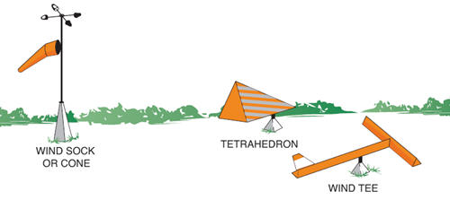
Weather reporting facilities
provide up-to-date meteorological information
2 most common systems
Automated Weather Observing System (AWOS)
Automated Surface Observing Systems (ASOS)
3 common Wind indicators

Slide 15
Airfield Signage
6 mains types of signs on airfields
Mandatory signs
Location signs
Direction signs
Destination signs
Information signs
Runway distance remaining sings

Slide 16
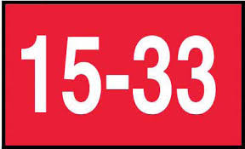
Airfield Signage
6 mains types of signs on airfields
Mandatory signs

Slide 17
Airfield Signage
6 mains types of signs on airfields
Location signs

Slide 18
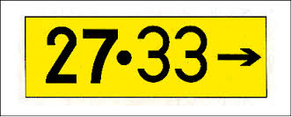
Airfield Signage
6 mains types of signs on airfields
Direction signs
Destination signs

Slide 19
Airfield Signage
6 mains types of signs on airfields
Runway distance remaining sings

Slide 20
Q & A

