Slide 1

Introduction to Financial Literacy
By Aj. Nalin Simasathiansophon
www.ssruic.ssru.ac.th

Slide 2





An overview of Financial Literacy
Financial literacy is the ability to understand how money works: how someone makes, manages and invests it, and also expends it (especially when one donates to charity) to help others.

Slide 3
Financial Literacy Framework of OECD

Slide 4
Thailand Financial literacy rate
Data from Organisation for Economic Co-operation and Development (OECD) shows that in year 2014-2015 Thailand has been ranked 17, scores 12.8 out of 21 scores, from 30 countries about financial literacy rate. Average score is around 13.2.

Slide 5
Thailand Financial literacy rate (Cont.)
Average rate of Thailand financial literacy is 61.0
There are three categories:
  Overall financial skills (21 scores)
  Knowledge (7 scores)
  Behavior (9 scores)
  Attitude (5 scores)
Among this rate, Thais age 10-19 has the lowest rate of financial skills

Slide 6
Thailand Financial literacy rate (Cont.)
Criteria | Lowest score (year 2016) | Average score | Highest score (Year 2016)
Overall (21 scores) | 2.7 | 12.8 | 21.0
Knowledge (7 scores) | 0.0 | 3.4 | 7.0
Behavior (9 scores) | 0.0 | 5.6 | 9.0
Attitude (5 scores) | 1.0 | 3.8 | 5.0
Source: National Statistical Office, 2019

Slide 7
Overall Financial Skill

Slide 8
Knowledge

Slide 9
Behavior

Slide 10
attitude

Slide 11
Problem in Thailand
From those four categories, it can be concluded that …
  Thais have low financial knowledge, such as effective interest rate, portfolio risk, interest rate for loan, risk and rate of return, inflation and its impacts, etc.

Slide 12

Financial Literacy Principles
1. Financial goals; spend less than you earn and save early
2. Budgeting; have a plan for using money

Slide 13


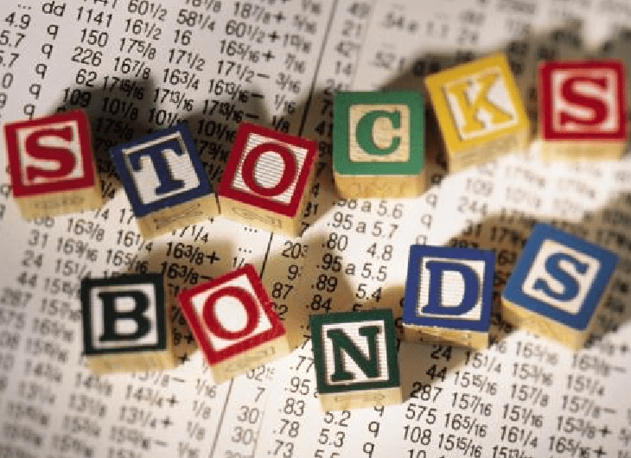


3. Investments; if you have money left, you should invest in …

Slide 14
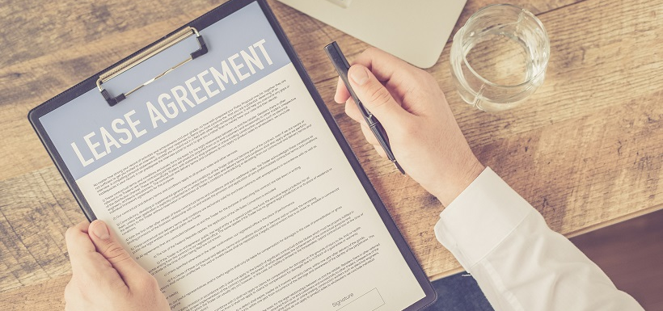
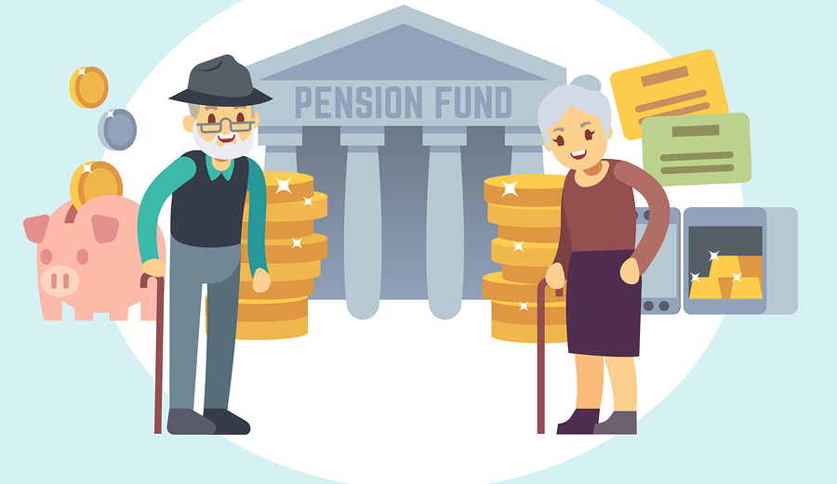
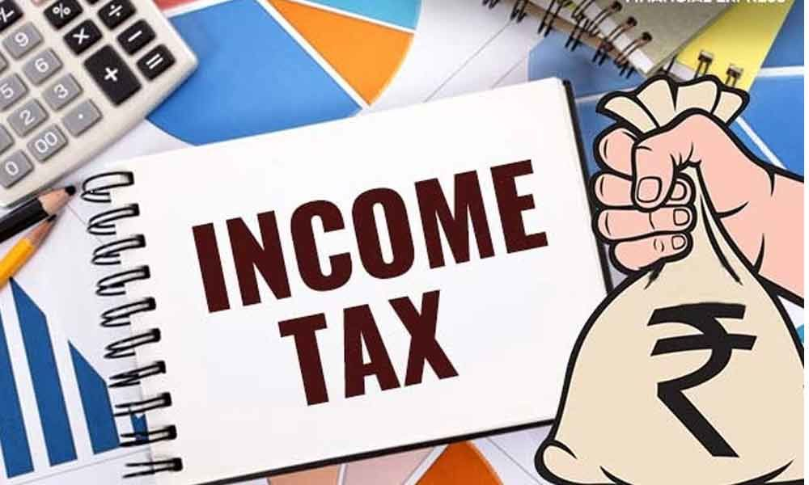
4. Retirement; Pension fund
5. Contracts
6. Employment: tax and benefits at workplace

Slide 15


Test yourself
Question 1 – At the market
You can buy tomatoes by the kilogram or by the box
Which choice you will choose? 12 bath per kg
or 40 bath for a 5 kg box?
Give a reason to support your answer…

Slide 16
Question 2 - Spending choices
Claire and her friends are renting a house. They have all been working for two months. They do not have any savings. They are paid monthly and have just received their wages. They have made this “To do” list.
To do
Get cable TV
Pay the rent
Buy outdoor furniture

Slide 17
Which of the tasks on the list are likely to need prompt attention from Claire and her friends? Circle “Yes” or “No” for each task.
Task | Is the task likely to need prompt attention?
Get cable TV | Yes / No
Pay the rent | Yes / No
Buy outdoor furniture | Yes / No
Notes:
This question in SPENDING CHOICES asks students to evaluate spending priorities for the home when working within a budget, distinguishing between wants and needs. It therefore falls under the content area of planning and managing finances.

Slide 18
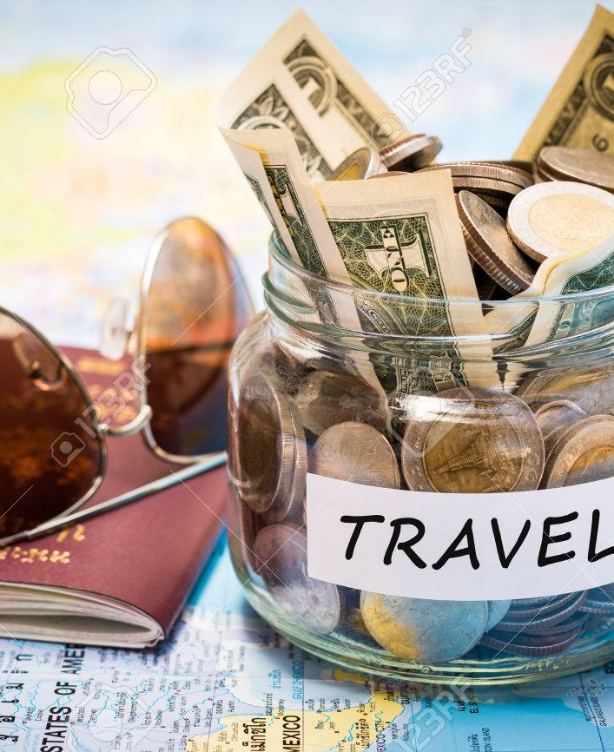
Question 3 – Travel Money
Natasha works in a restaurant 3 evenings each week. She works for 4 hours each evening and she earns 10 zeds per hour. Natasha also earns 80 zeds each week in tips. Natasha saves exactly half of the total amount of money she earns each week.
Natasha wants to save 600 zeds for a holiday.
How many weeks will it take Natasha to save 600 zeds?
Notes:
This task requires students to consider a set of conditions and constraints, while planning ahead to pay for future expenses – working out how long it will take to save for a holiday, given a fixed amount of savings each week. The correct answer is “6 weeks”. Fewer than half of the field trial sample gained credit for this item.

Slide 19
Question 4 – New Bank Card
Lisa lives in Zedland. She receives this new bank card.
The following day, Lisa receives the Personal Identification Number (PIN) for the bank card. What should Lisa do with the PIN?
Write the PIN on notepaper and keep this in her wallet.
Tell the PIN to her friends.
Write the PIN on the back of the card.
Memorise the PIN.
Notes:
This task assesses students’ understanding of the individual’s responsibility in maintaining security when accessing and using electronic banking.

