Slide 1
Chapter 1 : General Marketing

Slide 2
The Scope of Marketing
To prepare to be a marketer, you need to understand
what marketing is,
how it works,
who does it, and
what is marketed.

Slide 3
1. What Is Marketing?
Marketing is the activity,
set of institutions and processes for
creating, communicating,
delivering and exchanging
offerings that have value for customers, clients, partners, and society at large.
(American Marketing Association: AMA)

Slide 4
2. What Is Marketed?
Marketers market 10 main types of entities:
Goods
Services
Events
Experiences
Persons
Places
Properties
Organizations
Information
Ideas

Slide 5
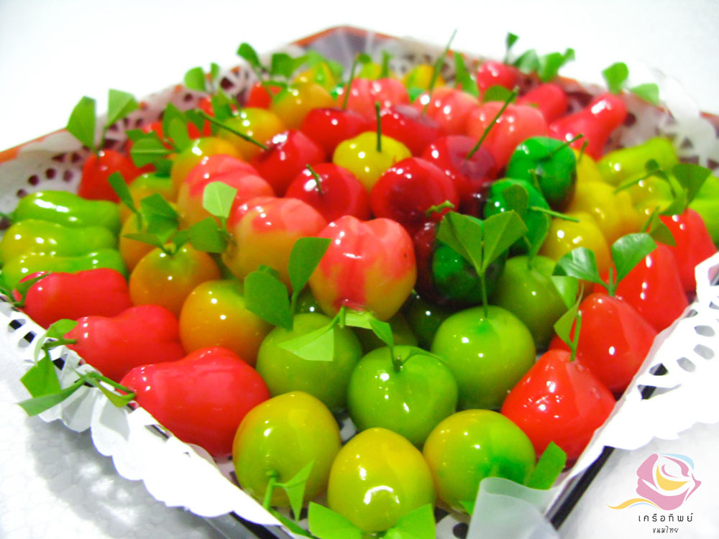
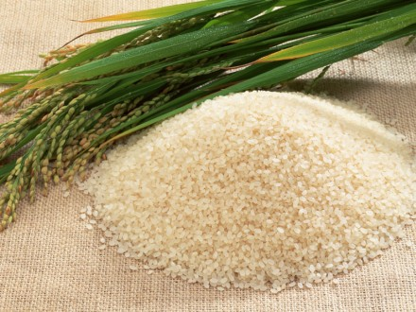
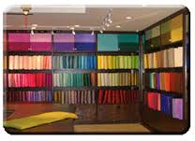
2.1 Goods
Physical goods constitute the bulk of most countries’ production and marketing efforts.

Slide 6
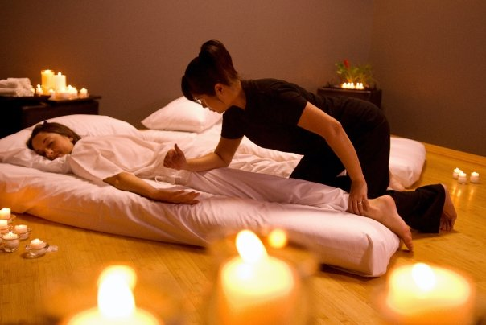
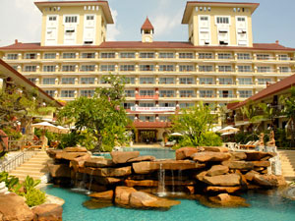
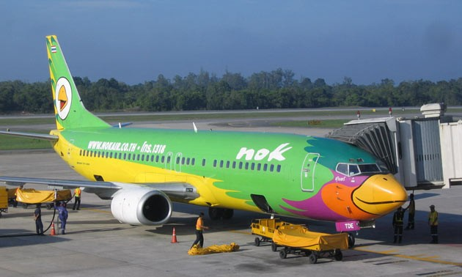
2.2 Services
A growing proportion of their activities focuses on the production of services.

Slide 7
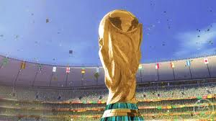
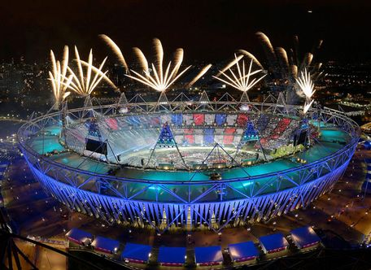
2.3 Events
Activities focuses on the production of MICE or Business Event.

Slide 8
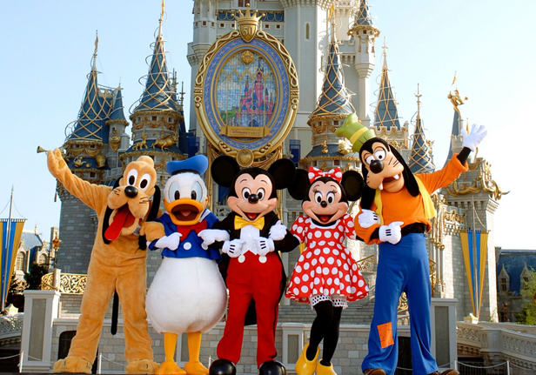
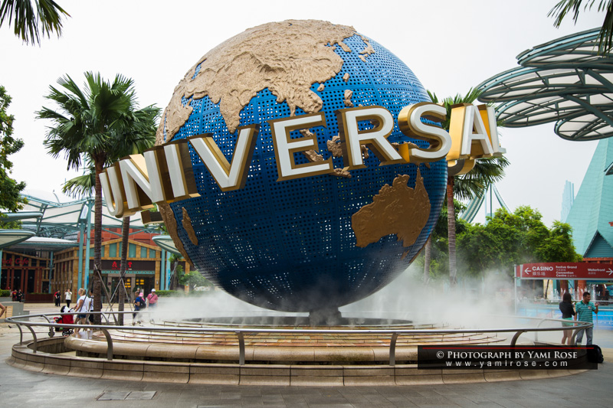
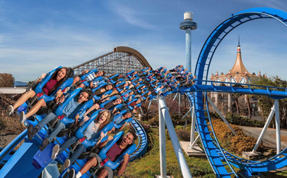
2.4 Experiences
Activities focuses on the production of memorable experiences or entertainment.

Slide 9
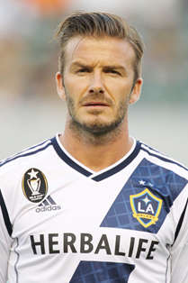
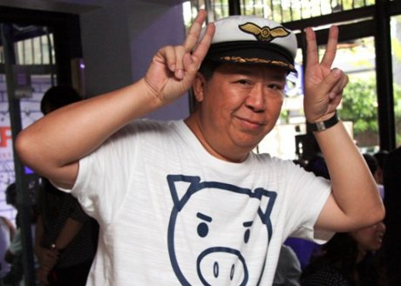
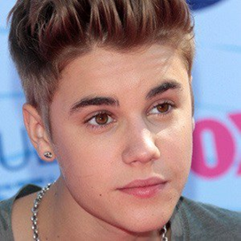
2.5 Persons
Artists, musicians, CEOs, physicians, and other professionals all get help from celebrity marketers.

Slide 10
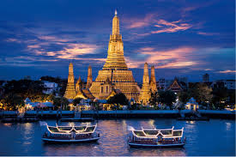
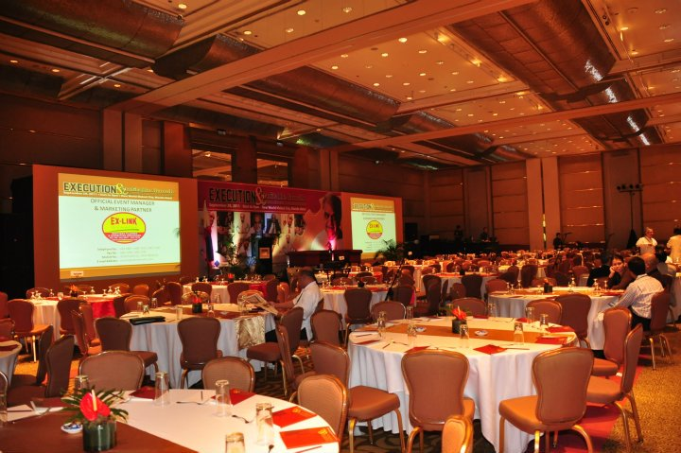
2.6 Places
Cities, provinces, regions and whole nations compete to attract tourists, residents, factories and company headquarters.

Slide 11
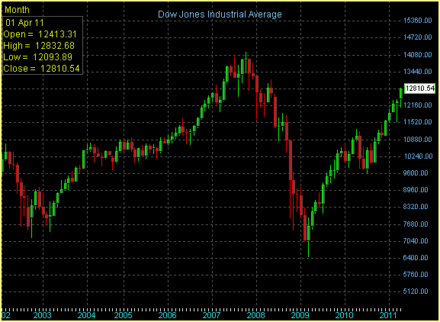
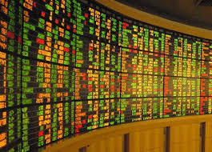
2.7 Properties
Properties are intangible rights of ownership to either real property (real estate) and financial property (stocks and bonds).

Slide 12
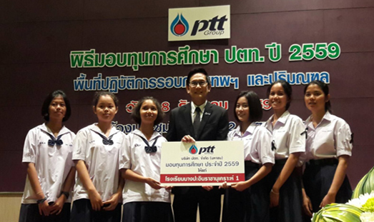
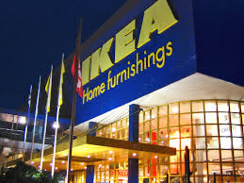
2.8 Organizations
Organization work to build a strong, favorable and unique image in the mind of their targeted publics.

Slide 13
2.9 Information
The production, packaging and distribution of information are major industries.

Slide 14
2.10 Ideas
Every market offering includes a basic idea.
“In the factory we make cosmetics;
In the drugstore we sell hope” Charles Revson

Slide 15
Who Markets?
“Marketers” and “Prospects”
A marketer is someone who seeks a response – attention, a purchase, a vote, a donation– from another party called prospect.

Slide 16
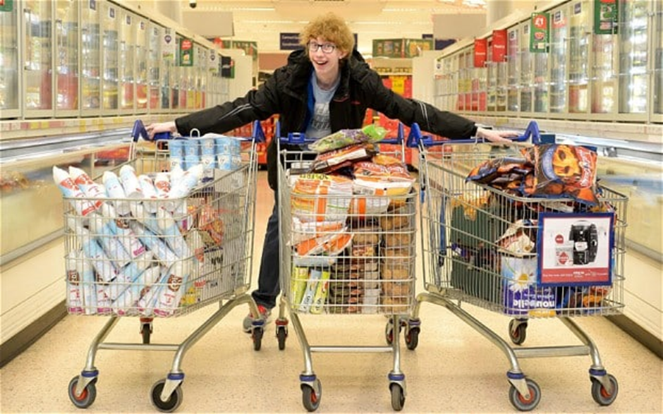
Marketers & Demand Management
Marketers are skilled at stimulating demand.

Slide 17
Needs, wants and demands
Needs are the basic human requirements such as for air, food, water, clothing, and shelter.
Humans also have strong needs for education and entertainment.
These needs become want when they are directed to specific objects that might satisfy the need.

Slide 18
Needs, wants and demands
Demands are wants for specific products with ability to buy.
E.g., many people want a Rolls Royce car; only a few are able to buy.
Marketers do not create need!
Marketers, along with other societal factors, influence wants.

Slide 19
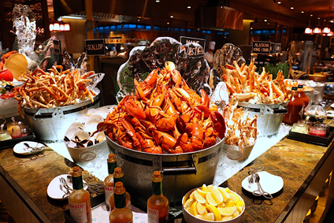
Needs Wants

Slide 20
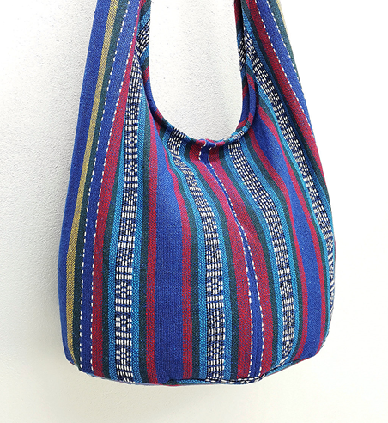
Needs Wants

Slide 21
Needs Wants

Slide 22
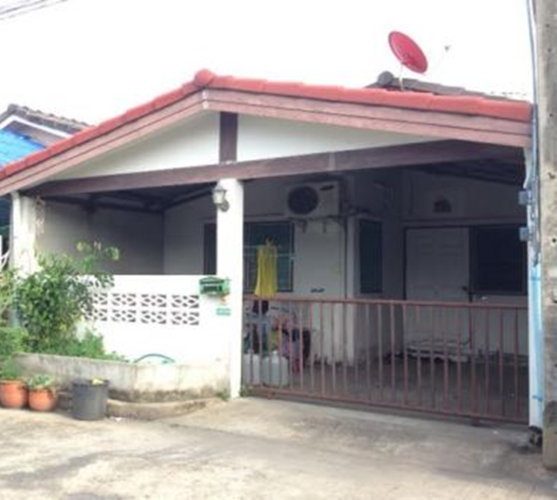
Needs Wants

Slide 23
Value and Satisfaction
Buyer chooses offerings he or she perceives to deliver the most value
Satisfaction reflects a person’s judgment of a product’s perceived performance in relationship to expectations.

Slide 24
Value and Satisfaction
Satisfaction reflects a person’s judgment of a product’s perceived performance in relationship to expectations.
If expectations > performance ➔ customer delights
If performance = expectations ➔ customer feels satisfied.
If performance > expectations ➔ customer is disappointed.

Slide 25
Competition
Competition includes all the actual rival and potential rival offerings and substitutes a buyer might consider.

Slide 27
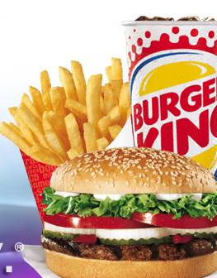
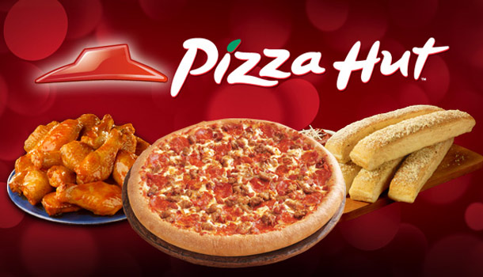
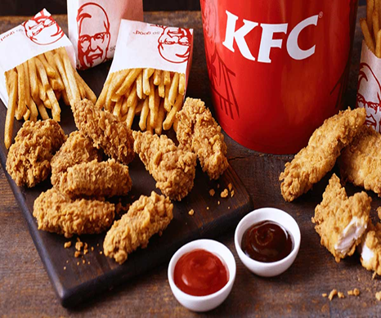
Actual Rival VS Potential Rival

Slide 28
Class Activity
Give one example of each; “need, want and demand.”
2. See product list and identify your competition; Actual Rival and Potential Rival
3. Imagine your product or service you really want to own, and think of Actual Rival and Potential Rival

