Slide 1
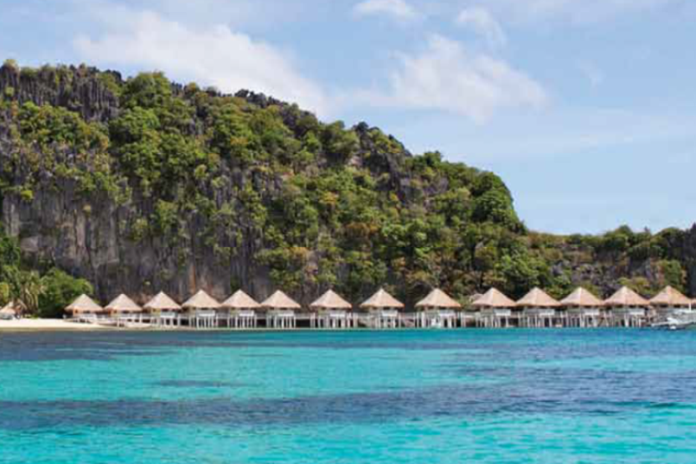
Hotel and Resort Development and Biodiversity
Chapter 4

Slide 2
Chapter 4
Hotel and Resort Development and Biodiversity
Hospitality sector, depends strongly on healthy ecosystems
Ecosystems – and the wildlife, habitats, landscapes and natural attractions draws tourists to the destination in the first place.

Slide 3
Biodiversity
Biodiversity is essential for human life. It provides human society with many important benefits and services:
Ex, insects pollinate our crops, birds disperse seeds, and fungi, worms and micro-organisms produce nutrients and fertile soils.

Slide 4
Biodiversity (cont’)
Even outside hotels, plants and animals make a hotel’s public areas and gardens attractive for guests,
Around hotel, national parks, green spaces, coasts and natural habitats provide guests with opportunities for recreation and enjoyment.

Slide 5
Biodiversity footprint of hotels and resorts
Hotels and resorts can have significant negative impacts on ecosystems and natural resources;
A hotel impacts biodiversity at each stage of its life cycle, from planning through to closure:

Slide 6
Life Cycle
1.
Planning stage
2.
Construction stage
3.
Operational stage
4.
Closure stage

Slide 7
1. At the planning stage
Choices about the materials that will be used to construct the hotel
Where those materials will come from?

Slide 8
2. At the construction stage
Size and location of the area cleared
Construction methods
Sources and amount and type of materials, water and energy used
Location of temporary camps for construction workers

Slide 9
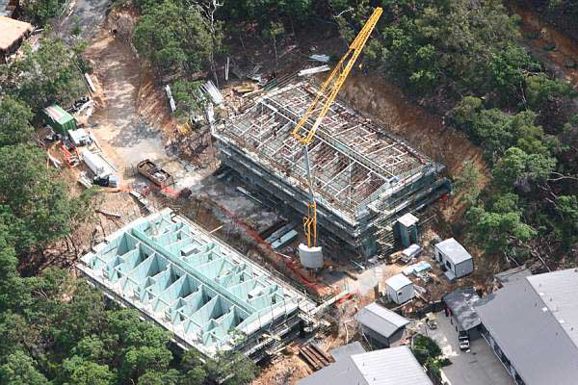

Slide 10
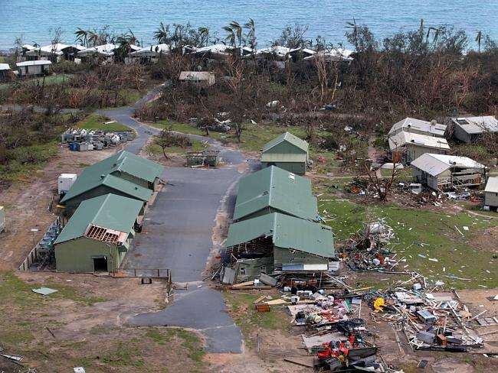

Slide 11
At the construction stage (cont)
Inadequate storage facilities for construction materials
Waste
Other types of damage, such as surface soil erosion or compaction caused by construction activities or disruption of natural water flows and drainage patterns.

Slide 12
3. In the operational stage
Energy, water, food and other resources that are consumed in running the hotel
Solid and liquid wastes
Its grounds are managed and by the direct impacts of its guests.
Regular renovation and replacement of furniture, appliances and facilities can increased waste generation.

Slide 13
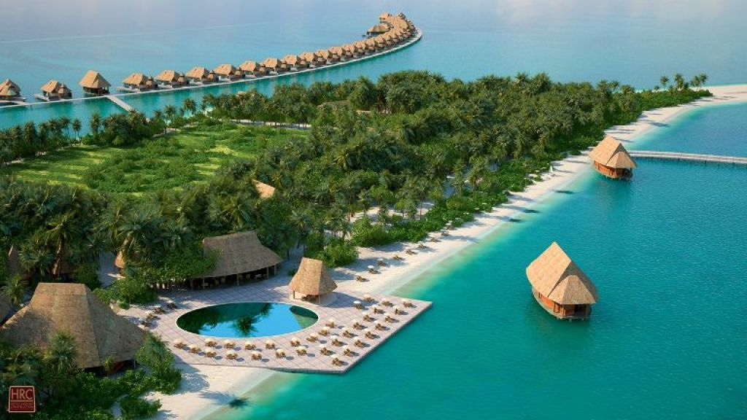

Slide 14
How can hotel reduce its adverse impacts on biodiversity ?
Using energy and water more efficiently
Using organic and sustainably produced food
Reducing, treating and disposing of waste
Making sustainable purchasing decisions
Managing gardens with natural-style plantings
Hotel’s relationship with host communities not only affects the sustainable operations of the hotel but also the use of environmental resources by communities themselves.

Slide 15
4. At the closure stage
Disposal of materials removed from the hotel to refurbish it, convert it for other uses, or demolish it
Some toxic materials, particularly from older buildings, which will require careful handling and management.

Slide 16
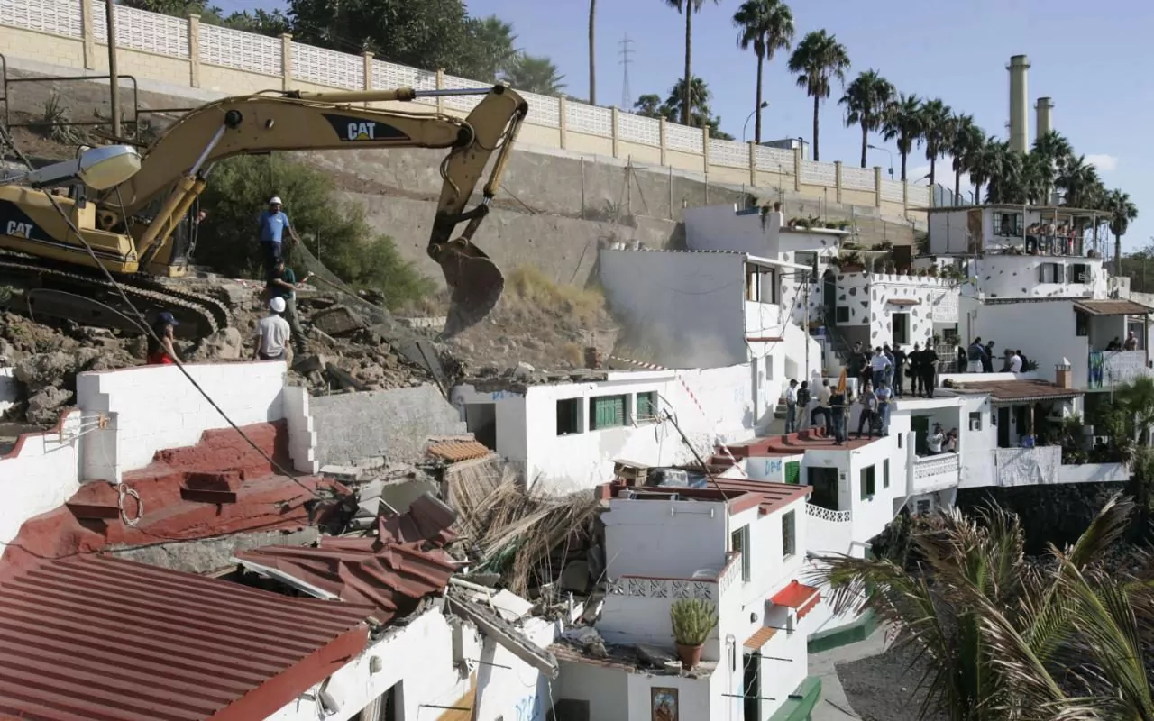

Slide 17
5 Biodiversity Principles for Siting and Design of Hotels and Resorts
5 Principles
From:The International Union for Conservation of Nature and Natural Resources (IUCN)
Adopt an ecosystem-based approach in tourism development planning
Manage impacts on biodiversity from hotel development and attempt to achieve an overall positive contribution
Design with nature and adopt nature-based solutions
Respect, involve and support local communities
Build collaboration among stakeholders

Slide 18
Principle 1
Adopt an ecosystem-based approach in tourism development planning
An ecosystem-based approach also calls for inter-sectoral cooperation between tourism, finance, land-use planning, academic institutions, and natural resource management departments and agencies in decision making.

Slide 20
Principle 1 (cont’)
Environmental Impact Assessments (EIAs) of hotel developments are carried out by qualified and independent individuals and companies, before any agreements are made to permit construction.

Slide 21
Principle 1 (cont’)
Study of species and habitats to ensure that critical natural habitats or areas that provide local livelihoods are conserved.
Scientific advice and expertise, especially from local academic and professional institutions.

Slide 22
Principle 1 (cont’)
Monitoring and impact indicators at all stages of the hotel life cycle (planning, construction, operation and closure) are integral to an ecosystem-based approach
The EIA process takes these potential impacts into account, and it is the shared responsibility of developers and planners to monitor and manage them.

Slide 24
Principle 1 (cont’)
If developments are already planned near sites of known high irreplaceability or vulnerability, the highest level of design and operational standards, due diligence, monitoring and enforcement controls must be applied, and competent specialized expertise must be sought to assist at the planning and implementation stages.

Slide 25
Principle 2
Manage impacts on biodiversity from hotel development and attempt to achieve an overall positive contribution
Impacts on highly irreplaceable and vulnerable biodiversity cannot be restored nor compensated
If negative impacts are unavoidable, developers must minimize harmful impacts, rehabilitate and restore areas of disturbance caused by the hotel

Slide 26
Principle 2 (cont’)
Invest in additional conservation actions that contribute to the long-term integrity and conservation of the ecosystem
Developers must plan for alternative designs, changes to construction schedules, and any offset activities.

Slide 27
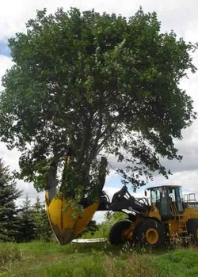

Slide 28
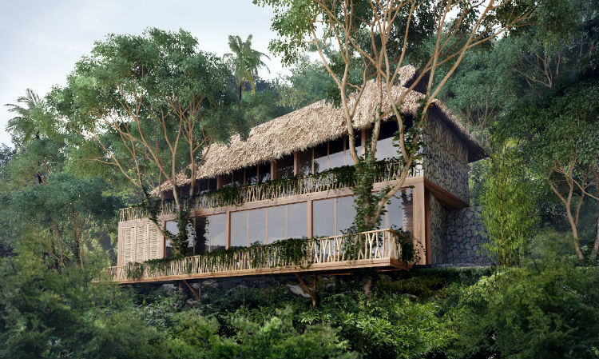

Slide 29
Principle 2 (cont’)
If roads and utilities are not already on site, land-use plans identify where such infrastructure will be laid prior to the approval of any construction, to minimize habitat disturbance and disruption to ecosystem services.

Slide 30
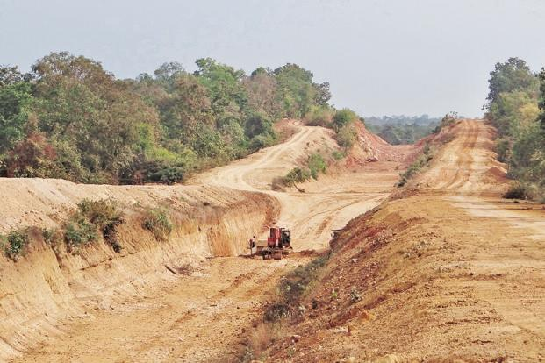

Slide 31
Principle 2 (cont’)
Employ comprehensive waste disposal mechanisms.
Carefully monitored to ensure that pollution and land contamination is avoided.
For example;
Sand, cement, plastic bags, wastewater, fertilizers and other hazardous chemicals washed into the sea can cause serious damage to coral reefs and other marine life and negatively affect water quality

Slide 32
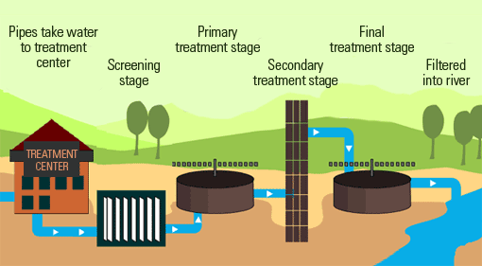

Slide 33
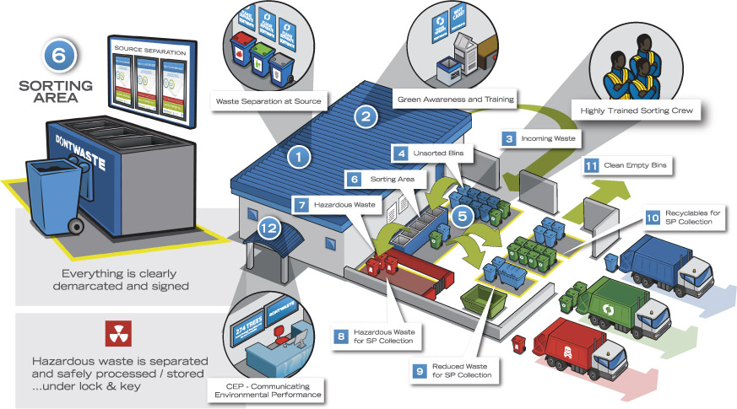

Slide 34
Principle 2 (cont’)
Rehabilitation is a key responsibility of the developer.
Strategies to provide incentives, including financial incentives for good practice, are formulated and introduced by governments
Governments give preference to developers and investors who have a good track record of achieving a positive impact to biodiversity

Slide 35


Slide 36
Principle 3
Design with nature and adopt nature-based solutions
Blend into the landscape and become integrated into the ecosystem.
Building design, height, and density is guided by the natural setting and local architectural style, in order to reduce visual impact and intrusion

Slide 37
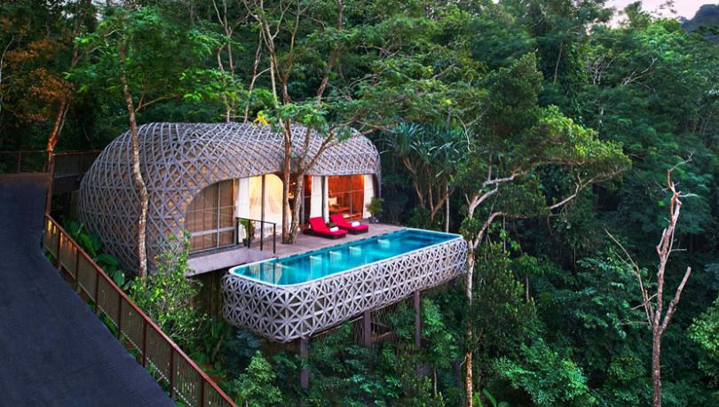
Keemala, Phuket – Thailand

Slide 38
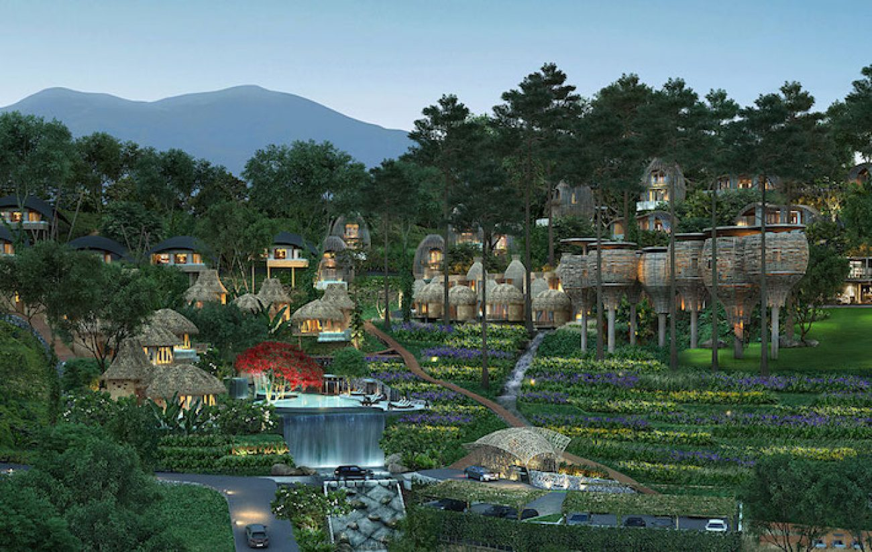
Keemala, Phuket – Thailand

Slide 39
Principle 3 (cont’)
Consideration is given to durability and the recyclable nature of all materials used in construction and furnishings.
Wastewater treatment systems, hotel and beachfront lighting, renewable energy systems and other measures to limit energy and water consumption are considered to avoid biodiversity and ecosystem impacts.

Slide 40
Principle 3 (cont’)
To the maximum extent possible, native or naturalized plant and animal species are used in landscaping and gardening.
One of the major threats to biodiversity is the use of non-native species
Eg. Non-native Lobster

Slide 41
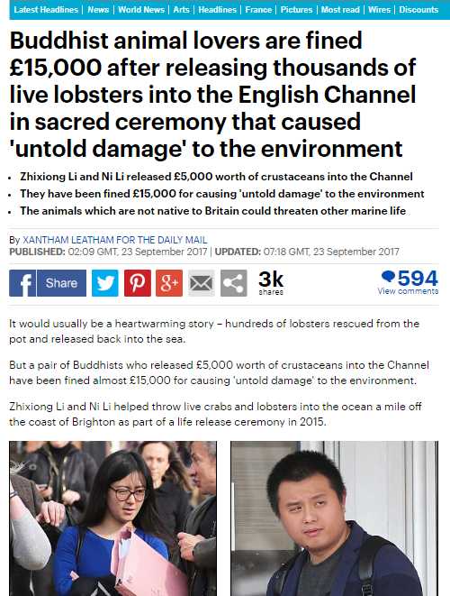
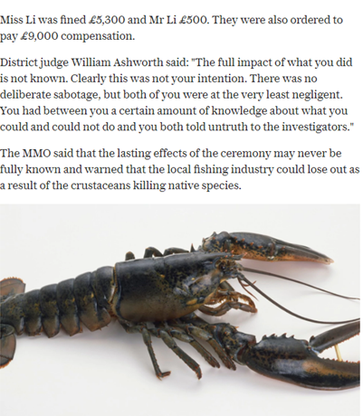

Slide 42
Principle 3 (cont’)
Indigenous (native) vegetation is the most cost-effective landscaping approach, because it is adapted to the climatic conditions, uses local knowledge and is culturally appropriate.

Slide 43
Principle 4
Respect, involve and support local communities
Developers assess social impacts on neighboring communities
The principle of Free, Prior and Informed Consent (FPIC) recognizes a community’s inherent and prior right to the land and resources and respects its legitimate authority, requiring that any third party enter into an equal and respectful relationship with the community

Slide 44
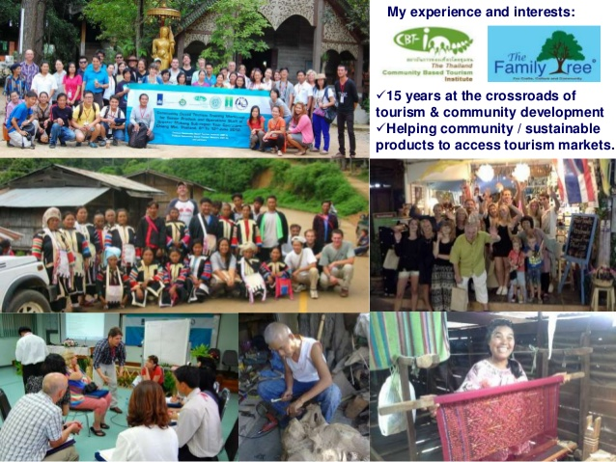

Slide 45
Principle 4 (cont’)
Provide communities with information on its likely impacts and involved in planning processes from the earliest planning stages and during the development process.
Governments are transparent in their decision-making process and establish sufficient time for locals and stakeholder participation

Slide 46
Principle 5
Build collaboration among stakeholders
Collaborative approaches at all levels!
“…Governments, private developers, investors and contractors, financial institutions, tourism and hotel associations, architect associations, civil society organizations, communities and academic institutions..”
All have a role to play in the search for forms of hotel and resort development that do not threaten, but instead enhance, biodiversity.

Slide 47
Principle 5 (cont’)
Share information, positive examples, the establishment of standards for biodiversity impacts; training of EIA practitioners and public and private sectors
Link with academic institutions are used to support cooperation

Slide 48
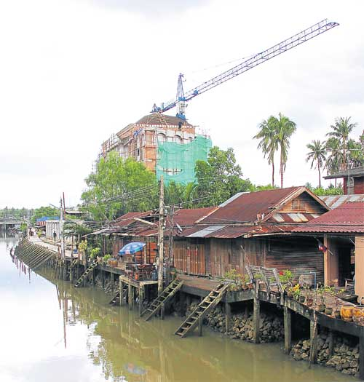
Class Activity

Slide 49
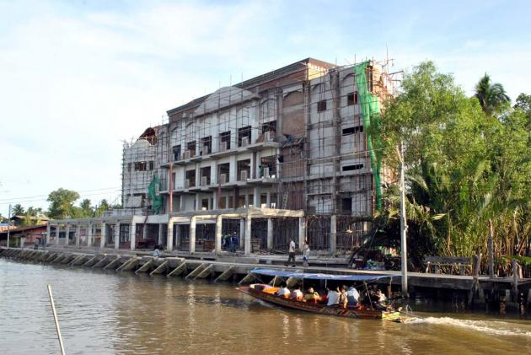

Slide 50
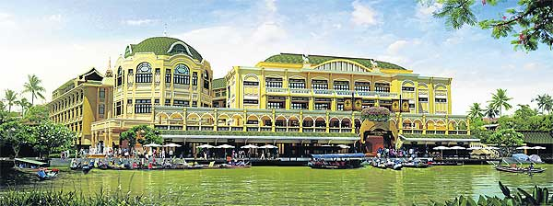

Slide 51
Environmental Impact | Rank the threat |  |  | Other comments/explanations
 | Low | Moderate | High
A. Natural & Physical Impacts
a.1
a.2
a.3
a.4
a.5
B. Cultural Impacts
b.1
b.2
b.3
b.4
b.5
C. Social Impacts
c.1
c.2
c.3
c.4
c.5

