Slide 1
IAC2403 Introduction to Security Risk and Crisis Management
Unit 5 Security Culture

Slide 2
Security culture is
A set of norms, beliefs, values, attitudes and assumptions that are inherent in the daily operation of an organization and
Reflected by the actions and behaviours of all entities and personnel within the organization.
Security should be everyone's responsibility - from the ground up.

Slide 3
Effective security culture
Recognizing that effective security is critical to business success;
Establishing an appreciation of positive security practices among employees;
Aligning security to core business goals; and
Articulating security as a core value rather than as an obligation or a burdensome expense.

Slide 4
The benefits of an effective security culture include:
◦ Employees are engaged with, and take responsibility for security issues;
◦ Levels of compliance with protective security measures increase;
◦ The risk of security incidents and breaches is reduced by employees thinking and acting in more security-conscious ways;

Slide 5
Employees are more likely to identify and report behaviors /activities of concern;
Employees feel a greater sense of security; and
Security is improved without the need for large expenditure.

Slide 6
Security culture is important to an airport’s operations because an airport could have the best written security plan and newest technology.
However, if there is not an accompanying security culture, then security may not be a priority and there may be issues with the implementation and effectiveness of aviation security programmes and countermeasures.

Slide 7
A security culture is a type of organizational culture that encourages optimal security behaviour and it is reflected by the actions of those within the organization.
Security is everyone’s responsibility. All personnel within an organization play a role- directly or indirectly- and contribute to the overall security of an organization.
Security is everyone’ s responsibility

Slide 8
Having an effective security culture is reflected by their understanding of threats to the airport, and how they can help to protect the airport and contribute to aviation security.
Having an effective security culture not only provides a robust counter-terrorism stance, it helps to reduce crime and other disruptive incidents (deterrence factor).

Slide 9
Elements of a Security Culture
• Positive Work Environment
• Training
• Leadership
• Understanding Threat
• Vigilance
• Reporting Systems
• Incident Response
• Information Security
• Training
• Leadership
• Understanding Threat
• Measures of Effectiveness

Slide 10
A positive Work Environment drives and facilitates a positive security culture, with staff who know what security behaviors are expected.
There is also an organized and systematic approach to managing security.
• Training, staff will have the knowledge, skills, and capability to practice good security.
• Leadership is imperative to an effective security culture. Managers and leaders, at all levels, lead by example and support staff in implementing good security.

Slide 11
Understanding the Threat to global aviation, where is all staff understand the nature of threats they and their organization face.
In implementing a security culture Vigilance is key. Alert staffs are able to identify and note suspicious behavior and report it.
To complement vigilance, Reporting Systems must be in place so that staff know how to respond and who to contact in the event of an incident or suspicious behaviour.

Slide 12
Information Security is to ensure sensitive information is maintained securely.
Measures of Effectiveness are necessary to both record incidents and act as a foundation for improvements to security policies and procedures.

Slide 13
If effective security culture is in place:
• Staff will possess the knowledge,skills,and capability to practice good security;
• Unintentional security lapses and breaches are less likely to happen;
• Employees are less vulnerable to social engineering;
• Employees become ‘eyes’ and ‘ears’ to help identify concerning behaviour ; and
• The insider threat is reduced.

Slide 14
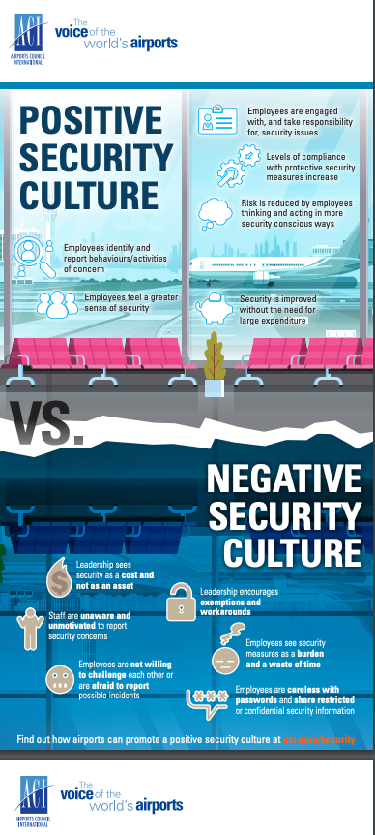

Slide 15
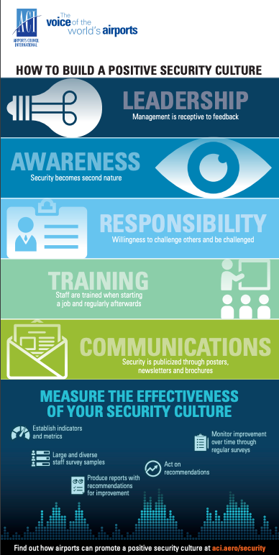

Slide 16
Reference
https://www.icao.int/Security/Security-Culture/Pages/default.aspx
https://www.icao.int/Security/Security-Culture/ICAO%20training/Sample%20of%20Security%20Culture%20Workshop.pdf

Slide 17
Question

