Slide 1
IIB3439: Corporate Social Responsibility
Session 2
Aj’ Pat Vivat
Line Id: Patosung

Slide 2
The concept of CSR
CSR has been around for a long time in business world, but it has been changed significantly in recent years as stakeholders in business have exerted much greater pressure on business and the CSR concept.
CSR become quite an important corporate objective for many organization, so for many business CSR is a core part of their business

Slide 3
What is the business for?
What contribution should it make to the society?

Slide 4
Business & Society
CSR is based on the concept of interdependence, interdependence of business & society
Society needs business
  Employment and wages
  Investment and innovation
  Profit and taxes
Business needs society
  Create demand
  Public assets & infrastructure
  Legal protection

Slide 5
The debate of CSR
Not all businesses behave in socially responsible manner
Two schools of thought:
  Free market view: the job of business is to create wealth for shareholders
    Maximization of profits to the shareholders, within the legal framework and the ethical custom of the country
    The business of business……. Is business (Milton Friedman)
  Corporate social responsibility view: business should be concerned with social issues
    Conducting business in an ethical way and in the interests of the wider community
    Balancing shareholder interests against the interests of the wider community.

Slide 6
Argument for CSR
Ethical?
Improves image and reputation
Socially responsible actions can be profitable
An improved social environment will be beneficial to business
Attractive to stakeholders – including customer and investors
Increase employee motivation
Helps to corrects the social problems caused by business

Slide 7
How can CSR be demonstrated
Sustainable sourcing
Responsible marketing
Safe working conditions & fair pay
Responsive customer service
Protecting the environment
Supporting social causes
Investing in education

Slide 8
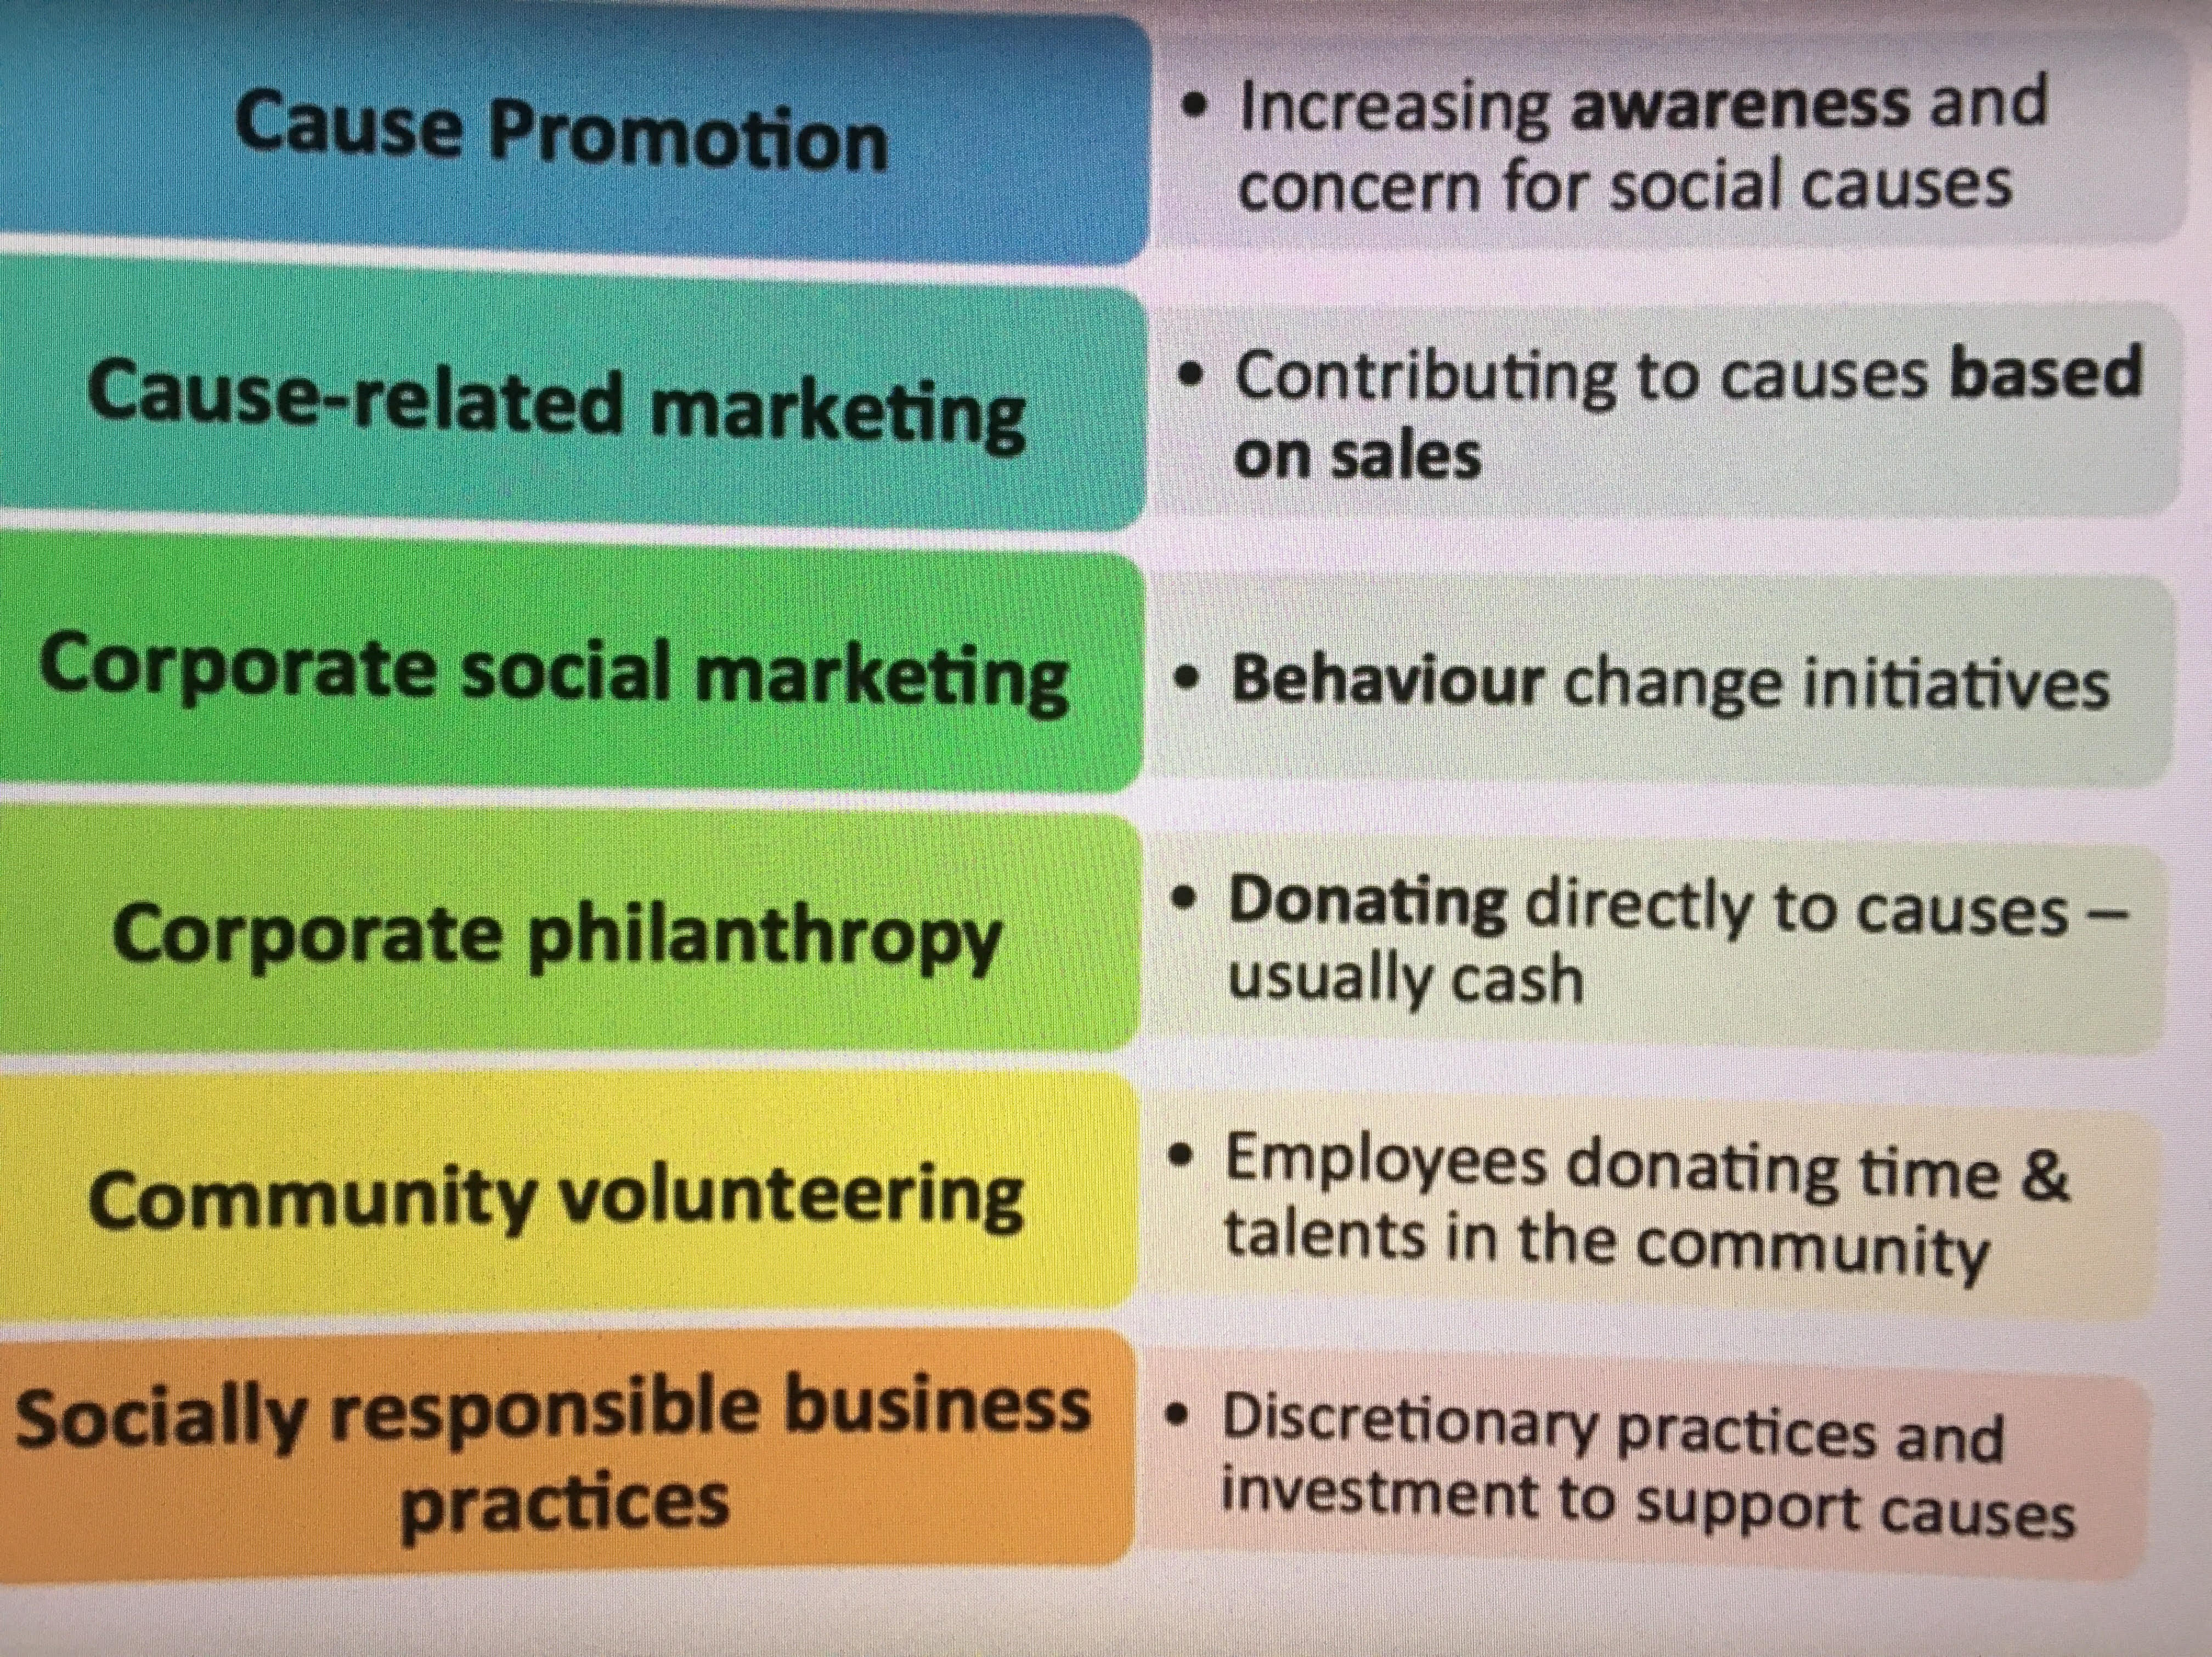

Slide 9
Example of good & bad CSR
Mark & Spencer
Unilever
IKEA
Abercrombie & Fitch
Primark

Slide 10
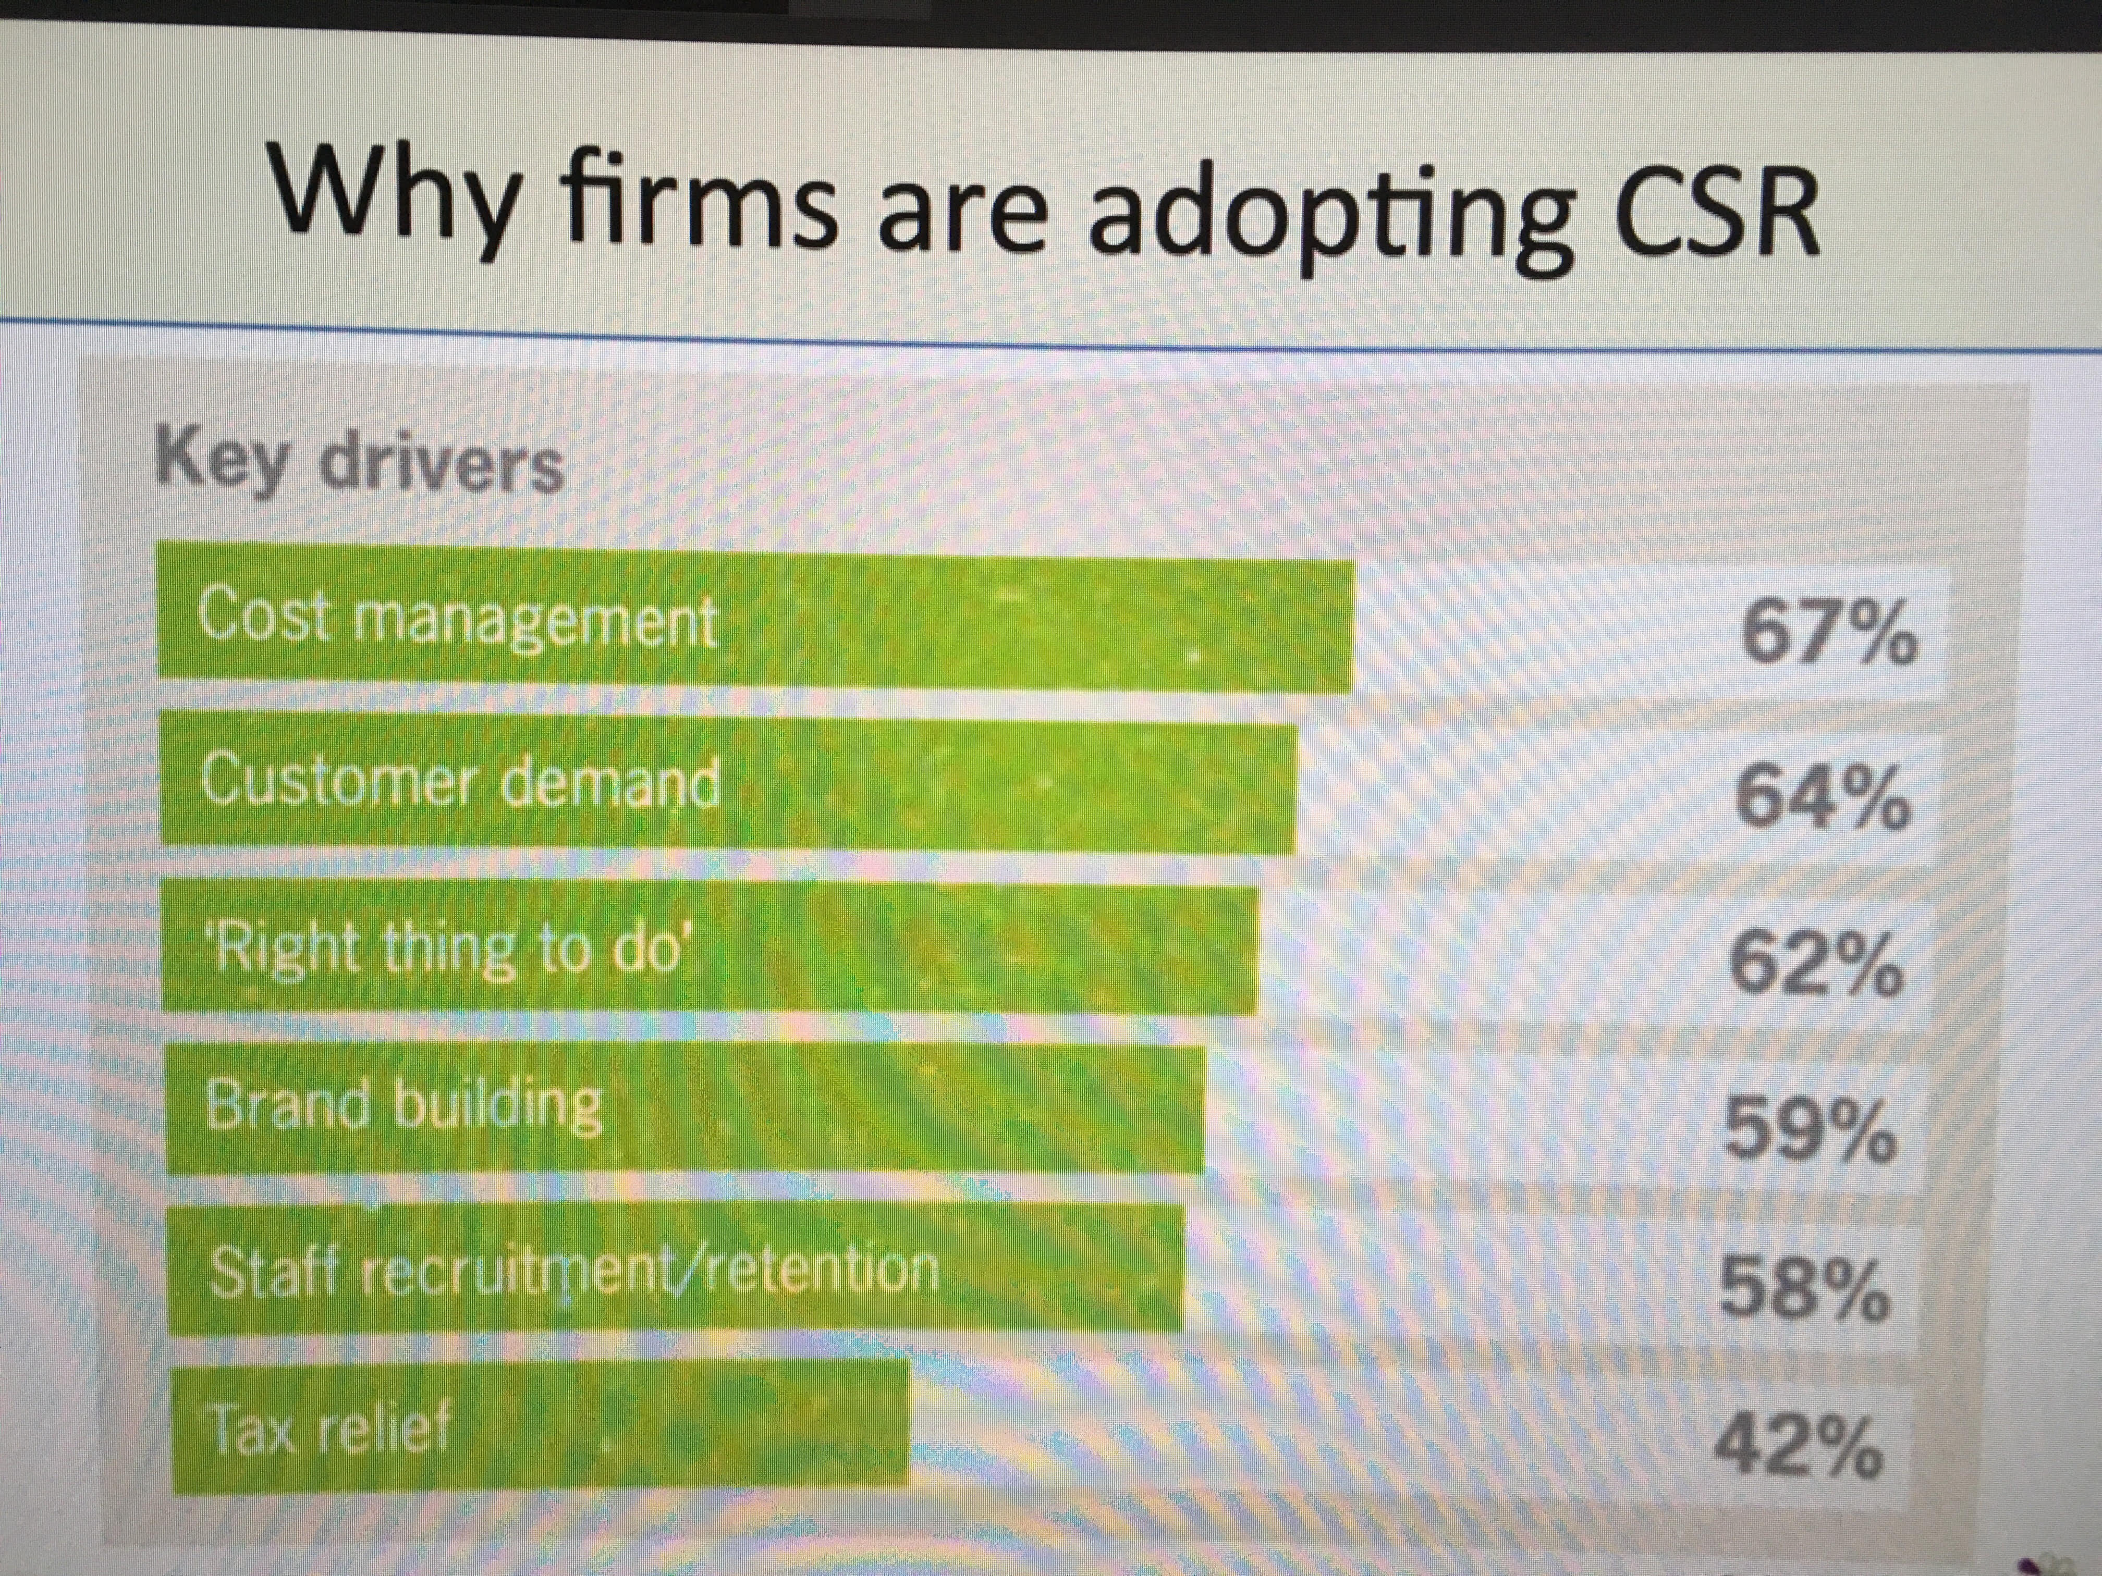

Slide 11
Assignment # 2
  1. Do the activities of businesses need to be more regulated by government in the future?
  2. In your opinion, does society need business more than business needs society?
  3. Are shareholders the most important stakeholders in a business
  4.Is there a conflict between maximizing profit and operating in a sustainable way?

