Slide 1
Personality Development and Grooming
Personality Development and Grooming
Lecturer : Kanittha Charernnit & Rodjanard Waramontri

Slide 2
Definition of Etiquette
Etiquette – Rules governing socially acceptable behavior.
The word “Etiquette” is derived from French which actually means “Ticket”. Your ticket to getting anything & any place you want.
It is defined as good behavior which distinguishes human beings from Animals.

Slide 3
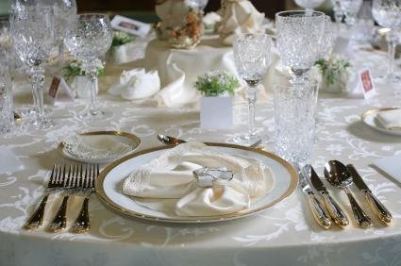
Table Manner

Slide 4
Basic Dining Etiquette
Table Manners “To do”
Do :
Rsvp
Queuing
Be on time
Bring a bottle
Wash hands before eating
Wear clean clothes to the table
Always say Please and Thank You.
Don’t slurp food or drinks.
Wipe your mouth with a napkin.
Clean your spot at the table.

Slide 5
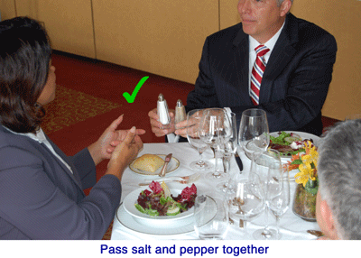
Table Manners “To do”
Salad – sometime salad can be served at the end of the main dish then the utensils will be at the in side of the main dish
Salt and Pepper – Should pass it together/ Pass to your right

Slide 6
Table Manners “To do”
Place napkin in your lap
Soup – sip from the side of your spoon
Stay at the table until finished
Lean over your plate
Chew with your mouth closed
Don’t talk with food in your mouth
Cover your mouth when you burp.
Say excuse me when you burp.

Slide 7
Table Manners “Don’t”

Slide 8
Table Manners “Don’t”
Don’t :
Last minute cancellations
Showing up unannounced
Name dropping
French leave
Talking over somebody
Unruly kids
Littering
Playing music
Slurp, burp and fart
Elbows on the table
Use mobile
Eat with hand
Drink before a toast

Slide 9
Napkin

Slide 10
Napkin

Slide 11
Napkin
Place napkin on chair when
Temporarily excusing yourself
Place napkin on the table on your left when the meal is finished

Slide 12
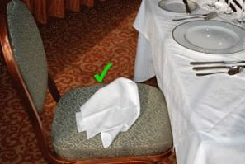
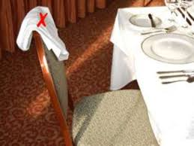
Napkin

Slide 13
Table Manners
At a Restaurant or At a Dinner Party.
Men remain standing until women are seated.
Traditionally, men remain standing until women are seated.
This is nice gesture when guests are of different generations, such as grandsons showing courtesy and respect to their grandmothers.
Men assist women with their chairs unless the waiter or host does.
At meal, wait until everyone is served before starting to eat in a private home or restaurant.
For family meals, the mother starts first. Guests should wait for the hosts. No one should leave the table until everyone is finished.

Slide 14
Table Manners
Posture at the Table
Sit up straight, with your arms held near your body. Never hang your elbows heavily on the table when at a formal dinner.
Between courses, elbows on the table is acceptable between courses or after everyone has finished eating, but never during the meal.

Slide 15
Table Manners
During Meal, if you need to visit the restroom, say “ Excuse me for a moment, I’ll be right back.”
To publicly announcing bodily function is crass.
If you got to go, -- just leave with the minimum amount of fuss.
A quiet “Excuse me for a moment, I’ll be right back” is sufficient.
At the end of the meal, lay the knife and fork across your plate with the handles at four o’clock to signal that you have finished eating.

Slide 16
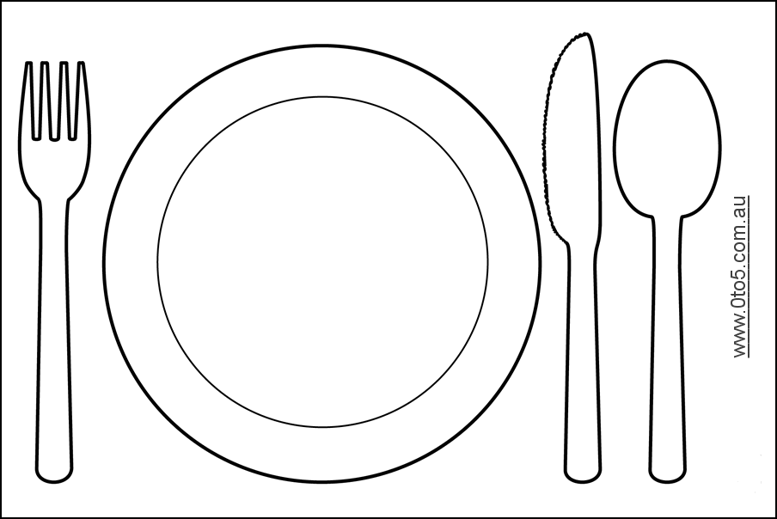
Basic Dining Etiquette - Using Utensils

Slide 17
Utensils
Solid on your “Left”
Liquids on your “Right”
Placement indicates the order of courses.
Always use utensils from the outside inward to the plate.
Work from the bottom up on your glassware
Keep blades of knives turned toward plate and bread knife blade turned downward toward yourself.
The number of pieces of silverware indicates the number of courses

Slide 18
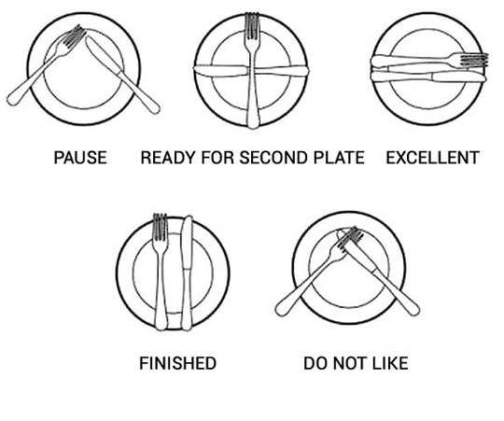
Utensils placement meaning

Slide 19
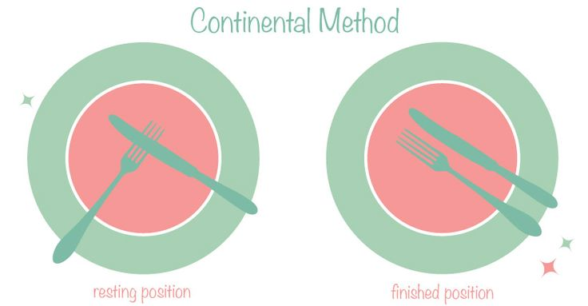
Differences between Continental Method & American Method
Utensils
Continental:
The resting position is in the middle of the plate as if you simple placed the silver down exactly as you were holding them.
The knife blade faces towards you in the 4 o’clock position and the fork tines face down over top of the knife in the 8 o'clock position.
Continental Method
Resting position
Finished position

Slide 20
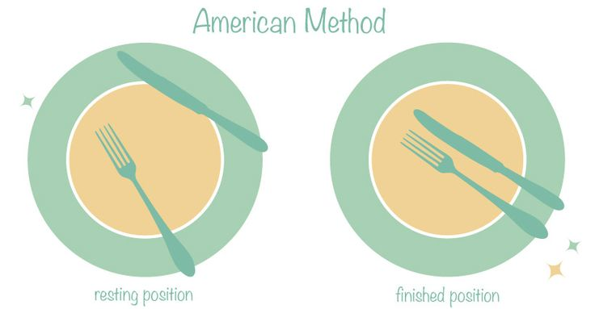
Utensils
Differences between Continental Method & American Method
American:
The resting position is the fork, tines facing up, in the 4 o’clock position and the knife resting along the top corner of your plate.
Once, finished, place your knife, with the blade facing towards you, next to your fork, tines facing up, both in the 4 o’clock position on the plate. This signals to the server that you are finished.
American Method
Resting position
Finished position

Slide 21
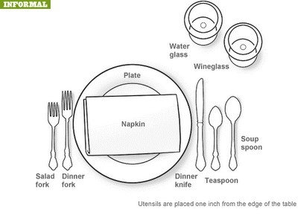
Utensils

Slide 22
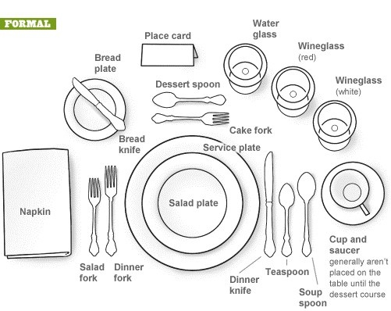
Utensils

Slide 23
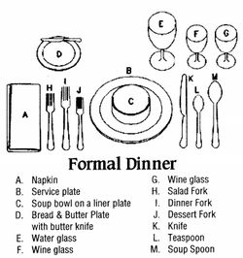
Utensils
Formal
E
F
G
D
N
B
M
H
I
J
K L
C
A
A.Napkin
B. Service plate
C. Soup bowl on a liner plate
D. Bread & Butter plate with butter knife
E. Water glass
F. Red Wine glass
G. White Wine glass
H. Salad Fork
I. Dinner Fork
J. Dessert Fork
K. Dinner Knife
L. Teaspoon
M. Soup Spoon
N. Name Tag

Slide 24
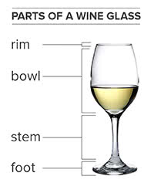
Wine Glass

Slide 25
Enjoy your lunch

