Slide 1
Negara Brunei Darussalam
نڬارا بروني دارالسلام‎
Notes:
Selamat pagi-Good morning/ Terima kasih -Thank you

Slide 2
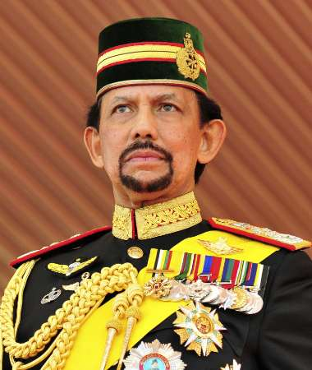
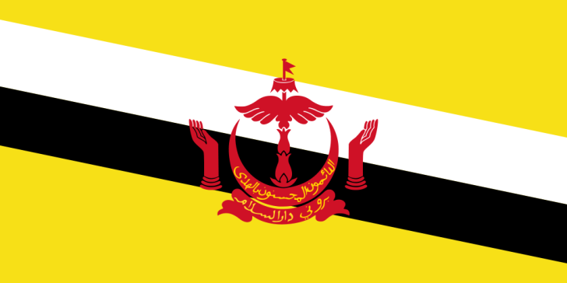
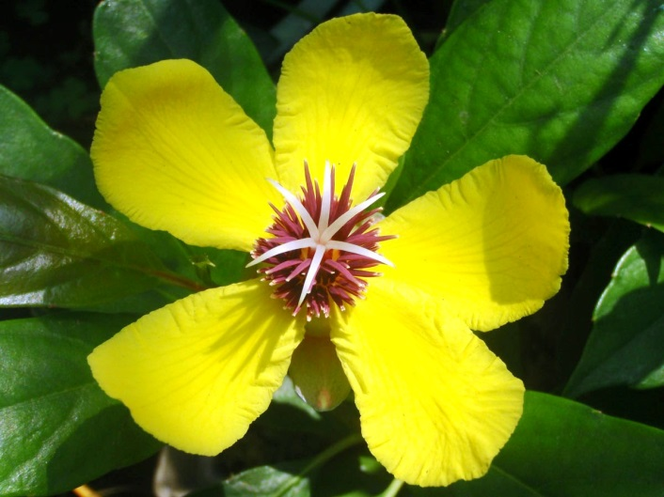
Introduction to Brubei
The national flag
Head of state
Sultan Haji Hassanal Bolkiah
Mu'izzaddin Waddaulah
Simpor flower
Notes:
Flag: Yellow background, cut by black and white stripes and the emblem of Brunei in the center.
Head of state: Also he are prime minister, head of government and minister of defence, Supreme commander of armed forces.

Slide 3
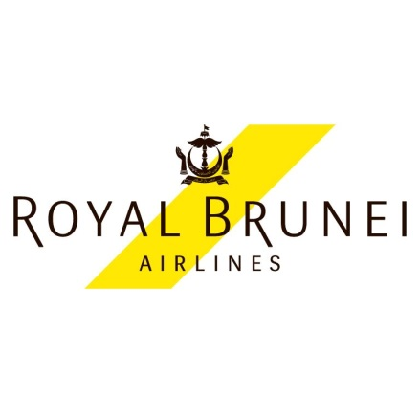
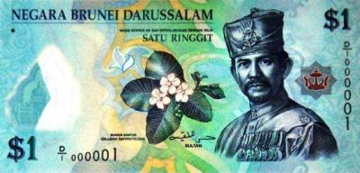
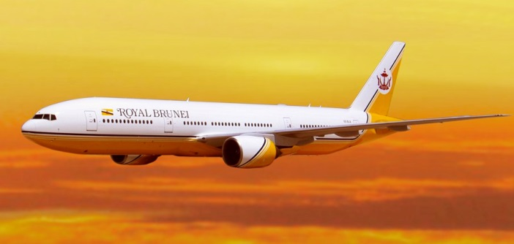
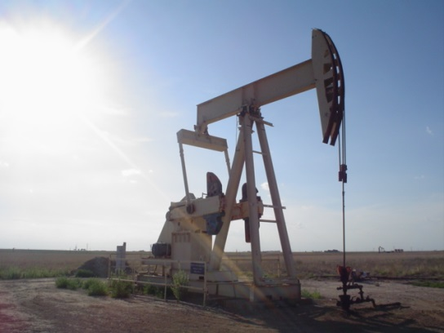
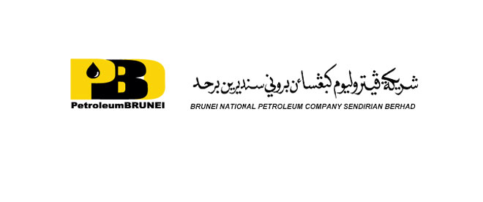
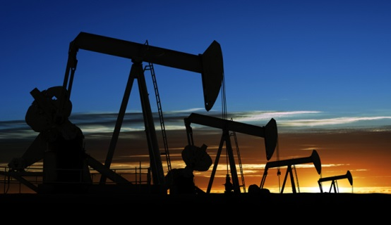
Introduction to Brubei
Royal Brunei Airlines
Brunei dollar
Export
Notes:
Currency: 1 BND about 24 Baht.
The national flag carrier airline of the Brunei is “Royal Brunei Airlines”.
An export of Brunei are petroleum, oil and natural gas.
Brunei is the third of petroleum export in the world.

Slide 4
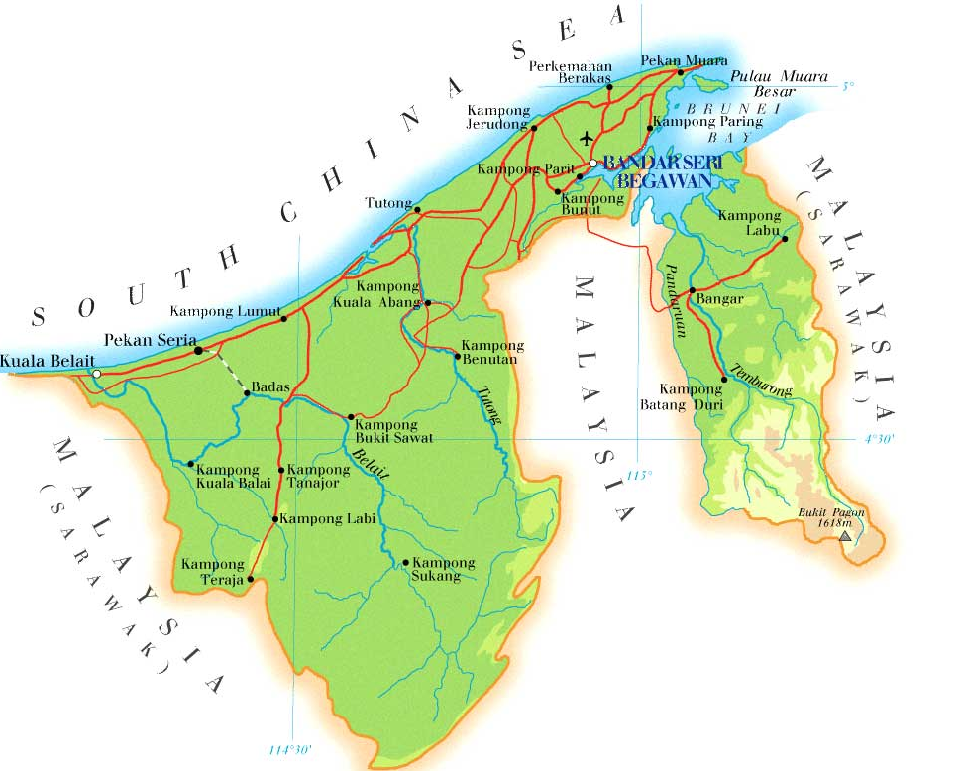
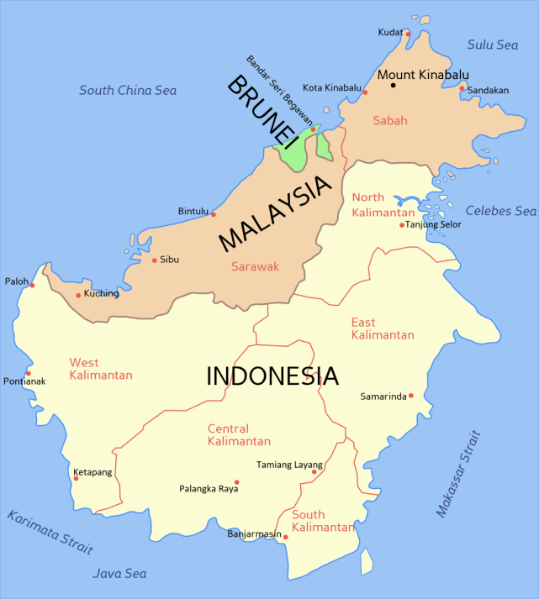
Geography
-Area
Total: 5,765 sq.km.
Located on Borneo island.
Northern coastline
next to South China Sea.
Southern border with
Sarawak, Malaysia.
Notes:
Borneo is the third-largest island in the world and the largest island in Asia.
Divided among three countries: Malaysia and Brunei in the north, and Indonesia to the south.

Slide 5
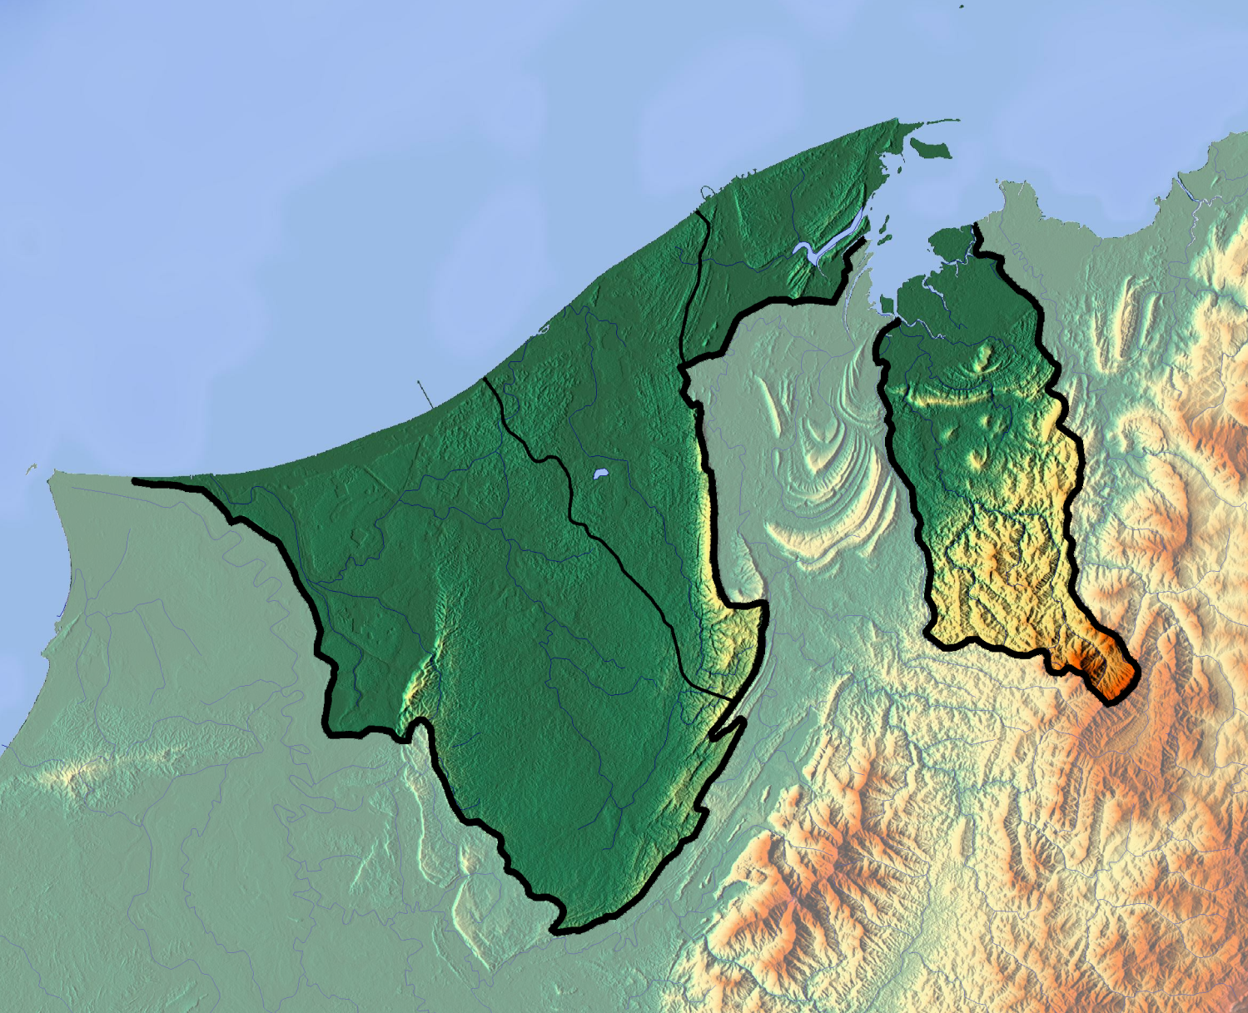
Geography
Brunei-Muara
Tutong
Temburong
Belait
Capital city : Bandar Seri Bergawan
The highest point: Bukit Pagon Mountain
Notes:
Brunei consists with 2 parts, western part and eastern part.
97% of population live in western part.
Divided to 4 districts, Belait, Tutog, Brunei-Muara and Temburong.
The highest point: 1,850 m.
Most of the country is a coastal plain with mountains in the east and hilly lowland in the west.

Slide 6
Climate
The climate of Brunei is tropical equatorial.
The weather are extremely hot and humid.
It have only 2 seasons summer and rainy.
Notes:
The highest average temp was 31.0 °C and the lowest average temp was 23.2 °C.

Slide 7
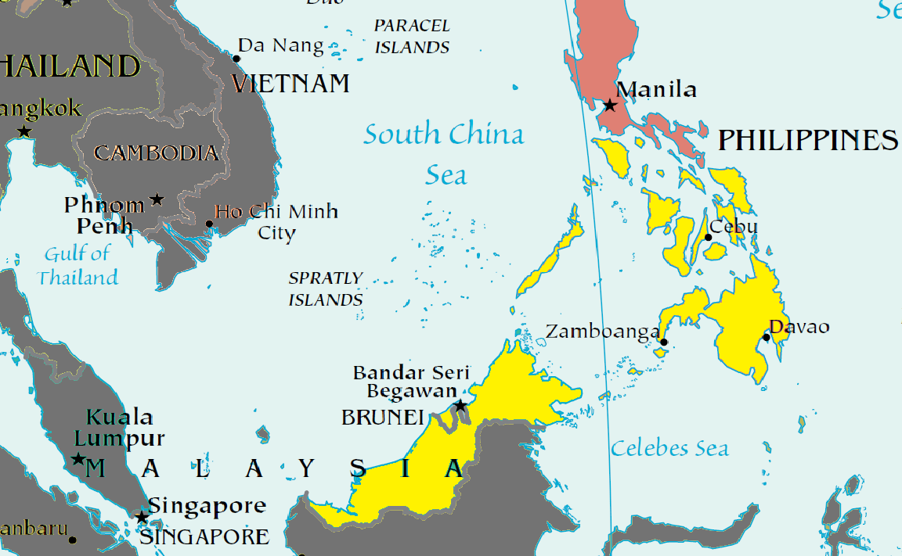
Historical
The Brunei empire
ruled during the 14th
to the 16th century.
The territory covered
the northern part of Borneo
and the southern Philippines.

Slide 8
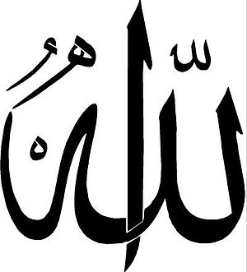
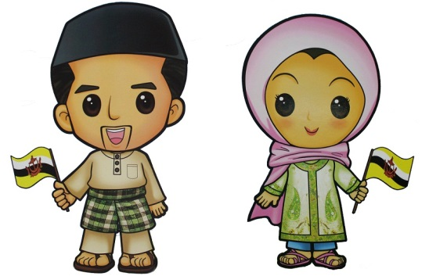
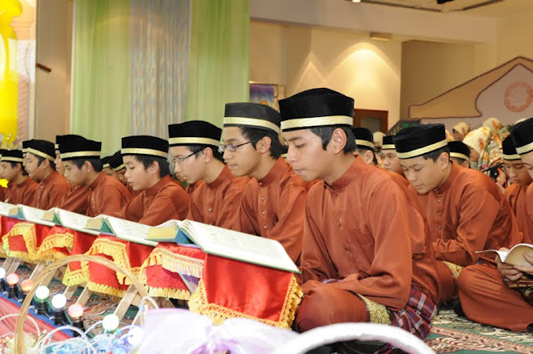
Historical
At that time, The Brunei empire
was famous of trading.
In 15th century, Brunei had relationship
with the Muslim kingdom of Malacca.
So Islam came to be a base
of Brunei’s culture.
Notes:
An export in that time are camphor, pepper and gold.

Slide 9
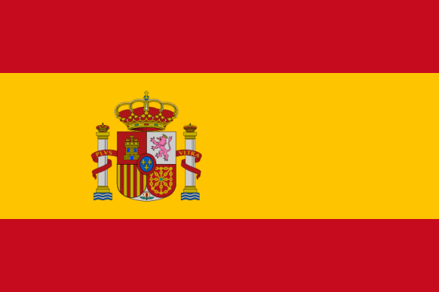
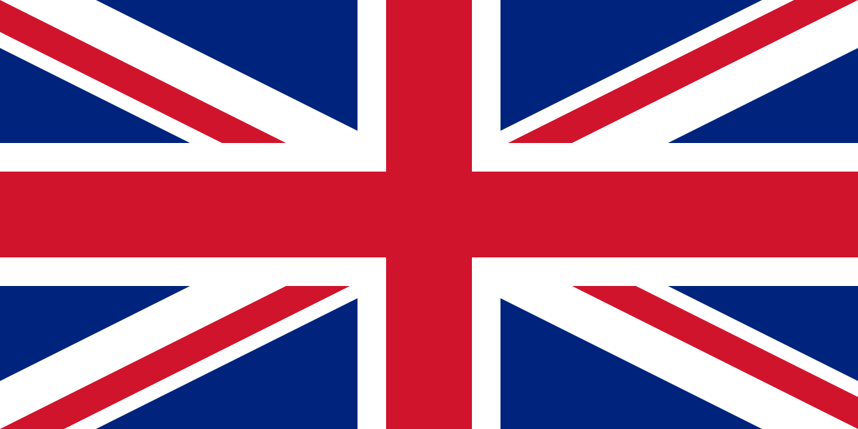
Historical
In 19th century, The Brunei empire declined,
there was a war with Spain
and lost much of the territory,
Brunei was a British protectorate from 1888
until 1st January 1984, Brunei got an independence from United Kingdom.
Notes:
resulting in current small landmass and separation into two parts.
Brunei afraid of losing territory.

Slide 10
Culture
Notes:
Population of Brunei: 68% Malays, 15% Chinese, and 17% Others.
Religion of Brunei: 67% Sunni Islam, 13% Mahayana Buddhism, 10% Christinity and 10% Other.

Slide 11
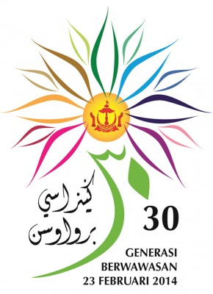
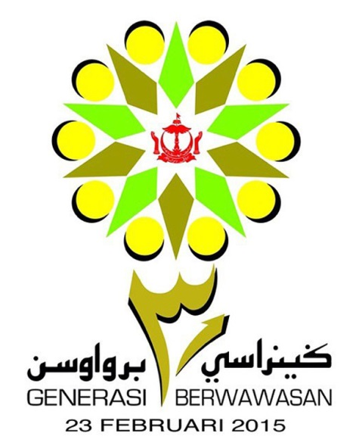
Culture
سلامت ڤاڬي
selamat pagi
Good morning
Languages
Official: Malay
Recognized: English
National Day
23rd February
Notes:
The first line, it is Jawi alphabets, next below it is pronunciation, and the last it is the meaning.
These are National Day’s celebration poster in 2014 and 2015

Slide 12
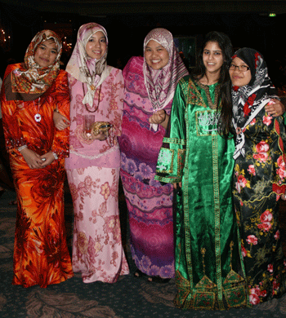
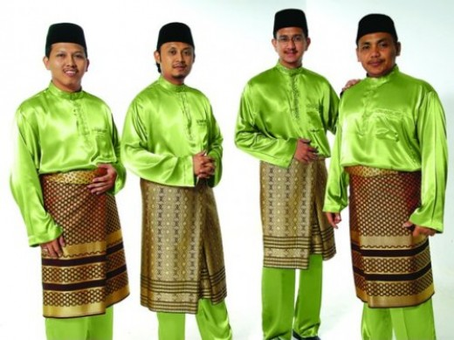
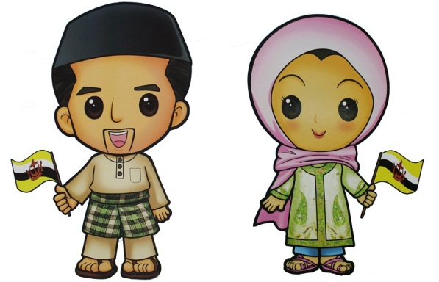
Culture
Costume
Female wears “Baju Kurung”
and head scarf called “Hijab”.
Male wears “Baju Melayu”
and hat or head scarf.
Notes:
Brunei’s culture based on Malay and Islam.
Female costume: long robe (Islam Traditionally .)
Male costume: Long sleeve shirt, Trousers, Cloth wrapped around the waist and hat or head scarf.

Slide 13
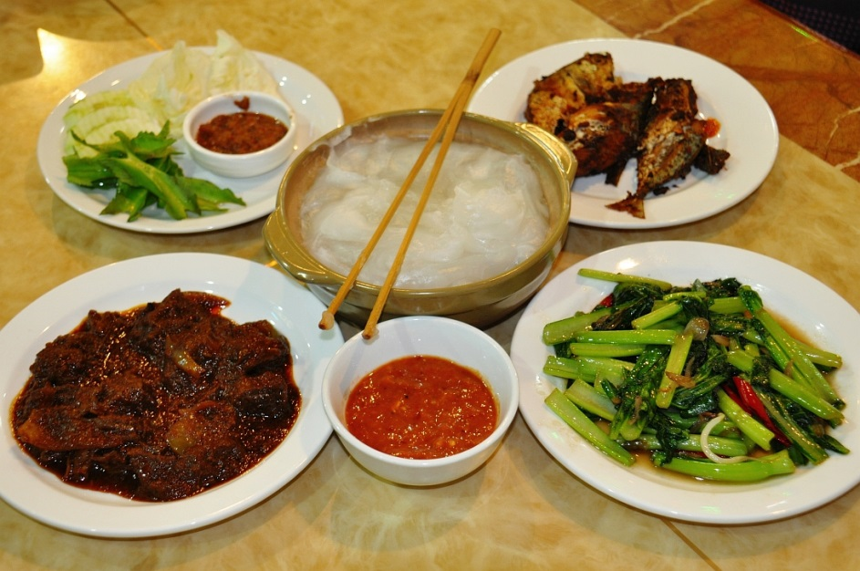
Culture
Food
Brunei’s food are Halal food, avoid pork
and alcoholic beverage.
Taste are spicy and oily.
Abuyat
Notes:
Halal food cook by Islam traditionally.
Abuyat is the national dish of Brunei, it is a starchy sticky from sago palm.
Ambuyat is eaten by rolling the starch around the prongs, then dipping it into a sauce and together with side dishes.

Slide 14
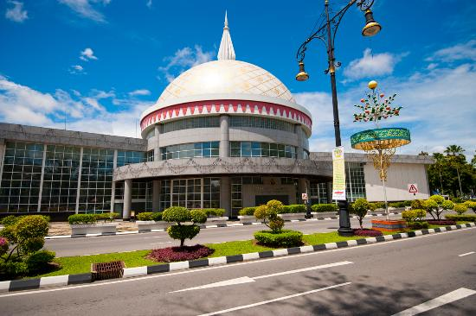
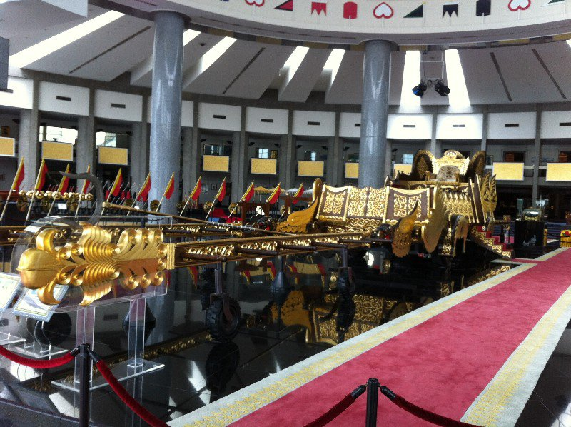
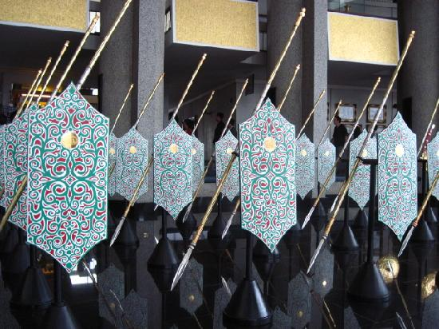
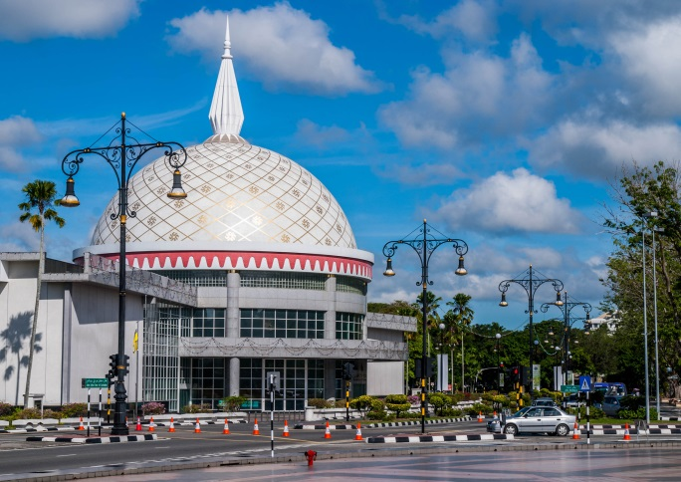
Tourism
Royal Regalia Museum
Notes:
Located at the downtown of Bandar Seri Bergawan, which collect the insignia of sultan, replica throne and etc. about royalty.
Disallow to take a picture inside the museum.

Slide 15
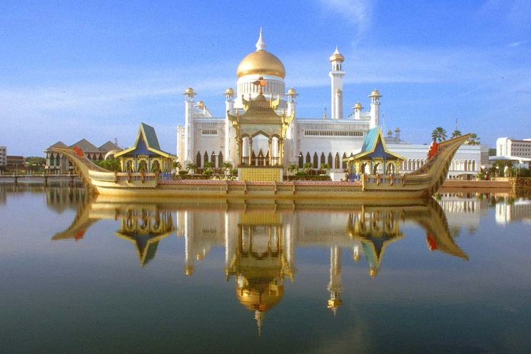
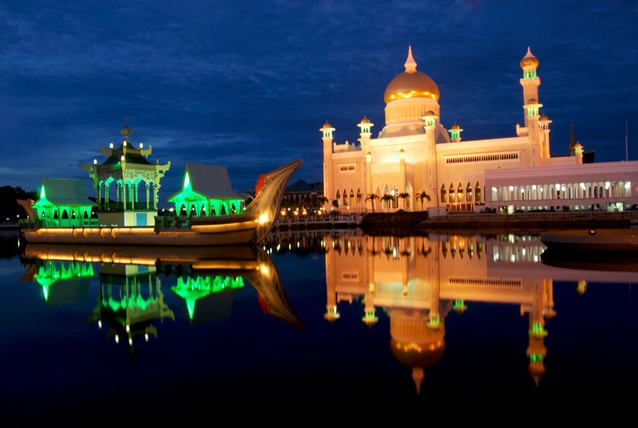
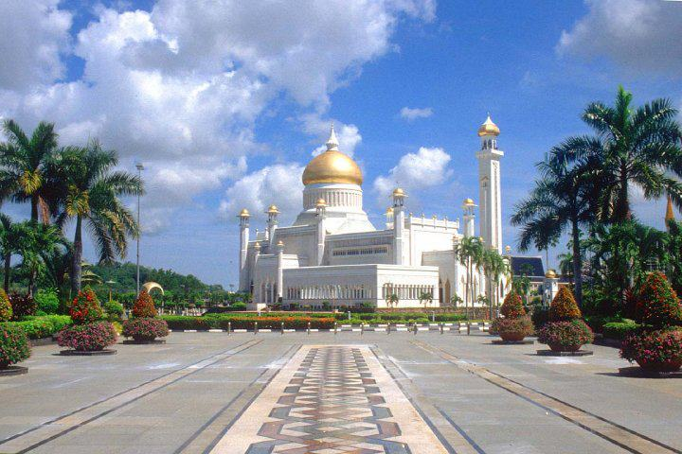
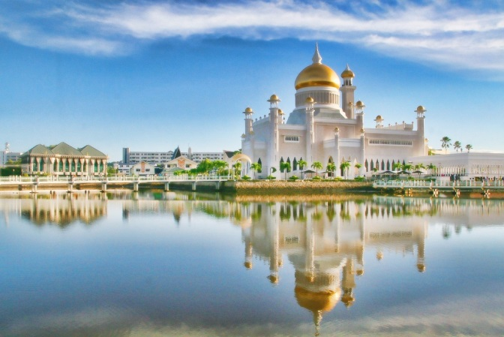
Tourism
Sultan Omar Ali Saifuddien Mosque
Notes:
Located at the downtown of Bandar Seri Bergawan. Designed and established by Sultan Omar Ali Saifuddien the third, father of present sultan.
It has been named “Mini-Taj Mahal.
Disallow to take a picture inside the mosque.

Slide 16
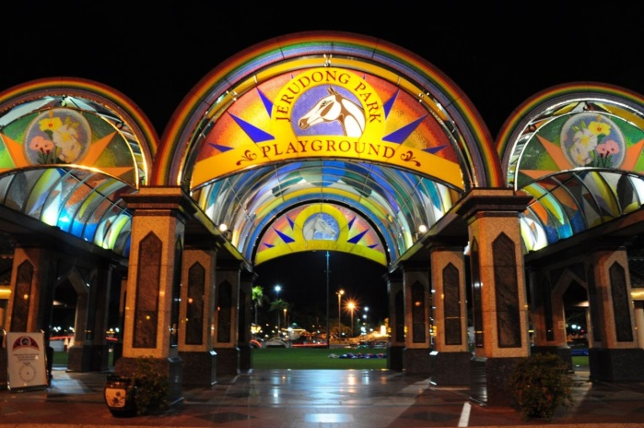
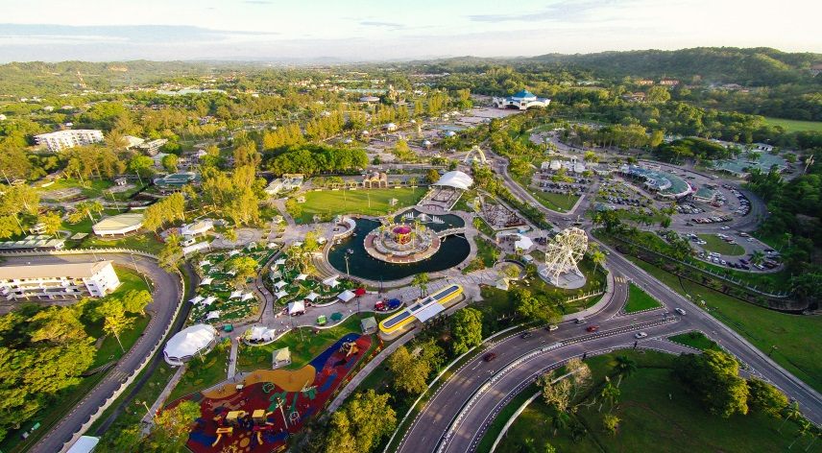
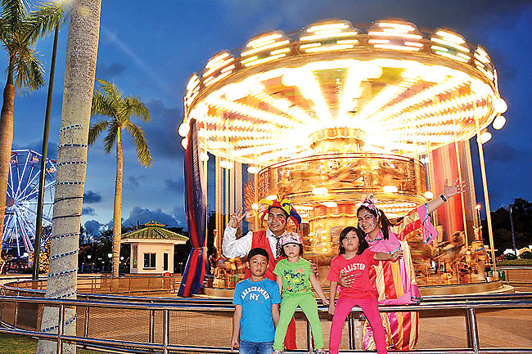
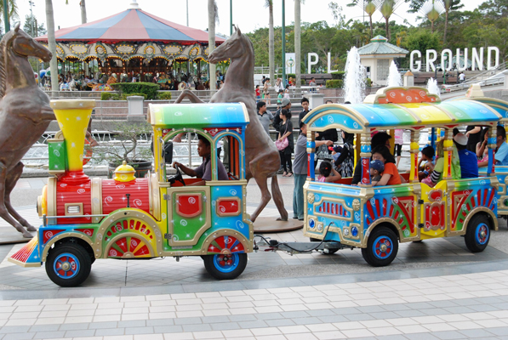
Tourism
Jerudong Park Playground
Notes:
Jerudong Park is an amusement park in Brunei. Built and funded by the Bruneian government.
It’s larger than Hong Kong Disneyland.

Slide 17
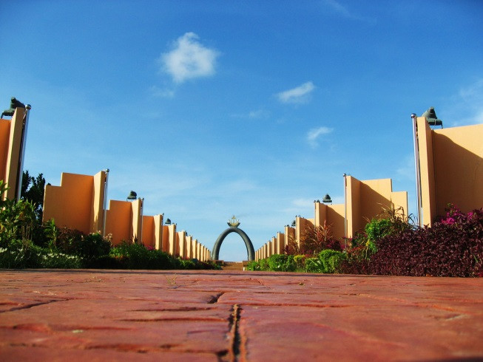
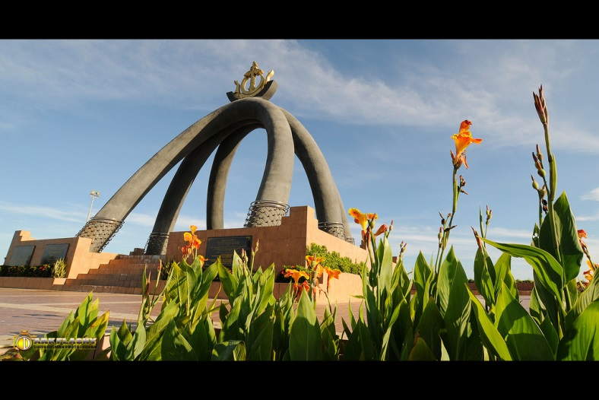
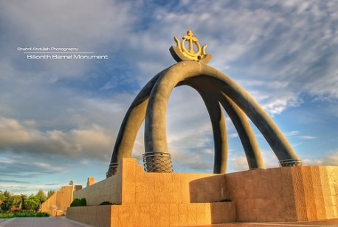
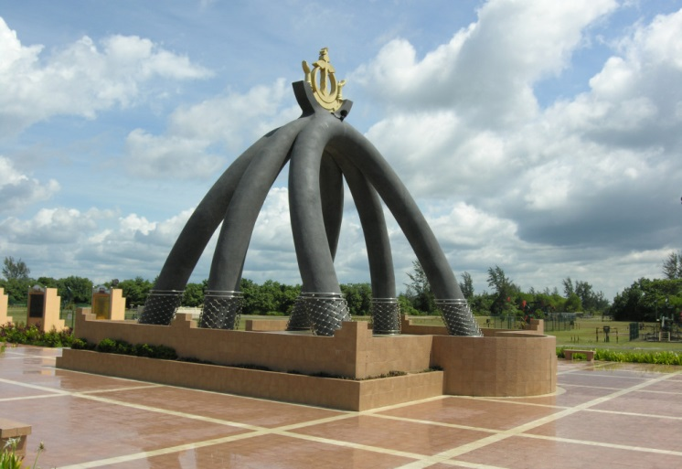
Tourism
Billionth Barrel Monument
Notes:
Located in the Seria, which is the heart of the oil industry in Brunei.
Since 1929, Brunei discovered petroleum and natural gas that brought the wealth to Brunei until nowadays.
This monument show the wealth of Brunei.

Slide 18
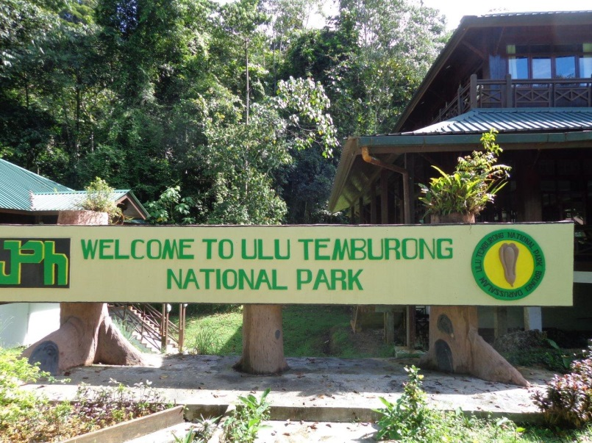
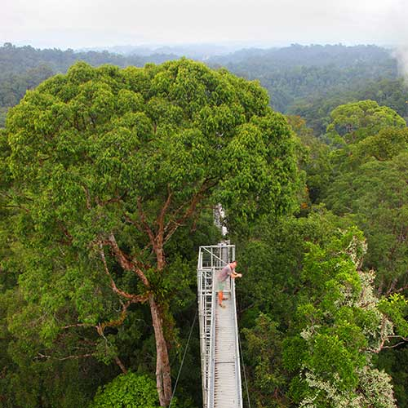
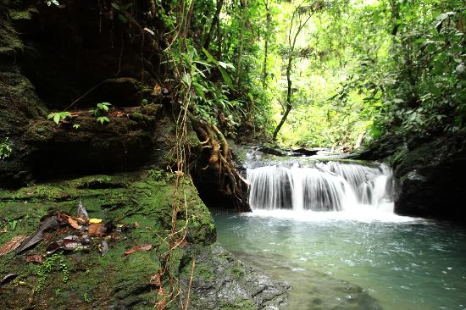
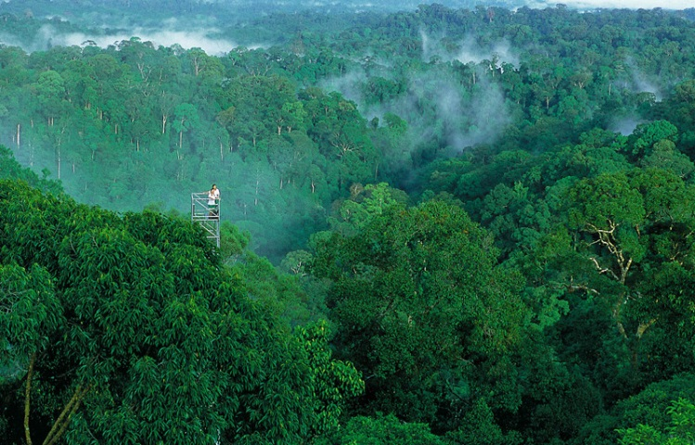
Tourism
Ulu Temburong
National Park
Notes:
Sense the nature, breathe the fresh air, enjoy with an adventure activity, learn lifestyle of native people and conquer the highest point of Brunei “Bukit Pagon”.
You can find it in Ulu temburong national park.

Slide 19
Assignment
Provide your knowledge of Brunei. Write an essay at least 200 words.
Do the itinerary 3 days 2 nights or 4 days 3 nights in Brunei? (start from BKK)

Slide 20
Reference
http://geography.about.com/library/cia/blcbrunei.htm
http://www.asiarooms.com/travel-guide/brunei-tourist-attractions/index.html
http://brunei.tourism-asia.net/brunei-information.html
http://bruneis.tourism-asia.net/brunei-tourism.html
http://brunei.tourism-asia.net/wonders-of-brunei.html

Slide 21
تريما كاسيه
Terima kasih
Thank you

