Slide 1
Chapter 1
Introduction
to tour operator and travel agency

Slide 2
Objectives
Definitions of tour operator
Tour operator VS travel agency
Historical perspective of tour operators and travel agencies
Types of tour operators and travel agencies

Slide 3
The Tourism industry
Business sector
Non Profit sector
Goods and Services
Tourism Product
Government sector

Slide 4
Travel agency
An entity engaged in the business of extending to individuals or groups:
Travel services and assistance to include documentation, ticketing, booking for transportation and/or accommodation; arrangements
Handling and/or conduct of tours within our outside the area
whether or not for a fee, commission or any form of monetary consideration (Tourism Code of 1980).

Slide 5
Travel agency (cont.)
A commercial enterprise where a traveler can secure information and expertise, get impartial counseling and make arrangements to travel by air, sea or land to any point in the world.

Slide 6
Traditional linkage
Supplier
Travel Agents
Consumer

Slide 7
Traditional linkage
Supplier
Travel Agents
Consumer
Transportations
Accommodations
Restaurants
Tours

Slide 8
Traditionally
Travel agency acts as an agent for different suppliers that cater to the need of the travelers.
Travel agency reacts to the needs of the traveler while acting as an agent for the supplier.
The agency earns income in the form of rate-minus or net-plus.

Slide 9
With the introduction of the internet, do you think travel agents will lose their jobs?

Slide 10
Travel management company
TMCs become vendors and principal selling travel services and solutions.
TMCs form a tripartite alliance where all partners (suppliers and consumers) are treated equally.
TMCs become partner to both suppliers and consumers.
TMCs evaluates the consumer’s preferences and the suppliers’ assets to determine the best travel arrangements.

Slide 11
The emerging linkage
Traveler
Supplier
TMC
Offers different proposals that can meet the clients needs

Slide 12
The emerging linkage
Client will choose from different proposals given. If acceptable the client and TMC will agree on professional fee.
TMC manages the client’s needs while capitalizing on the available suppliers so as to have a win-win situation for all the 3 parties involved.

Slide 13
Functions of travel management companies
How to get there?
Where to stay?
What to do?

Slide 14
The travel consultant must be knowledgeable in order to provide the information needed by the client.
The initial exchange of information is important because it is during this time the travel consultant can accurately assess the needs and requirements of the client.

Slide 15
Processing travel arrangements means:
Placing reservations
Obtaining confirmation
Determine package cost and inform client
Issuing ticket, vouchers and other documents
Monitoring the travel.

Slide 16
Sources of revenues of TMCS
Negotiated handling fee (cost plus)
Fixed commission (Rate minus) or Mark Up (Net plus)
Service fees for other service/s
Production incentives and rebates.

Slide 17
Characteristics of tmcs
Retailer
Counselor to the end-user, agent/intermediary for the suppliers
Derives revenues from fixed commission or professional fees
Charges fees for ancillary services

Slide 18
Tour operators
Assemble accommodation, transportation, and other travel services into a package for resale through travel agents.
Responsible for the operation of all facets of the tour.
Many tour operators own and operate tourist transportation units and provide a tour escorts and guides.

Slide 19
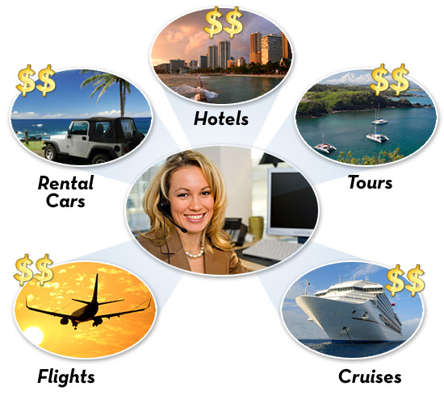
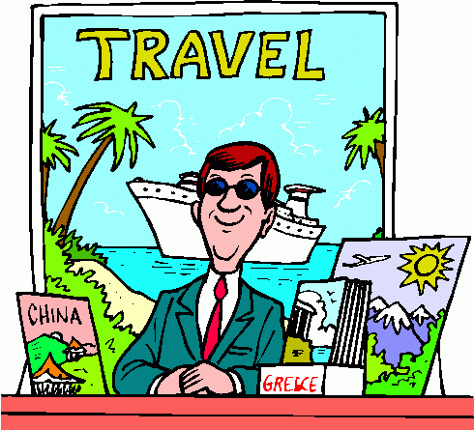
Tour operators
Supplier
Tour Operators
Travel Agents
Transportations
Accommodations
Restaurants
Entrance fees, tour guides, tour escort

Slide 20
Tour operators
Tour Operators are usually called Destination Management Companies (DMCs).

Slide 21
Functions of tour operators
Conceptualize, plan and develop tour packages.
Number of participants
Tailor made packages
(Ad hoc)
Duration of stay
Preferred destination
Based on specific client’s needs
Hotel category
Preferred airlines
Other services

Slide 22
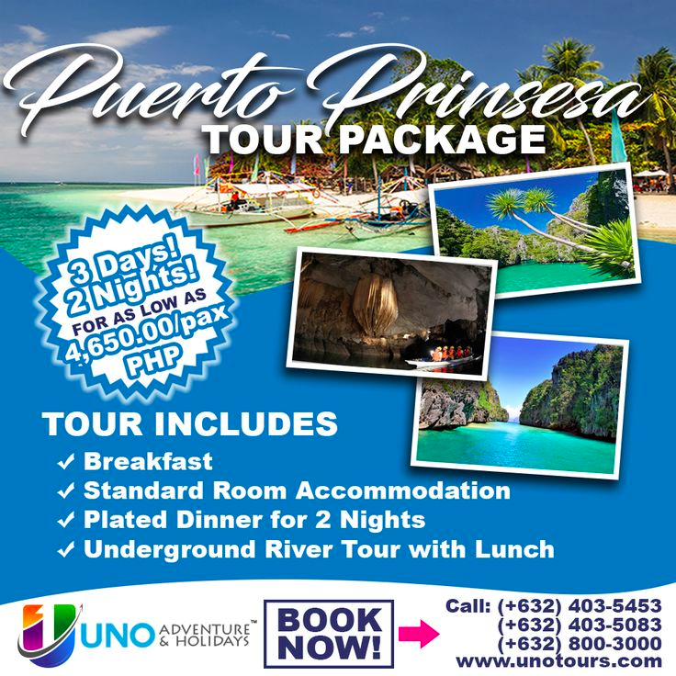
Functions of tour operators
Standard Packages
Based on perceived needs of market

Slide 23
Functions of tour operators
Special Rates
Suppliers
Special Conditions

Slide 24
Functions of tour operators
Assemble and integrate the various travel components into a single tour package.
Airline
Hotel
Tour Package
Activities & Other services

Slide 25
Functions of tour operators
Deliver the tour package
Overseeing the operation of the tour

Slide 26
Sources of revenues of tour operators
Variable mark up
Sales of optional tours, excursions and extensions
Shopping commissions

Slide 27
Characteristics of tour operators
Wholesalers
Intermediary and integrator
Income is variable
Generates additional income from sales of optional tours, excursions and extensions.

Slide 28
Conclusion
Travel Agency
an enterprise regularly engaged in the business of inbound and/or local tour operation
such as making online reservations, arranging and booking for transportation and accommodation, handling and/or conducting tours for a fee, commission, or any form of remuneration.
Tour Operator
an enterprise regularly engaged in the business of providing services
such as reservations/bookings, documentation of travel papers, sales and/or issuance of tickets and selling of outbound tours for a fee, commission, or any form of remuneration.

Slide 29
Conclusion
Travel Agency | Tour Operator
Retailers | Wholesalers. Deals with travel agents (retailers)
Acts as consultants or advisers to the traveller. | Acts as middlemen between the suppliers and the vendors.
Revenues are fixed and pre determined by suppliers | Have variable but limited revenues income and profit margins
Charges fees for documentation and ancillary services | Sells optional products and services and makes use of deposits

