Slide 1
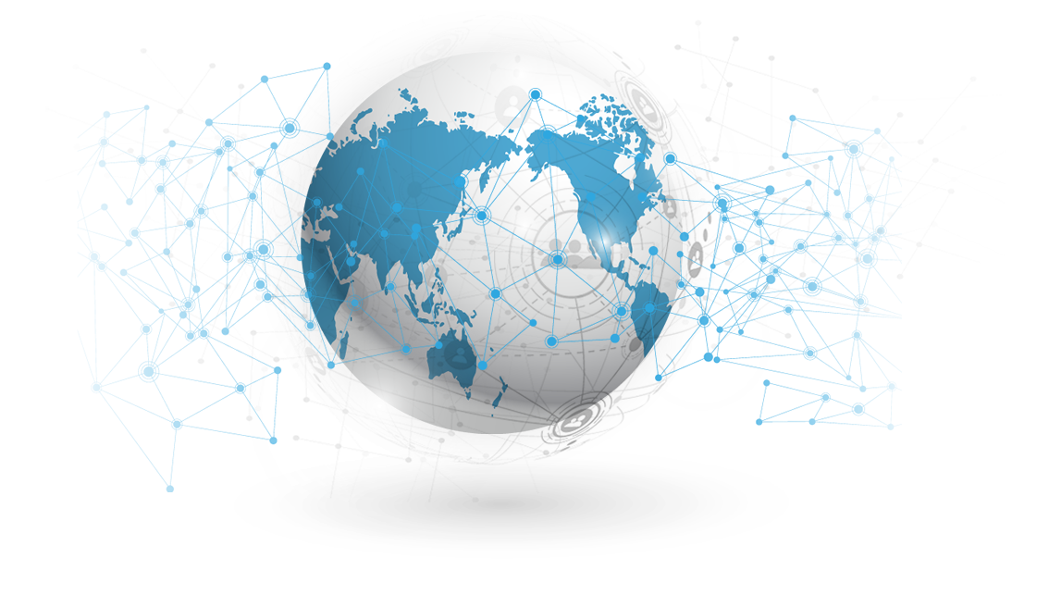
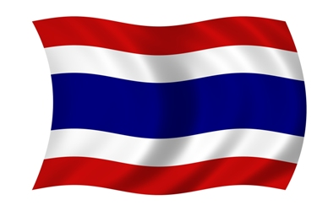
GEN 0104 Thai Society in Global Context
Thailand in Modern World

Slide 2
01
Thailand in modern world
02
5S Thailand Master Plan
We will discover
03
Board of Investment’s New Campaign Highlights Thailand’s Resilience
04
Activity

Slide 3
Introduction
In 20 years, Thailand applies a master plan to strengthen 5S.
1. Security
2. Sustainability
3. Standard
4. Status
5. Synergy

Slide 4
1. Security
Through traditional and external threats such as crime, terrorism, pandemic, and disaster, Thailand struggles by making a partnership and relationship across the globe.

Slide 5
1. Security
We are friendly and ties with all nations for diplomatic, economic, and cultural accomplishment. Additionally, ASEAN is a great example of partnership between Thailand and neighbor nations.

Slide 6
1. Security
Thailand and their ASEAN colleagues work together for enhancing regional cooperation in various socio‐cultural areas, such as disaster management, education, narrowing development gap, environment, public health, as well as building an ASEAN identity, in order to achieve a caring and sharing society in ASEAN.

Slide 7
2. Sustainability
Even COVID-19 and other crises, Thailand still ensures the economic growth and industrial green revolution. The country becomes ASIA’s hub for transport, infrastructure, hospitality, and trade.

Slide 8
2. Sustainability
In 2020, we declared the best countries to start a business ranked by the US News & World Report, was based on the results of a global perception-based survey.

Slide 9
2. Sustainability
It categorized countries based on scores 6,000 decision-makers gave relating to five attributes: affordability, bureaucracy, low manufacturing costs, connection with the rest of the world and access to capital.

Slide 10
2. Sustainability
The survey also took into account the fact that Thailand is one of the most visited countries, has a strong agricultural sector and a competitive manufacturing industry, which has kept Thailand's growth strong with low poverty and unemployment rates. It is also the world's largest exporter of rice and a leader in textiles, tin and electronics.

Slide 11
3. Standard
Thailand is striving to become developed country. The government makes a strong effort to be in-line with international standards such as the eradication of human trafficking, forced labor to work.

Slide 12
3. Standard
The principle of Thailand’s master plan is based on global norms. They are “common expectations or standards of appropriate behavior for humanity, social equality, democracy, ethics, and rights”.

Slide 13
4. Status
Thailand’s status in the global community is created trough the soft power.
The country has provided the world their legendary gastronomy and culture.

Slide 14
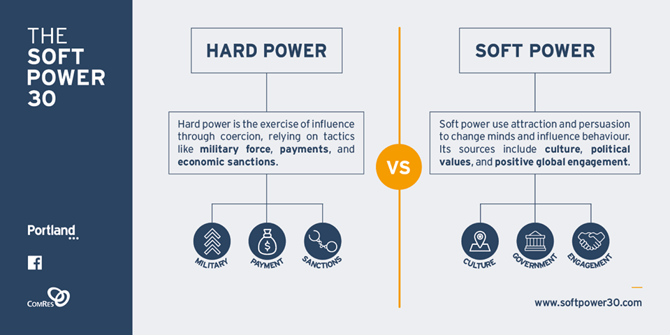
4. Status

Slide 15
5. Synergy
Thai government continues working with international and national agencies in order to access new technology, capital, information sharing, and partnership.
Study the article relating to COVID-19 and Thailand’s economic recovery action…

Slide 16
Board of Investment’s New Campaign Highlights Thailand’s Resilience
(Jul 22. 2020)
The Thailand Board of Investment has unveiled a new 2020 campaign, titled “Think Resilience, Think Thailand”, to showcase the country’s tested strengths and reinforce its status as the region’s prime investment destination.

Slide 17
Board of Investment’s New Campaign Highlights Thailand’s Resilience
(Jul 22. 2020)
The campaign comes as Thailand receives international praise for its efficient control of the coronavirus outbreak, showing the country’s ability to cope with crisis and emerge even stronger as it did during the Asian and global financial shocks of 1997 and 2008.

Slide 18
Board of Investment’s New Campaign Highlights Thailand’s Resilience
(Jul 22. 2020)
“The new campaign captures four core competencies that are engrained in Thailand’s strategic positioning as ASEAN’s investment hub and gateway to Asia -- Diversity, Ecosystem, Location and Supply Chain,” said BOI Secretary General Ms. Duangjai Asawachintachit.

Slide 19
Board of Investment’s New Campaign Highlights Thailand’s Resilience
(Jul 22. 2020)
The country’s economic development over the past 40 years, its position as the second largest economy in Southeast Asia and a leading manufacturer of food, electronics and cars, testify to its strong fundamentals and diverse industries.

Slide 20
Board of Investment’s New Campaign Highlights Thailand’s Resilience
(Jul 22. 2020)
Now the country is taking a step further by implementing the Thailand 4.0 development model which focuses on developing high-tech, sustainable industries of the future and making Thailand the digital innovation hub of Asia.

Slide 21
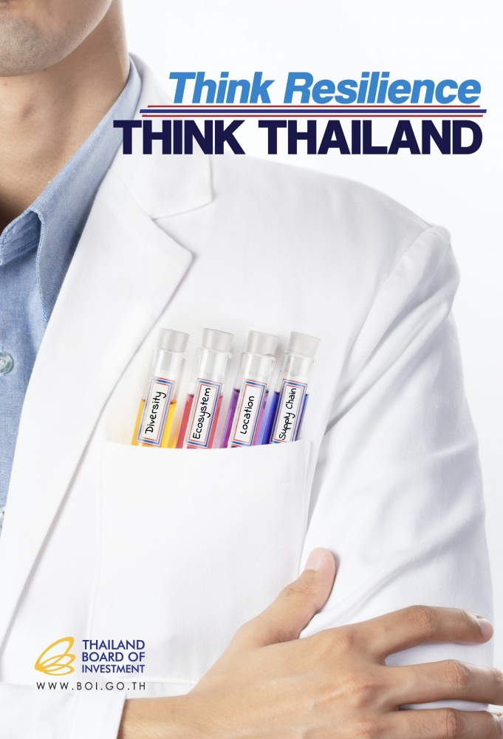
Board of Investment’s New Campaign Highlights Thailand’s Resilience
(Jul 22. 2020)

Slide 22
Board of Investment’s New Campaign Highlights Thailand’s Resilience
(Jul 22. 2020)
Thailand’s investment ecosystem offers advanced infrastructure, supportive investment policies, and comprehensive tax and non-tax incentives.

Slide 23
Board of Investment’s New Campaign Highlights Thailand’s Resilience
(Jul 22. 2020)
Moreover, investors with facilities in Thailand enjoy cost effective operations and ease of doing business. In 2019, Thailand ranked 21st for ease of doing business, out of 190 countries surveyed by the World Bank.

Slide 24
Board of Investment’s New Campaign Highlights Thailand’s Resilience
(Jul 22. 2020)
The country’s strategic location at the heart of ASEAN enables investors to conveniently access a combined market of more than 630 million people, the world’s third largest after China and India.

Slide 25
Board of Investment’s New Campaign Highlights Thailand’s Resilience
(Jul 22. 2020)
Thailand’s diverse manufacturing and service industries has also placed Thailand into a significant position in global supply chains.

Slide 26
Board of Investment’s New Campaign Highlights Thailand’s Resilience
(Jul 22. 2020)
Moreover, the past experiences in dealing with various forms of disruptions ranging from financial crises to natural disasters have helped Thailand build resilience and efficiency to prepare for new norms of global and regional supply chains.

Slide 27
Board of Investment’s New Campaign Highlights Thailand’s Resilience
(Jul 22. 2020)
“While COVID-19 brings the world to unprecedented social and economic challenges, it could also open the way for opportunities awaiting to emerge,” Ms Duangjai said. “Our message is meant to show investors that Thailand’s resilient environment is the perfect place to seize those opportunities.”

Slide 28
Activity

