Slide 1
Week 5
Sufficiency Economy

Slide 2
Outlines
01
Sufficiency Economy
02
The Concept of Sufficiency Economy
03
Sufficiency for Sustainability

Slide 3
Sufficiency Economy
“Sufficiency Economy” is a philosophy introduced by King Bhumibol Adulyadej.
For over three decades, His Majesty offered his insight into a sustainable way of life to his people. And this was well before the major economic crisis in Thailand.
Subsequently, more emphasis was given to survival solutions that were both stable and sustainable under the currents of globalization and changes.

Slide 4
Sufficiency Economy
The philosophy of “Sufficiency Economy” provides a set of living and practical guidelines for people at all social levels starting from family to community and eventually the nation.

Slide 5
Sufficiency Economy
On a larger scale, the principles stress the Buddhist middle path that can be applied by the private and public sectors in their development and management efforts, in particular at the national level in terms of economy and development in the global era. Sufficiency suggests moderation, reasonableness and the need for self-immunity given the impacts of external and internal changes.

Slide 6
Sufficiency Economy
However, in order to achieve sufficiency, an application of knowledge with due consideration and prudence is essential. Great care is also needed in the utilization of theories and methodologies in every step of the planning and implementation process.

Slide 7
Sufficiency Economy
Moral foundations meanwhile represent an essential element to be fostered at all levels through the cultivation of moral awareness, integrity and resourcefulness. Other qualities including perseverance, tolerance, conscience, wisdom and prudence required to achieve balance and the ability to cope appropriately with critical challenges arising from rapid and extensive socioeconomic, environmental and cultural changes in the world are also mandatory.

Slide 8
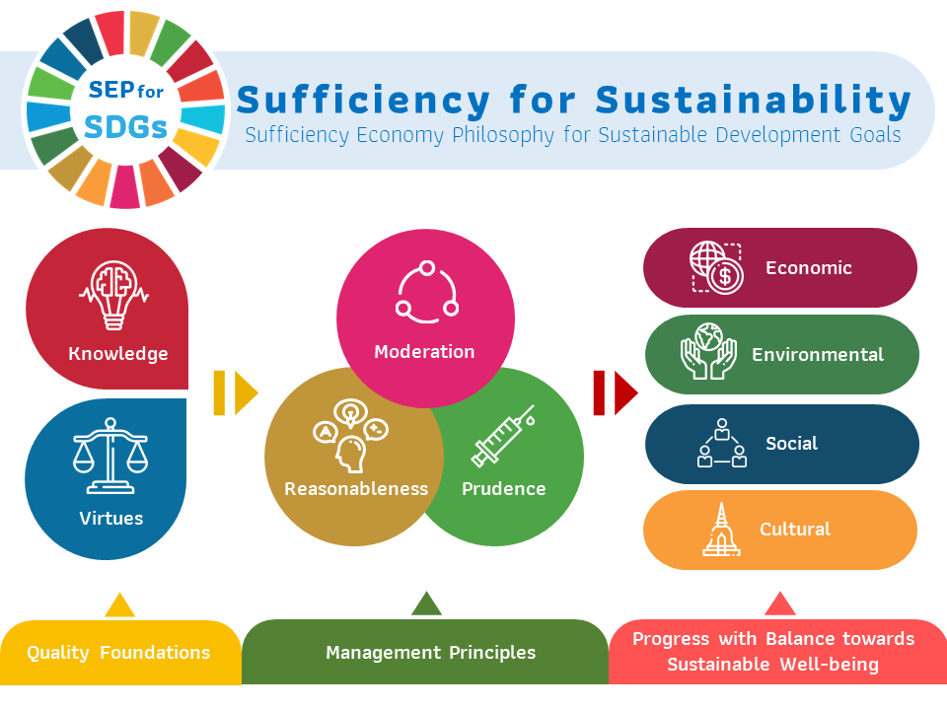
First, consider three concept

Slide 9
Sufficiency Economy
1. Knowledge
Great care/ Technical know-how /
2. Virtue
Honesty/ Patience/ Diligence/ Wisdom/ To portion out

Slide 10
Sufficiency Economy
1. Moderation
2. Reasonableness
3. Self-immunity
Moderation
Reasonableness
Self-immunity

Slide 11
Moderation
A good way to apply this is to avoid debt and buy items what you can afford.
Sufficiency at a level of not doing something too little or too much at the expense of oneself or others, for example, producing and consuming at a moderate level.

Slide 12
Reasonableness
All choices made should be justified by ethics, law justice, and social norms
The decision concerning the level of sufficiency must be made rationally with consideration of the factors involved and careful anticipation of the outcomes that may be expected from such action.

Slide 13
Self-immunity (Risk Management)
This concept is also known as resilience. It means developing the strength and resources to survive.
Immunity to environmental changes
Immunity to cultural changes
Immunity to social changes
The preparation to cope with the likely impact and changes in various aspects by considering the probability of future situations.

Slide 14
Self-immunity
Immunity to social changes:
This can be achieved by developing a sense of inner peace, controlling one’s anger and learning not to take offense at insults.

Slide 15
Self-immunity
This can be achieved by living in harmony and learning not to harm the environment.
Immunity to environmental changes:
You can achieve this state by living in a way that does not harm the environment,
for example by walking or taking mass transit instead of driving to work.

Slide 16
Self-immunity
This is achieved by understanding, appreciating and value your culture, history, and heritage.
Immunity to cultural changes:
It also involves understanding and respecting the culture, history, heritage and values of other nations and peoples.

Slide 17
Why Sufficiency for Sustainability? What is to be done?
Sustainability has at least four components:
2. Environment
1. Economic
Distributing income so as to achieve at least a basic income for all.
Such as win-win solution, welfare and sufficiency
Internalized impact to be managed, friendly with environment, natural resource is a heritage for next generation.

Slide 18
Why Sufficiency for Sustainability? What is to be done?
Sustainability has at least four components:
3. Social
Maintaining the social fabric avoiding collapse through a just distribution of income and wealth in the face of globalization and technological change including artificial intelligence (AI) consistent with physical limits to growth at a global level.
4. Culture
Balancing individual and social satisfaction
Giving is saving

Slide 19
How to lead a life in accordance with the Philosophy of Sufficiency Economy
1. Adhere to economizing by cutting down expenses in all aspects and forego extravagances in leading one’s life.
2. Adhere to pursuing one’s occupation with decorum and honesty.
3. Stop contending for beneficial gains and using harsh methods in commercial competition.

Slide 20
How to lead a life in accordance with the Philosophy of Sufficiency Economy
4. Never cease to find a way to escape hardship by attempting to gain knowledge in order to increase one’s income to the point of sufficiency.
5. Leading one’s life by following the good path, avoiding the bad, and adhering to religious principles.

Slide 21
Conclusion

