Slide 1
Kamphaeng Phet

Slide 2
GEOGRAPHY
Geographically located in the lower portion of Northern Thailand along the banks of the Ping River, Kamphaeng Phet is 358 kilometers from Bangkok. To the east of Kamphaeng Phet are flatlands, while in the west there are a number of national parks with high rising mountains and lush, fertile forests.
In the areas along the Ping River near the provincial capital of Kamphaeng Phet there were once a number of ancient towns that served as strategic front-line frontier-posts between the northern and central kingdoms. In fact, the name Kamphaeng Phet literally means “strong as walls” or “forts make of diamonds”.

Slide 3
Kamphaeng Phet Historical Park
Kamphaeng Phet Historical Park is an archeological site in Kamphaeng Phet, Thailand.
Along with Sukhothai Historical Park and Si Satchanalai historical park, it is a part of the UNESCO World Heritage Site Historic Town of Sukhothai and Associated Historic Towns.
Major features in the Kamphaeng Phet Historical Park include archaeological remains of ancient sites such as Mueang Chakangrao to the east of the Ping River, Mueang Nakhon Chum to the west and Mueang Trai Trueng some 18 km from the town to the southwest.

Slide 4
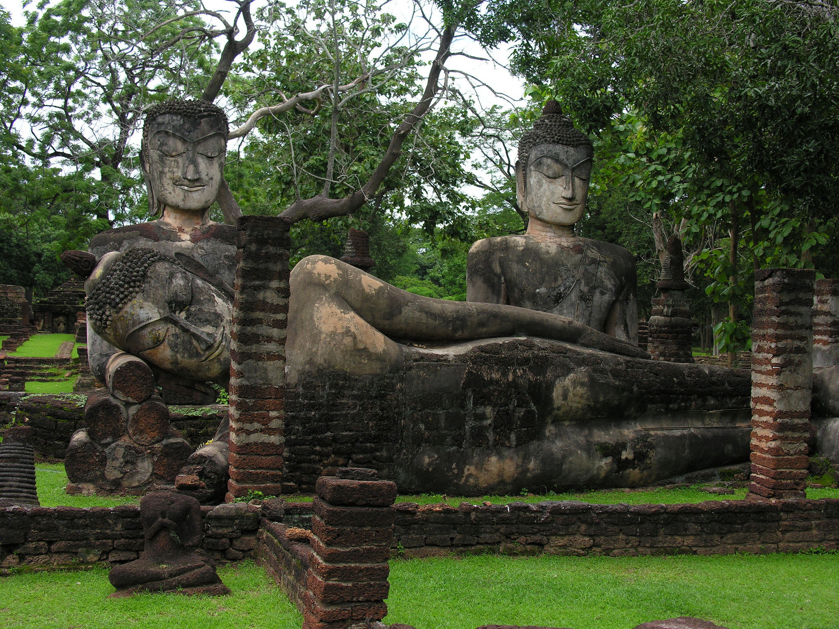

Slide 5
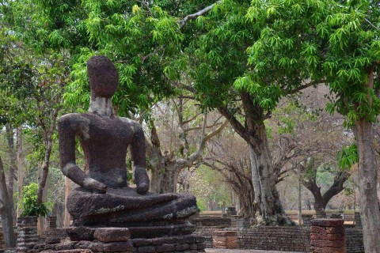

Slide 6
City Pillar Shrine
It has been built by King Woraman, during Sukhothai Period. It is highly respected by Kamphaeng Phet residents.

Slide 7
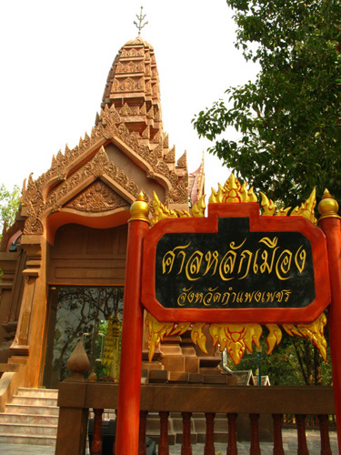

Slide 8
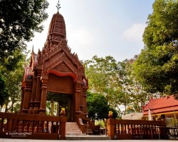

Slide 9
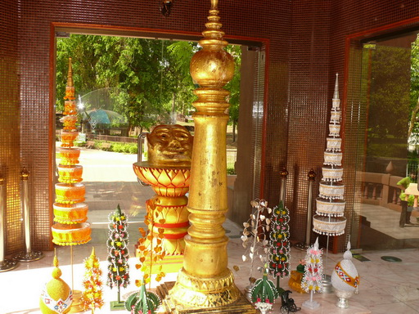

Slide 10
Wat Phra Si Iriyabot (Phra Si Iriyabot Temple)
Wat Phra Si Iriyabot is located to the north of Wat Phra Non and has similar pond and bathroom facilities as its neighbour.
Walls on the four sides are of laterite materials with an entrance also made of laterite.
A Mondop structure houses Buddha statues in four postures-walking, sitting, standing and reclining in the Sukhothai artistic style.
Today only the statue in the standing posture still remains.

Slide 11
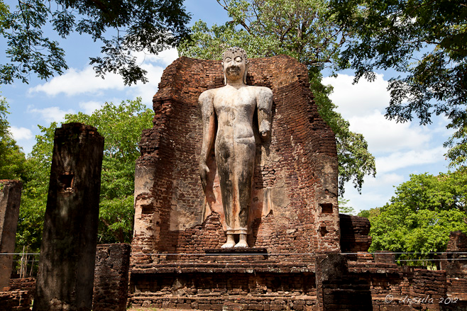

Slide 12
Wat Phra Borommathat Chediyaram (Phra Borommathat Chediyaram Temple)
That is a temple situated in the centre of Mueang Nakhon Chum featuring a Burmese-style Chedi. To the south is an Ubosot housing several Sukhothai- and Ayutthaya-style bronze Buddha statues. The Chedi itself is believed to originally have been a Sukhothai-type structure, its style having been altered during a restoration work financed by a wealthy Burmese about a century ago.

Slide 13
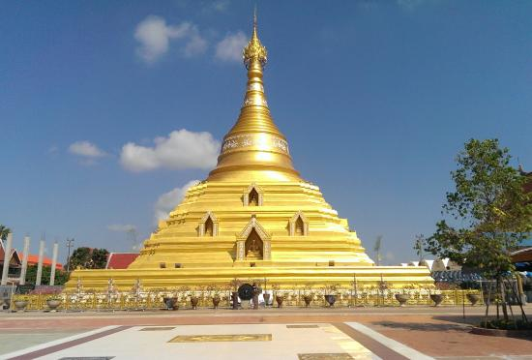

Slide 14
Ho Trai Wat Khu Yang
This scripture hall, the architecture of the Rattanakosin Period, is situated in Wat Khu Yang under the responsible area of the Kamphaeng Phet Municipality. It was referred to in the writings of King Rama V.
The building was established in the water but its lower part was very far from the water surface. This distinguished pattern was designed to prevent Buddhist Scriptures from damage by termites, cockroaches and rats.
Presently, the building is still begin in a complete condition.

Slide 15
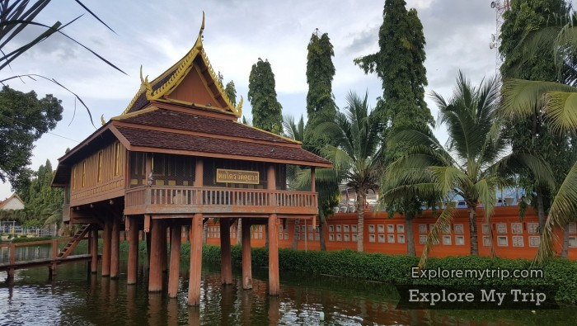

Slide 16
References
http://findthailand.com/places/city-pillar-shrine-kamphaeng-phet-%E0%B8%A8%E0%B8%B2%E0%B8%A5%E0%B8%AB%E0%B8%A5%E0%B8%B1%E0%B8%81%E0%B9%80%E0%B8%A1%E0%B8%B7%E0%B8%AD%E0%B8%87%E0%B8%81%E0%B8%B3%E0%B9%81%E0%B8%9E%E0%B8%87%E0%B9%80/
http://thailand.sawadee.com/kamphaengphet/attractions.html

