Slide 1
Lamprang

Slide 2
Geography
Lampang is situated in Northern Thailand with an area of 12,534square kilometers. It is the fifth largest city in the North after Chiang Mai, Tak, Mae Hongson, and Phetchaboon.
Lampang sits on a plateau with the altitude of 268.80 meters above sea level. It is surrounded by mountains range from the north to the south with a plain in the middle.

Slide 3
Climate
Since Lampang is surrounded by mountains in every direction, the general climate is hot all year round. The temperatures in summer and winter are varied; average temperature in summer is 41.5 Celsius and 10.5 Celsius in winter. The average rainfall intensity is 1,098 ml. There are 3 season summer, rainy, and winter.

Slide 4
Wat Phra That Lampang Luang
Set atop a small hill around 20km from Lampang town, it dates back to 1486 and is believed to be one of the oldest wooden buildings in Thailand. The central viharn is open-sided and held up by two rows of massive teak pillars. The murals within remain in reasonably good nick and tell stories from court life. The wat is home to two important Buddha images, Phra Jao Lan Tang, which was cast in 1563 and is enclosed in a golden mondop towards the rear of the viharn and Phra Jao Tan Jai, which sits behind it. Also behind the viharn is a grand chedi. The entire complex is surrounded by a high brick wall and the main entrance is via a large staircase, the arch of which is topped by beautiful and intricately carved lintels depicting intertwined dragon heads dating to the 15th century. This wat is a big hit with tour buses so it can go from being extremely crowded to completely empty throughout the day. Early morning and late afternoon are generally good times to visit.

Slide 5
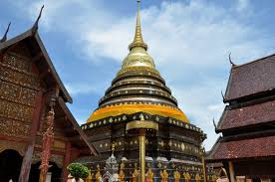

Slide 6
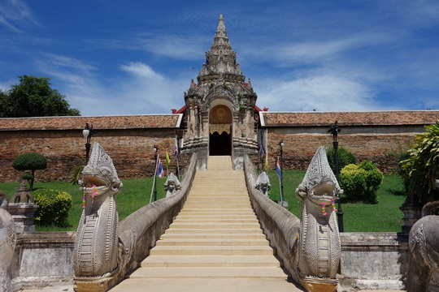

Slide 7
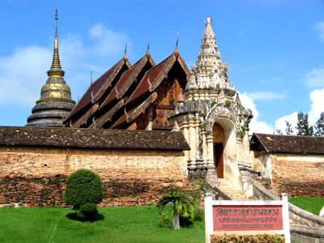

Slide 8
Wat Phrakaewdontao
It probably originally dates from the Haripunchai era and is one of several Thai temples to have been an earlier home of the Emerald Buddha, of Bangkok's Wat Phra Kaew fame. Further prestige is added to the wat due to the stupa reportedly containing one of Buddha’s hairs. There’s a large main hall with a reclining Buddha statue as well as a small museum housing Lanna artefacts. If you’re getting templed-out you could always have a coffee in the car park and feed the fish, but best not to miss this prestigious wat on any Lampang temple tour.

Slide 9
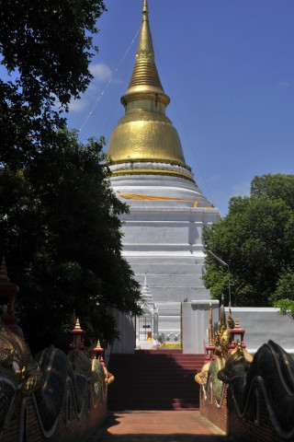

Slide 10
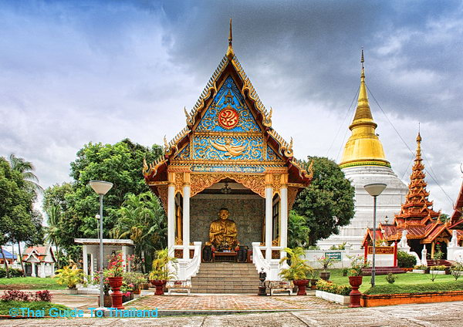

Slide 11
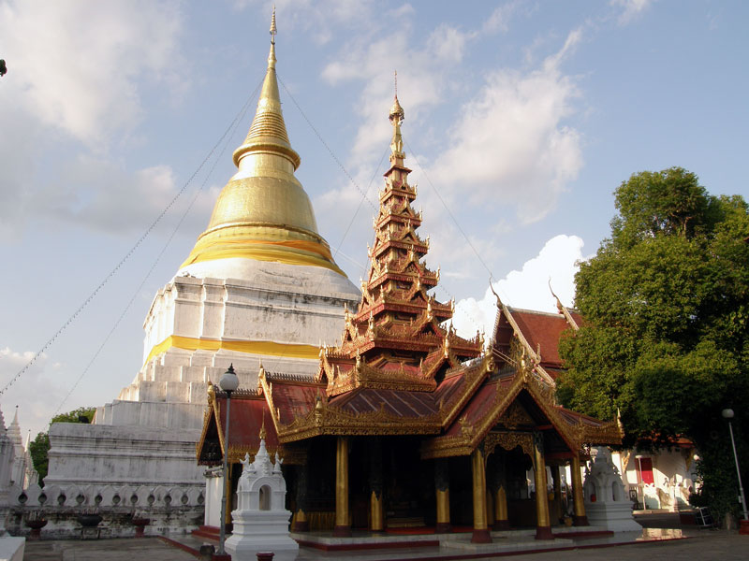

Slide 12
Wat Chedi Sao Lang
They're a mix of Burmese and Lanna styles and there is a small temple on site as well with a Chiang Saen-style Buddha image. A sign says "one can assume they are over one thousand years old," on account of votive tablets from the Haripunjaya period unearthed by villagers here. Locals say counting all 20 chedis will bring you good luck. It wouldn’t be worth going all this way just to see the chedis but you can take in the more spectacular Wat Phrakaewdontao on the way.

Slide 13
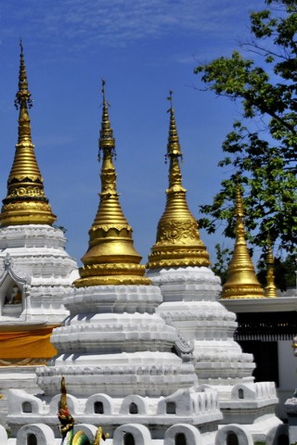

Slide 14
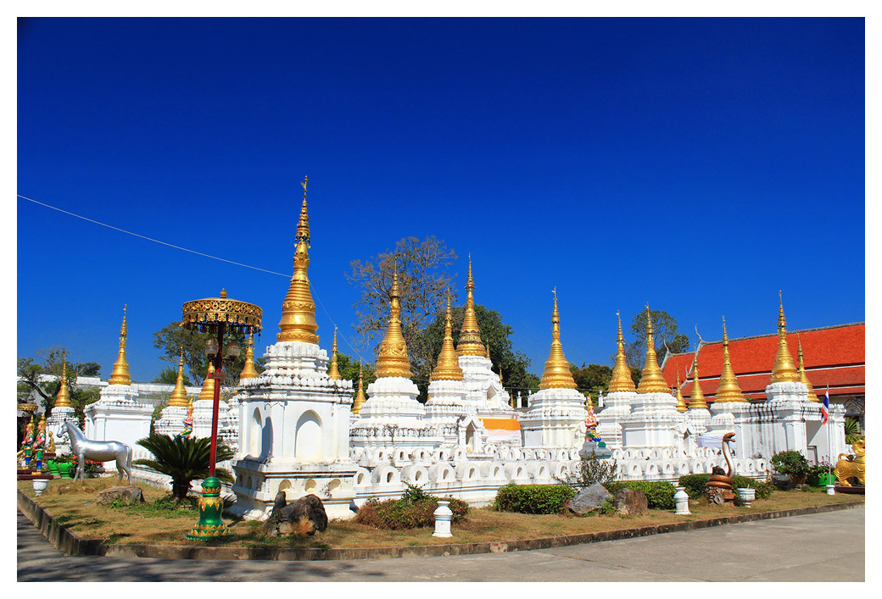

Slide 15
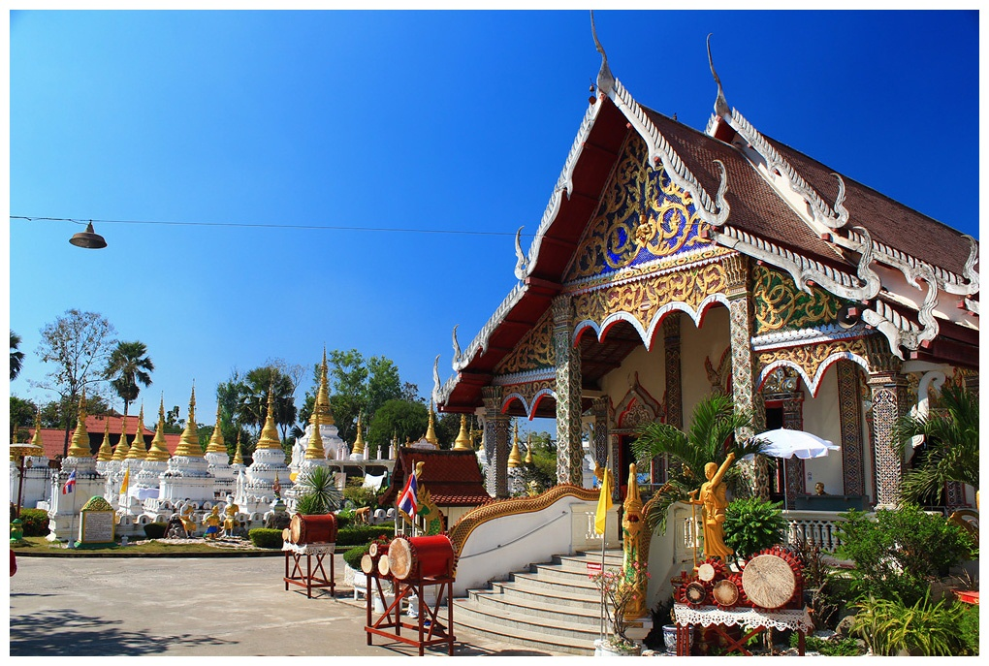

Slide 16
References
http://www.lampang.go.th/images/Eng/eng_v.html
https://www.travelfish.org/sights/thailand/northern_thailand/lampang/lampang
http://thailand.sawadee.com/lampang/attractions.html

