Slide 1
Sukhothai

Slide 2
Geography
Sukhothai is located in the valley of the Yom River on the lower edge of the northern region, 427 kilometres north of Bangkok, and covers some 6,596 square kilometres.
The Khao Luang Mountain Range, with its four main peaks: Khao Phu Kha, Khao Phra Mae Ya, Khao Chedi, and Pha Narai, lies within the Ramkhamhaeng National Park in the south of the province.
The Si Satchanalai National Park is located in the north-west, protecting the mountainous forest areas of the province.

Slide 3
Sukhothai Old City
This UNESCO World Heritage site stands as a testament to Thailand's storied and colorful past. Nearly 200 temples were excavated and partly reconstructed, providing visitors with a look at what Thailand's early capital might have been like. This was the cradle of Thai culture, and archaeologists have found the remnants of artistic and religious works that would define a society for centuries. In the city's heyday, three earthen walls and two moats surrounded the old center. Twenty-one temples and four ponds were uncovered during excavations. For guests' convenience, there is an information center and information boards in English outside every building.

Slide 4
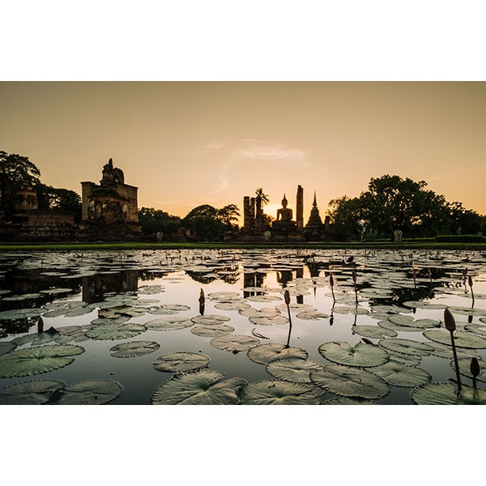

Slide 5
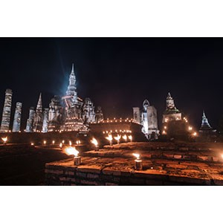

Slide 6
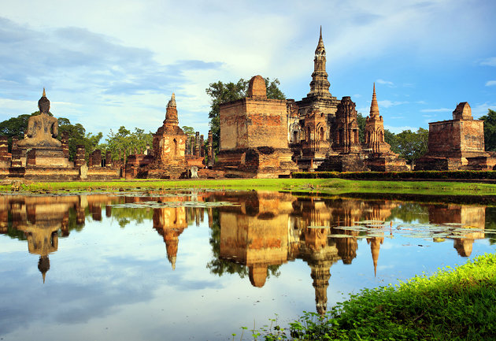

Slide 7
Wat Mahathat
The most splendid wat of the present ruined city (and one of the oldest and most important in Thailand) is the Wat Mahathat.
It was near the earlier Royal Palace (a wooden building of which no trace remains), and this wat alone covered an area of 4 ha, surrounded by 185 chedis, six wiharns of varying size, a bot, and eleven salas.
The towering main chedi at the center of the site is most impressive, with both a wiharn and a bot.

Slide 8
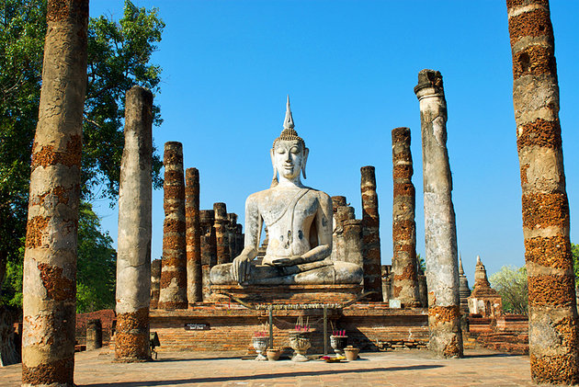

Slide 9
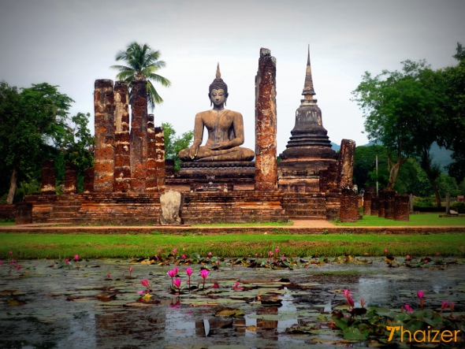

Slide 10
Wat Traphang Ngoen
Traphang-Ngoen Temple features the stunning stucco of the Buddha. And just like other temples, there is a Wihan on the front, the pond on the east, and an island with an ubosot.
This temple was already damaged and only the Buddha image and laterite columns survived. There’re also many other monuments around the scenic area.

Slide 11
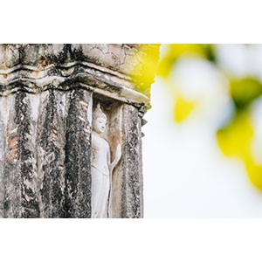

Slide 12
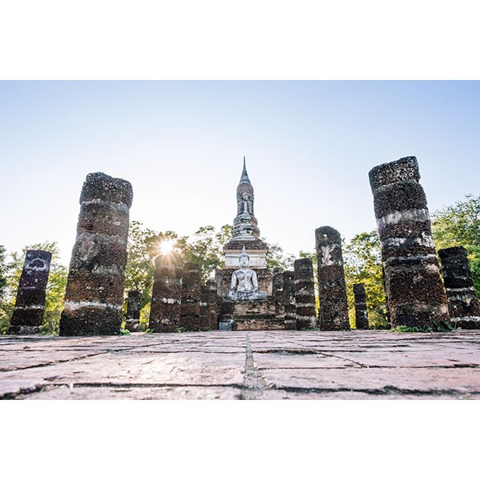

Slide 13
Ramkhamhaeng Museum
The museum exhibits artifacts and antiques found during a series of excavations in Sukhothai Historical Park and Sri Satchanalai Historical Park in 1960s. Highlights of the museum are the Sukhothai-style Buddha images, regarded the most beautiful Buddhist image-style in the Thai history. Also, the exhibitions also display Chinese porcelain and precious artifacts that show to prosperity of Sukhothai during its heydays.

Slide 14
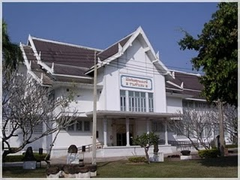

Slide 15
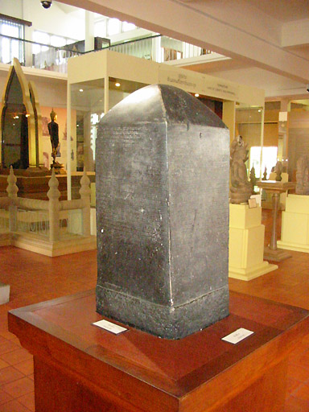

Slide 16
References
https://www.tourismthailand.org/Attraction/Ramkhamhaeng-Museum--6078
https://www.tourismthailand.org/Attraction/Wat-Traphang-Ngoen--749
https://www.tourismthailand.org/Attraction/Sukhothai-Historical-Park-or-Old-Sukhothai-City--743
http://www.planetware.com/tourist-attractions-/sukhothai-tha-su-sus.htm

