Slide 1
TRM 1202 Service Psychology

Slide 2
Contents
Knowing each other
Introduction to TRM 1202
Course description
Course aims
Course objectives
Learning assessment
Class rules
Definitions
Pre-test

Slide 3
Knowing Each Other
Please introduce yourself
Name & nickname
Your education background
Which careers in the tourism industry are you interested in?

Slide 4
Unit 1 - Introduction to TRM1202
Credit: 3 (3-0-6)
Lecture – 3 hours
Practice / Field – 0 hours
Self-study – 6 hours
Course description
Definition of service psychology, importance, relationship between service and psychology, schools of thoughts in psychology and the application in service business, society, marketing and consumer behavior. Techniques of providing a satisfactory service, use of psychology in work place and communication.

Slide 5
Course Aims
To discuss the definition and importance of service psychology, and also its significance in the tourism industry.
To apply knowledge and analyze the relationship between service and psychology, and the application in service business.
To become aware of providing techniques of satisfactory service in the tourism industry.

Slide 6
Course Objectives
To discuss the definition and importance of service psychology, and also its significance in the tourism industry, and realize providing techniques of satisfactory service.
To recommend the way to develop the service business in Thailand in order to touch with the world quality standard.

Slide 7
Learning Assessment
Class attendance & participation 10%
Minor and Major Assignments 30%
Minor 10%
Major 20%
Quiz I and II 10%
Examinations 50%
Mid-term 20%
Final 30%

Slide 8
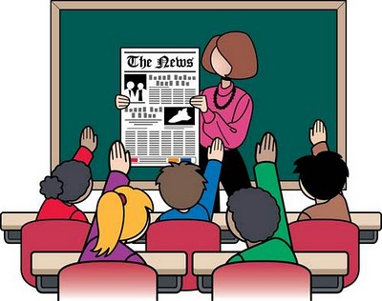
Class Rules
DO
DON’T

Slide 9
Class Rules (cont.)
DO
DON’T

Slide 10
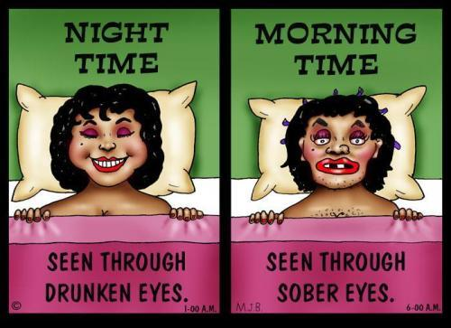
Class Rules (cont.)
DO
DON’T

Slide 11
Definitions
Service
The process of helping guests by addressing their wants and needs with respect and dignity and in a timely manner (Hayes, 2006).
Intangible products such as accounting, banking, cleaning, consultancy, education, insurance, expertise, medical treatment, or transportation.
Sometimes services are difficult to identify because they are closely associated with a good; such as the combination of a diagnosis with the administration of a medicine.
No transfer of possession or ownership takes place when services are sold, and they (1) cannot be stored or transported, (2) are instantly perishable, and (3) come into existence at the time they are bought and consumed (Business Dictionary, 2012).

Slide 12
Definition (cont.)
Psychology
the mental or behavioral characteristics of an individual or group (Merriam, 2013)
the study of mind and behavior in relation to a particular field of knowledge or activity (Merriam, 2013)
the scientific study of the human mind and its functions, especially those affecting behavior in a given context (Oxford, 2013)

Slide 13
Pre-test
In your opinion, what is service psychology? Is it important in your career life?(100 words)

