Slide 1
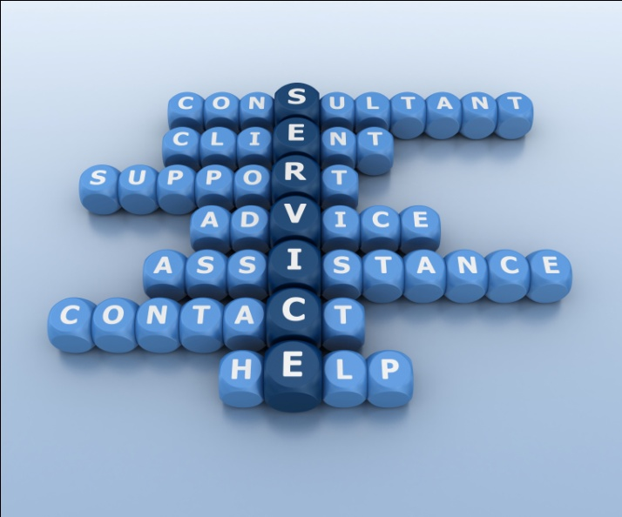
Introduction to Service Psychology
Unit II

Slide 2
Contents
Types of Tourism Business
Direct Tourism Businesses
Indirect Tourism Businesses
Characteristics of Service Business
Definition of Service
Definition of Psychology
Definition of Service Psychology
Importance of Service Psychology
Expected Levels of Service Receivers
Elements of Service

Slide 3
Types of Tourism Business
Involve businesses related to production of tourism product, services and facilities to cater tourist needs and wants.
2 types: direct and indirect businesses
Direct: main businesses directly relate to tourism and cater for visitors
Indirect: other businesses which support tourism industry and cater for both people at the destinations and visitors

Slide 4
Direct Tourism Businesses
Accommodation
Hotel, motel, resort, guesthouse, bungalow, lodge, apartment, homestay, farmstay, bed & breakfast (B&B), youth hostel, camp ground, boutique hotel or resort, and spa resort
Food and Beverage (F & B)
Restaurant, food center, fast food restaurant, local food restaurant, international food restaurant, seafood restaurant, and overnight market
Transportation
Land, water and air transportations
Shopping/ Souvenirs
Department stores, retail shops, shopping centers, Duty-free shops, souvenir shops, and handicraft streets/ villages

Slide 5
Direct Tourism Businesses (cont.)
Tour operators/Travel Agents
Sale representatives of tourism businesses and services
Recreation and Entertainment
Dream World, Siam Park, Siam Niramit, Phuket Fantasea, night club, pub
Financial Services
Travel cheque, bank draft, and foreign money exchange services

Slide 6
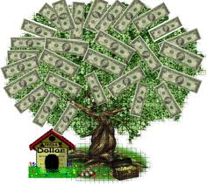
Indirect Tourism Businesses or Supporting Businesses
Finance Industry
Agricultural Manufacturers
Health Services
Insurance Industry
Construction Industry
Printing and Publishing Industry
Cleaning services
Training service centers
Telecommunication

Slide 7
Characteristics of Service Business
Intangibility
the tourist cannot sample the product prior to purchase
**essential to have well-trained staff --> quality service ≠ poor services
Heterogeneity
the service quality of being diverse and not comparable in kind
Perishability
cannot be stored if they are unused e.g. unoccupied rooms, and empty seats in the aircraft
Non-ownership
cannot be possessed and owned
Inseparability
simultaneous production and consumption of service, or inseparability between production process and consumption process
the products are primarily consumed at the place of production

Slide 8
Service
The process of helping guests by addressing their wants and needs with respect and dignity and in a timely manner (Hayes, 2006).
Intangible products such as accounting, banking, cleaning, consultancy, education, insurance, expertise, medical treatment, or transportation.
Sometimes services are difficult to identify because they are closely associated with a good; such as the combination of a diagnosis with the administration of a medicine.
No transfer of possession or ownership takes place when services are sold, and they (1) cannot be stored or transported, (2) are instantly perishable, and (3) come into existence at the time they are bought and consumed (Business Dictionary, 2012).

Slide 9
Psychology
the mental or behavioral characteristics of an individual or group (Merriam, 2013)
the study of mind and behavior in relation to a particular field of knowledge or activity (Merriam, 2013)
the scientific study of the human mind and its functions, especially those affecting behavior in a given context (Oxford, 2013)

Slide 10
Service Psychology
The study of human’s behavior in order to understand characteristics of one’s personality and affecting behavior.
Its objective is to predict, control and/or change behaviors with appropriateness.
The study will cover both sides of service provider and receiver in order that the service provider will facilitate, help and fulfill the service receiver’s need and want with the highest satisfaction.

Slide 11
Importance of Service Psychology
Know yourself
Potentiality, ability and qualifications
Strength Vs Weakness
Know your customer
Different needs and wants, expectations and behaviors
Customer’s satisfaction
Know value and importance of customer, and excellent service
Customer is GOD → Money → Salary → Service provider
Customer’s behavior and demand are sensitive and variable.
Service provider → excellent service → customer → Loyal customer

Slide 12
Expected Levels of Service Receivers
Core Service
Activity or process which be responsible directly by the organization.
E.g., Hotel → room, and Airline → air seat (for travelling to the destination)
Expected Service
Activity or process, and physical facilities, expected from the customers apart from the core service.
E.g., Hotel → room service and mini-bar, and Airline → food and beverage
Exceeded Service
Activity or process, and physical facilities which customers are unexpected to be included in the product, then, when they get it, they will be impressive and satisfied.
Ex., Remember guest’s information → Marketing strategy → Loyal customer

Slide 13
Elements of Service
Service receiver (customer or guest)
The most important element and the starting point of the service
Service organization
Direct and indirect tourism businesses
Service provider
Front-line staff, supervisor and manager
Product
The process and way of presentation for serving product and service
Physical and surrounding of service
E.g., building style, decoration, atmosphere and staff’s uniform

Slide 14
Elements of Service (cont.)
Service Business | Product & Service | Service Receiver | Service Provider | Physical & Surrounding
Hotel | Room, F & B, cleaning service, and greeting & reception | Guest | Hotel departments e.g., front office, housekeeping, and banquet | Building, decoration, atmosphere and facilities
Travel agency & Tour operator | Guiding, air ticket & hotel booking, and travelling document providing | Tourist | Tour guide, tour leader, and ticketing staff | Office surrounding, tools & equipments, and vehicles
Restaurant | F & B (food ordering and serving), live music and other performances | Guest | Chef, waiter / waitress, and cashier | Surrounding, decoration, car parking, and staff’s uniform
Airline | Air transportation, greeting, and F & B | Passenger | Captain, flight attendant and ground service staff | Model and size of airplane, seat, toilet, and staff’s uniform

