Slide 1
Service Receiver
Unit III

Slide 2
Contents
Loyal customer
Types of service receiver
Risk awareness in using service
How to avoid risk factors in using service
Service receiver’s expectation of service quality
Complaint and its importance
Minor Presentation (10%)

Slide 3
Loyal customer
Customer loyalty is the result of consistently positive emotional experience, physical attribute-based satisfaction and perceived value of an experience, which includes the product or services.
Naturally, we need to be communicating with these customers on a regular basis by telephone, mail, and email.
They are the ones who can and should influence our buying and merchandising decisions. Nothing will make a Loyal Customer feel better than soliciting their input and showing them how much you value it.
Many times, the more you do for them, the more they will recommend you to others.

Slide 4
Types of service receiver (Blumberg, 1991)
Price-Sensitive Customer
Concentrating on the price only → save or cheap price
Do not care about the service quality
Price-Quality Customer
Considering the appropriateness between service quality and price → value for money
Quality-Sensitive Customer
Focusing on the service quality only → Good service quality → Fulfilling their satisfaction
Do not care about the price
Price-Surrogate Customer
Believing in the concordance of service quality and price
Good service quality = Expensive
Bad service quality = Cheap

Slide 5
Risk awareness in using service
Is it in accordance with my Expectation?
Is it Safety and Security?
Is it Value for Money?
Is it Wasting my Time?
Is it Guarantee my Social class?
Is it Fulfill my Demand?
Answer:
Yes, it is. → Customer satisfaction
No, it is not. → Customer unsatisfied → no more revisit

Slide 6
How to avoid risk factors in using service
Search information
Sources of information
Reliable sources (Word of mouth): friends, family and ex-customer
Other sources: internet, newspaper and magazine
Use ex-service organization
Use service from good image and famous organization
Reputation of organization can guarantee the service quality.
Use the most expensive service
High price = High quality
Use service guarantee
Money refund for unsatisfied customer

Slide 7
Factors of Service receiver’s expectation of service quality
Factors influencing human’s behavior
E.g., social class, educational level and age level
Past experience
Ex-customer expects to receive the same level of service or better level in the same product.
Information
Word of mouth, advertisement and public relations

Slide 8
Service receiver’s expectation of service quality
Tangibles
Physical facilities e.g., hotel’s lobby, or audio-video on demand for airplane
Reliability
Ability of service organization and provider which will serve service on time and completely by following the commitment.
Ex., A tourist guide can follow strictly an itinerary.
Assurance
Service receivers feel value for money and time, and confident in using the service.
This feeling occurs from the professional and specialization of service organization and provider.
Ex., Safety and security regulations of the hotel, a waitress can recommend the highlighted dish, a tourist guide can answer all information and history of tourist attractions.

Slide 9
Service receiver’s expectation of service quality (cont.)
Responsiveness
Readiness of service organization and provider which will fulfill service receiver’s demands immediately (without any waiting time).
Ex., giving information to a guest by a hotel receptionist, and serving beverages to passenger by a flight attendance
Empathy
Helpfulness and carefulness of service organization and provider being send to the service receiver.
E.g., Wake-up call service, and One Stop Service

Slide 10
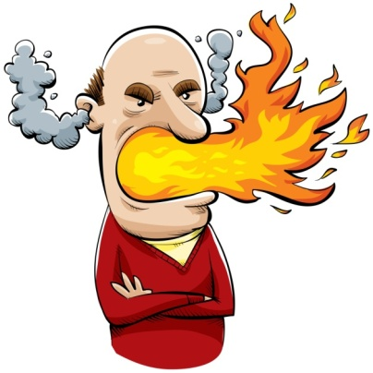
Complaints
Definition: Non-satisfaction of service receiver, happened because they do not receive the service from their expectation.
Importance: It is a mirror of your organization, reflecting your service quality in the eyesight of customers in order that you can improve your problems and errors.

Slide 11
Complaints (cont.)
Determinants of non-satisfaction of service receiver
No service quality
Service provider: no service-minded, no interpersonal relations, and lack of knowledge
Policy and management of service organization
Break an agreement
Refuse for responsibility
No after- sale service
Physical facilities ex., power failure and water shortage
Service receivers (themselves)
self-centered, or emotional variance
Other service receivers
Noise annoyance, or smoking permission

Slide 13
Minor Presentation (10%)
“Role Play on Direct Tourism Business”
Choosing one direct tourism businesses, making a role play by showing the interaction between the service receiver and service provider.
You can play up 2 situations (if it’s too short)
You can be at the real scene (must submitting VDO file with CD) or in the classroom
5 persons a group
Duration: 10 – 15 minutes
Date:

