Slide 1
Individuals in Organizations Part I
Unit 5

Slide 2
Contents
What is individual behavior?
Model of individual behavior
Employee motivation
Ability
Roles
Situational contingencies

Slide 3
What is Individual Behavior?
Behavior:
the way in which one acts or conducts oneself, especially towards others (Oxford Dictionaries, 2013)
the actions or reactions of a person or animal in response to external or internal stimuli (The Free Dictionary, 2013)
Human Behavior / Individual Behavior is complex and every individual is different from another.
Individual behavior in organization is the challenge of an effective organization is in successfully matching the task, the manager and the subordinate.

Slide 4
Individual Behavior
Four factors that affect individual behavior in organizations:
Motivation
Ability
Role perceptions
Situational Contingencies
Drive behavior
Provide opportunities and constraints

Slide 5
Model of Individual Behavior
Role
Perceptions
Motivation
Individual
Behaviour and
Performance
Ability
Situational
Contingencies

Slide 6
Employee Motivation
Forces within a person that drive his or her direction, intensity, and persistence of voluntary behavior
Direction - goal oriented
Intensity - amount of effort
Persistence - continuing effort

Slide 7
Ability
Natural Aptitudes
based on talents, size, capabilities
cannot be learned, or acquired
Learned Capabilities
can be taught and learned
physical and mental skills
Competency VS Person Job Fit
generic competencies not specific task abilities

Slide 8
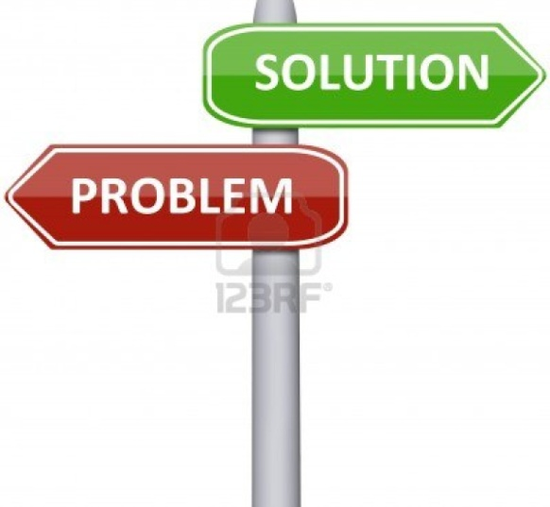
Roles
Role Perceptions
beliefs about what behaviors are appropriate or necessary in a particular situation, including job tasks, relative importance, and preferred behaviors to accomplish those tasks
Role Problems
Role overload
Role conflict
Role ambiguity

Slide 9
Situational Contingencies
Environmental Factors outside of employee control that constrain or facilitate their behavior and/or performance
Time, people, resources, working conditions, and customers

Slide 11
Major Assignment (20%)
Interview 3 working persons (all of them should work in the service organizations):
Let them introduce themselves.
Describe about their occupations? (Workplace, working environment and atmosphere)
How emotions are important in their work life? (Unit 7-8)
How can they deal with the tempered customers / guests and boss? Can they give an example situation? (Unit 7-8)
What kind of the leadership do they want? Describe some characteristic. (Unit 9)

Slide 12
Major Assignment (20%)
Conclude the information from your interviewees in your own words.
Take photos with them as the evidences.
Presentation time: 10 -15 minutes per group
Submit: VDO clips in the CD, and PPT handout

