Slide 1
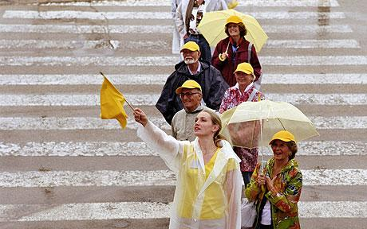
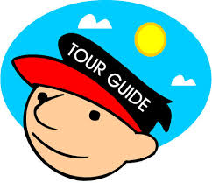
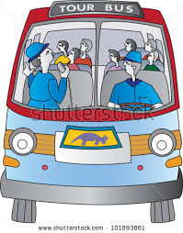
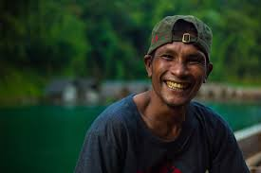
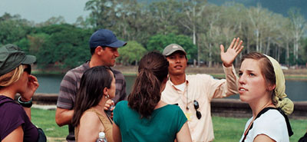
ITM 2309 The Principle of Tourist Guide

Slide 2
ITM2309 The Principles of Tourist Guide
Types of tourist guide
Tour guiding; principles and techniques
Protocols; duties and responsibilities
Personality and characteristics
Tourism related laws
Field trips

Slide 3
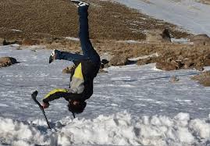
Objective of the Course
- Understand the role & duty of tour guide
correctly and distinctly
- Practice in the right way
- Functional

Slide 4
Ethics
Morals
The rules of conduct recognized in respect to a particular class of human actions or a particular group or culture
Principles or habits with respect to right or wrong conduct. While morals also prescribe dos and don'ts, morality is ultimately a personal compass of right and wrong.
Social system - External
Individual - Internal

Slide 5
To be a tour guide is “Everybody”
To be a quality tour guide is “Some”

Slide 6
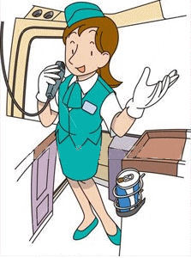
What is a Tour Guide?
Tour guides work in the travel industry, giving guided tours to groups of visitors.
They are experts on the history of the location and offer their tour groups interesting or enlightening information about points of interest at nature attractions, historic sites, museums, scenic locations, and other travel destinations.

Slide 7
Guides may give walking tours, bus tours, or even lead river tours on a boat. Often hired by visitors' bureaus or travel companies, tour guides are typically residents of the region in which they give tours.

Slide 8
What does a Tour Guide do?
A tour guide's duties depend on their location and employer.
If they are self-employed, they will usually give tours of publicly accessible travel destinations like national parks or nature attractions.
Those who are employed by a visitor's bureau or corporation offer tours of cities, industrial locations, or other points of interest..

Slide 9
Assignment
1. Introduce yourself (Oral Presentation & Paper)
2. Why did you choose to study at SSRUIC?
3. What do you want to be in the future?

