Slide 1
General Information of Tourist guide

Slide 2
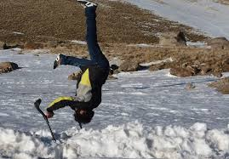
Objective of the Course
- Understand the role of tour guide correctly
- Practice in the right way
- Functional

Slide 3
To be a tour guide is “Everybody”
To be a quality tour guide is “Some”

Slide 4
What is a Tour Guide?
Tour guides work in the travel industry, giving guided tours to groups of visitors.
They are experts on the history of the location and offer their tour groups interesting or enlightening information about points of interest at nature attractions, historic sites, museums, scenic locations, and other travel destinations.

Slide 5
Guides may give walking tours, bus tours, or even lead river tours on a boat. Often hired by visitors' bureaus or travel companies, tour guides are typically residents of the region in which they give tours.

Slide 6
A tour guide (U.S.)
A tourist guide
(European)

Slide 7
The CEN (European Committee for Standardization) definition for "tourist guide“
Tourist guide = person who guides visitors in the language of their choice and interprets the cultural and natural heritage of an area, which person normally possesses an area-specific qualification usually issued and/or recognized by the appropriate authority

Slide 8
CEN also produced a definition for "tour manager":
Tour manager = person who manages and supervises the itinerary on behalf of the tour operator, ensuring the programme is carried out as described in the tour operator's literature and sold to the traveller/consumer and who gives local practical information
Note: Tour managers may or may not be tourist guides as well. They are not trained or licensed to work in specific areas unless they have the proper requirements or legal right, depending on the region.

Slide 9
What does a Tour Guide do?
A tour guide's duties depend on their location and employer.
If they are self-employed, they will usually give tours of publicly accessible travel destinations like national parks or nature attractions.
Those who are employed by a visitor's bureau or corporation offer tours of cities, industrial locations, or other points of interest..

Slide 10
Tour Guide/Tour Leader
Is there any difference?
These job titles are often used interchangeably, though there are some subtle differences between the two. The skills of a tour guide and leader, though are usually required by most companies.
Generally speaking, tour guides are expected to know a city (or country) intimately and offer guests interpretive information such as history and anecdotes on all sites.

Slide 11
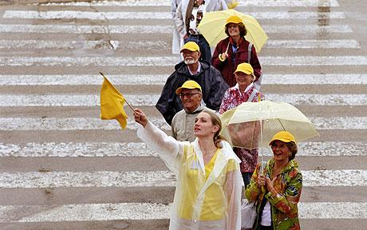
Tour Guide/Tour Leader (Cont’)
While tour leaders also need knowledge of the places they are visiting, they are also responsible for the logistics and planning of a trip, ensuring everything runs smoothly. It is not uncommon for guides and leaders from the same company to work closely together. For simplicity, the term “guides” is used in the rest of this article to refer to both positions.

Slide 12
Tourism is a major economic factor in the Kingdom of Thailand, directly contributing an estimated 7.3% to Thailand's GDP in 2012.
When including the indirect effects of tourism, it accounted for 16.7% of Thailand's GDP. On June 1, 2013,

Slide 13
Gross domestic product (GDP) is defined by the Organisation for Economic Co-operation and Development (OECD) as "an aggregate measure of production equal to the sum of the gross values added of all resident institutional units engaged in production (plus any taxes, and minus any subsidies, on products not included in the value of their outputs)

Slide 14
The three main areas of specialization
within the guiding industry are
1. Historical tour guiding
2. Corporate tour guiding
3. Nature or eco-tour guiding

Slide 15
Historical tour guides
lead groups of visitors to national monuments, historical sites, historical districts, religious or archaeological sites, and museums.
These guides are well-versed in the history of the site or monument.
They offer visitors an interesting description of the location, including its history and what effect it has had on modern society.
In addition, they answer visitor questions and keep the tour organized, efficient, and safe.

Slide 16
Corporate tour guides
are employed by large companies that are usually a well-known corporation or travel destination, though non-profit organizations often require guides as well.
They lead groups through factories, describing the manufacturing process or history and mission of the business.
Theme parks
zoos, wildlife refuges,
safari parks,
animal reserves,

Slide 17
Nature tour guides
lead groups to natural attractions, national parks, and other outdoor locations where wildlife and scenic locations are the focus of the tour.
These guides are experts in the natural sciences and have the ability to engage visitors with their knowledge of biology, geology, and the history of the location.
An increasingly popular area of the industry is eco-touring. The goal of the eco-tour guide is to lead a small group of individuals to an often protected but scenic natural area while having little or no impact on the environment.
Visitors are offered insight on the environmental impact of human actions as guides attempt to foster a general appreciation of the natural habitat.

Slide 18
Regardless of the specialization of the tour guide, some fundamental responsibilities apply to all positions.
Their primary responsibility is to make sure the tour is as safe as possible for the entire group.
They will monitor the group's activities to ensure everyone complies with the site's or guide's safety regulations.
In some cases, they may have to provide first-aid or emergency services to visitors. Tour guides typically plan itineraries as well.

Slide 19
They will research thoroughly prior to giving the tour and be prepared and organized for each step of the process, from greeting visitors upon arrival to arranging transportation between locations.
Guides are also required to perform clerical duties, collect fees, and in many cases, promote gift shops and sell souvenirs.

Slide 20
Positive
Negative
Freedom
Good Income
Fun / Challenge
Uncertain Job/ Income
Time management
Credit

Slide 21
How to become a Tour Guide
Self Preparation
License
Apply for a job

Slide 22
Self Preparation
- Love Service job
- Language
- Knowledge
- Personality -

Slide 23
Introduction is one of the very most important….
10% Self introduction
30% General
50% Program
10% Conclusion/ Q&A

Slide 24
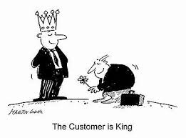
Customer is king !!!
The only way for the company to evaluate the guide is from the “Guests”

Slide 25
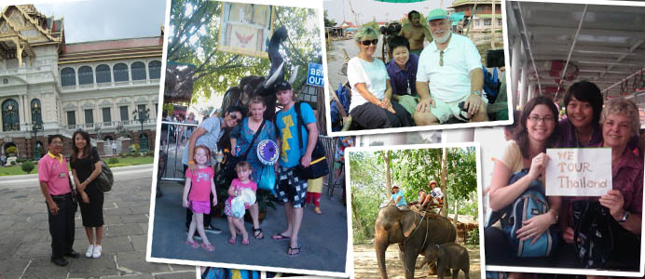
Learn and Give whatever they want under you limit
Don’t promise!!!!

Slide 26
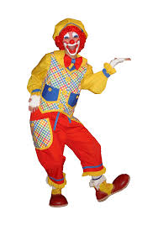
Don’t always smile !!!
And only make a lot of joke.
- Only joker & crazy can laugh all day
- Fake and Tried

Slide 27
Great Joke!!
Story
Timing
Polite

Slide 29
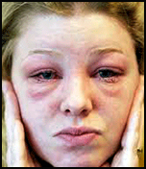
Try not to give your medicine to clients..
Sick…
Are you allergic to any medications?

Slide 30
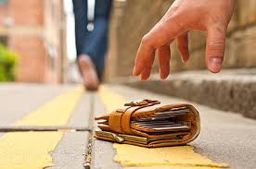
Forget things/ lost
If can’t come back
Follow program and try to send later
Contact Person / Police/ Embassy
Ask for name/ position/ contact number…

Slide 31
First time (No information)
- Try to distract
- Use your Script…..
- Accept
I will find out for you later!!!

