Slide 1
Tourist Guide License
International College, Suan Sunandha
Rajabhat University (SSRUIC)

Slide 2
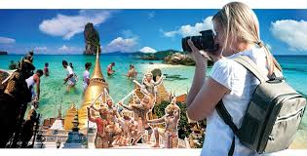
Taking full advantage of the return to peace and order in the kingdom, the Tourism Authority of Thailand (TAT) has laid out a marketing plan targeting an estimated 1.4 trillion Baht in revenue from foreign tourists and 800 billion Baht from domestic tourists.
The core concepts will be to restore visitors’ confidence in Thailand by promoting Thainess, happiness, sustainability, as well as balanced and equitable growth.

Slide 3
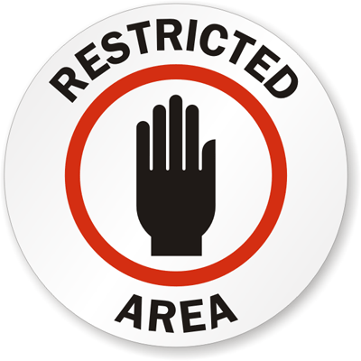
Being a tour guide in Thailand is a ‘Restricted Occupation'
That's only legally open to
“Thai Nationals”

Slide 4
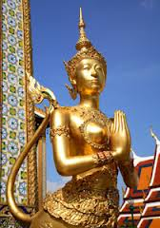
Tourist Guide License at the Present time
has a total of more than 50,000 People
But real working in the industry
is only about 10,000 People
Source: database, business and tour guides and tour guides Central Business Registration Office as of January 26, 2558.

Slide 5
Visitor Statistics 2014
Ministry of Tourism and Sports, Thailand International Tourist Arrivals to Thailand from
January - December 2014
2014 Grand Total 24,779,768 100.00
2013 Grand Total 26,546,725 100.00
Result -6.66 %

Slide 6
The Travel agent and Tour guide business is regulated by the Tourist Business and Guide Act.
Before engaging in the tourist business, one has to apply for a TAT license (Tourism Authority of Thailand) with the Tourist Business and Guide Registration Office.

Slide 7
With the travel and tour guide business being a Restricted activity under the Foreign Business Act, a foreigner that wants to get involved in the tourist business will have to incorporate a juristic person to apply for the TAT license.

Slide 8
Tour guide License
&
Company License

Slide 9
TAT License TRAVEL/TOUR GUIDE BUSINESS REGISTRATION IN THAILAND
One of the most lucrative businesses in Thailand is the Travel/Tour Guide Business.
This is supported by the increasing number of visiting foreigners in Thailand. Based on the statistics, an estimated of 30 million tourists arrived in Thailand in 2015 despite the H1N1 threats, economic meltdown, political situation in the country and etc.
It is expected that inbound tourist expenditure per head will increase by around 10.49% in 2016 as compared to 2010.

Slide 10
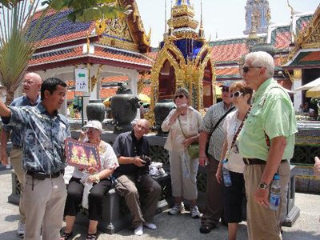
Qualifications of
Natural Person Applicant
- Being of Thai Nationality
- Being not less than 20 years old
- Having domicile or residence in the
Kingdom of Thailand
- Not being bankrupt
- Not being a lunatic or incompetent or quasi-
incompetent person
- Not being a person whose license is being
suspended
- Not being a person whose license has been
revoked five years prior to the current
application

Slide 11
Thai Tourist Guide License
1. General Tourist Guide License (2)
2. Specific Tourist Guide License (8)

Slide 12
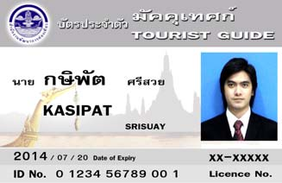
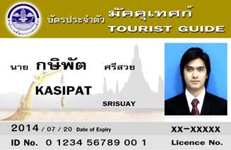
Tourist Guide License
General Guide
Foreigner Language/ English Language
Silver line
Around Thailand
Both Thai/Foreigner Tourist
Thai Language
Gold line
Around Thailand
Thai Tourist Only

Slide 13
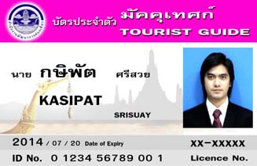
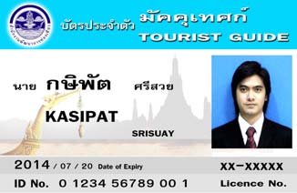
Tourist Guide License
Specific Licenses ( 8 types )
Foreign language / specific area
Pink line
Foreign language
Both Thai/foreigner
Some area that shown on the card
Thai Language/Specific are
Blue line
Thai language
Thai Tourist Only
Some area that shown on the card

Slide 14
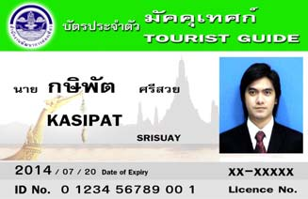
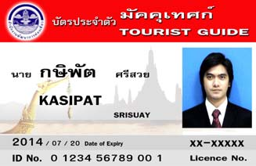
Tourist Guide License
Specific Licenses ( 8 types )
Specific area ( Forest area)
Green line
Both Thai/foreigner
Forest Only/ Trekking
Specific are a(Culture)
Red line
Both Thai/Foreigner
History/Art and Culture
Around Thailand

Slide 15
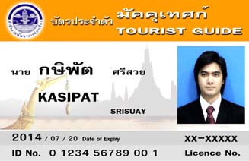
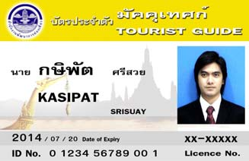
Tourist Guide License
Specific Licenses ( 8 types )
Specific area ( Sea)
Orange line
Both Thai/foreigner
Sea Only
Specific are a(Sea beach)
Yellow line
Both Thai/Foreigner
Sea beach/ Island that not over 40 miles

Slide 16
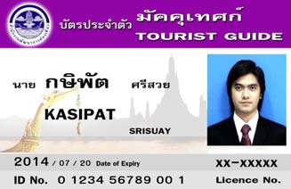
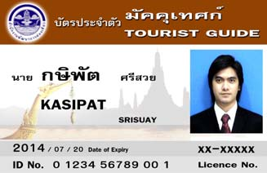
Tourist Guide License
Specific Licenses ( 8 types )
Specific area ( Natural)
Purple line
Both Thai/foreigner
Natural place that shown on the card
Specific are a(Local Cultural)
Brown line
Both Thai/Foreigner
Local Art/Cultural /Geography/custom that show on the card

Slide 17
Document for apply the New Tourist Guide License
Application Form ( Sor Nor Thor 9)
Copy of ID card with signature
Copy of Household registration with signature
Doctor Certificate ( not over 1 month with hospital stamp)
Copy of Bachelor Degree Certificate, Transcript, Tourism certificate with signature
Above Original Document to present with the Officer.
Fee
New License 200 THB

Slide 18
Document for renew
The Tourist Guide License ( Expired)
- Application Form ( Sor Nor Thor 9)
- Copy of ID card with signature
- Doctor Certificate ( not over 1 month with hospital stamp)
- Original and copy of old Tourist Guide License with signature
(If lost, present the notice.)
- Tourist Guide Certificate (If lost, present the notice.)
- Name Changing; present the copy of name changing with signature
above original document to present with the Officer.
Please renew by 120 days before the license expired
If the license is already expired please present the document to apply the new one
Fee : Renew License 200 THB

Slide 19
Decree Change channels,
The Office of Tourism Development for being to The Department of Tourism BE: 2553 (2010)
King Bhumibol Adulyadej Given on 20 August 2553. A 65 year reign in the current
Change name from The Office of Tourism Development to the Department of Tourism
Countersigned. Apisit Vejchacheewa Prime Minister.

Slide 20
Ministerial Regulation Fee for Tourism Business and Guide Fee BC: 2555 (2012)
Tourism Business has to renew the license every 2 year
Fee :
License for Tourism Business 2000 THB
License for Guide 200 THB
Suspension of Tourism Business License 1000 THB
Suspension of Guide License 200 THB
Fee for 2 Years Tourism Business 1000 THB
Fee for renew the Guide License 200 THB
Dated: April 26, 2555
By CHUMPOL SILAPA-ARCHA
Minister of Tourism and Sports

Slide 21
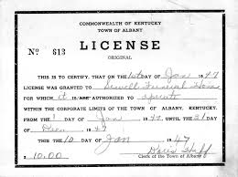
Company License

Slide 22
Thailand Tourism License
To operate a tourism business, a Tourism License must be obtained. The governing law in this regard is the Tourism Business and Guide Act B.E.2535 (1992).
According to the Act, there are numerous requirements which must be satisfied and documents which must be submitted before a License will be issued. It should be noted that the documents preparation and application process may take up to three months.
The government organization in charge of this matter is the Tourism Business and Guide Register Office (TBGR).
Referrence: http://www.samuiforsale.com/company-law/thailand-tat-tourism-license-tourism-business-and-guide-act.html

Slide 23
Definition of “Tourism Business”
‘Tourism Business’ refers to a business operation providing services for tourists such as sightseeing tours and tourist guide services. It does not include vehicle leasing, transportation of passengers, hotel or restaurant reservations or arranging field trips.
A tourism business operator must have direct contact with the tourists in order to provide tourism services. Therefore the tourists buy services direct from the operator as opposed from a business acting as an agent for the actual service provider.

Slide 24
Qualification of Licensee
To limit liability and act professionally, it is advisable to set up a juristic entity, such as a limited company, to operate a tourism business. The following are requirements for a limited company to qualify as a tourism licensee:
1. The business must be registered under Thai Law
2. The business must have an office in Thailand
3. At least half of the directors must be Thai nationals
4. No less than 51% of the company shares must be
held by Thai natural persons

Slide 25
5. The Managing Director must be at least 20 years old, domiciled or residing in Thailand, credit-worthy, not incapacitated, never have been imprisoned unless for a negligence offence or a minor offence
6. The business must not have had a Tourism License suspended
7. The business must not have had a Tourism License revoked, except for the revocation of a Tourism License exceeding 3 years

Slide 26
Required Documents
- TAT license application form, signed by a Thai director
and stamped with the seal of the company
- Certificate of Registration and objectives of the company
under the Civil and Commercial Code (not older than
one month). Do note, only a Thai director has the power
to sign and stamp the seal of the company.
- List of shareholders’ names, certified by The Minister of
Commerce
- Memorandum of association which must be certified by
The Minister of Commerce

Slide 27
- Company’s regulation or report of company establishment’s
meeting (If the company has no the company’s regulation)
which must be certified by The Minister of Commerce
- Copy of the director’s personal ID card and his registered
address which must be certified by the director
- Seal of the company
- Two photos of the front of the office (showing the address
and nameplate)
- A map of the office
- Ownership or possession evidence of the office
- Power of Attorney
- Guarantee, cash or cashier’s check which is used as security

Slide 28
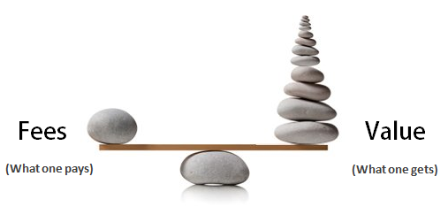
Fees
Outbound: security of 200,000 THB and a government fee of 500 THB
Inbound: security of 100,000 THB and a government fee of 500 THB
Domestic: security of 50,000 THB and a government fee of 300 THB

Slide 29
Insurance Requirement
The TBGR regulations require a Tourism Business to hold ‘Tourist & Guide’ insurance. The insurance company will need to know approximately how many clients will use the business services per day. The Insurance cover will then be based on that number of persons. For example, if you think you will have 500 clients a day, your policy will cover a maximum of 500 clients.
The annual insurance premium is approximately 15 Baht per person. Therefore, if your policy insures 500 people, your premium will be 7,500 Thai baht per annum. Further, the insurance only covers each client for periods of 15 days or less.

Slide 30
In the event of injury an insured tourist will receive 100,000 Baht for medical bills and in the event of death, the estate of the deceased will receive 200,000 Baht.
The insurance company will issue an insurance policy which the Tourism Business must submit to the TBGR, together with other documents.

Slide 31
Credibility Records
Tourism is a vulnerable business considering the effect on a country’s national reputation. Therefore, it is crucial that a tourism business operator is credible. The TBGR has a criteria to screen applicants in this regard.
In order to obtain a reference on credibility, an applicant has two options. One is to submit a document issued by the TBGR to a police station where the applicant (a managing director in case of a limited company) is domiciled. The police will hopefully certify that the applicant has no criminal record. Then, the applicant returns the certified document back to TBGR.

Slide 32
The other option is to find two licensed tourism business operators who will certify the applicant’s credibility. The two operators will have to complete a part of the tourism application form and furnish a copy of their Tourism License. Thereafter, they will have to submit these to the TBGR.

Slide 33
Documentation
In the case of a limited company, on the submission date, the applicant must furnish a copy of all company documents including the tax identification card, director’s identification card (passport) and/or work permit to the TBGR official. The said copies shall be accompanied by the original version.
Additionally, an applicant should prepare the following documents:
1. Two photos, size 7.6 x 12.7 cm, of the front and inside of the office 2. A map of the office 3. Ownership or possession evidence of the office such as a sale agreement, lease agreement, a letter of consent to use the place issued by the owner or the lessor 4. Power of Attorney (if any)
All of the above documents must be certified true copies and must be marked with the director’s signature and the company seal (if required).

Slide 34
Submission, Time Frame and Penalty
Applications for a Tourism License must be submitted to the TBGR branch which has jurisdiction over the area where the Business Tourism office is located. For instance, a registered company in Phuket must submit an application to the Phuket branch of the TBGR.
The TBGR official should issue a temporary receipt for reference. This receipt explicitly specifies that it cannot be used in lieu of an actual Tourism License. This, in turn, means that during the consideration period, which is approximately 60 days, the operator has no right to operate the tourism business. Anyone who violates this rule may be fined between 100,000-500,000 Baht.
As for the business trade name, it must not be identical to any other licensed tourism operator.

Slide 35
Official Fees and Security Deposit
Once the application has been approved, the TBGR will send a letter to the applicant to advise that the Tourism License is ready for collection. On the collection date, the applicant will have to pay official fees and a security deposit as stated below:-.
Area of Tourism Operation Official Fees
Official Fees (baht) Security Deposit Specific 100 10,000
Domestic 300 50,000
International (Inbound) 500 100,000
International (Outbound) 500 200,000
The security deposit can be in the form of cash, bank security letter and government or state enterprise bond.

Slide 36
Validity and Extension
The Tourism License is valid for 2 years from the date of issue. The operator must renew the license within 120 days prior to the expiry date. In the event the operator wishes to dissolve the Tourism Business, the license must be returned within 30 days of the expiry date. Any breach of this regulation is subject to a fine equivalent to 1,000 Baht.

Slide 37
Advertisement Document
If the operator wishes to display advertisement materials, such as brochures or posters, such documents must contain the following details:
1. Name of operator, office place and Tourism License number 2. Period of tourism service 3. Service charge 4. Type of vehicles used for traveling 5. Destination, accommodation area including tourist attraction place in the tour program 6. Type of accommodation and number of meal provided
Prior to distribution, at least three specimens of such material must be submitted to the TBGR. Furthermore, any amendment of the documents must be reported to the TBGR without delay.

Slide 38
Summary
The Tourism License is the key to a tourism business operation. The license must be displayed at the office where it has been registered at all times. It is advisable that the operator contacts an attorney who is familiar with tourism business for further details.
Source: http://www2.tat.or.th

