Slide 1
Uniform
Unit 6
IAC1204 Personality Development and Grooming

Slide 2
How do you feel when you are in a hurry?
www.shutterstock.com

Slide 3
Soldier
Policeman
Government officer
Doctor and nurse
University student
High school students
Airline staff

Slide 4
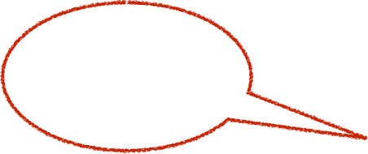
What are
the functions
of uniform?
What is
about the
airline’s uniform?
What is
the uniform?

Slide 5
What is the uniform?
1. Symbolic communication
2. Hierarchical empowerment
Bunyawanich, S., Jarvela, M. & Ghaffar, A. (2018). The Influence of the Uniform in Establishing Unity, Hierarchy, and Conformity
at Thai Universities. Retrieved from www.researchgate.net

Slide 6
1. Symbolic communication
symbol (n.) a sign, a shape, an object that is used to represent something
“Uniform is a costume identifying similar appearance,
distinctiveness, or uniformity of a group. ”
“Uniform is a symbol of membership of a group.”
(Joseph and Alex, 1977)

Slide 7
1. Symbolic communication
Uniform is a symbol of work or career.

Slide 8
2. Hierarchical empowerment
hierarchical (adj.) level of importance
“Uniform functions as a social class marker and
operates as a symbol of cultural representation,
social class, uniformity, and unity.”
“Uniform contents a sense of superiority and inferiority.”
Bunyawanich, S., Jarvela, M. & Ghaffar, A. (2018). The Influence of the Uniform in Establishing Unity, Hierarchy, and Conformity
at Thai Universities. Retrieved from www.researchgate.net

Slide 9
2. Hierarchical empowerment
Stripe = ขีด
Uniform is
a positioning mark.

