Slide 1
What are the functions of uniform?
1. Industry demand
2. Uniform as perks
3. A sense of belonging
4. A feeling of equality
5. Mutual Growth

Slide 2
Function of the Uniform
1. Industry demand
Customers recognize
the company’s staff.
Customers recognize
the role and responsibility
of each staff in
different uniform.
Customers recognizes the
company image by looking
at the uniform.

Slide 3
Function of the Uniform
2. Uniform as perks
Save money to by new
clothes to wear to work.
Save time to choose what
to wear to work.
Save energy to look after
and prepare your clothes.

Slide 4
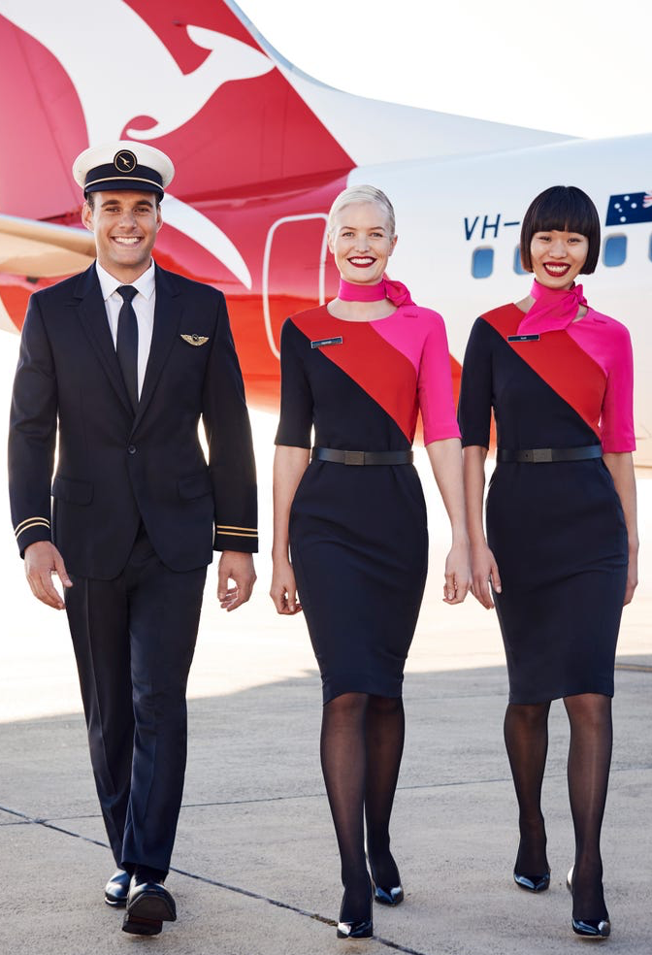
Function of the Uniform
3. A sense of belonging
Uniform indicates membership
of the group.
Uniform creates unity and
teamwork.

Slide 5
Function of the Uniform
4. A feeling of equality
Uniform brings everyone to
the same platform.

Slide 6
Function of the Uniform
5. Mutual Growth
Uniform reduces individual identity and brings staff
to focus on the team.

