Slide 1
Airline Uniform changed
across the decades.
1. Pioneer Era (1920s-1930s)
2. World War II (1940s-1950s)
3. Golden Age (1960s-1980s)
4. Modern Time (1990s- Present)

Slide 2
Pioneer Era (1920s - 1930s)
Waiter uniform

Slide 3
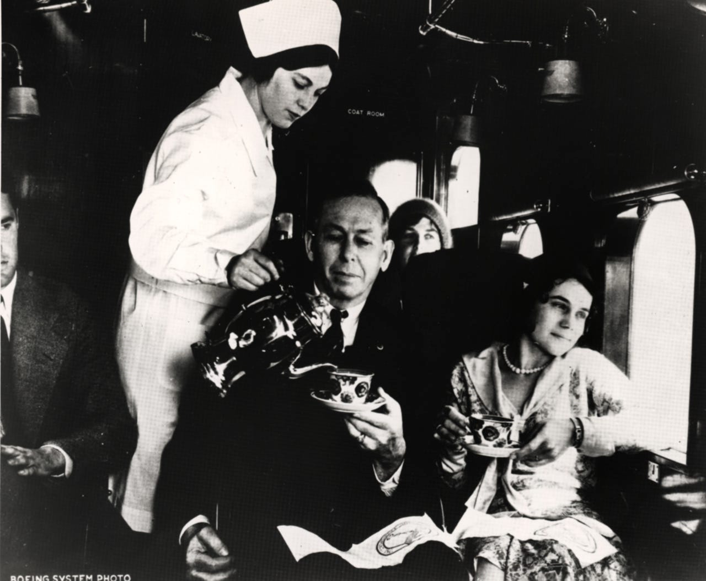
Pioneer Era (1920s - 1930s)
Nurse-like uniform

Slide 4
World War II (1940s - 1950s)
Military-like uniform

Slide 5
Golden Age (1960s - 1980s)
Glamorous and fashionable uniform

Slide 6
Golden Age (1960s - 1980s)
Thai traditional costume
Sarong kebaya
Traditional costume

Slide 7
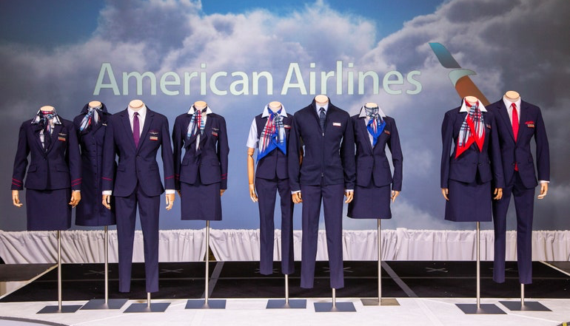
Modern Time (1990s - Present)
Business Formal

Slide 8
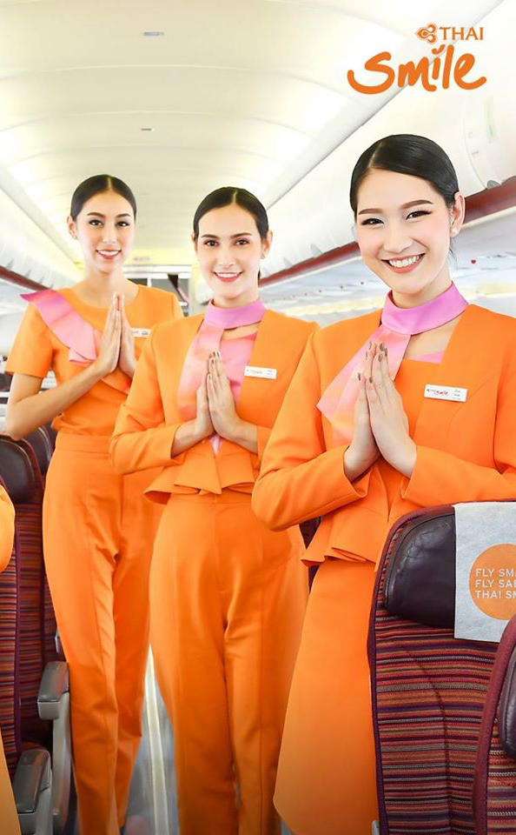
Modern Time (1990s - Present)
Business Casual

Slide 9
Modern Time (1990s - Present)
Casual

Slide 10
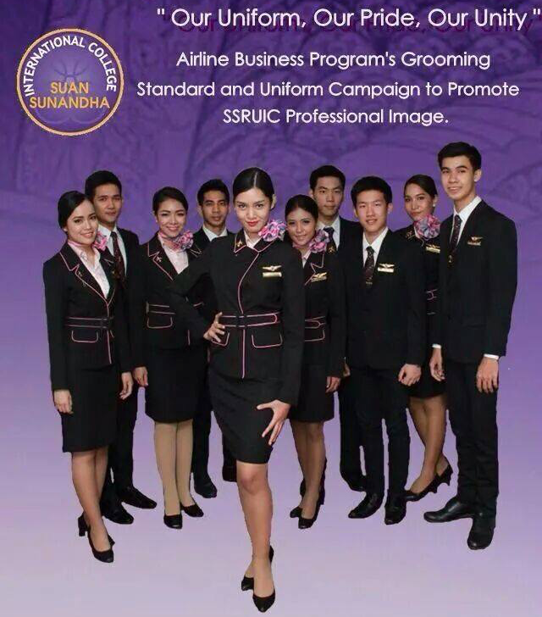

Slide 11
250-300 words essay
Instruction
1. Write an essay with 250-300 words on one A4 paper.
2. Write your opinion about the uniform, for example,
- do you like or dislike the uniform?
- why do you like it or dislike it?
- what uniform that you like?
- why you like that uniform?
or etc.
3. Write your name and student ID on the top of your essay.
4. Take a picture of your essay and add a picture to LINE
group album. Students can find your group album at
LINE: Personality Class.
5. Deadline for adding your essay to LINE album is April 3, 2020.

Slide 12
Group 1
Group 2
LINE group
Personality Class
Group 3
Group 4

