Slide 1
White Tie

Slide 2
White bowtie
Lapel corsage
Solid white shirt with
cuffed sleeves
Black tuxedo
Evening gown
Full-length solid
color glove
Tailcoat
White Tie

Slide 3
Black Tie

Slide 4
Black bowtie
Black tuxedo
Solid white shirt with
cuffed sleeves
Evening gown
Elegant arm jewelry
Black leather shoes
Black Tie

Slide 5
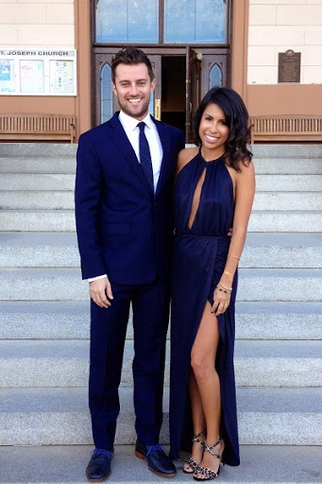
Semi-formal

Slide 6
Collared shirt with cuffed sleeves
Necktie
Cocktail dress
Dark suit
Elegant arm jewelry
Leather shoes
Semi-formal
High heel shoes

Slide 7
2. Vest
1. Jacket
3. Trousers
Three-piece suit

Slide 8
Dress
is a piece of clothing for women or girls that covers the top half of the body and hangs down over the legs.
www.pinterest.com

