Slide 1
Business Formal

Slide 2
Solid-color and
collared button down shirt
Solid-color blouse or
collared button down shirt
Solid-color or simple
pattern necktie
Solid-color suit
Solid-color suit
Simple jewelry
Stockings
Leather shoes
High heel shoes
Business Formal

Slide 3
Business Casual

Slide 4
Oxford or Polo shirt
Blazer or jacket
Fitted-blouse
Knee-length skirt
or dress
Pants
Leather shoes
Flat or high heel shoes
Business Casual

Slide 5
Casual

Slide 6
Collared shirt
Modest arm jewelry
Metal or leather watch
Sundress
Watch
Pants
Leather shoes
Casual
Flat or high heel shoes

Slide 7
Ultra Casual

Slide 8
T-shirt or shirt
T-shirt
Collared or hooded sweater
Collared or hooded sweater
Jeans or pants
Jeans or pants
Comfortable footwear
Comfortable footwear
Ultra Casual

Slide 9
Sportwear

Slide 10
T-shirt
T-shirt
Short pants
Legging
Comfortable footwear
Comfortable footwear
Sportwear

Slide 11
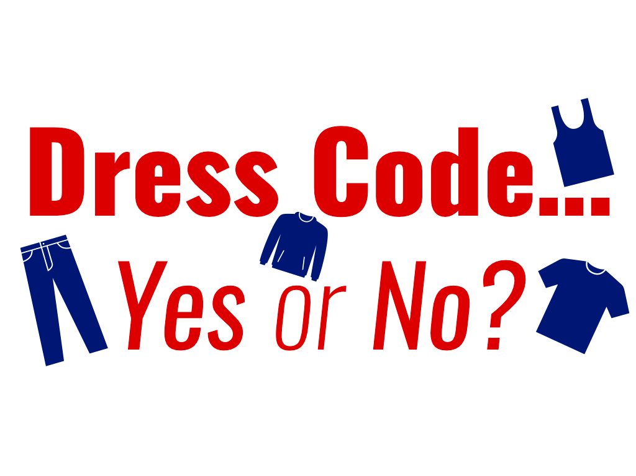
https://bhhsoracle.org/2018/03/25/dress-code-yes-or-no/

