Slide 1
Airline Business Uniform
Unit 7
IAC1204 Personality Development and Grooming

Slide 2
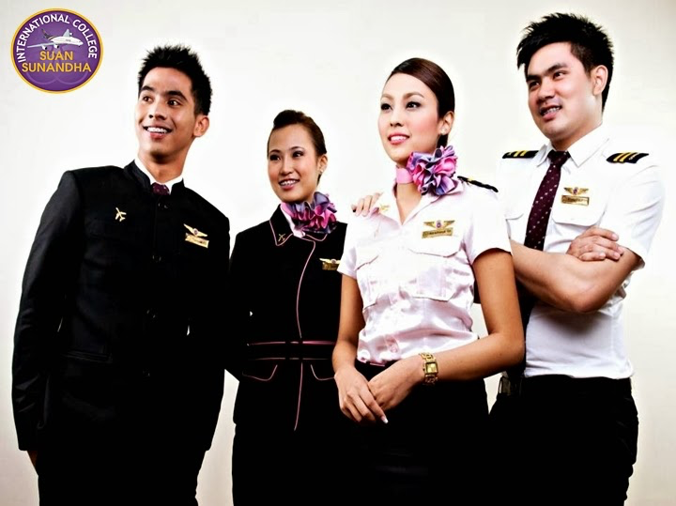
AB Uniform since 2009

Slide 3
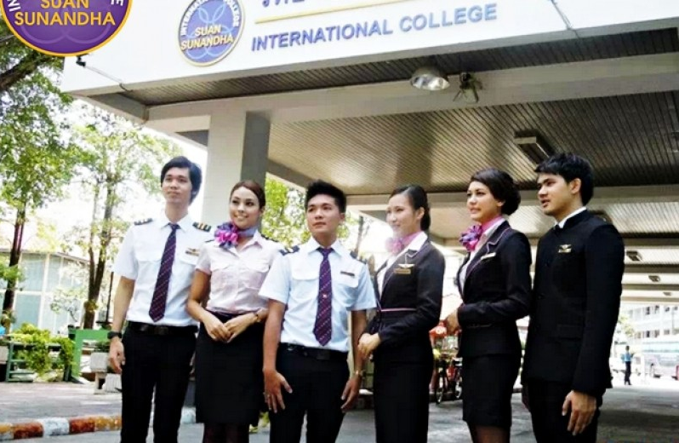

Slide 4
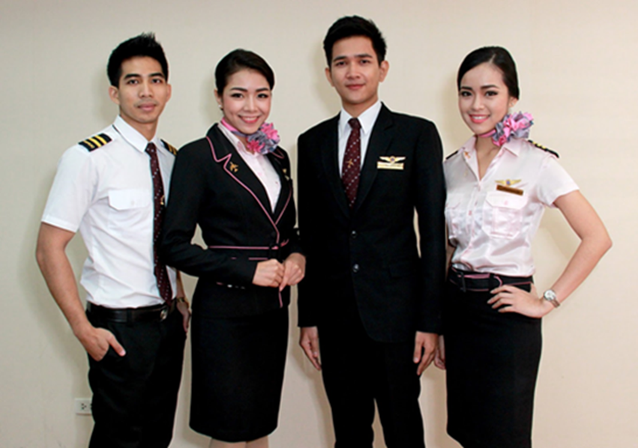
AB Uniform Minor Change in 2011

Slide 5
Airline Business Program has been selected to be one of
niche gurus
of Suan Sunandha Rajabhat University.

Slide 6
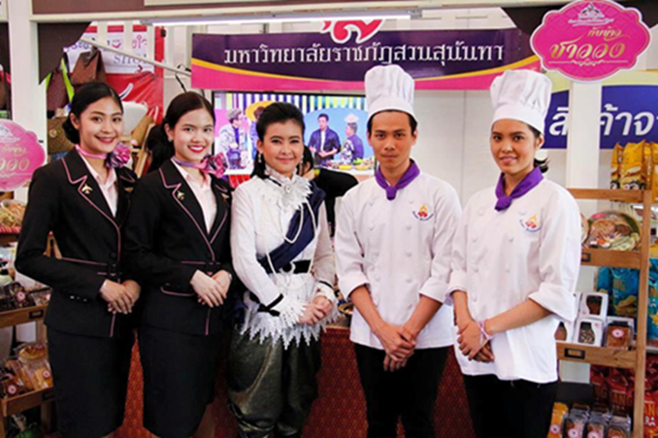

Slide 7
AB Uniform Standard
1. Hairstyle
2. Make up
3. Personally Hygiene
4. Uniform
5. Deportment

