Slide 1
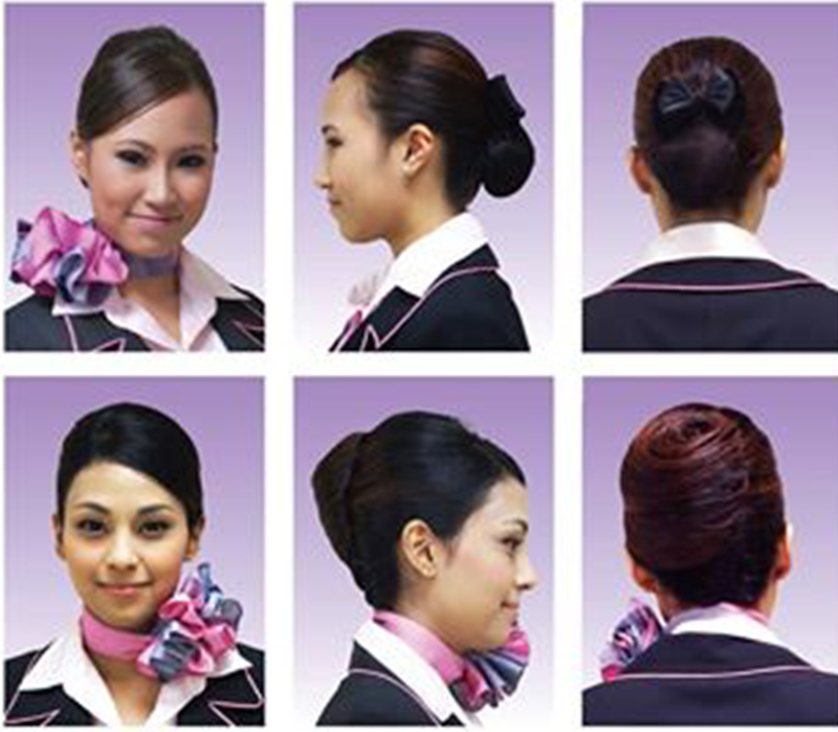
1. Hairstyle
Hair clip with ribbon

Slide 2
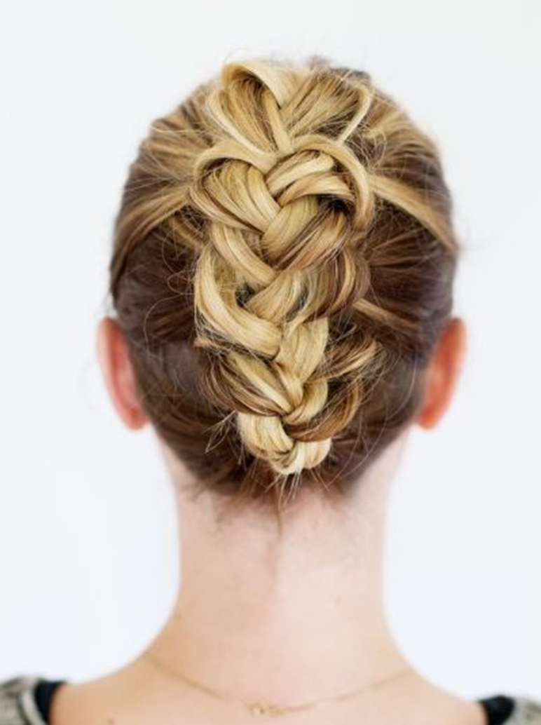
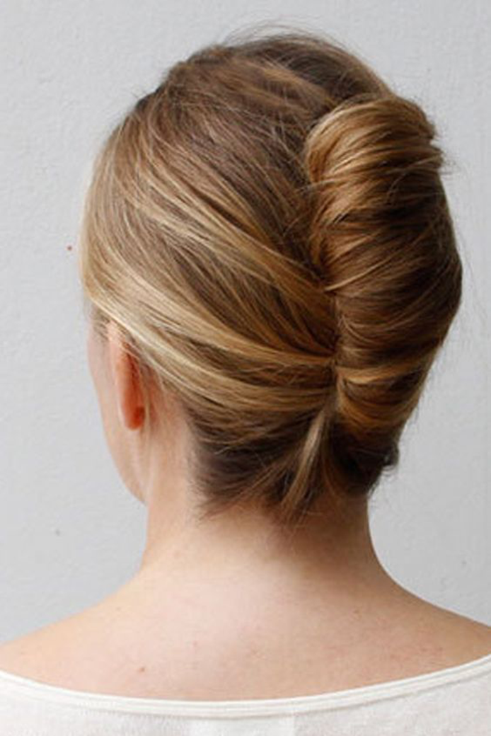
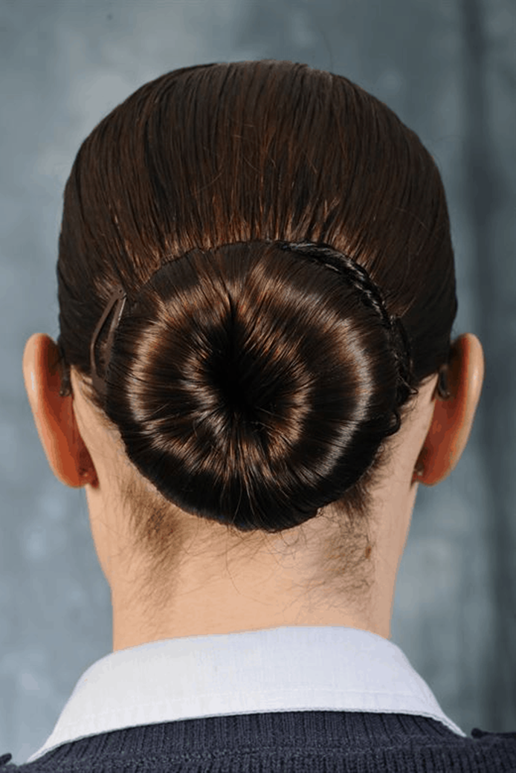
1. Hairstyle (Female)
French Braiding
French Twist
French Bun

Slide 3
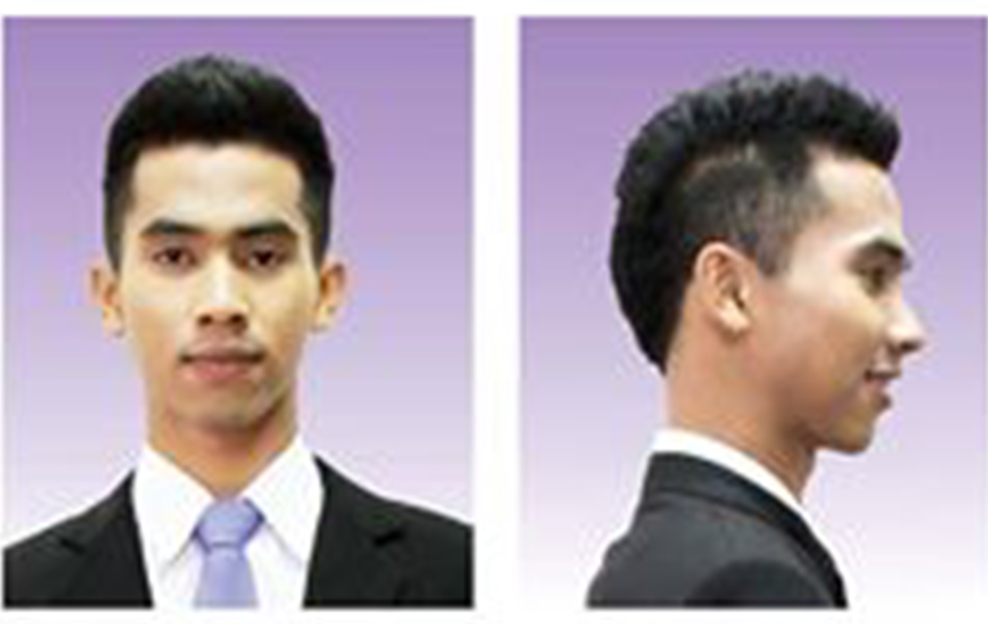
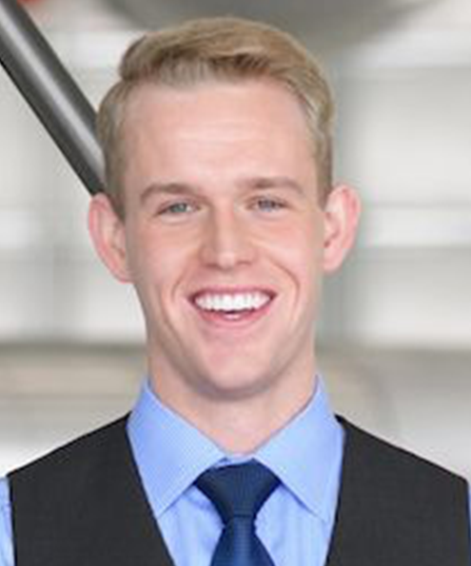
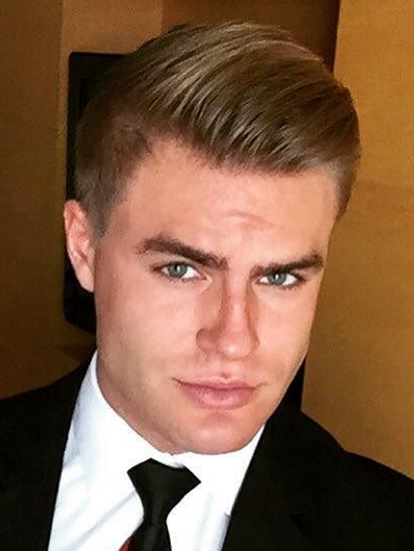
1. Hairstyle (Male)
www.pinterest.com
www.ifly.global.com

Slide 4
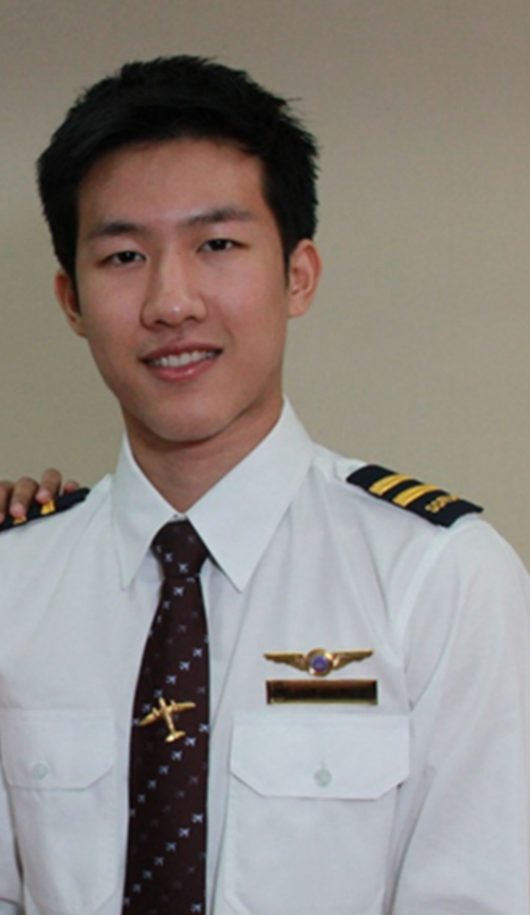
Moustache
Clean shave

Slide 5
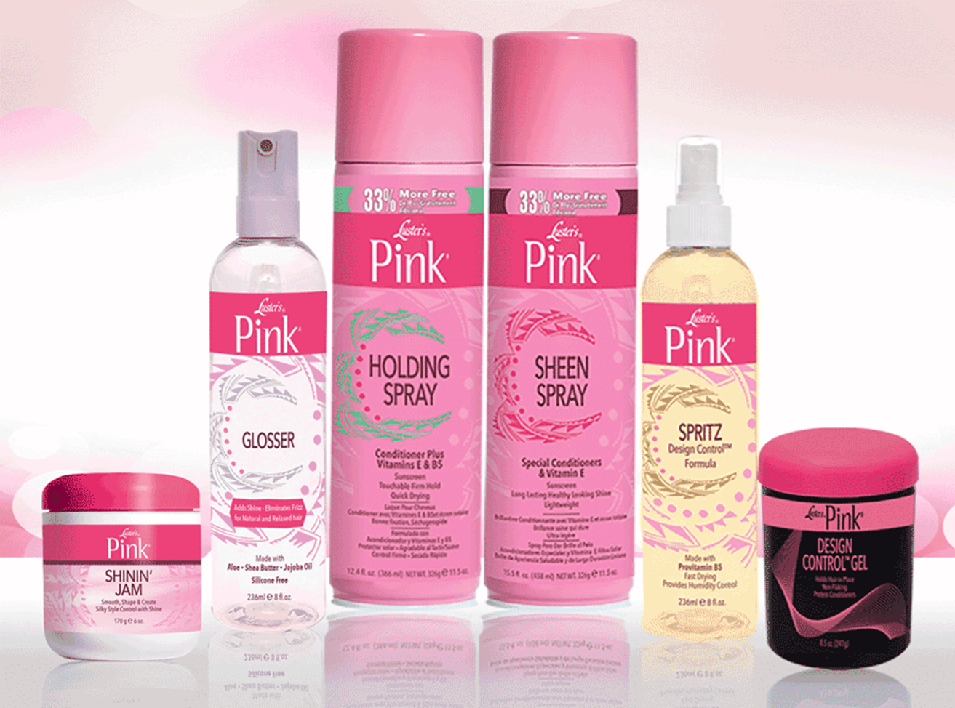
1. Hairstyle (Hair Styling Products)
Hair gel
Hair spray
Hair mousse
Hair wax
Pomade
Hair serums
Hair setting lotions

