Slide 1
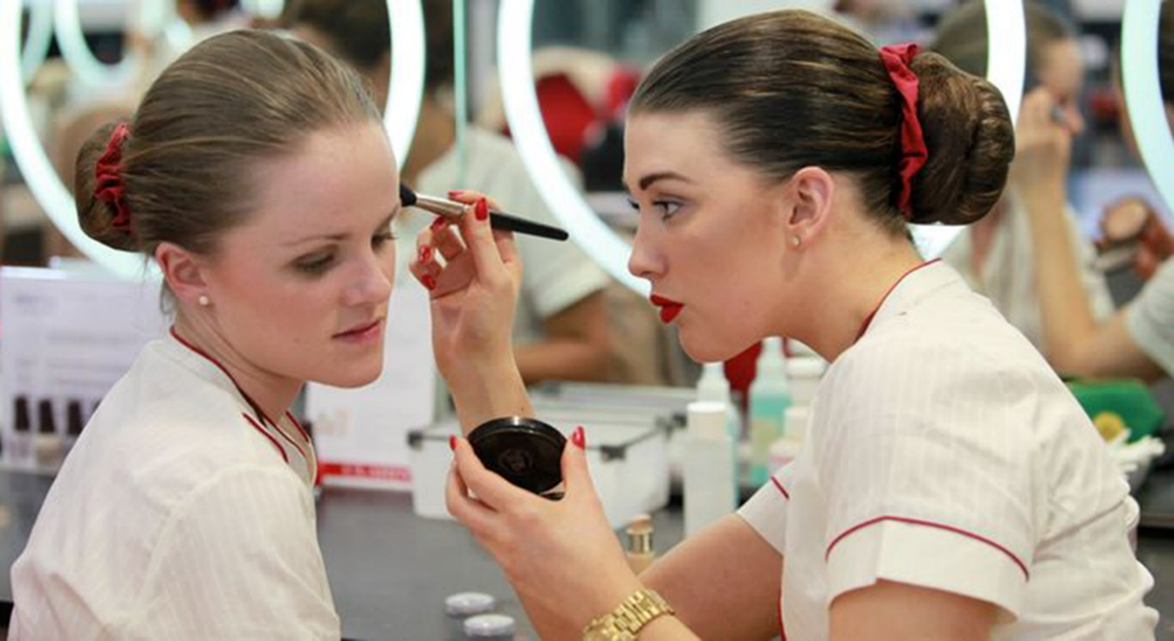
2. Make up (Female)
www.huffpost.com

Slide 2
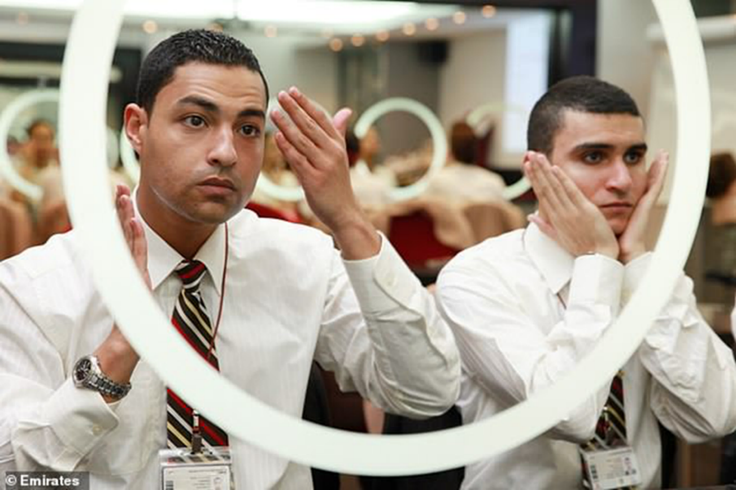
2. Make up (Male)
www.dailymail.co.uk

Slide 3
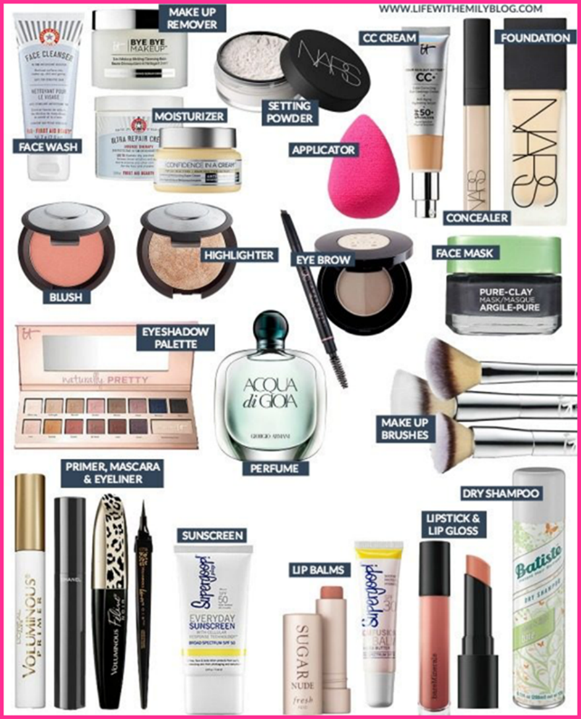
2. Make up Products
Make up for Ladies
Make up for Men

Slide 4
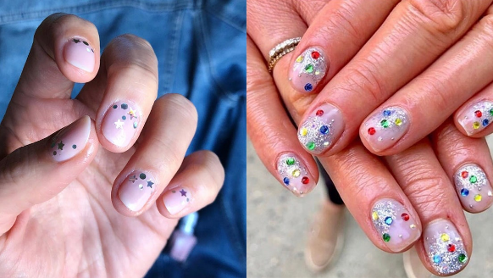
3. Personally Hygiene
Nails (Female)

Slide 5
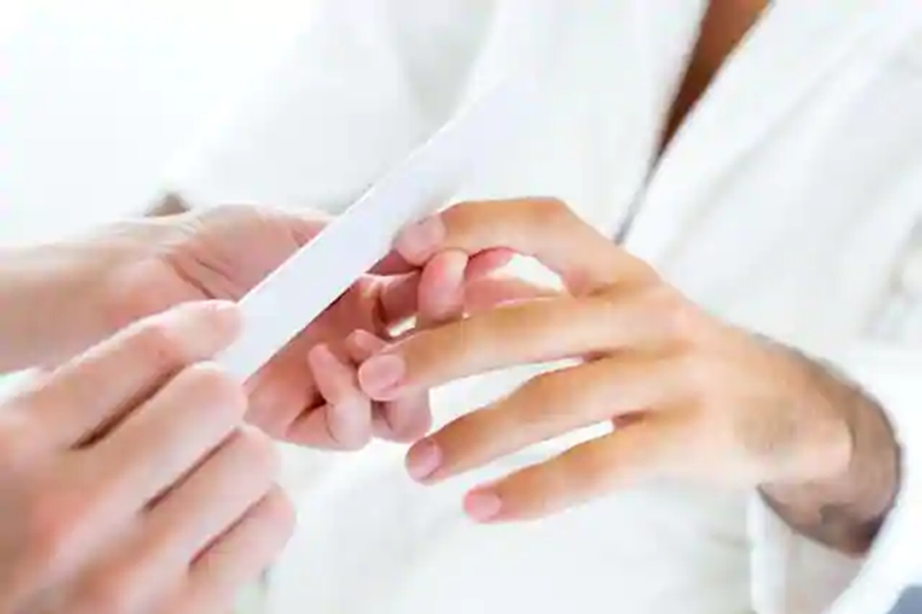
3. Personally Hygiene
Nails (Male)

Slide 6
3. Personally Hygiene
Body odour
www.freepic.com

Slide 7
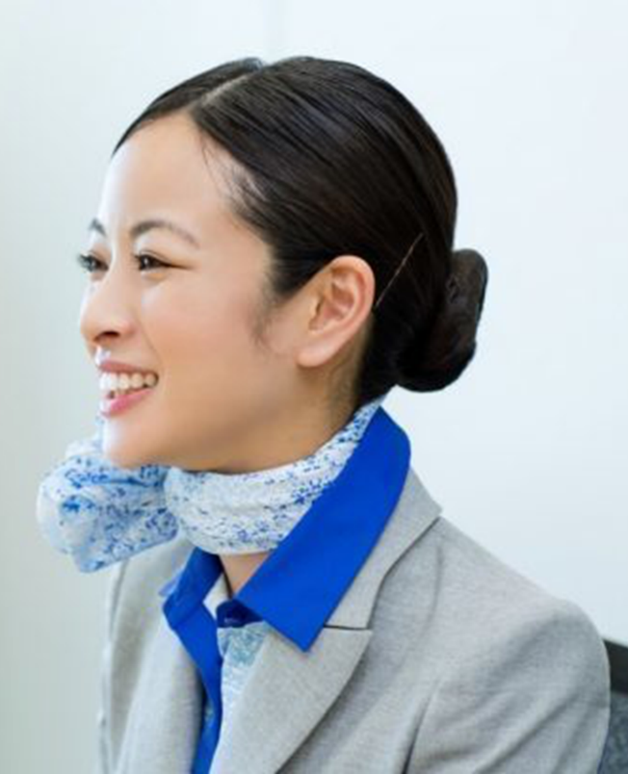
3. Personally Hygiene
Fresh breath

