Slide 1
4. Uniform (Female)
Blouse
Scarf
Jacket
Belt
Skirt
Stocking
Shoes

Slide 2
4. Uniform (Female)
Wing and Name badge
Blouse
Jacket
Belt
Skirt

Slide 3
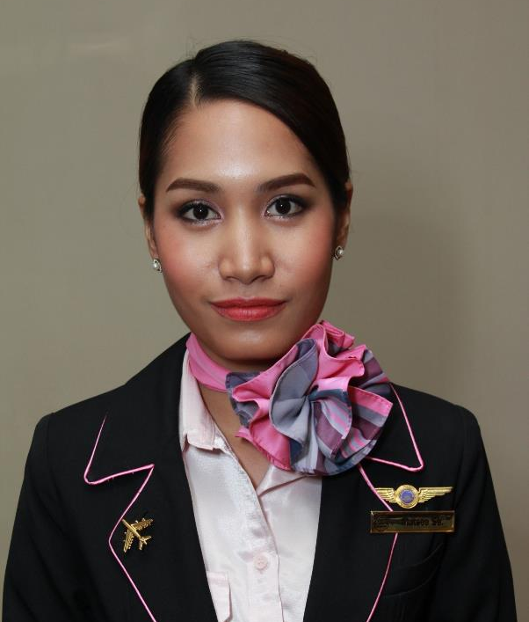
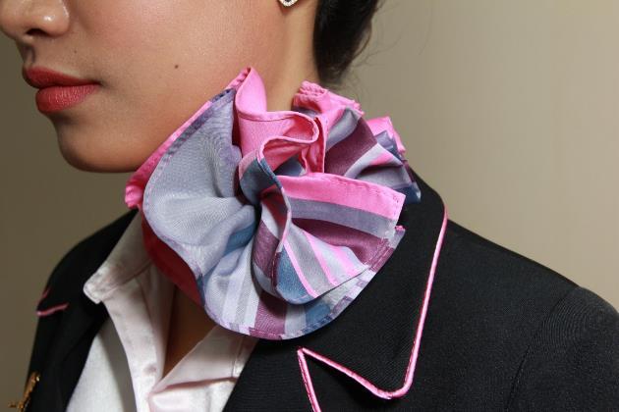
4. Uniform (Female)
Scarf and Rosette Warp Knot (Rose)
Youtube “How to tie a scarf”
https://www.youtube.com/watch?v=3BLtrn1Z9Z4&feature=youtu.be

Slide 4
4. Uniform (Female)
Shoes
Shoes (High heel)

Slide 5
4. Uniform (Female)
Stocking
Hand bag

Slide 6
4. Uniform (Female)
Accessory
Ring
Ear studs
Bracelet
Watch

Slide 7
4. Uniform (Male)
Shirt
Jacket
Belt
Trousers
Shoes

Slide 8
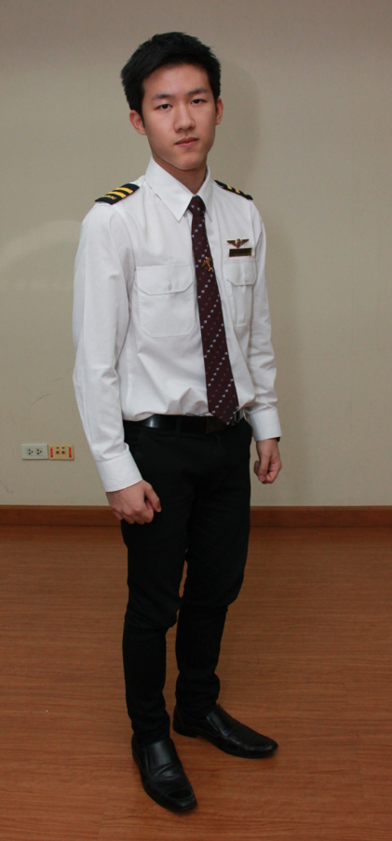
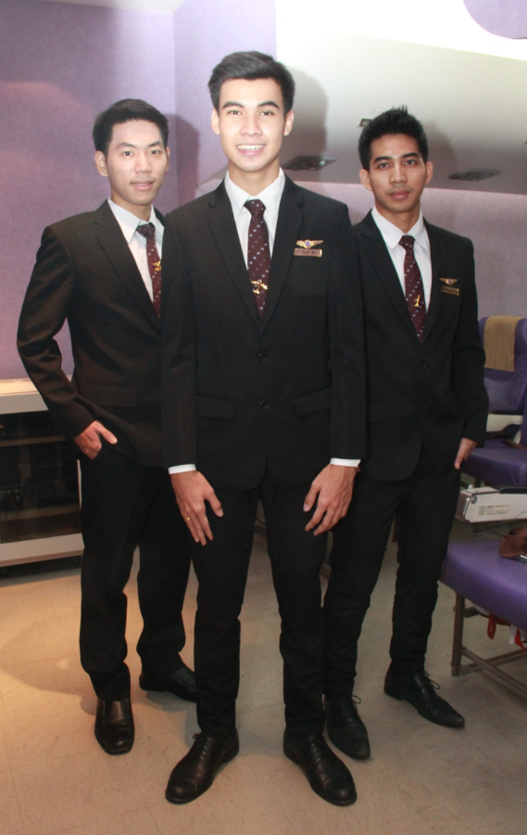
4. Uniform (Male)
Shirt
Jacket
Belt
Trousers

Slide 9
4. Uniform (Male)
Shoes
Socks

Slide 10
4. Uniform (Male)
Bag

Slide 11
4. Uniform (Male)
Accessory
Ring
Watch
Bracelet

Slide 12
Don’t
Tongue and Nose Stud
Dangling Earrings
Color Contact Lenses

