Slide 1
5. Deportment
www.qz.com
“Stand tall, walk tall, and sit tall.”

Slide 2
5. Deportment
Standing Posture
Head up and chin up
Pull
stomach in
Back up straight

Slide 3
5. Deportment
Standing Posture - Feet Position
10 am feet position

Slide 4
5. Deportment
Wai and Greeting
1. Put your palm together in front of your chest.
2. Say “Sawasdee Krub/Kha”.
3. Slightly bow your head.

Slide 5
5. Deportment
Walking

Slide 6
5. Deportment
Sitting
Knee
Ankles
Air China Flight Attendant

Slide 7
5. Deportment
Avoid negative body gestures

Slide 8
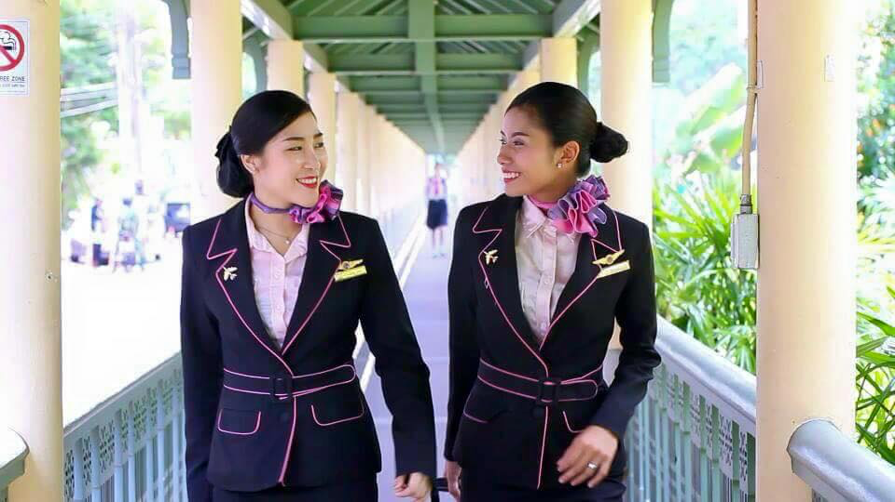
Wear your Uniform with Pride

Slide 9
Workshop Online (5 points)
Instruction 1
Watch these following short videoclips on Youtube. After that, practice making up and styling your hair according to what you have learnt from the clips.
Clips 1 - 3 are for girls and clip 4 - 5 are for boys.
Clip 1 - Flight Attendant “Running Late” Make up/Hair
Clip 2 - 3 Easy Flight Attendant Hairstyle
Clip 3 - My Everyday Make Up & Hair for Flying
Clip 4 - Get Ready with Me to Work! Flight Attendant/Cabin Crew Preparation by BryanGrey
Clip 5 - Top 3 Asian Hair Tutorials/ Men’s Hair Inspiration

Slide 10
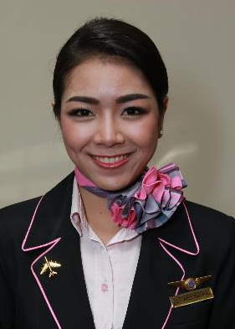
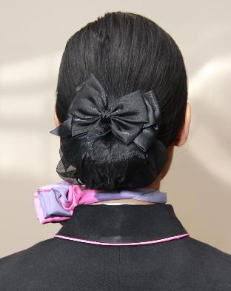
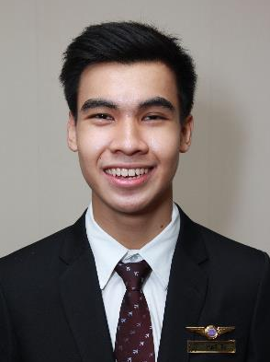
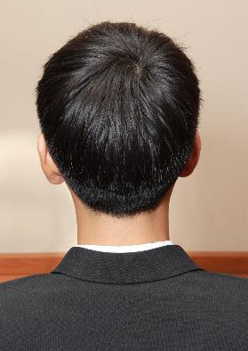
Workshop Online (5 points)
Instruction 2
Take pictures of yourself to show your skills on making up and hairstyling that are suitable for Airline Business Uniform Standard. Your pictures are required to be
a “close ups” or a “facial shot”.
Again, each students has to submit two photos, including;
“1 front side photo” and “1 back side photo”.

Slide 11
Workshop Online (5 points)
Instruction 3
Submit your two photos to the LINE group
“Personality Class”.
Place your two photos on the one page and
add them on your study group’s album.
Please put your name and student ID on your work
before submitting.
Deadline for this assignment is Friday, 10th April, 2013.
“Stay safe and enjoy online learning.”

