Slide 1
Appearance
and
Personality
Unit 2
IAC1204 Personality Development and Grooming

Slide 2
What is he look like?
What is he like?

Slide 3
What is she look like?
What is she like?

Slide 4
What is she look like?
What is she like?

Slide 5
What is he look like?
What is he like?

Slide 6
What is she look like?
What is she like?

Slide 7
What is he look like?
What is he like?

Slide 8
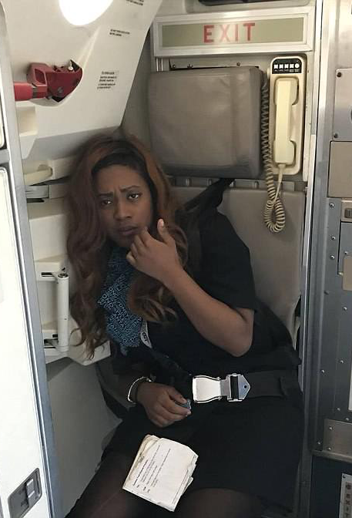
What is she look like?
What is she like?

Slide 9
Flight Attendant Was So Drunk,
Passengers Had To Look After HER

Slide 10
Alaska Airlines Pilot Agrees to Plead Guilty to Flying Passenger Aircraft while under the Influence of Alcohol

