Slide 1
Mindset
Unit 3
IAC1204 Personality Development and Grooming

Slide 5
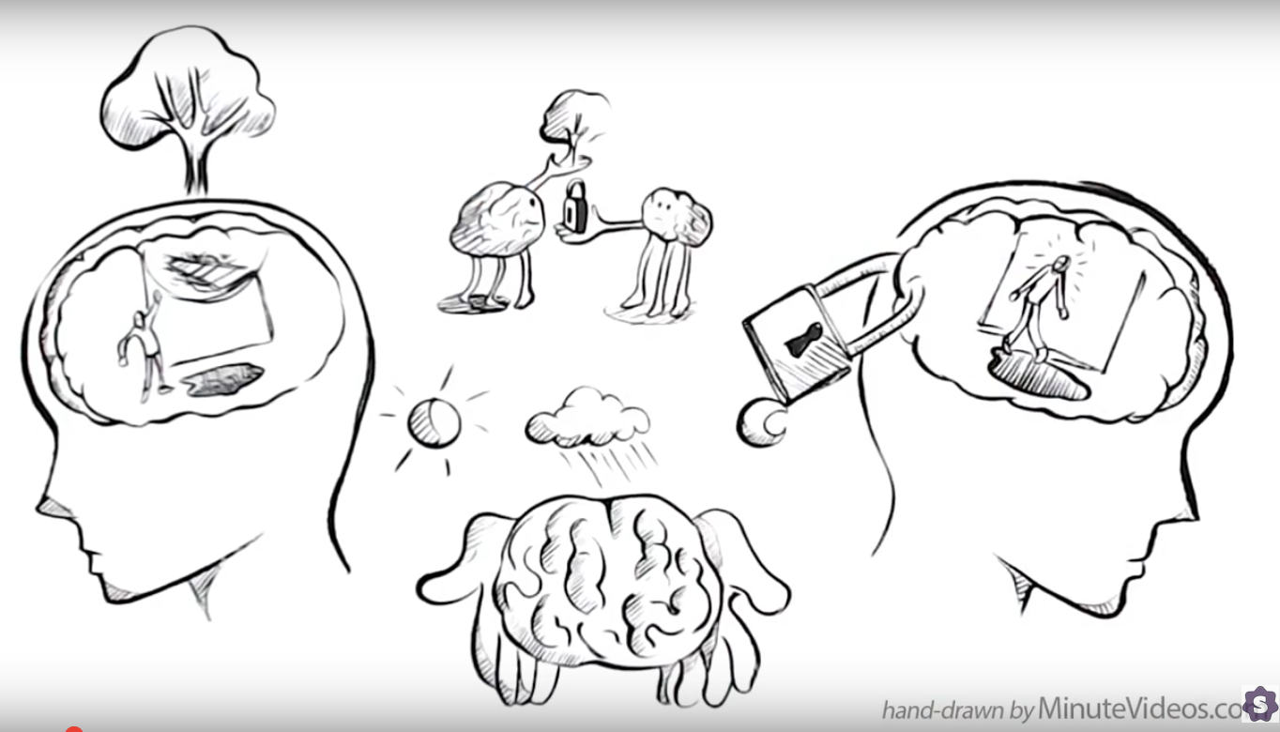
Growth Mindset vs. Fixed Mindset
https://www.youtube.com/watch?v=KUWn_TJTrnU&t=35s

Slide 6
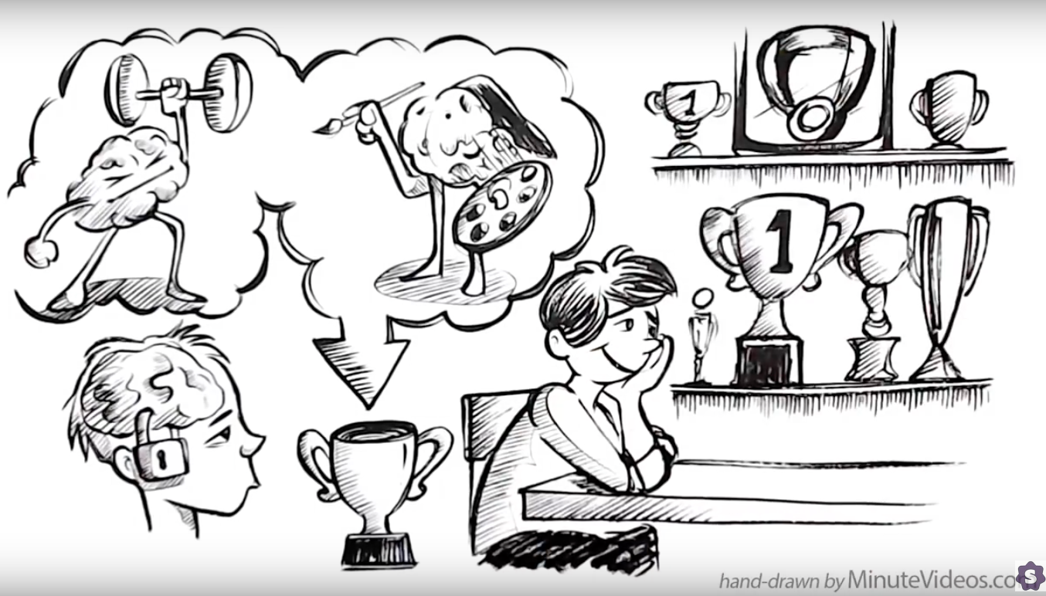
Growth Mindset vs. Fixed Mindset
https://www.youtube.com/watch?v=KUWn_TJTrnU&t=35s

Slide 7
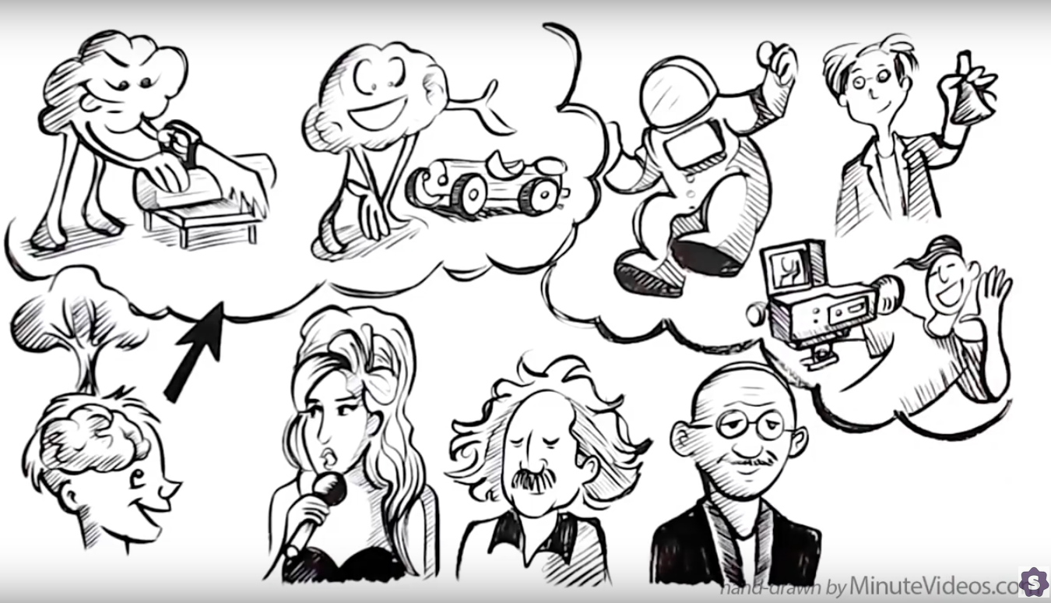
Growth Mindset vs. Fixed Mindset
https://www.youtube.com/watch?v=KUWn_TJTrnU&t=35s

Slide 8
Growth Mindset vs. Fixed Mindset
https://www.youtube.com/watch?v=KUWn_TJTrnU&t=35s

Slide 9
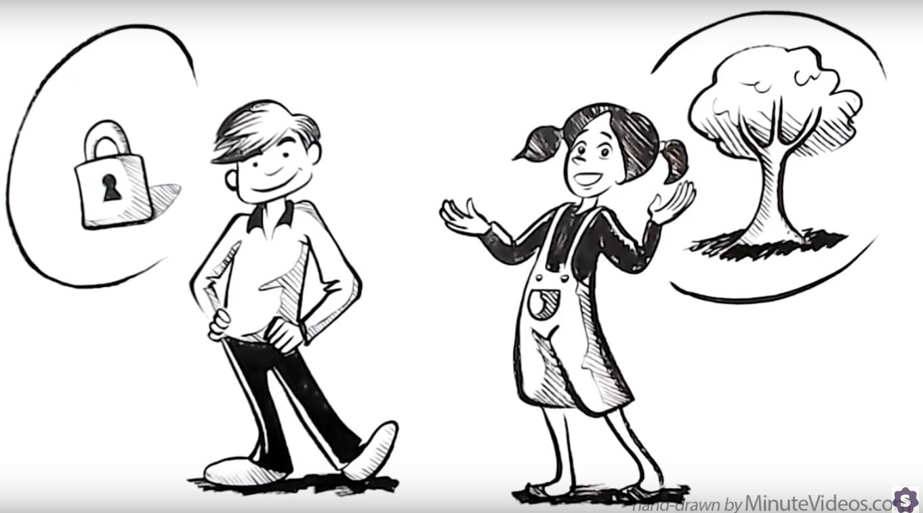
Growth Mindset vs. Fixed Mindset
https://www.youtube.com/watch?v=KUWn_TJTrnU&t=35s

Slide 10
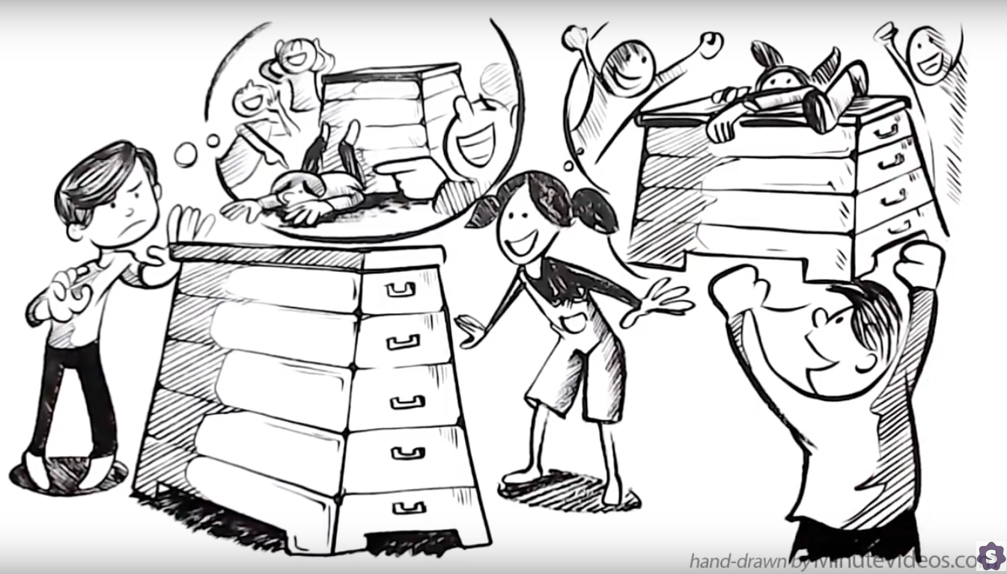
Growth Mindset vs. Fixed Mindset
https://www.youtube.com/watch?v=KUWn_TJTrnU&t=35s

Slide 11
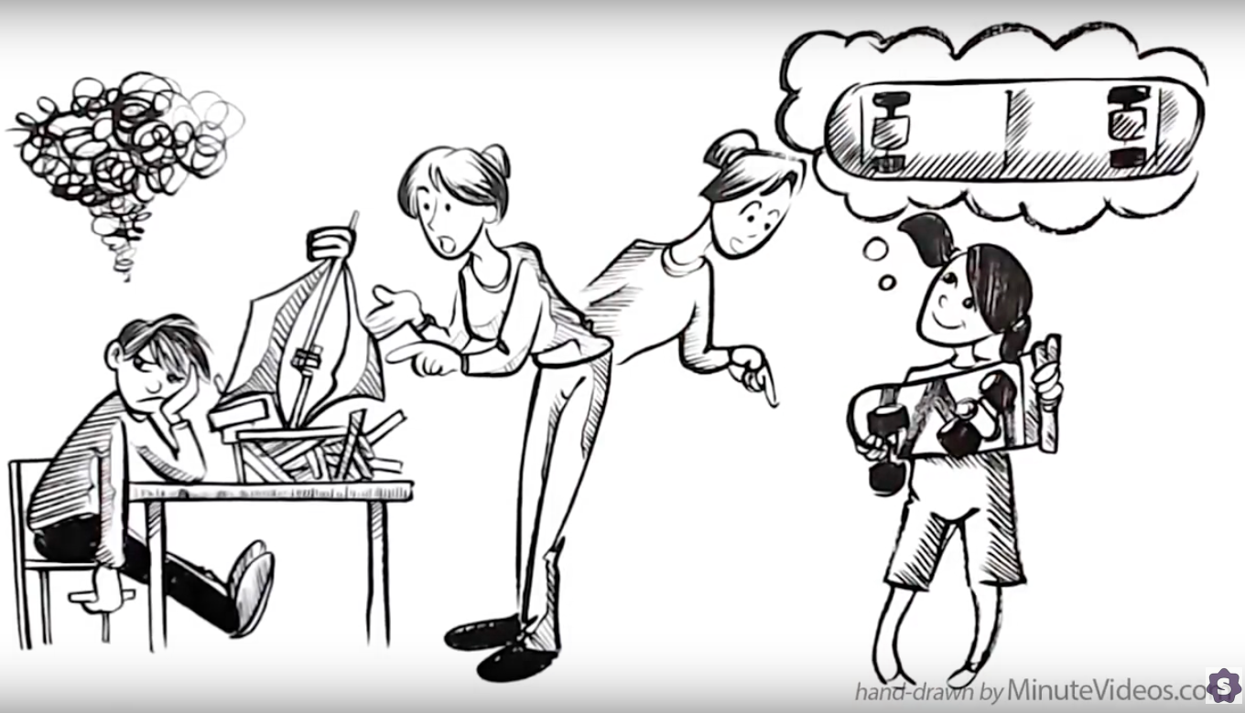
Growth Mindset vs. Fixed Mindset
https://www.youtube.com/watch?v=KUWn_TJTrnU&t=35s

Slide 12
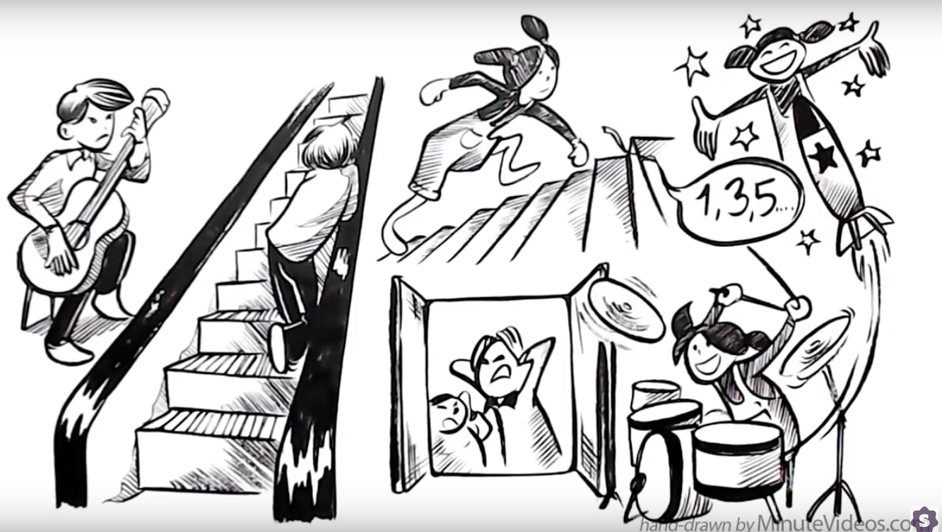
Growth Mindset vs. Fixed Mindset
https://www.youtube.com/watch?v=KUWn_TJTrnU&t=35s

Slide 13
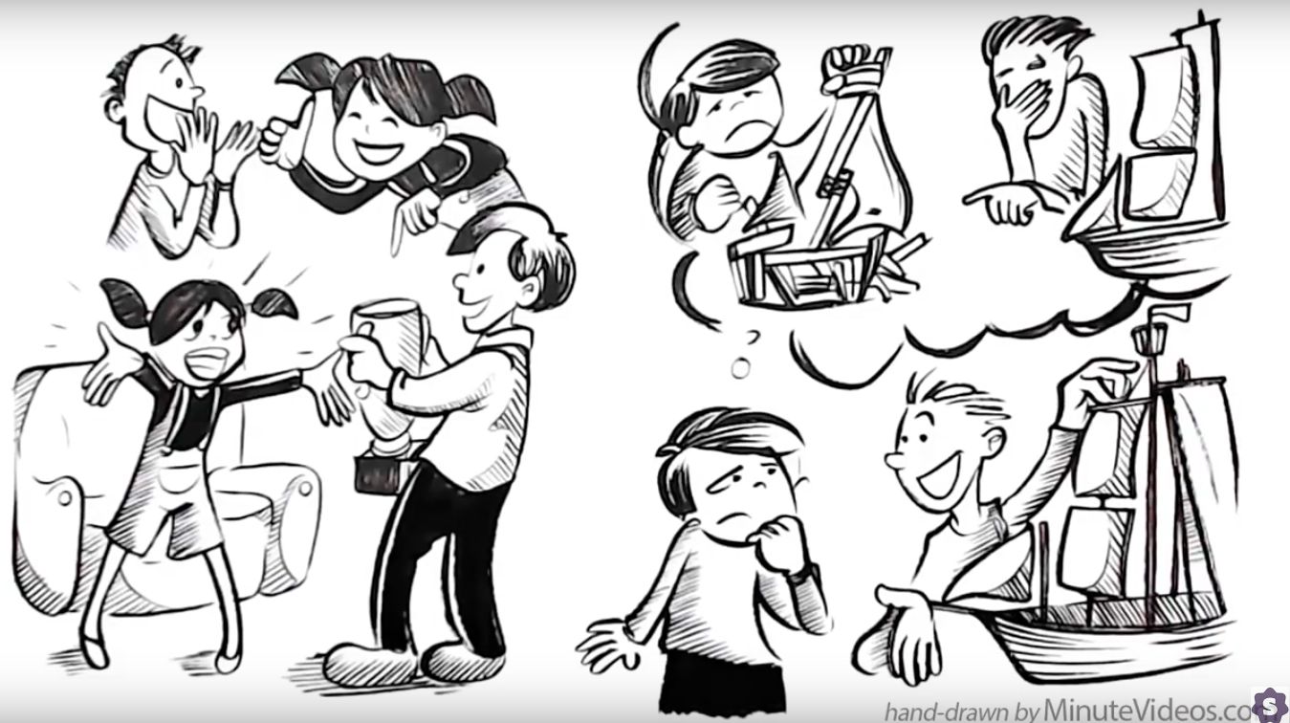
Growth Mindset vs. Fixed Mindset
https://www.youtube.com/watch?v=KUWn_TJTrnU&t=35s

Slide 14
Growth Mindset vs. Fixed Mindset
https://www.youtube.com/watch?v=KUWn_TJTrnU&t=35s

Slide 15
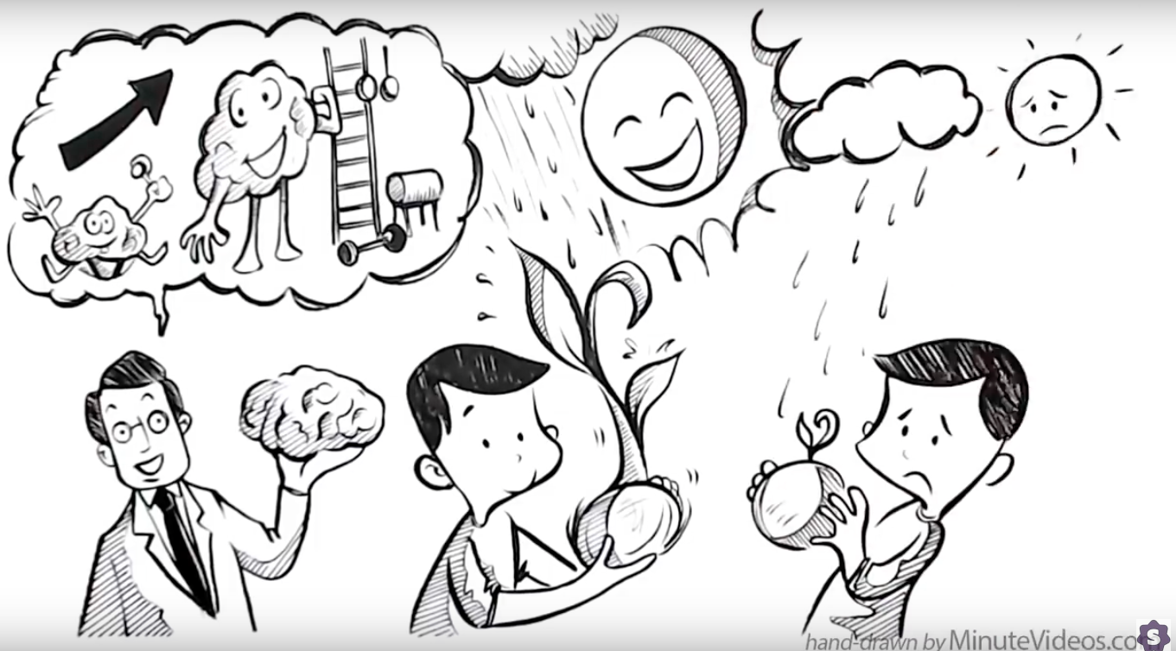
Growth Mindset vs. Fixed Mindset
https://www.youtube.com/watch?v=KUWn_TJTrnU&t=35s

Slide 16
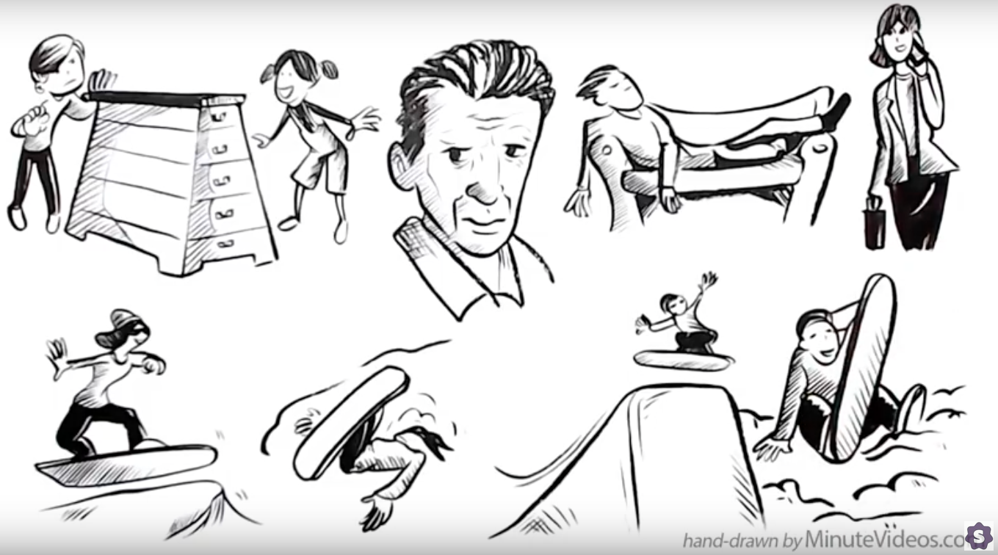
Growth Mindset vs. Fixed Mindset
https://www.youtube.com/watch?v=KUWn_TJTrnU&t=35s

Slide 17
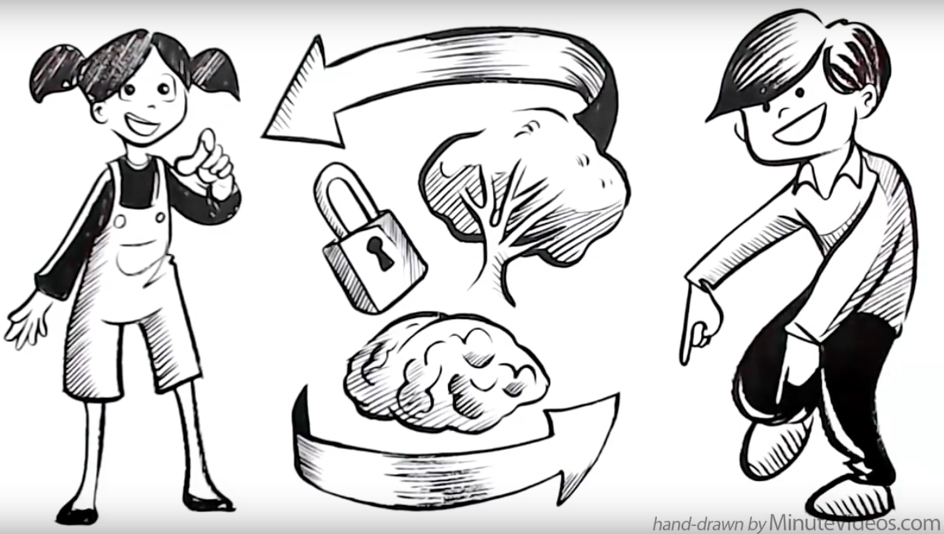
Growth Mindset vs. Fixed Mindset
https://www.youtube.com/watch?v=KUWn_TJTrnU&t=35s

