Slide 1
IRB3306 Food and Beverage Management

Slide 2
IRB3306 Food and Beverage Management
Course introduction and introducing food and beverage department
The restaurant sector
Developing the concept
The menu: Food and beverage
Food and Beverage operations: Purchasing and storage
Food and Beverage operations: Production and service

Slide 3
IRB3306 Food and Beverage Management
Food and beverage control
Staffing issues
Food and beverage marketing
Managing quality in food and beverage operations
Trends and developments

Slide 4
Course outline
Principles of Food and Beverage and food service industry. Study about products and services, food and beverage operations. The procurement and storage of materials, planning, cost control, food menu items management, marketing management, quality of staff management, legal trends and restaurant management, food and beverage industry.

Slide 5
Evaluation criteria
Class attendance 10%
Midterm 20%
Final 30 %
Analysis and writing
Individual assignment 30%
Group work and presentation 20%

Slide 6
Additional reading
Davis, B., Lockwood, A. Pantelidis, I.S. and Alcott, P., (2008). Food and Beverage Management 4th ed. London: Elsevier.
Walker, J. R. (2004). Introduction to hospitality management.
Anderson, C. and Blakemore, D. (1991). Modern Food Service. Oxford: Linacre House.
Brown, G. and Hepner, K. (2004). The waiter’s handbook edition 3.
Klunklin, P. Food and beverage service in the restaurant.
Websites.

Slide 7
Food and Beverage industry
The food industry is a complex, global collective of diverse businesses that supply most of the food consumed by the world population. Only subsistence farmers, those who survive on what they grow, can be considered outside of the scope of the modern food industry.

Slide 8
The food industry includes:
Agriculture: raising of crops and livestock, and seafood
Manufacturing: agrichemicals, agricultural construction, farm machinery and supplies, seed, etc.
Food processing: preparation of fresh products for market, and manufacture of prepared food products
Marketing: promotion of generic products (e.g., milk board), new products, advertising, marketing campaigns, packaging, public relations, etc.
Wholesale and distribution: logistics, transportation, warehousing

Slide 9
The food industry includes: (cont.)
Foodservice (which includes Catering)
Grocery, farmers' markets, public markets and other retailing
Regulation: local, regional, national, and international rules and regulations for food production and sale, including food quality, food safety, marketing/advertising, and industry lobbying activities
Education: academic, consultancy, vocational
Research and development: food technology
Financial services: credit, insurance

Slide 10
Food and Beverage Department
Offer and guarantee the services to guests during theirs stay
All quality services with good attentions and courtesy
Maintaining the standards of Services of the Restaurants and Bars
Hostelry worldwide and in system a good competition of marketing

Slide 11
Food and Beverage Department
F&B Director
F&B Planning
Kitchen
Restaurant/Outlet
Bars
Stewarding Department
Catering Department
In-Room Dining/Room Service
Trends in F&B Operations

Slide 12
Structure of department
F & B Director
Assistant F&B Director
Administrative Assistant
In-Room Dining Manager
Order taker
Servers
Beverage Manager
Bartenders
Chief Steward
Stewards
Executive Chef
Sous chef
Cooks
Catering Manager
Service Manager
Supervisors
Servers
House man
Restaurant Manager
Supervisors
Servers

Slide 13
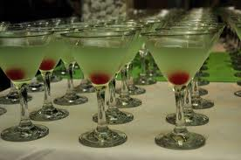
Food & Beverage Director
Directs and organizes the activities of the F&B department to maintain high standards of F&B quality, service, and merchandising to maximize profits
Qualification and needed skill
Operation planning
Business forecast

Slide 14
F&B planning
Staffing of the department
Controlling costs
Liaisons with executive chef menus, food quality, and quantity
Guest feedback analysis
Regular competition analysis
Liaisons with purchasing manager for inventory control

Slide 15
Kitchen
Executive chef
Cost controlling
Quality and quantity of food
Menu creation
Position in the kitchen

Slide 16
Restaurants/outlets
Restaurant Manager
Exceeding guest service expectations
Hiring, training, and developing employees
Setting and maintaining quality standards
Marketing
Room service, mini bars, or cocktail lounge
Presenting annual, monthly, and weekly forecasts and budgets to the F&B director

Slide 17
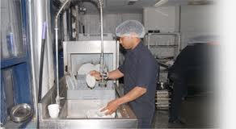
Stewarding Department
Chief steward
Cleanliness of the back of house
Maintaining clean glassware, chinaware, and cutleries for the outlets
Maintenance of dishwashing machines

Slide 18
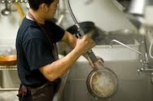
Inventory of chemical stock
Sanitation of kitchen, banquet isles, storerooms, walk-ins/freezers, and all equipment
Pest control and coordination with exterminating company
Forecasting labor and cleaning supplies

Slide 19
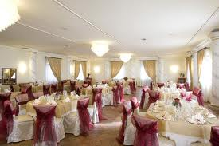
Staff attributes skills and knowledge
Success in food and Beverage service
Product knowledge
Well developed interpersonal skills
A range of technical skills, and
The ability to work as part of a team

Slide 20
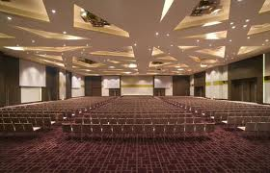
Attributes of food and beverage service personnel
Professional and hygienic appearance
Knowledge of food and beverage and technical ability
Punctuality
Local knowledge
Personality
Attitude to customers
Memory

Slide 21
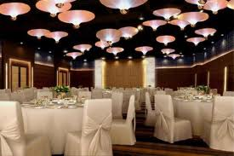
Attributes of food and beverage service personnel (continue)
Honesty
Loyalty
Conduct
Sales ability
Sense of urgency
Complaints
Contribution to the team

Slide 22
Service conventions
The traditional ways of doing things
All have some logic behind them
Being effective and efficient in carrying out the service
Ensure the standardization in the service sequence and the customer process
Rationale of service convention
So-called “service standard”

Slide 23
Basic technical skills
Holding and using a service spoon and fork
Carrying plates
Using a service salver (round tray)
Using a service plate
Carrying glasses
Carrying and using large trays

Slide 24
Interpersonal skills
Dealing with customers
Dealing with incidents during service
Spillage
Returned food
Lost property
Illness of customer
Alcohol over-consumption
Unsatisfactory appearance

Slide 25
Interpersonal skills (continue)
Dealing with children
Customers with additional needs
Customer mobility
Blind and partially sighted customers
Customers with communication difficulties
Handling complaints
Recording incidents

Slide 26
Health, safety and security
Maintaining a safe environment
Avoiding hazards
Procedure in the event of an accident
Procedure in case of fire
Cleaning programmers
Maintaining a secure environment
Dealing with a suspicious item or package
Dealing with a bomb threat

Slide 27
Moments of truth
Phrase credited to Jan Carlson, President of SAS
How to handle those guest encounters
Service commitment is total organization approach that makes a quality of service as perceived by the customer
Every hospitality organization has thousands of moments of truth everyday
Challenges in maintaining the expected levels of service

Slide 28
Question?

